Slide 1
DoD Science and Technology Enterprise
Mr. Dale Ormond, Principal Director, Assistant Secretary of Defense for Research
December 1, 2016

Slide 2
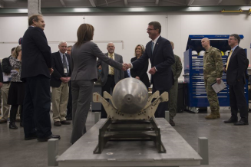
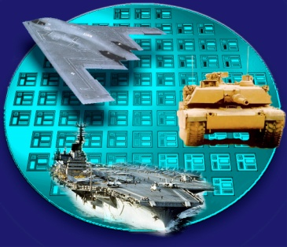
DoD Science and Technology
Vision
Sustaining U.S. technological superiority, preparing for an uncertain future, and accelerating delivery of technical capabilities to the warfighter
Mission
Create technological surprise through science and engineering to ensure technological superiority.
Mitigate current and anticipated threats to win the current and future fight.
Provide affordable options for new concepts and extended legacy capabilities through basic sciences and applied and advanced technology.
Science and technology creating revolutionary capabilities to win the fight today and in the future

Slide 3
The Landscape
Technology is global – adversaries have equal access to technology
Adversaries have watched us for 15 years --studied our methods and assessed our strengths and weaknesses
They’ve invested in capability that mitigates our strengths
As a result…we are moving towards technology parity

Slide 4
Basic Research: Building Blocks for National Security
Asymmetrically compensating for a disadvantage
Changing the competition to more favorable footing
Enabling the application of strengths to problems that are otherwise unwinnable or winnable only at unacceptable cost
Competitive strategy that seeks to maintain advantage over potential adversaries
Today’s Capabilities
_{Funding}
_{Potential Impact}
Applied and Advanced Research
Basic Research
Basic research provides the greatest potential for fundamentally new ways of defending our nation

Slide 5
Challenges
Offset - sustainable disruptive advantage
Opportunities - investing in the art of the possible
Sustaining advantage - both internally (labs) and externally (industry, academia)
Opening the aperture - engaging with allies and partners
Adding cost-effective capabilities for the warfighter
Operational constructs - its not just about technology

Slide 6
Opportunities
Autonomous Learning Systems
Delegating decisions to machines in applications that require faster-than-human reaction times (e.g., Cyber Defense, Electronic Warfare, Missile Defense)
Human-Machine Collaborative Decision Making
Exploiting the advantages of both humans and machines for better and faster human decisions (e.g., “Human strategic guidance combined with the tactical acuity of a computer”)
Assisted Human Operations
Helping humans perform better in combat
Advanced Manned-Unmanned System Operations
Employing innovative cooperative operations between manned and unmanned platforms (e.g., “Smart swarm” operations and tactics)
Network-enabled, autonomous weapons hardened to operate in a future Cyber/EW Environment
Allowing for cooperative weapon concepts in communications-denied environments

Slide 7
R&D Creating the Future
Autonomy & Robotics
Electronic Warfare / Cyber
Micro-electronics
Hypersonics
Directed Energy
Manufacturing
Artificial Intelligence / Man-Machine Interface
Future of Computing
Novel Engineered Materials
Precision Sensing: Time, Space, Gravity, Electromagnetism
Emerging Biosciences
Understanding Human and Social Behavior

Slide 8
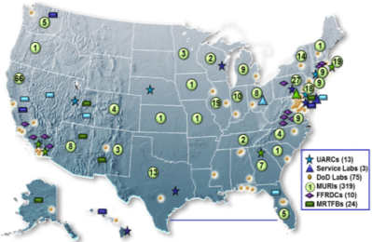
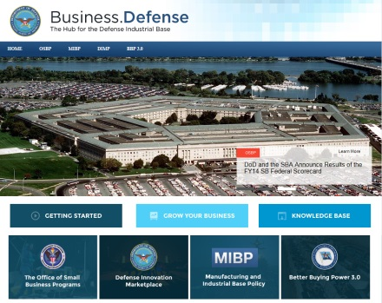
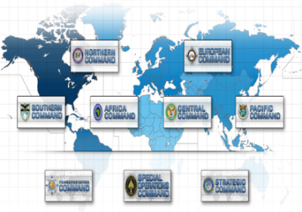
DoD R&E Ecosystem
Engaging with all partners to ensure technological superiority
Global Partners
Academia and Industry Partners
FFRDCs and UARCs
A foundation built on our organic S&T enterprise
DoD Laboratories, Engineering and Warfare Centers
Force acceleration of science and engineering – driving ideas to capability
Global technology outreach,
and strong coalition
partnerships

Slide 9
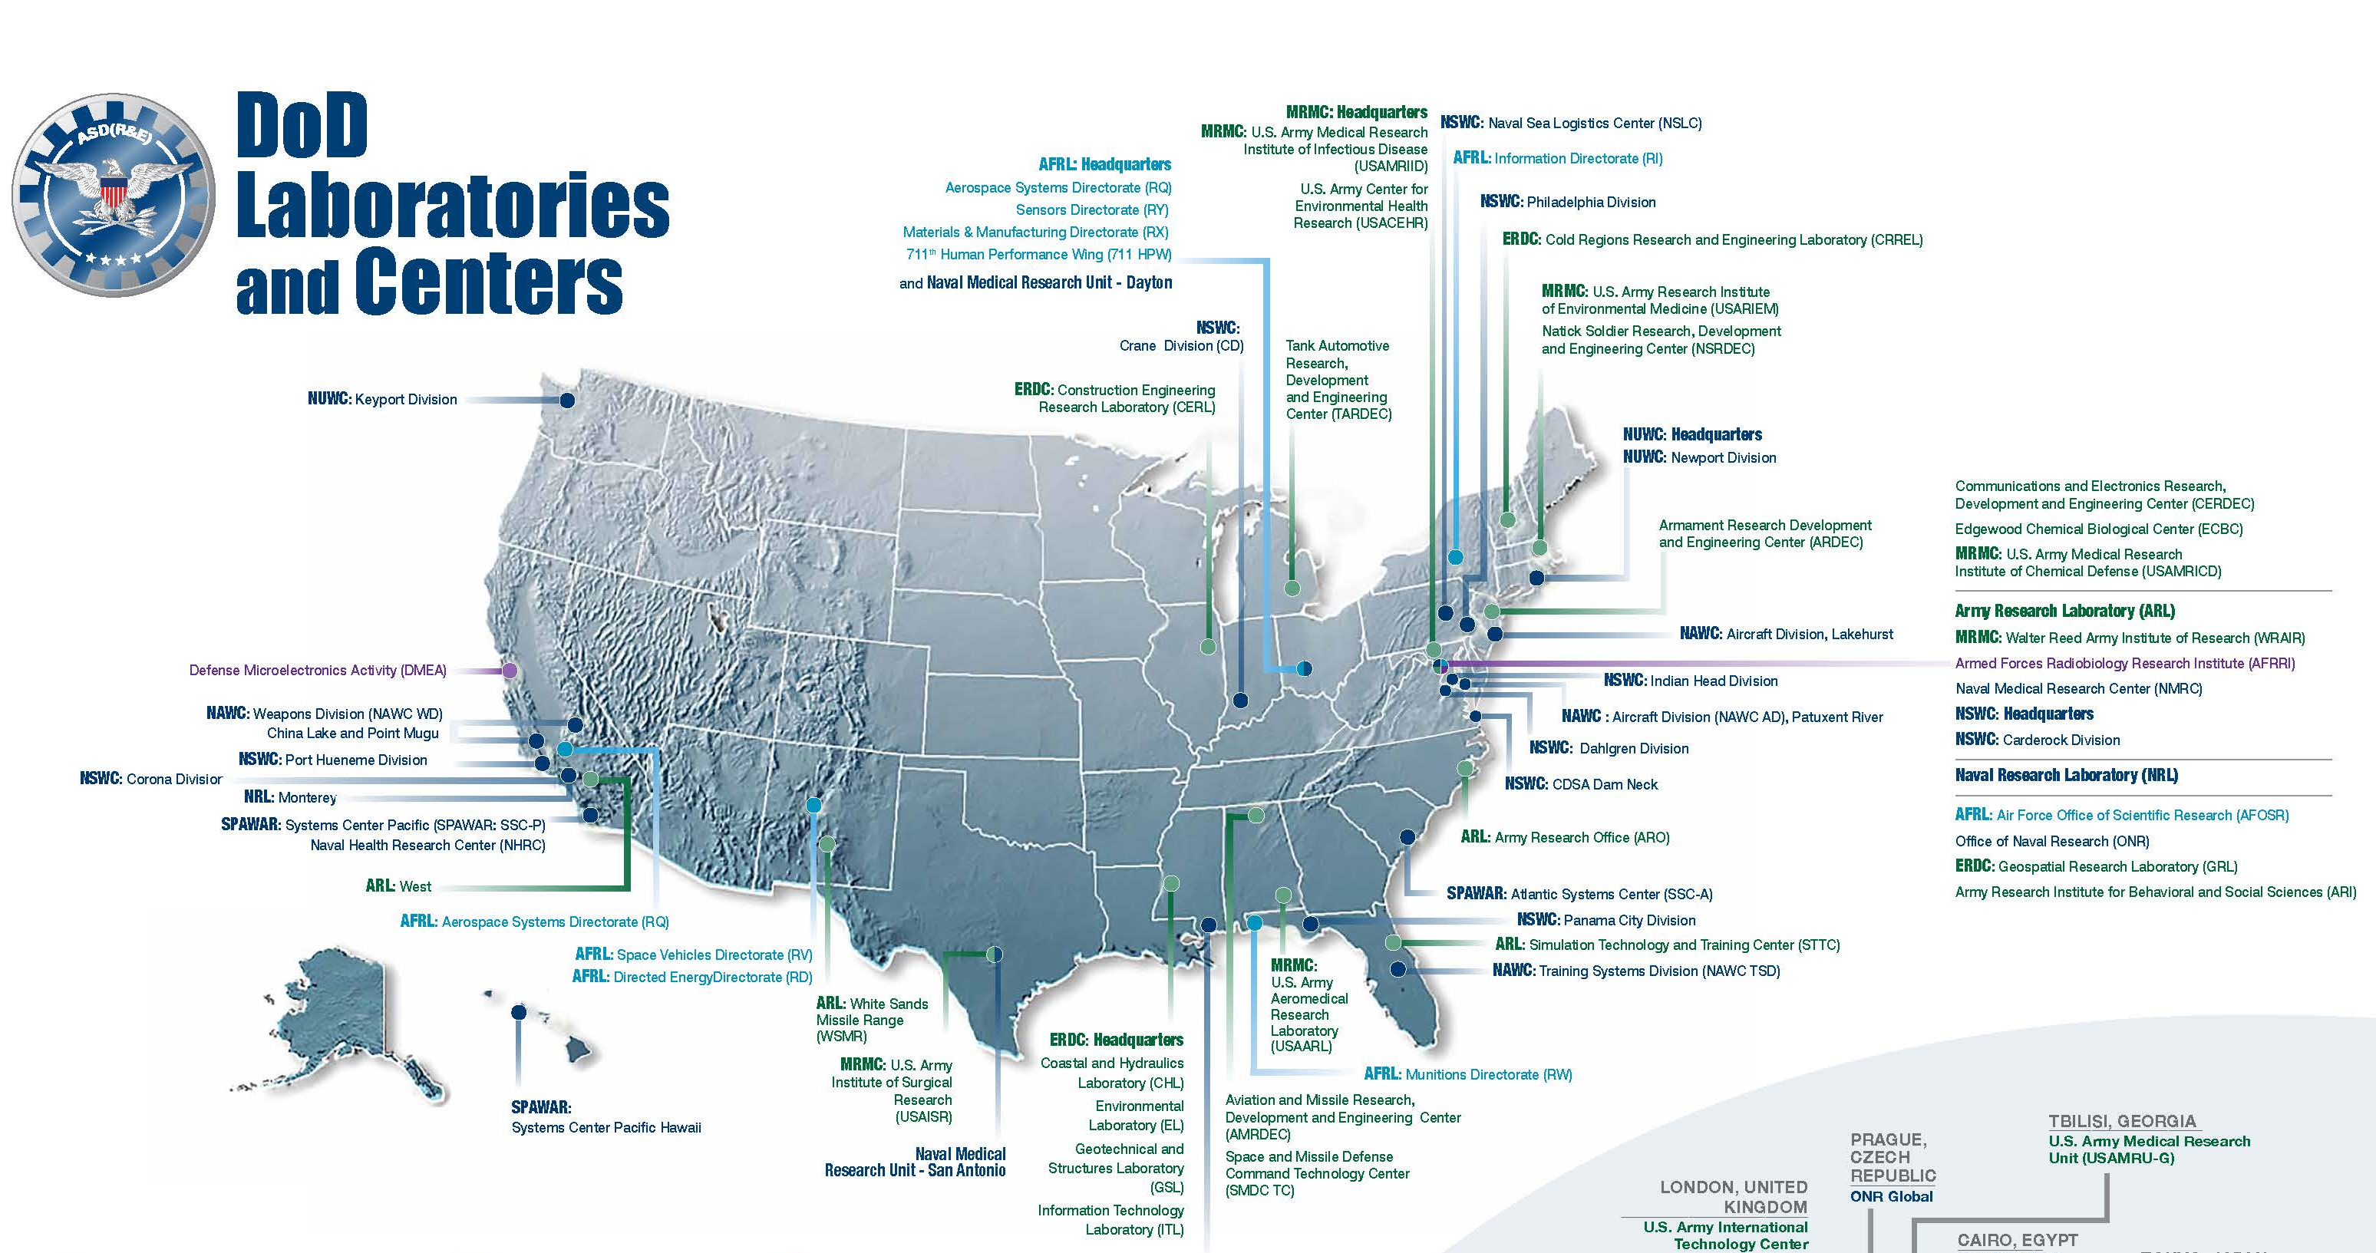
DoD Laboratories and Centers
63 Defense laboratories and engineering centers with ~40,000 scientists and engineers in 22 states and the District of Columbia

Slide 10
Communities of Interest (COI)
17 cross-cutting, S&T areas staffed with senior leaders and subject matter experts from the Services and Defense Agencies
Mission focus
Capabilities enabled by advanced technologies and systems
Counter-IED
Counter-WMD
Biomedical (ASBREM)
Command, Control, Comms, Computers, and Intelligence (C4I)
Human Systems
Cyber
Systems/ Capability focus
Multiple technologies are integrated into complex systems to achieve mission impact
Autonomy
Engineered Resilient Systems
Electronic Warfare
Sensors
Air Platforms
Ground & Sea Platforms
Weapons Technologies
Space
Technology focus
Technology goals with multiple applications
Advanced Electronics
Energy & Power Technology
Materials & Manufacturing Processes

Slide 11
DoD Laboratories and Industry
Entering an era where US technical capability & capacity is being challenged by military technology investments made by increasingly capable and assertive powers
DoD labs and their partners work to develop leap-ahead S&T advances that offer enduring disruptive advantage to U.S. forces and impose prohibitive costs on adversaries
Industry is a key partner and supports DoD by bringing new innovations to market
FY15 Technology Transfer activities by DoD labs and engineering centers:
2,000+ Cooperative Research and Development Agreements
Established nearly 1,500 Material Transfer Agreements
More than 900 patents were filed and 623 issued
Example: Partnership between the DoD and Raytheon led to the “biggest invention in semiconductors since silicon”
Gallium Nitride semiconductors produce five times the power of current technology, and is more reliable and efficient
Currently being used in Active Electronic Scanned Array radars but potential for use is extensive
Active Denial System
Microwave ovens

Slide 12
Basic Research and Industry
Service and DARPA Broad Agency Announcements: A competitive solicitation procedure used to obtain proposals for basic and applied research and that part of development not related to the development of a specific system or hardware procurement
http://www.grants.gov/
https://www.fbo.gov/
ARL Open Campus: Open sharing of world-class ARL facilities and research opportunities for all partners, including foreign nationals, to enhance synergistic relationships with the international, academic, and entrepreneur communities
Creation of flexible career paths in defense research that allow easy transition between government, academia and industry
Increased opportunities for technology advancement and transfer of research knowledge
Improved public involvement in defense research to create enhanced understanding of the value and importance of defense science, technology, and exploration
http://www.arl.army.mil/opencampus/
Defense Enterprise Science Initiative (DESI) Concept:
Focuses on use-inspired basic research with industry participants
Leverages industry IR&D, and other activities at DoD Laboratories
Supports STEM efforts
DESI is the only basic research effort that requires a concurrent industry IR&D or DoD lab 6.2+ program

Slide 13
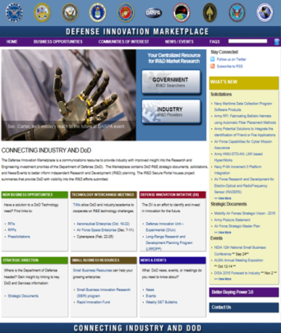
Independent Research and Development (IR&D)
IR&D is important to innovation
DoD – and industry – benefit from IR&D efforts to address technical challenges – reduce cost, technical and schedule risk early
IR&D as Market Research: DoD uses the IR&D Secure Portal to find projects that address, mitigate, or improve a DoD technical challenge (potential transition to a program of record)
Encourages greater contribution to technology related to future defense systems.
Translates new ideas and technologies into defense capabilities
Defense Federal Acquisition Regulation Supplement (DFARS) at 231.205–18, Independent Research and Development and Bid and Proposal Costs published on November 4, 2016
IR&D projects generating the costs must be reported and updated at least annually, and when the project is completed
For IR&D projects initiated in the contractor’s fiscal year 2017 and later, major contractors must engage in a documented technical interchange with a technical or operational DoD government employee before IR&D costs are generated
This technical interchange (to include the name of the DoD Government employee and the date that the interchange occurred) will be documented through contractors reporting any cost-generating IR&D projects
I
For the most up-to-date information, visit the Defense Innovation Marketplace:
http://www.defenseinnovationmarketplace.mil/index.html
Notes:
The new IR&D rule requires a technical interchange (i.e., government review) of any IR&D project prior to commencing work in order to receive government reimbursement
Industry may be required to provide proof of the government review (i.e., a written statement) prior to the start of work before validating the charges for reimbursement
The rule only requires that a knowledgeable DoD government employee review the project abstract – Acceptable reviewers include a scientist/engineer or other subject matter expert working similar science and technology (S&T) projects, an acquisition official working similar projects, and/or an operator who might use the technology in a future fight, such as a COCOM official
The review is not a determination of allowability – Any work that would have been reimbursed prior to the rule will still be allowable
The review does not include a statement that the costs are reimbursable, that the projects is deemed useful in the view of the government, or that the project costs should be declined – The government reviewer will only state that the project has been reviewed, and will not issue any official declaration stating that the project is or is not allowable
Before January 30, 2017, DoD will initiate an electronic process through the Defense Innovation Marketplace website, which will have the necessary security to ensure protection of proprietary information, to meet the requirement.
Using the electronic process, the contractor will submit the IR&D proposal to a targeted DoD organization, and upon completion of the review, an employee from that organization will send an email to the project point of contact to notify them that the review has been completed. The email will serve as the documentation of the date of completion of the review and the name of the reviewer. If submitted through the Defense Innovation Marketplace, the Service/Agency/Command will execute the review and respond with review documentation (i.e., a written statement the date of review and name of the DoD government employee who reviewed the project) within 30 days of submission.

Slide 14
Opportunities to Engage
Upcoming events:
Technology Interchange Meetings
Strategic Development Planning and Experimentation (February 2017)
Materials and Manufacturing Processes COI (March 2017)
Electronic Warfare COI (April 2017)
Find out more: Defense Innovation Marketplace
Small business resources
Rapid Innovation Fund information
Broad agency announcements and requests for proposals/information
http://www.defenseinnovationmarketplace.mil/business.html

Slide 15
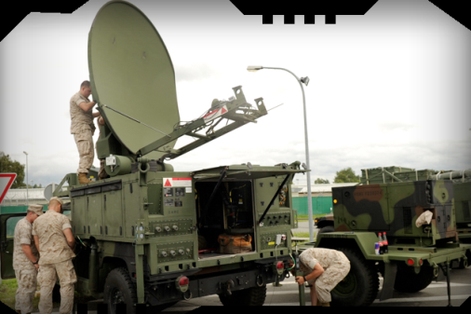
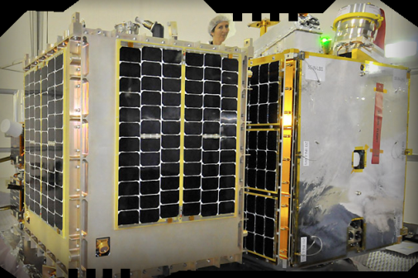
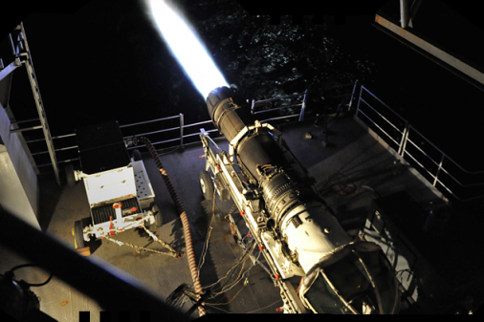
DoD Research Directorate: Pursuing Sustained Technical Advantage
Technologies
Basic Research
Laboratories
DMEA
DoD Research Directorate:
http://www.acq.osd.mil/rd/
Twitter: @DoDInnovation

