Slide 2
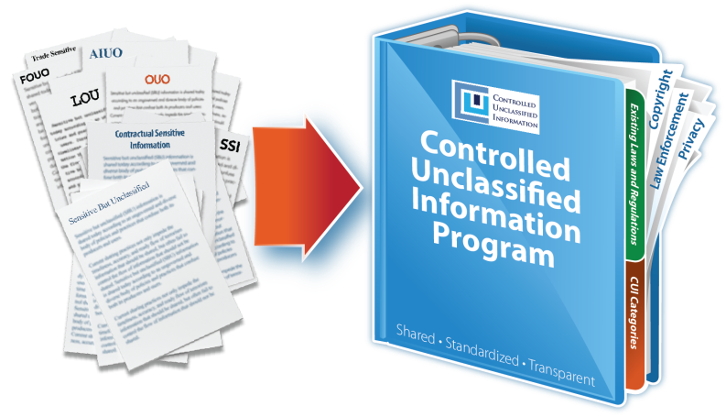
Briefing Outline
Executive Order 13556
32CFR2002 (implementing directive)
Approach to Contractor Environment
Phased Implementation
Understanding the CUI Program

Slide 3
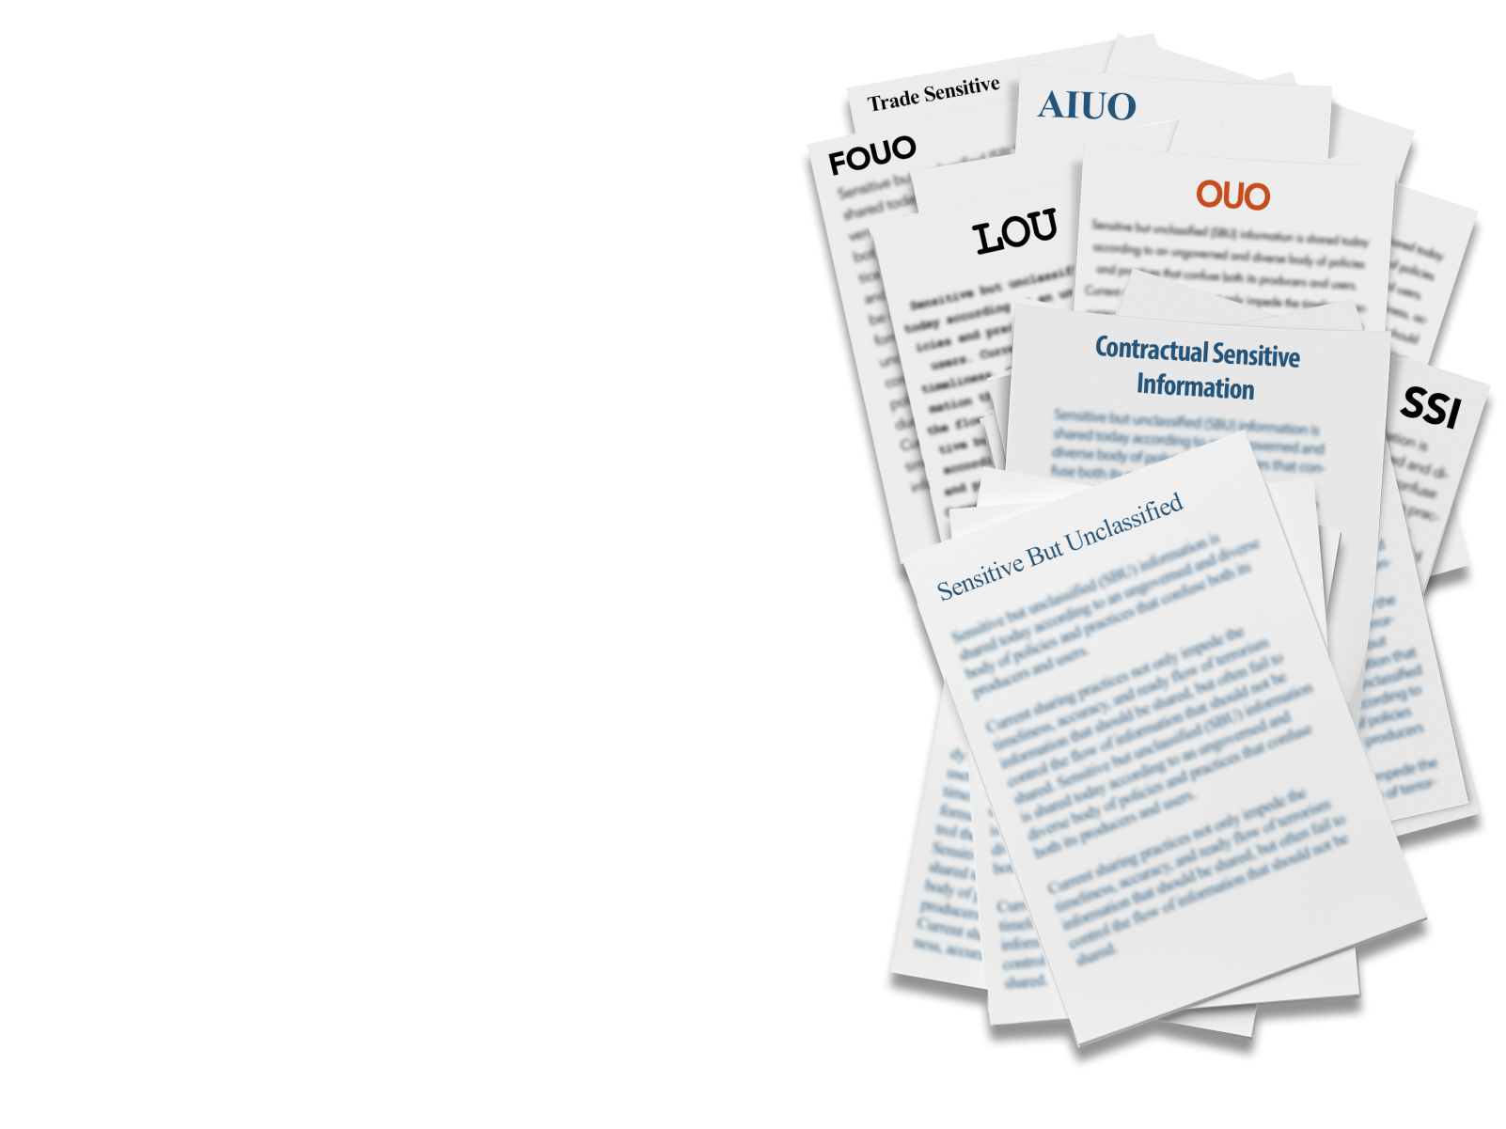
Why is the CUI Program necessary?
Executive departments and agencies apply their own ad-hoc policies and markings to unclassified information that requires safeguarding or dissemination controls, resulting in:
An inefficient patchwork system with more than 100 different policies and markings across the executive branch
Inconsistent marking and safeguarding of documents
Impediments to authorized information sharing
Unclear or unnecessarily restrictive dissemination policies

Slide 4
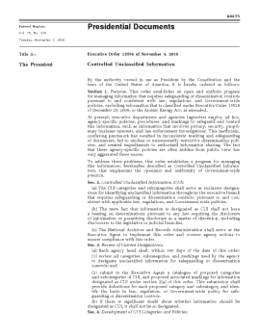


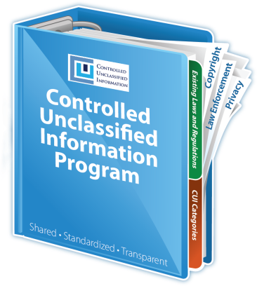
Executive Order 13556
Established CUI Program
  In consultation with affected agencies (CUI Advisory Council)
Designated an Executive Agent (EA) to implement the E.O. and oversee department and agency actions to ensure compliance.
  National Archives and Records Administration
  Information Security Oversight Office
An open and uniform program to manage all unclassified information within the executive branch that requires safeguarding and dissemination controls as required by law, regulation, and Government-wide policy

Slide 5
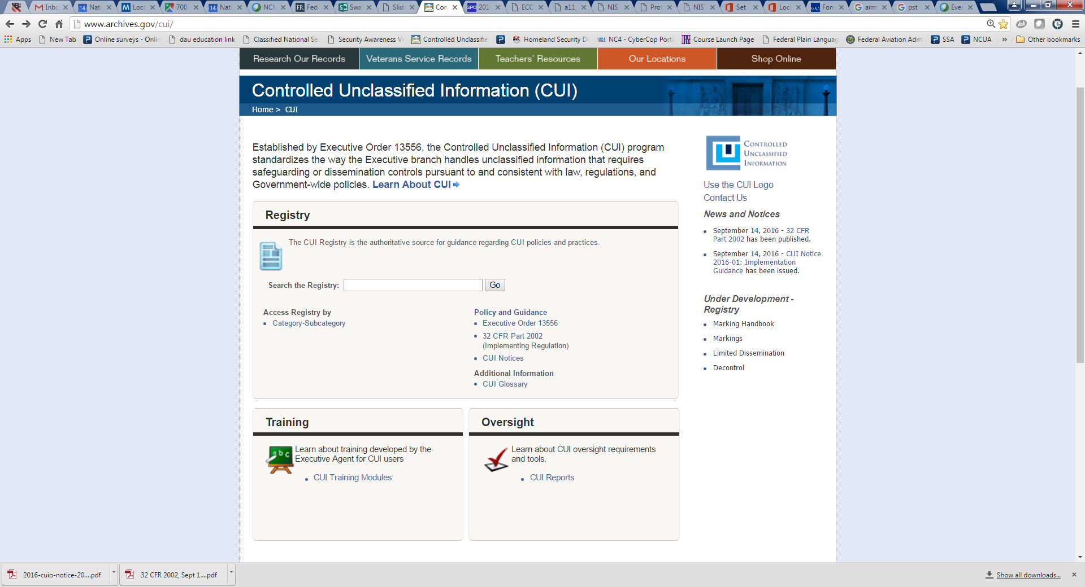
CUI Registry
EO 13556 called for a review of the categories, subcategories, and markings currently used by agencies.
  Agencies submitted over 2,200 authorities for controlling many types of information.
  Information types were grouped together, legal authorities were examined, and a CUI Registry was published.
  23 Categories
  84 Sub-categories
  315 Control citations
  106 Sanction citations
www.archives.gov/cui

Slide 6
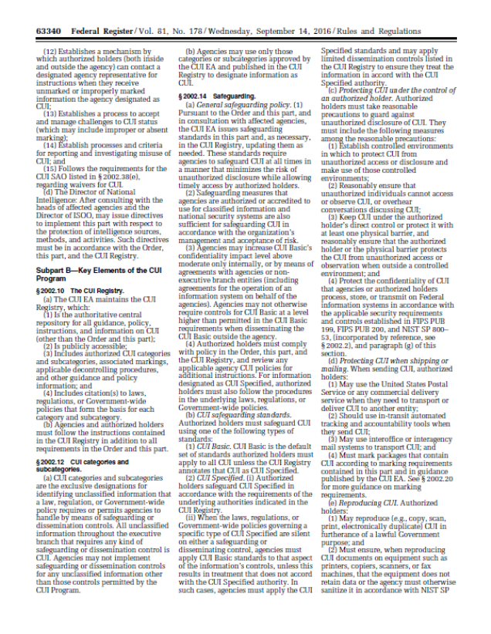
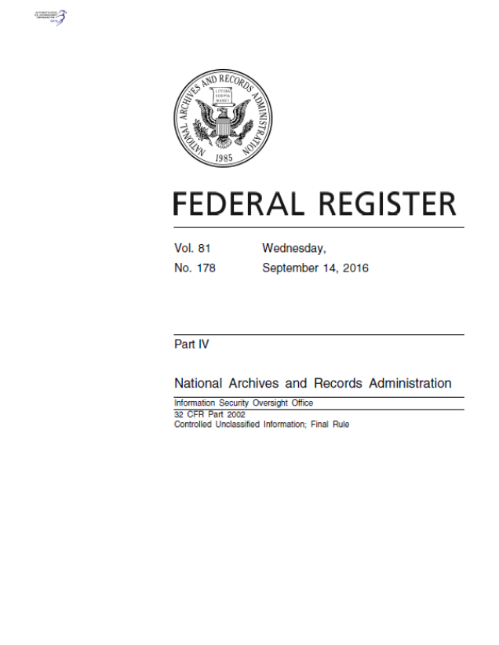
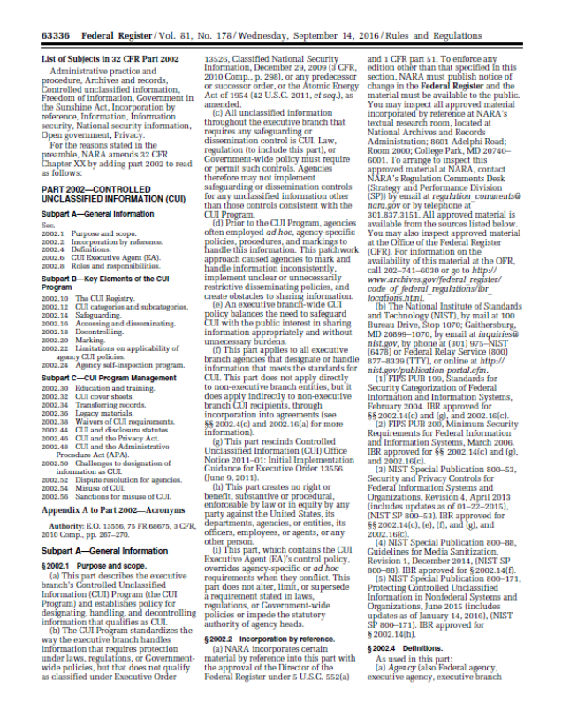
32 CFR 2002 (September 14, 2016)
Implements the CUI Program
  Establishes policy for designating, handling, and decontrolling information that qualifies as CUI
  Effective : November 14, 2016 (Day 0)
Describes, defines, and provides guidance on the minimum protections (derived from existing agency practices) for CUI
  Physical and Electronic Environments
  Marking
  Sharing
  Destruction
  Decontrol
Emphasizes unique protections described in law, regulation, and/or Government-wide policies (authorities)

Slide 7
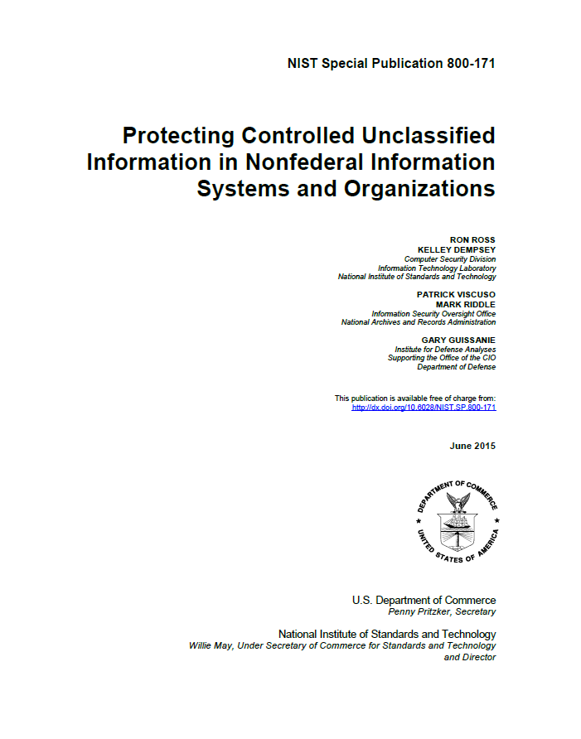
NIST Special Publication 800-171
Agencies must use NIST SP 800-171 when establishing security requirements to protect CUI’s confidentiality on non-Federal information systems.
The NIST 800-171 is intended for use by federal agencies in appropriate contractual vehicles or other agreements established between those agencies and nonfederal organizations.
Establishes requirements for protecting CUI at the Moderate Confidentiality Impact Value.
Non-tailorable requirements
Flexibility in how to meet requirements

Slide 8
When to use the NIST SP 800-171
Use the NIST SP 800-171 when a non-Federal entity:
  Receives CUI incidental to providing a service or product to the Government outside or processing services. Examples: producing a study, conducting research, creating a training program, building an aircraft or ship, etc.
  In these instances, the Government is only concerned with the confidentiality of the information and the CUI is regarded as the asset requiring protection.
Do NOT use the NIST SP 800-171 when a non-Federal entity:
  Collects or maintains CUI as part of a Government function (e.g., census takers or records storage).
  Builds an information system or operates an information system for the Government (an email provider, or payroll system).
  Provides processing services for the Government (a cloud service provider)
  In these instances, the Government has a concern in the confidentiality, integrity, and availability of the information system and the system is the asset requiring protection.
  Agencies may require these systems to meet additional requirements the agency sets for its own internal systems.

Slide 9
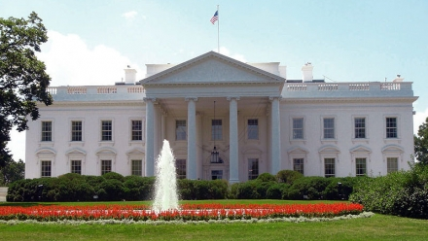

Federal Acquisition Regulation
E.O. 13556
Registry
FAR
Implementing Directive (32 CFR 2002)
Government
Industry
To promote standardization, the CUI Executive Agent plans to sponsor a Federal Acquisition Regulation (FAR) clause that will apply the requirements contained in the 32 CFR Part 2002 and NIST SP 800-171 to industry.
1 Year

Slide 10
Implementation of the CUI Program
180
Year 2
Day 0 (14 Nov ‘16)
Year 1
180
Policy
Develop and Publish Policy
Develop and Publish Component Policy
Training
(Planning)
Develop and Deploy Training
Complete CUI Training
Physical Safeguarding
(Planning)
Implement Physical Safeguarding
Systems
Assessment of Systems
Develop Systems Transition Strategy
Self-Inspection
Initiate Internal Oversight

Slide 11
Additional Implementation Concerns
Program Management
  Senior Agency Official, Program Manager, internal planning teams
Incident Management
  Reporting, Mitigation, and Preventing Recurrence
Contracts & Agreements (agencies and non-federals)
  Guidance given to external entities on how to handle CUI
  Limitations on Applicability of Agency Policies

Slide 12
Understanding the CUI Program
CUI Basic versus CUI Specified
Limitations of Agency Policy
Controlled Environments
Systems Requirements: Moderate
Marking CUI
  Banner, Designator, Specified, Portion, Limited Dissemination Control Markings
  Bulk & Systems (splash screens)
  Legacy Information, derivative use.
  Handbook & Coversheets
Destruction

Slide 13
Two types of CUI: Basic and Specified
CUI Basic = LRGWP identifies an information type and says protect it.
CUI Specified = LRGWP identifies an information type and says to protect it, and also includes one or more specific handling standards for that information.
Examples include: Agriculture, Ammonium Nitrate, Water Assessments, Emergency Management, Bank Secrecy, Budget, Comptroller General, Geodetic Product Information, Asylee, Visas, Information Systems Vulnerabilities, Terrorist Screening, Informant, Privilege, Victim, Death Records
Examples include: Sensitive Security Information, Student Records, Personnel, Source Selection, Nuclear, Safeguards Information, NATO Restricted, NATO Unclassified, Federal Grand Jury, Witness Protection, DNA, Criminal History Records, Financial Records, Export Control, Protected Critical Infrastructure Information, Controlled Technical Information

Slide 14
Limitations on applicability
Limitations on applicability of agency CUI policies
  Agency policies pertaining to CUI do not apply to entities outside that agency unless the CUI Executive Agent approves their application and publishes them in the CUI Registry.
  Agencies may not levy any requirements in addition to those contained in the Order, this Part, or the CUI Registry when entering into contracts, treaties, or other agreements about handling CUI by entities outside of that agency.

Slide 15
General Safeguarding Policy
Agencies must safeguard CUI at all times in a manner that minimizes the risk of unauthorized disclosure while allowing for access by authorized holders.
  For categories designated as CUI Specified, personnel must also follow the procedures in the underlying law, regulation, or Government-wide policy that established the specific category or subcategory involved.
Safeguarding measures that are authorized or accredited for classified information are sufficient for safeguarding CUI.

Slide 16
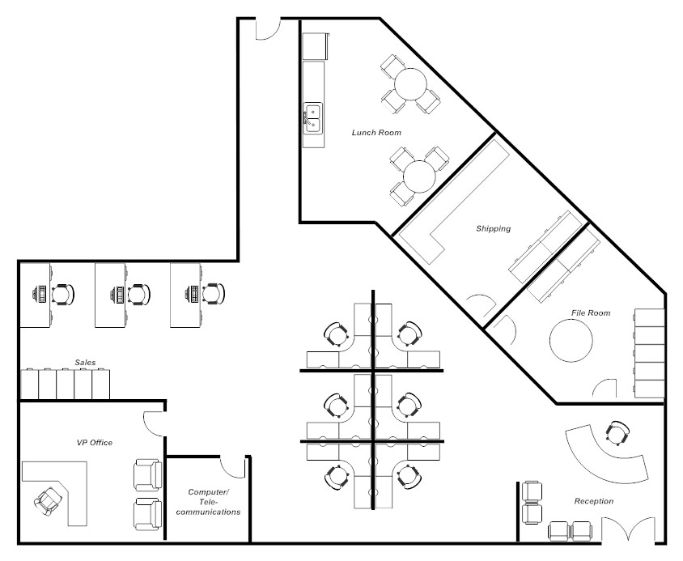
Controlled Environments
Controlled environment is any area or space an authorized holder deems to have adequate physical or procedural controls (e.g., barriers and managed access controls) for protecting CUI from unauthorized access or disclosure.
When outside a controlled environment, you must keep the CUI under your direct control or protect it with at least one physical barrier. You or the physical barrier must reasonably protect the CUI from unauthorized access or observation.
Reception Area used to control access to workspace.

Slide 17
System Requirements: Moderate
Systems that store or process CUI must be protected at the Moderate Confidentiality Impact Value.
  FIPS PUB 199 & 200
  NIST SP-800-53 (Risk Based Tailoring)
  Moderate = The loss of confidentiality, integrity, or availability could be expected to have a serious adverse effect on organizational operations, organizational assets, or individuals. (FIPS PUB 199)
    A serious adverse effect means that, for example, the loss of confidentiality might: (i) cause a significant degradation in mission capability to an extent and duration that the organization is able to perform its primary functions, but the effectiveness of the functions is significantly reduced; (ii) result in significant damage to organizational assets; (iii) result in significant financial loss; or (iv) result in significant harm to individuals that does not involve loss of life or serious life threatening injuries

Slide 18
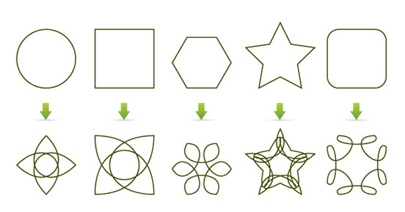
Marking CUI
Agencies must uniformly and conspicuously apply CUI markings to all CUI prior to disseminating it unless otherwise specifically permitted by the CUI Executive Agent.
The CUI banner marking must appear, at a minimum, at the top center of each page containing CUI
CONTROLLED
Department of Good Works
Washington, D.C. 20006
June 27, 2013
MEMORANDUM FOR THE DIRECTOR
From: John E. Doe, Chief Division 5
Subject: (U) Examples
(U) We support the President by ensuring that the Government protects and provides proper access to information to advance the national and public interest.
(CUI) We lead efforts to standardize and assess the management of classified and controlled unclassified information through oversight, policy development, guidance, education, and reporting.
CONTROLLED
Portion Marking = Best Practice
18

Slide 19
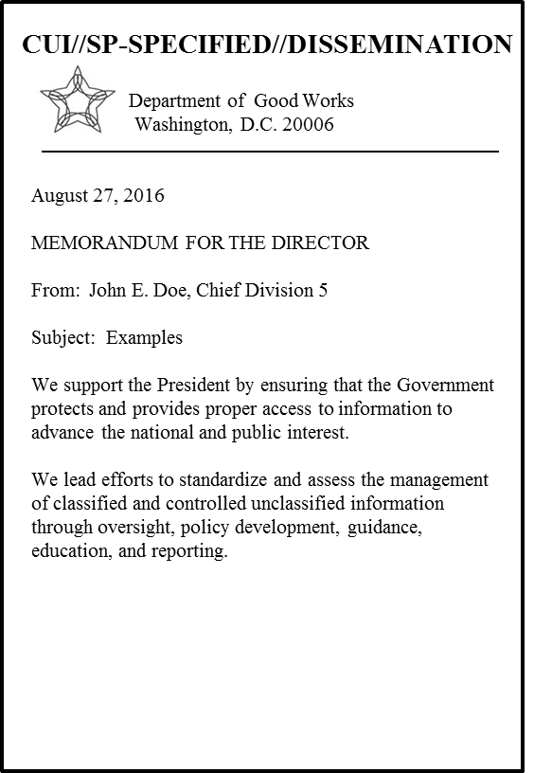
Marking CUI: Banner Marking
  The CUI Banner Marking may include up to three elements:
    The CUI Control Marking (mandatory) may consist of either the word “CONTROLLED” or the acronym “CUI.”
    CUI Category or Subcategory Markings (mandatory for CUI Specified). CUI Control Markings and Category Markings are separated by two forward slashes (//). When including multiple categories or subcategories in a Banner Marking they are separated by a single forward slash (/).
    Limited Dissemination Control Markings. CUI Control Markings and Category Markings are separated from Limited Dissemination Controls Markings by a double forward slash (//).

Slide 20
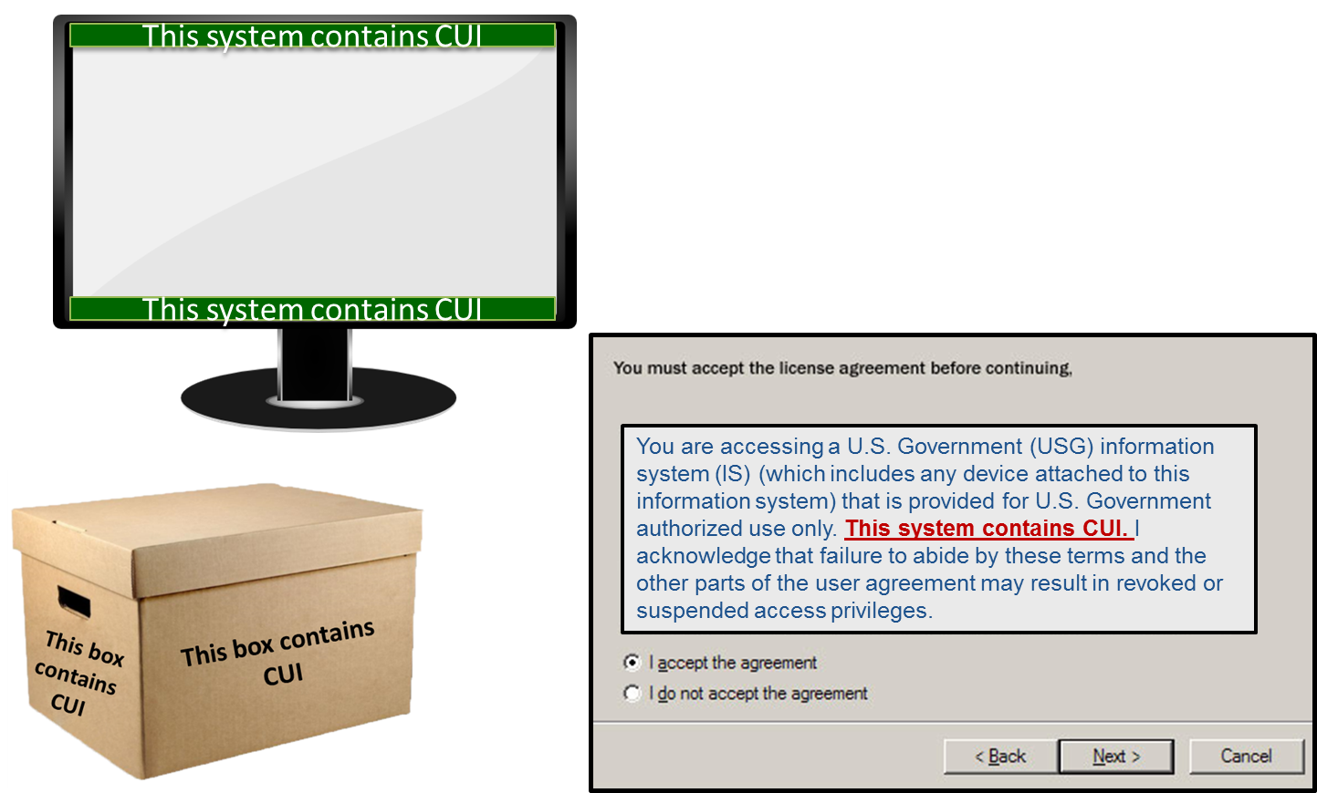
Bulk & System Markings
Agencies may authorize or require the use of alternate CUI indicators on IT systems, websites, browsers, or databases through agency CUI policy. These may be used to alert users of the presence of CUI where use of markings has been waived by the agency head.

Slide 21
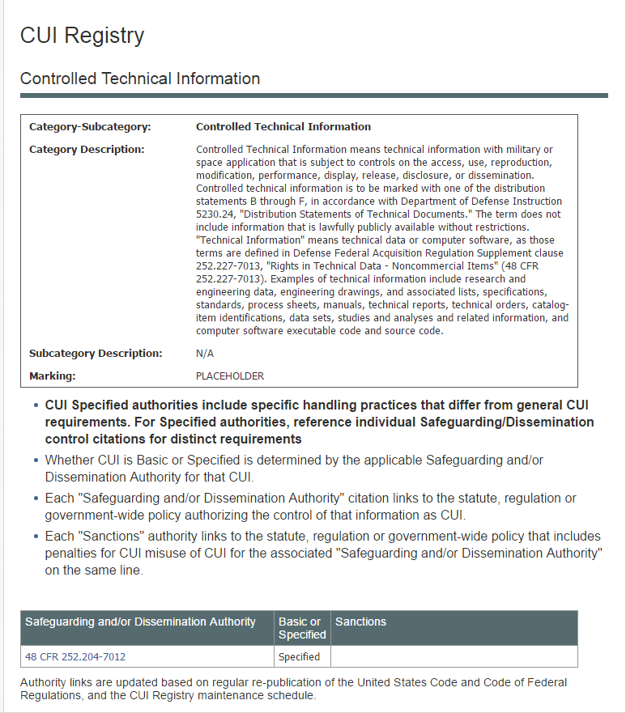
CUI Specified
In the CUI Registry, if the authority that relates to the information is indicated to be specified, documents must be marked to indicate that CUI Specified is present in the document.
Add “SP-” before any category/subcategory markings where the authority is followed by an asterisk.

Slide 22
Marking CUI Specified
CONTROLLED//SP-XXX
“SP-” Indicates that an authority contains specific safeguarding or dissemination measures.
Recipients are encouraged to reference the underlying, “specified,” authority(s) for specific handling guidance.
Department of Good Works
Washington, D.C. 20006
June 27, 2013
MEMORANDUM FOR THE DIRECTOR
From: John E. Doe, Chief Division 5
Subject: Examples
We support the President by ensuring that the Government protects and provides proper access to information to advance the national and public interest.
We lead efforts to standardize and assess the management of classified and controlled unclassified information through oversight, policy development, guidance, education, and reporting.

Slide 23
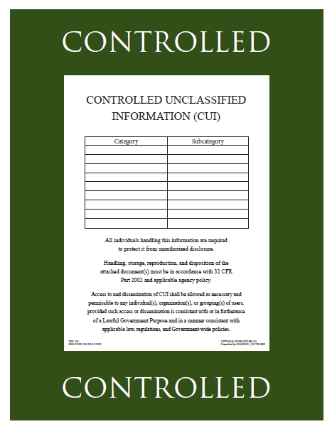

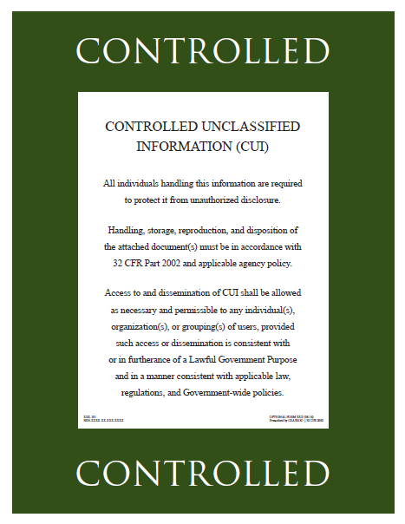
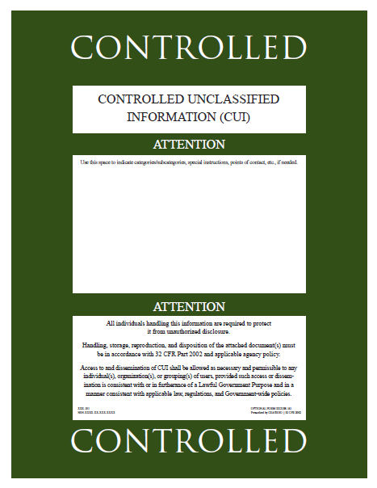
Marking Handbook & Cover Sheets

Slide 24

Legacy Information and Markings
Legacy Information is unclassified information that an agency marked as restricted from access or dissemination in some way, or otherwise controlled, prior to the CUI Program.
All legacy information is not automatically CUI. Agencies must examine and determine what legacy information qualifies as CUI
Discontinue all use of legacy markings

Slide 25
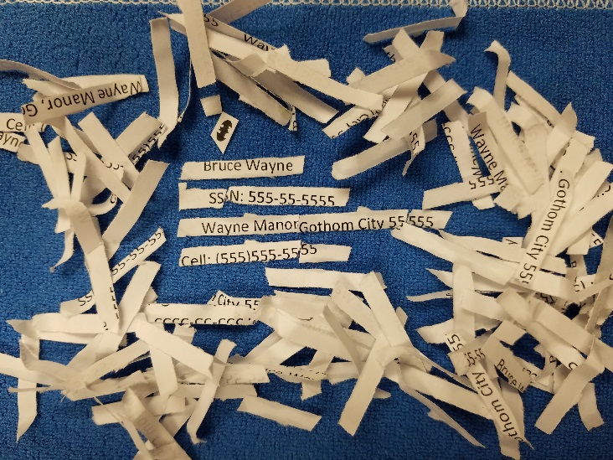
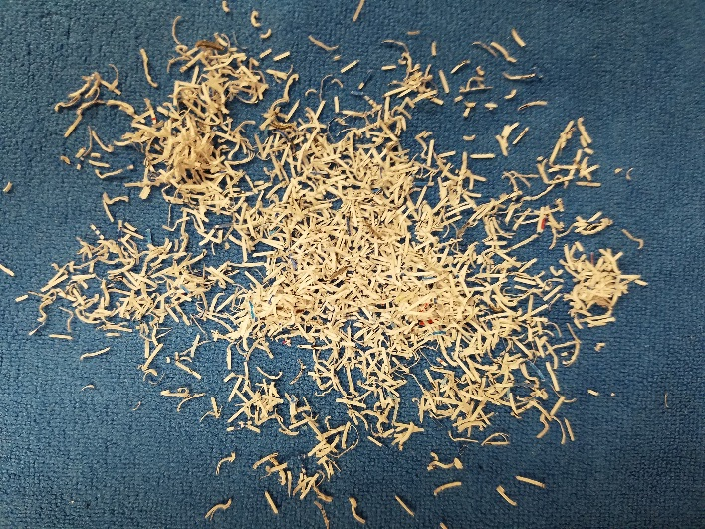
Destruction
When destroying CUI, including in electronic form, you must do so in a manner that makes it unreadable, indecipherable, and irrecoverable, using any of the following:
  Guidance for destruction in NIST SP 800-53, Security and Privacy Controls for Federal Information Systems and Organizations, and NIST SP 800-88, Guidelines for Media Sanitization;
  Any method of destruction approved for Classified National Security Information
  Any specific destruction methods required by law, regulation, or Government-wide policy for that item.
Destroy paper using cross cut shredders that produce particles that are 1mm by 5 mm.

Slide 26
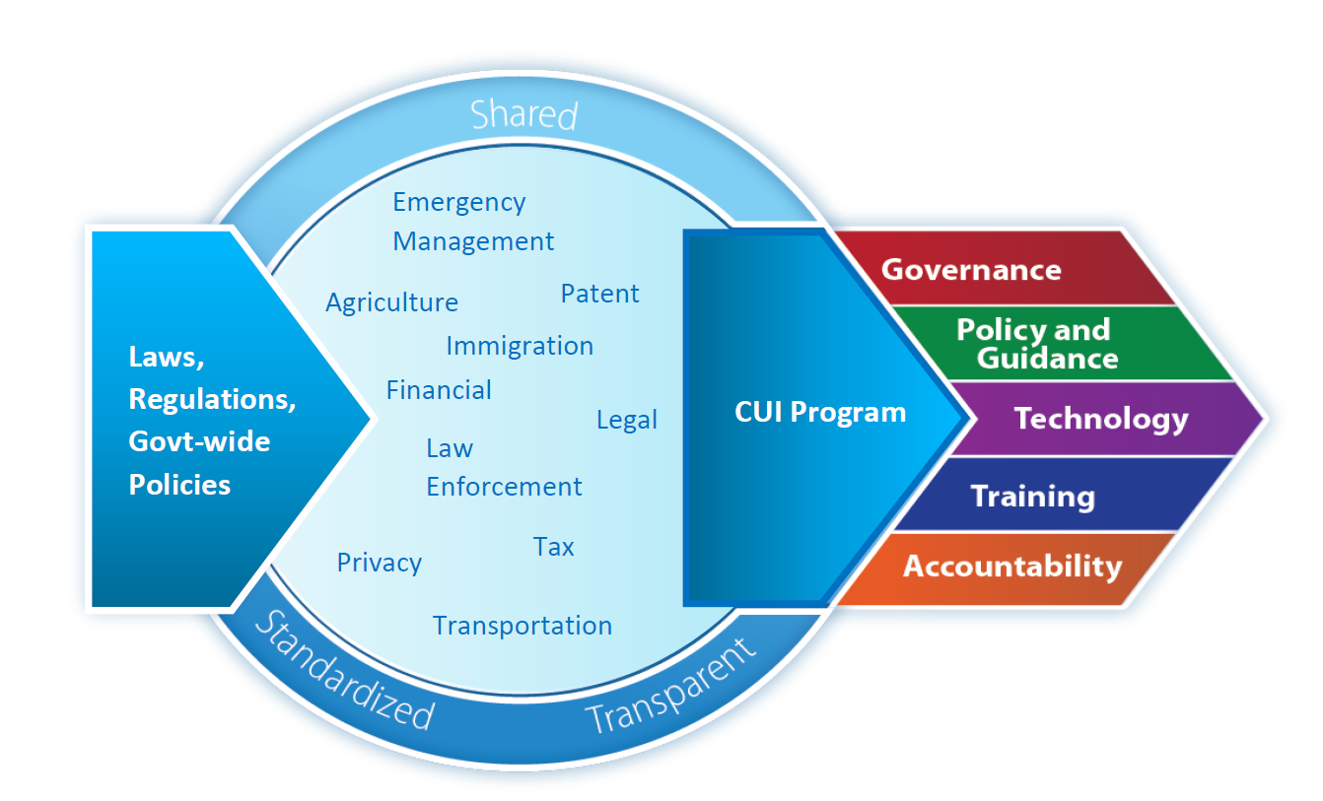
Questions?
Patrick Viscuso, Ph.D.
Associate Director, Controlled Unclassified Information
patrick.viscuso@nara.gov
Mark Riddle
Lead for Implementation and Oversight
mark.riddle@nara.gov
Bryan M. Oklin
Attorney Advisor
bryan.oklin@nara.gov

