Slide 1
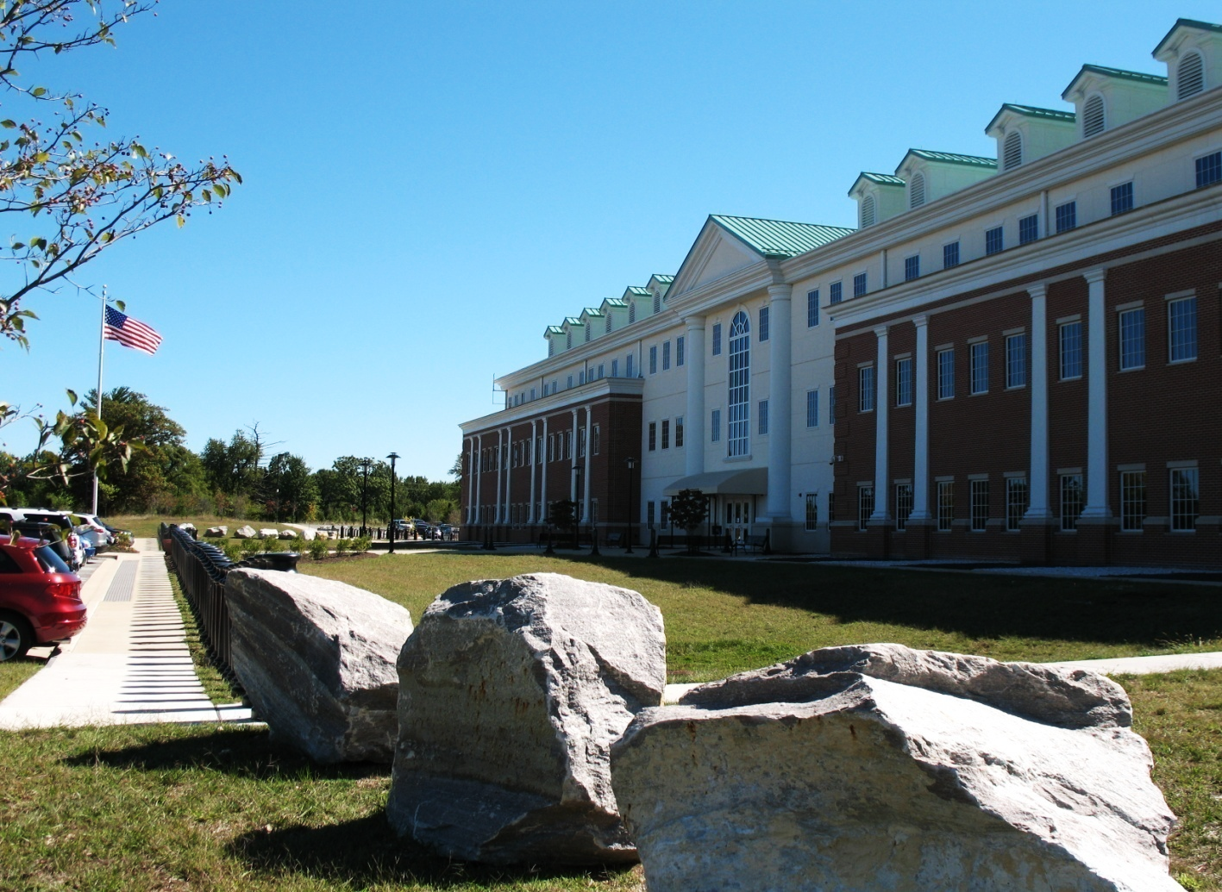
UNCLASSIFIED
Department of Defense Consolidated Adjudications Facility
National defense industrial (ndia)
and the aerospace industries association (aia)
Director, Ned Fish
dod consolidated adjudications facility
November 14-16, 2016
UNCLASSIFIED

Slide 2
UNCLASSIFIED
Agenda
Mission
CAF Transformation
Metrics
Initiatives
Questions
2
UNCLASSIFIED

Slide 3
UNCLASSIFIED
DoD CAF Mission
To determine security clearance eligibility of non-Intelligence Agency DoD personnel occupying sensitive positions and/or requiring access to classified material including Sensitive Compartmented Information (SCI). These determinations involve all military service members, applicants, civilian employees, and consultants affiliated with the Department of Defense, to include DoD personnel at the White House and contractor personnel under the National Industrial Security Program (NISP). The DoD CAF also adjudicates security clearance eligibility for staff of the United States Senate and House of Representatives, the Congressional Budget Office, and the United States Capitol Police. Additionally, the DoD CAF renders favorable adjudicative determinations for employment suitability of DoD civilian employees and Common Access Card (CAC) or Fitness eligibility of non-cleared DoD contractors.
3
UNCLASSIFIED//FOR OFFICIAL USE ONLY

Slide 4
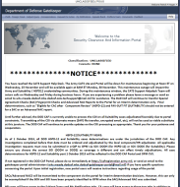
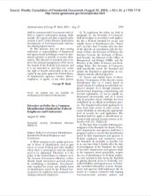
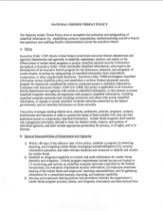
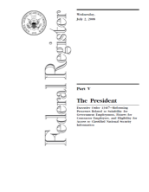
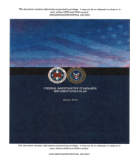
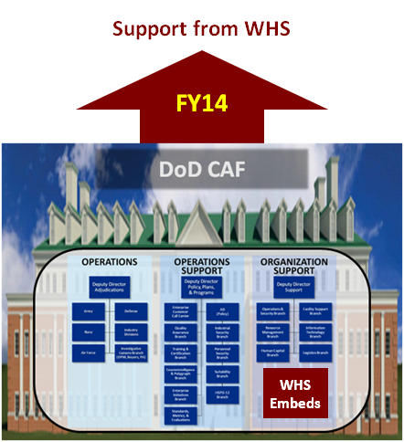
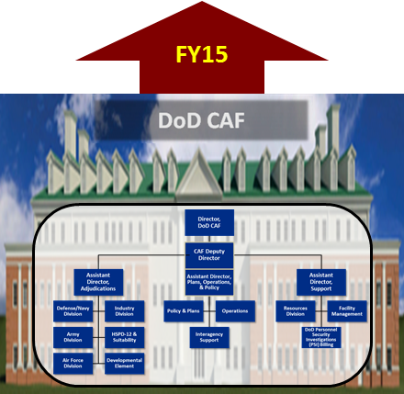
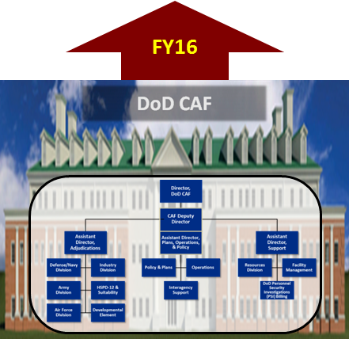
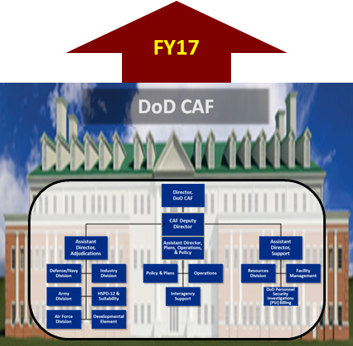
DOD CAF TRANSFORMATION
Stabilization
Transition
Mission Expansion
HSPD-12 & SUITABILITY DETERMINATIONS
REVISED FEDERAL INVESTIGATIVE STANDARDS
& CONTINUOUS EVALUATION
IMPROVE AUTOMATED CHECKS & AUTOMATIC TECHNOLOGY
HSPD-12
NISP & MS
CATS PORTAL
EO 13467
CONTINUOUS EVALUATION
FIS Implementation Plan
October 1, 2013
October 1, 2014
October 1, 2015
October 1, 2016
Begin integration of best
practices and cultures
Normalize the culture and
continue integration
Prepare for mission growth
and begin final phases
of integration
Consolidate PERSEC IT
DoD-wide upon
implementation
of DISS/CATS v.4; Expand Support to CE
UNCLASSIFIED

Slide 5
UNCLASSIFIED
METRICS
5
UNCLASSIFIED

Slide 6
UNCLASSIFIED
Industrial Cases Pending Adjudication
Re-baselined. Includes 4th Estate SCI Mission and all Industrial SCI cases
Age of Bklog Cases¹
0-1 Year: 1,167
1-2 Years: 256
>2 Years: 135
Total: 1,560
In Due Process²
LSR: 305 Othr: 378
Total: 683
Increase due to addition of DIA SCI cases and re-baselined calculations to include all Industrial SCI cases
Backlog to be eliminated not earlier than 4QTR FY17
Legal Sufficiency Review (LSR) cases expected to stabilize at 200-300
Month | NISP Backlog | FY 16 NISP Receipt* | Backlog % of Total NISP
October 13 | 13,515 |  | 7.4%
October 16 | 1,560 |  | 0.9%
 | -11,955 | ~ 183,000
OPR: M&A
¹ Age based on date case received at the DoD CAF
² Data as of 01 November 16
Slide Revised: 08 November 2016
* Includes Personal Security Investigations, Incident
Reports, Reconsiderations, etc. (does not include SACs)
6
UNCLASSIFIED
Notes:
Definition Notes:
Industry backlog: Includes Div A (IND Division) Personal Security Investigations, Incident Reports, Reconsiderations, etc. (does not include SACs) and ANY backlogged industry cases assigned to Div B (Army), Div C (Navy), Div D (USAF) and the 4th Estate
Industry Work (Steady State): includes all Industry cases (PSIs, IR, Reconsiderations, etc) to include SCI contractor cases in the other Divisions (Div B (Army), Div C (Navy), Div D (USAF) and the 4th Estate).
Calculation Notes:
Backlog Reduction Calculation: % Diff btwn Dec 13 Industry Bklog: 14,702 and current backlog (1,255, as of 7/26/16) = 91%
Age of Bklog Cases Calculation:
2nd Rev: Open data pull, use IND only; Determine: what is backlogged (use Assigned date); what is Case Age (Target Date) and create pvtble to sort out 0-1yr, 1-2 yrs, >2yrs
Supsense: Open WAR, isolate Susp Data, filter out Susp Pop Null Data; ; Determine: what is backlogged (use Susp Pop date); what is Case Age (Initiated Date) and create pvtble to sort out 0-1yr, 1-2 yrs, >2yrs
In Due Process Calculation: LSRs + DP Referrals + Final SOR to Prep (see DISCO WAR, WIP worksheet, LSR (AY13) + DP Referrals (BK6) + Final SOR to Prep (BU6))

Slide 7
UNCLASSIFIED
INDUSTRY Intelligence Reform and Terrorism Prevention Act Performance
(Based on OPM Reporting)
Jun 15-Sep 16
Avg for FY 15 Initial: 20
PR: 37
Avg for FY 16
Initial: 17
PR: 58
Average for Tier 3 Products in FY 16: Initial: 5 days; PR: 4 days
Anticipate continued focus on initial investigations as the priority until the backlog is eliminated and CATSv4 implementation occurs. Timelines for Periodic Reinvestigations expected to remain high through FY 17
Spike in Jul-Sep 16 is the result of:
4th Estate SCI/DIA case transfer/ingest
IT latency issues and challenges from legacy CATS
Increase in closed older cases
Final determinations made on backlogged cases transferred from DIA CAF (beginning on 01 Jul 16)
UNCLASSIFIED
OPR: M&A | As Of: 30 September 2016
7

Slide 8
UNCLASSIFIED
OPM Oversight Report for FY2016
IRPTA Timelines Achieved In FY2016 Despite Detractors
All Agencies National Security Initial End To End: 148 Days
DoD CAF: 144 Days
Army: 139 Days
Navy: 127 Days
Air Force: 135 Days
Industry: 196 Days
DoD CAF Adjudication Timelines:
Initial (All Types) – Adjudicated in 12 of 20 days
SSBI-PRs – Adjudicated in 27 of 30 days
Contributing Factors (Detractors):
Several periods of extended IT service instabilities including periods of low to no ingest contributed to increased timelines
During periods of low to no ingest, CAF focused on closing aged backlog cases
Combination of aging ingest (before receipt) and focus on aged cases (in inventory) caused increases in timeliness particularly Industry;
Later in the FY, CAF placed emphasis on incident reports
No Tier 3 cases were eAdjudicated in FY2016
Industry Division’s focus on Suspense Case Management and Converting NACLC Re-Opens to RSI also contributed to increased timelines
Acceptance of 4th Estate SCI Mission included accepting backlogged cases from DIA
Army Only Timelines:
Initial (All Types) – Adjudicated in 19 of 20 days
SSBI-PRs – Adjudicated in 28 of 30 days
Navy Only Timelines:
Initial (All Types) – Adjudicated in 5 of 20 days
SSBI-PRs – Adjudicated in 10 of 30 days
Air Force Only Timelines:
Initial (All Types) – Adjudicated in 7 of 20 days
SSBI-PRs – Adjudicated in 9 of 30 days
Industry Only Timelines:
Initial (All Types) – Adjudicated in 17 of 20 days
SSBI-PRs – Adjudicated in 58 of 30 days
"Even though we have successfully implemented T3 eAdjudication (October 2016), we anticipate the FY17 IRTPA timelines to be similar due to disruptions resulting from the planned deployment of CATSv4. Industry SSBI-PR timelines should improve with elimination of last vestiges of legacy backlog in 2017
As Of: 8 Nov 16
8
UNCLASSIFIED

Slide 9
UNCLASSIFIED
INITIATIVES
9
UNCLASSIFIED

Slide 10
UNCLASSIFIED
Initiatives
Transfer of 4th Estate SCI Adjudications (includes NISP)
Non-DIA contractors requiring TS/SCI eligibility from DIA CAF, are now sent to DoD CAF SOI
Defense Agencies
DoD Field Activities
Combat Support Agencies
CECD Pilot:
CY 2015 – 225,00
CY 2016 – 275,000 (500,000 Cumulative)
Pilot capability evolving into operational CE system; ramp up continues
OUSD(I) integrating CE requirements into DISS, maintaining alignment w/ODNI CE capability
Tier 3/Tier 3R eAdjudication:
Phased deployment in legacy CATS
31 Oct 2016: DISCO ✓
As of : 7 Nov 16
10
UNCLASSIFIED

Slide 11
UNCLASSIFIED
Initiatives (cont’d)
Industry Specific CATS V4 Deployment by DISS PM
Mar - Apr 2017: Deployed to CAF Industry Division
Mar - Apr 2017: Industry Portal Deployment
5 May 2017: Tentative Date to “sunset” DISCO CATS
As of : 7 Nov 16
11
UNCLASSIFIED

Slide 12
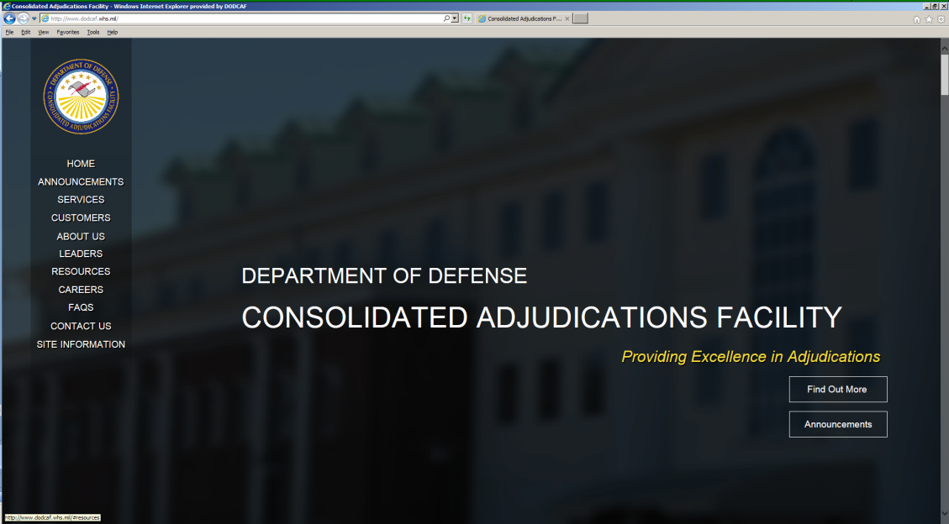
UNCLASSIFIED
Visit our website!!
The Department of Defense Consolidated Adjudications Facility Public Website has been crafted to reflect what our customers would like to see. It also builds upon the foundation of the DoD CAF, which is the tradition of excellence established by the seven former component CAFs in making adjudicative determinations.
You will notice streamlined menus, simple navigation and access to the information you need, any time of day.
Visit the DoD CAF website today at http://www.dodcaf.whs.mil/
NEW! HSPD-12
General Information
COMMUNICATIONS EMAILBOX:
whs.meade.dodcaf.mbx.dodcaf-interagency-communications@mail.mil
12
UNCLASSIFIED

Slide 13
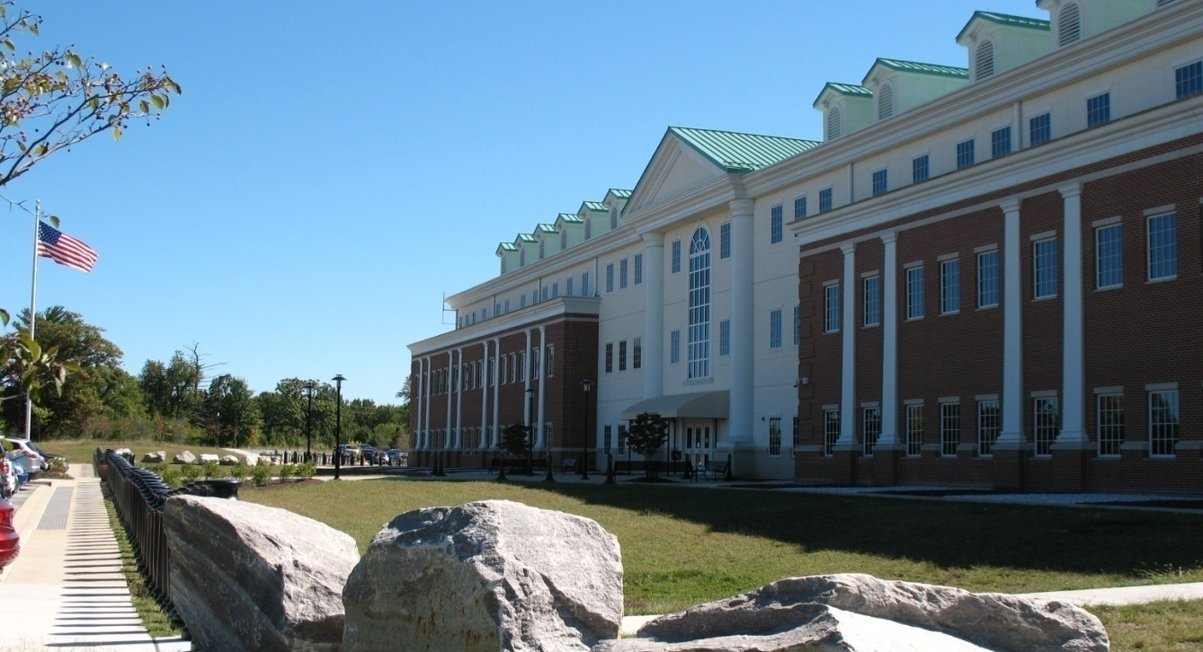
UNCLASSIFIED
DoD CAF
Bldg. 600, 10th Street, FGGM
QUESTIONS???
13
UNCLASSIFIED

