Slide 1
Software Assurance – Building Security In Carol Woody, Ph.D. Technical Manager, Cybersecurity Engineering, CERT NDIA Industrial Committee on Test and Evaluation Meeting (ICOTE) November 12, 2015

Slide 2
Notices
Copyright 2015 Carnegie Mellon University
This material is based upon work funded and supported by the Department of Defense under Contract No. FA8721-05-C-0003 with Carnegie Mellon University for the operation of the Software Engineering Institute, a federally funded research and development center. Any opinions, findings and conclusions or recommendations expressed in this material are those of the author(s) and do not necessarily reflect the views of the United States Department of Defense. NO WARRANTY. THIS CARNEGIE MELLON UNIVERSITY AND SOFTWARE ENGINEERING INSTITUTE MATERIAL IS FURNISHED ON AN “AS-IS” BASIS. CARNEGIE MELLON UNIVERSITY MAKES NO WARRANTIES OF ANY KIND, EITHER EXPRESSED OR IMPLIED, AS TO ANY MATTER INCLUDING, BUT NOT LIMITED TO, WARRANTY OF FITNESS FOR PURPOSE OR MERCHANTABILITY, EXCLUSIVITY, OR RESULTS OBTAINED FROM USE OF THE MATERIAL. CARNEGIE MELLON UNIVERSITY DOES NOT MAKE ANY WARRANTY OF ANY KIND WITH RESPECT TO FREEDOM FROM PATENT, TRADEMARK, OR COPYRIGHT INFRINGEMENT. This material has been approved for public release and unlimited distribution. This material may be reproduced in its entirety, without modification, and freely distributed in written or electronic form without requesting formal permission. Permission is required for any other use. Requests for permission should be directed to the Software Engineering Institute at permission@sei.cmu.edu. Carnegie Mellon® and CERT® are registered marks of Carnegie Mellon University. DM-0002788

Slide 3
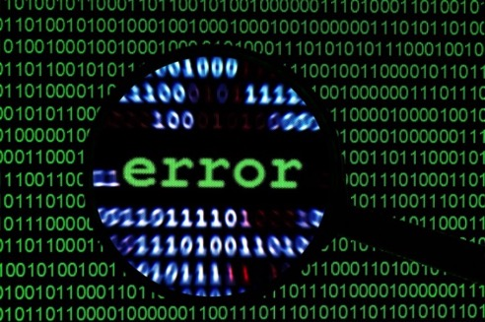
CERT Division
The CERT Division produces, and transitions technologies and practices that reduce the opportunity for—and limit the damage of—cyber attacks.
Focus areas include
Cyber Risk Management
Digital Intelligence & Investigations
Insider Threat
Incident Management
Vulnerability Analysis
Operational Resilience
Secure Coding
Cybersecurity Engineering
Situational Awareness
Workforce Development

Slide 4
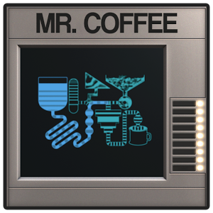
Automation and Risks
Automation of …
…builds
…functional tests
…deployment
…reporting
…the coffee machine
But security testing is still typically manual pen testing,
done only on release
Image: https://lh4.ggpht.com/z_w-yCMvUcrqZd_6eXlt7E24YvSHEak1k5lNvk5GGNYmzMaBQkH1oe3emhZk0scIWg=w300

Slide 5
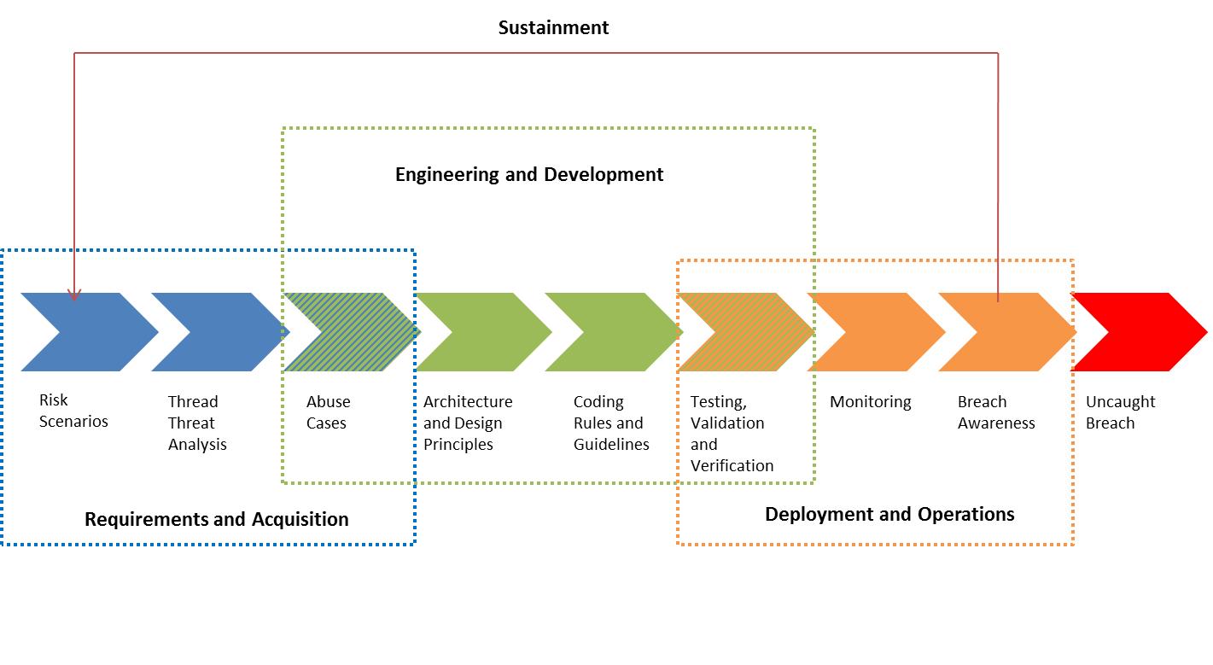
Security Requires a Lifecycle Focus
Mission thread (Business process)
Design Weaknesses
Coding Weaknesses
Implementation Weaknesses
Notes:
SERA: Security Engineering Risk Analysis
AADL: Architecture and Analysis Design Language
TSP-Secure: Team Software Process

Slide 6
Many Opportunities for Improvement
More than 81% do not coordinate their security practices throughout the development life cycle.
19% fail to carry out security requirement definition.
27% do not practice secure design.
30% do not use static analysis or manual code review during development.
47% do not perform acceptance tests for third-party code.
Sustainment
Engineering and Development
Mission thread (Business process)
Threat
Analysis
Abuse
Cases
Architecture
and Design
Principles
Coding
Rules and
Guidelines
Testing,
Validation
and
Verification
Monitoring
Breach
Awareness
Requirements and Acquisition
Deployment and Operations
Source: Forrester Consulting, “State of Application Security,” January 2011

Slide 7
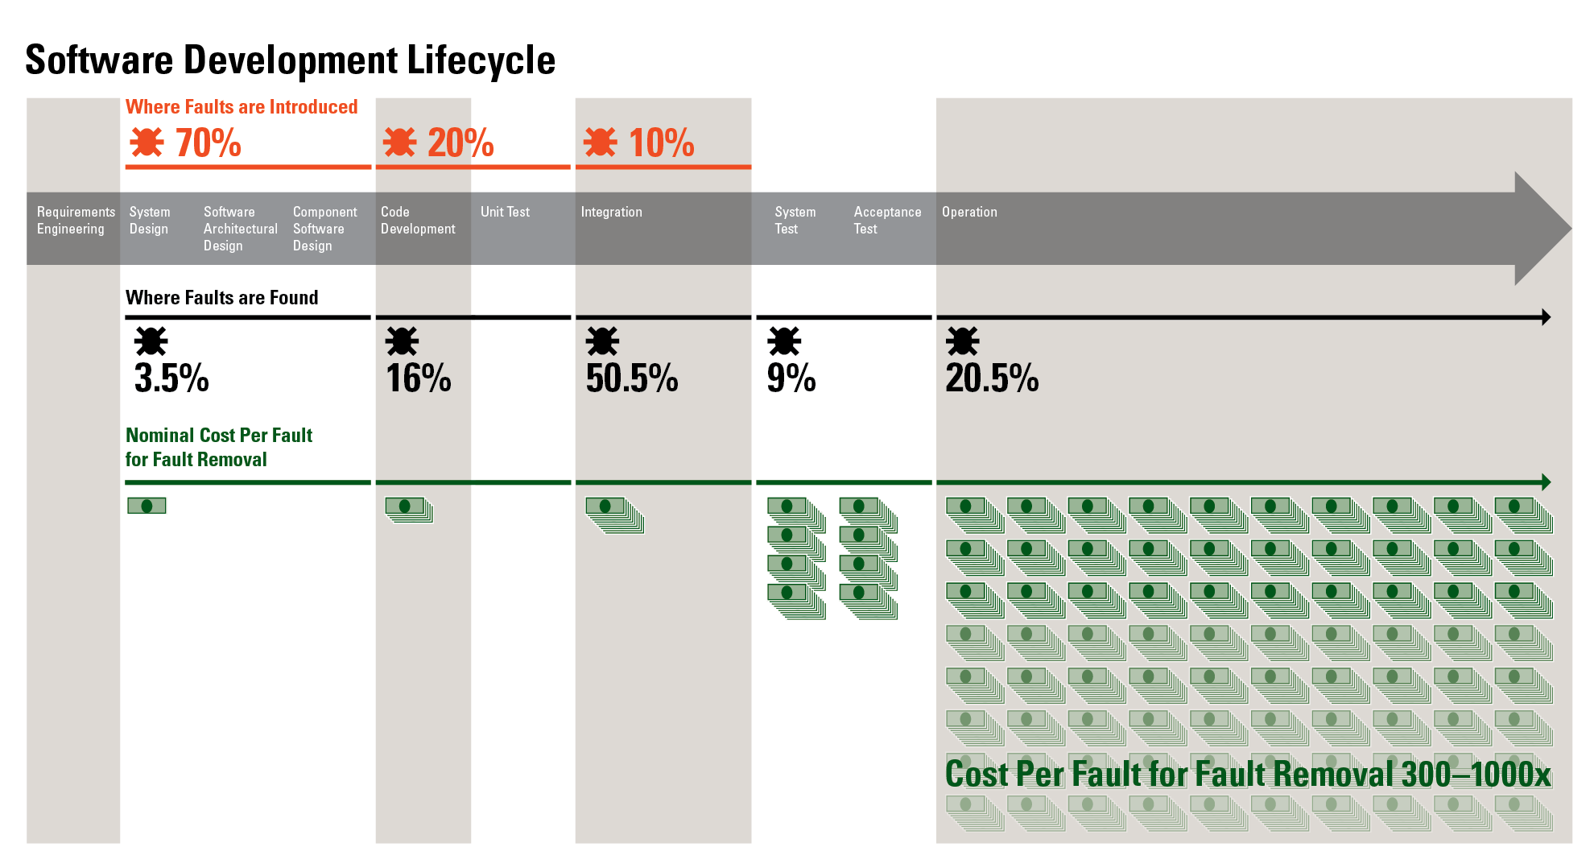
Catching Faults Early Saves Money
Faults accounts for 30‒50% percent of total software project costs
Sources: Critical Code; NIST, NASA, INCOSE, and Aircraft Industry Studies

Slide 8

What Can Be Done? Effective Software Assurance

Slide 9
Software Assurance (SwA)
Defined as “the level of confidence that software is free from vulnerabilities, either intentionally designed into the software or accidentally inserted at anytime during its lifecycle, and that the software functions in the intended manner.” National Information Assurance Glossary"; [CNSS Instruction No. 4009; DoDi 5200.44 p.12]
Software assurance is a level of confidence that the software functions as intended and only as intended
Trustworthiness - No exploitable weaknesses exist, either maliciously or unintentionally inserted.
Predictable Execution - When executed, software functions as intended.

Slide 10
Address Design Weaknesses
Mission thread (Business process)
Design Weaknesses
Coding Weaknesses
Implementation Weaknesses
Notes:
SERA: Security Engineering Risk Analysis
AADL: Architecture and Analysis Design Language
TSP-Secure: Team Software Process

Slide 11
Plan for Secure Requirements
Agree on definitions*
Select elicitation techniques
Elicit security requirements
Categorize requirements*
Prioritize requirements*
Review and inspect requirements
Identify assets and security goals*
Develop artifacts
Perform risk assessment*
CERT SQUARE -- A robust SQUARE tool is available for download from http://www.cert.org/sse/square.html
Notes:
Security Quality Requirements Engineering (SQUARE) is a nine-step process that helps organizations build security, including privacy, into the early stages of the production lifecycle. Instructional materials are available for download that can be used to teach the SQUARE method.
These are the 9 steps of SQUARE for development. They are also described in more detail in a tabular form. This can be found in the SQUARE technical report and also in our brochures. We’ll be briefly describing each step.
For each step, we say what it is, who does it, exit criteria.

Slide 12

Perform Security Engineering Risk Analysis
What
Analyze complex security risks in software-reliant systems and systems of systems
Why
Build security into software-reliant systems by addressing design weaknesses as early as possible
Assemble a shared organizational view (business and technical) of cybersecurity risk
Benefits
Correct weaknesses before a system is deployed
Reduce residual cybersecurity risk in deployed systems
Ensure consistency with NIST Risk Management Framework (RMF)

Slide 13
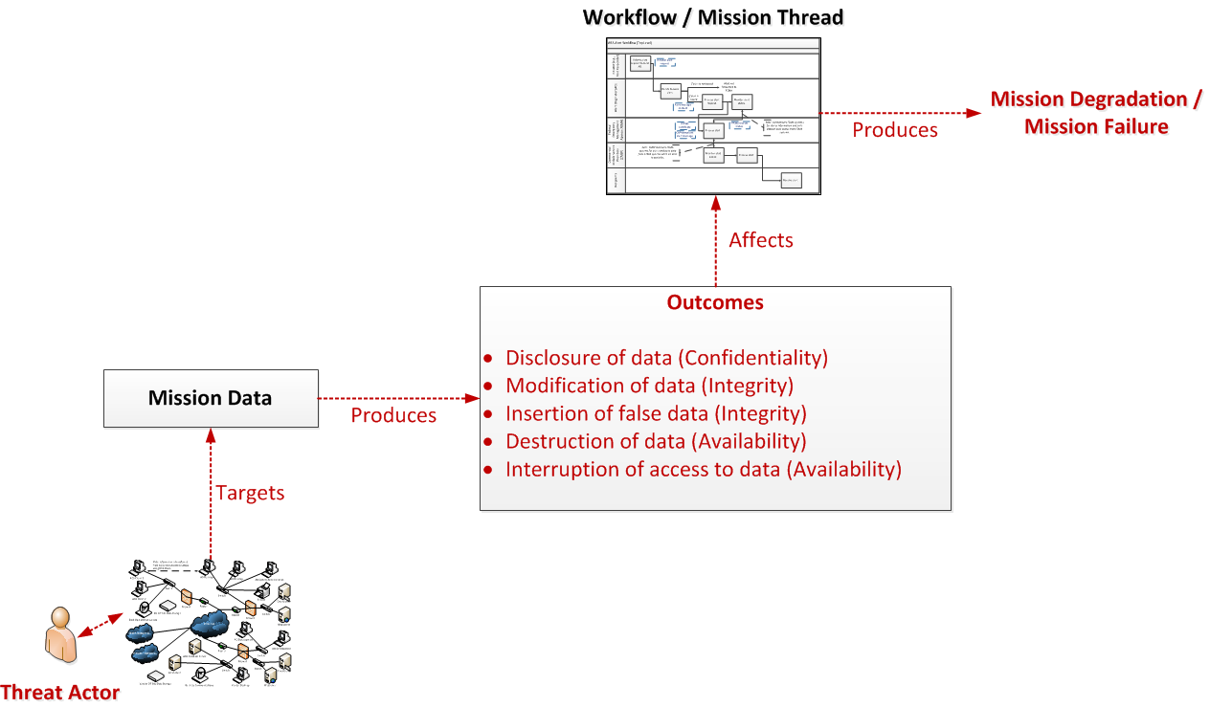
Security Engineering Risk Analysis (SERA) Framework
Model the system, context, and attacks to determine critical software security risks

Slide 14
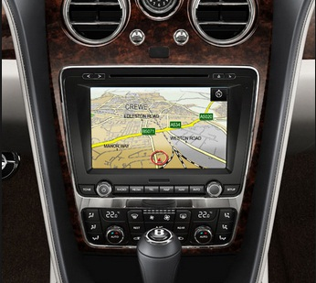
Extending Formal Modeling for Security
We evaluated security concepts and associated semantics and behavior to explore what extension mechanisms would suffice to allow specification and analysis of security concerns.
To drive this analysis we began by specifying concrete threats in the context of automotive electronics.

Slide 15
Value of Security Formal Modeling
Crucial security decisions to address threats are made in the architecture.
Analyzing an architecture for is a huge opportunity for improving security.
Formal modeling provides a means to verify a design.
Identify Threats
Create Architecture Candidate
Resolve Design Flaws
Model Architecture
Find Security Design Flaws

Slide 16
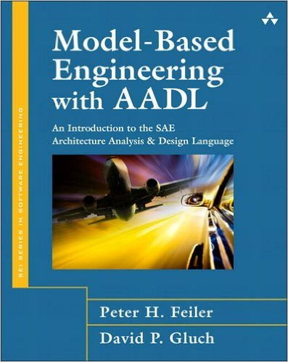
Using AADL to Model Architectures
AADL (Architecture Analysis and Design Language):
specifies a static representation of a system architecture
can model logical flows, binding of software to hardware
is strongly typed, allowing a consistency checks via a modeling tool set.
Notes:
Define AADL
Add graphic of book
Describe the tool ecosystem

Slide 17
Address Coding Weaknesses
Mission thread (Business process)
Design Weaknesses
Coding Weaknesses
Implementation Weaknesses
Notes:
SERA: Security Engineering Risk Analysis
AADL: Architecture and Analysis Design Language
TSP-Secure: Team Software Process

Slide 18
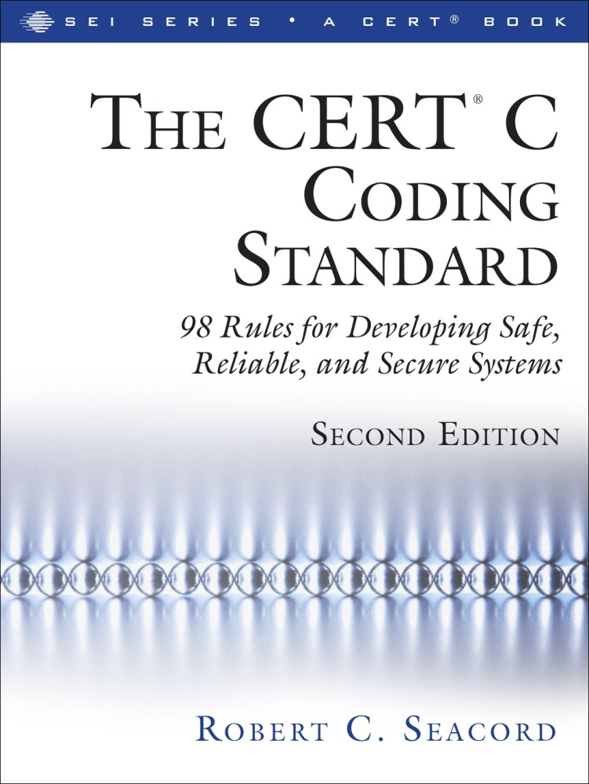
Implement Coding Standards
Collected wisdom of programmers and tools vendors
Fed by community wiki started in Spring 2006
1,576 registered contributors
Basis for ISO Standard
Adopted corporately, e.g., Oracle and Cisco
Secure Coding in C/C++ Workshop (http://www.sei.cmu.edu/training/p63.cfm)
Notes:
This book was made possible through a broad community effort. First I would like
to thank those who contributed guidelines to this book, including Arbob Ahmad,
Juan Alvarado, Dave Aronson, Abhishek Arya, Berin Babcock-McConnell,
Roberto Bagnara, Bruce Bayha, Joe Black, Jodi Blake, Jill Britton, Levi Broderick,
Hal Burch, J. L. Charton, Steve Christey, Ciera Christopher, Geoff Clare, Frank
Costello, Joe Damato, Stephen C. Dewhurst, Susan Ditmore, Chad Dougherty,
Mark Dowd, Apoorv Dutta, Emily Evans, Xiaoyi Fei, William Fithen, Hallvard
Furuseth, Jeff Gennari, Andrew Gidwani, Ankur Goyal, Douglas A. Gwyn, Shaun
Hedrick, Michael Howard, Sujay Jain, Christina Johns, Pranjal Jumde, Andrew
Keeton, David Kohlbrenner, Takuya Kondo, Masaki Kubo, Pranav Kukreja, Richard
Lane, Stephanie Wan-Ruey Lee, Jonathan Leffler, Pengfei Li, Fred Long, Justin
Loo, Gregory K. Look, Larry Maccherone, Aditya Mahendrakar, Lee Mancuso,
John McDonald, James McNellis, Randy Meyers, Dhruv Mohindra, Nat Lyle,
Bhaswanth Nalabothula, Todd Nowacki, Adrian Trejo Nuñez, Bhadrinath Pani,
Vishal Patel, David M. Pickett, Justin Pincar, Thomas Plum, Abhijit Rao, Raunak
Rungta, Dan Saks, Alexandre Santos, Brendan Saulsbury, Jason Michael Sharp,
Astha Singhal, Will Snavely, Nick Stoughton, Alexander E. Strommen, Glenn
Stroz, Dean Sutherland, Kazunori Takeuchi, Chris Tapp, Chris Taschner, Mira
Sri Divya Thambireddy, Melanie Thompson, Elpiniki Tsakalaki, Ben Tucker,
Fred J. Tydeman, Abhishek Veldurthy, Wietse Venema, Alex Volkovitsky, Michael
Shaye-Wen Wang, Grant Watters, Tim Wilson, Eric Wong, Lutz Wrage, Shishir
Kumar Yadav, Gary Yuan, Ricky Zhou, and Alen Zukich.
I would also like to thank the following reviewers: Stefan Achatz, Arbob
Ahmad, Laurent Alebarde, Kevin Bagust, Greg Beeley, Arjun Bijanki, John Bode,
Konrad Borowski, Stewart Brodie, Jordan Brown, Andrew Browne, G. Bulmer,
Kyle Comer, Sean Connelly, Ale Contenti, Tom Danielsen, Eric Decker, Mark
Dowd, T. Edwin, Brian Ewins, Justin Ferguson, William L. Fithen, Stephen
Friedl, Hallvard Furuseth, Shay Green, Samium Gromoff, Kowsik Guruswamy,
Peter Gutmann, Douglas A. Gwyn, Richard Heathfield, Darryl Hill, Paul Hsieh,
Ivan Jager, Steven G. Johnson, Anders Kaseorg, Matt Kraai, Piotr Krukowiecki,
Jerry Leichter, Nicholas Marriott, Frank Martinez, Scott Meyers, Eric Miller,
Charles-Francois Natali, Ron Natalie, Adam O’Brien, Heikki Orsila, Balog Pal,
Jonathan Paulson, P. J. Plauger, Leslie Satenstein, Kirk Sayre, Neil Schellenberger,
Michel Schinz, Eric Sosman, Chris Tapp, Andrey Tarasevich, Josh Triplett, Yozo
Toda, Pavel Vasilyev, Ivan Vecerina, Zeljko Vrba, David Wagner, Henry S. Warren,
Colin Watson, Zhenyu Wu, Drew Yao, Christopher Yeleighton, and Robin Zhu.
Thanks also to the team at Addison-Wesley, including Kim Boedigheimer,
assistant editor; Caroline Senay, production editor; Julie B. Nahil, full-service
production manager; Deborah Thompson, copy editor; Christopher Guzikowski,
executive editor; John Fuller, managing editor; and Stephane Nakib, product
marketing manager.

Slide 19
Additional CERT Coding Standards
CERT C++ Secure Coding Standard
CERT Oracle Secure Coding Standard for Java
Java Secure Coding Guidelines (Version 1.0 (Java 7) published in 2011)
Secure Coding Java Workshop Available
CERT Perl Secure Coding Standard
Version 1.0 under development
CERT Python Secure Coding Standard
Version 1.0 under development
Engage community
Tool vendor analysis
Consensus on vulnerability and mitigation

Slide 20
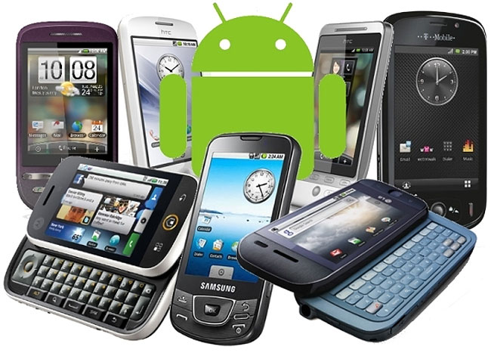
Coding Rules for Android
Extends Java coding rules with specific Android guidance
Recommendations for using Android specific features

Slide 21
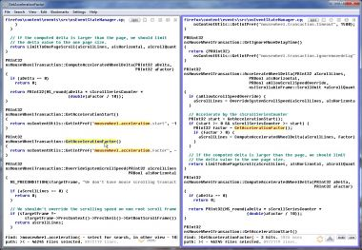

Use Static Testing and Source Code Analysis
Secure Code Analysis Laboratory (SCALe)
C, C++, Java, PERL, Python, Android rule conformance checking
Information flows across applications
Operating system call flows
Manual review against threat models
Web services: SOAP, REST, XML-RPC
Java applets
Access control matrices
Custom network or data protocols.
Notes:
SCALe is a package of static analysis tuned to identify secure coding violations.
CERT also works in the area of dynamic testing: fuzz testing and penetration testing. Trends are moving into platform testing, such as baseband/cellular communication platforms (smart phone processing platforms) and automotive communications platforms.

Slide 22

Implement Dynamic Testing
Available Tools & Training
Tapioca
a network-layer man-in-the-middle (MITM) proxy VM that is based on UbuFuzz and is preloaded with mitmproxy
BFF/FOE
a software testing tool that finds defects in applications that run on the Windows, Linux, and Mac OS X platforms
Introductory Fuzzing Course
Learn how to use CERT’s fuzzing tools to crash applications and find exploitable vulnerabilities
Notes:
SCALe is a package of static analysis tuned to identify secure coding violations.
CERT also works in the area of dynamic testing: fuzz testing and penetration testing. Trends are moving into platform testing, such as baseband/cellular communication platforms (smart phone processing platforms) and automotive communications platforms.

Slide 23
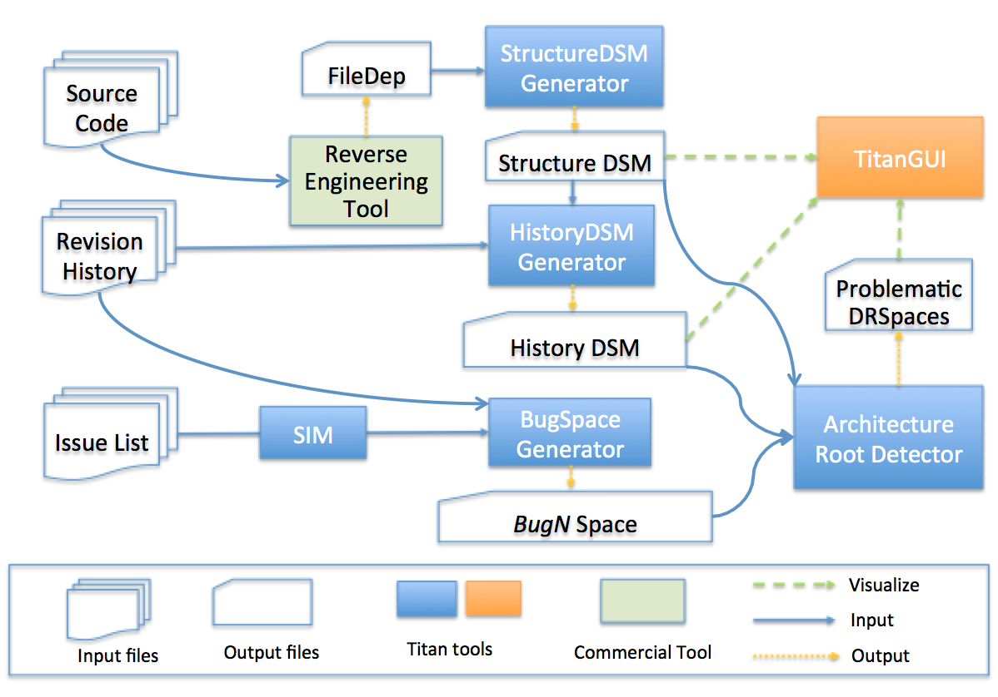
Architecture Analysis for Security
Tools for discovering architecture weaknesses in code - Design Rule Analysis for Security (Titan tool suite)
Unstable Interface
(2) Implicit Cross-module Dependency
(3) Unhealthy Inheritance Hierarchy
(4) Cross-Module Cycle, (5) Cross-Package Cycle.
Identify and Address Security Technical Debt

Slide 24
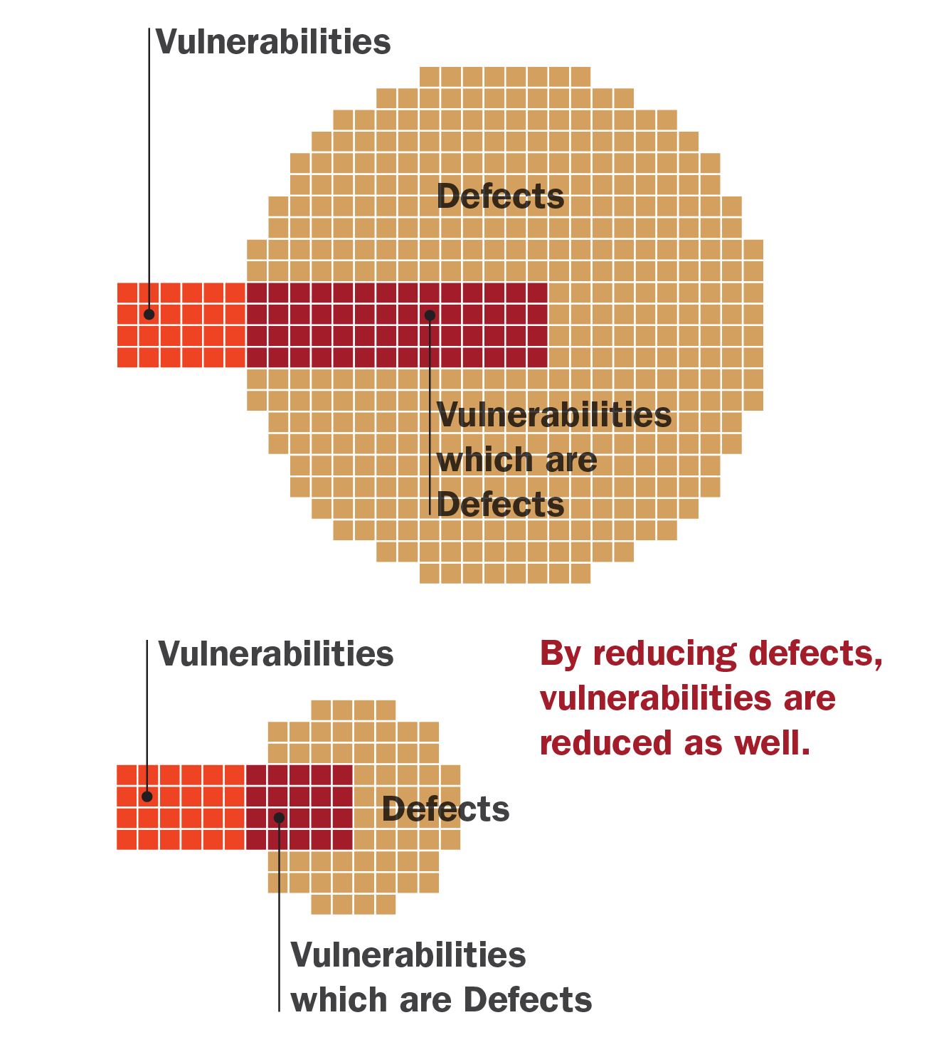
Use Testing to Verify Achieved Results
If defects are measured, from 1-5% of these should be considered to be security vulnerabilities.
It is also feasible that when security vulnerabilities are measured then code quality can be estimated by considering these to be 1-5% of the expected defects.
Quality does not happen by accident and neither does security
Neither quality nor security can be “tested in”
Reducing defects reduces vulnerabilities

Slide 25
Address Implementation Weaknesses
Mission thread (Business process)
Design Weaknesses
Coding Weaknesses
Implementation Weaknesses
Notes:
SERA: Security Engineering Risk Analysis
AADL: Architecture and Analysis Design Language
TSP-Secure: Team Software Process

Slide 26
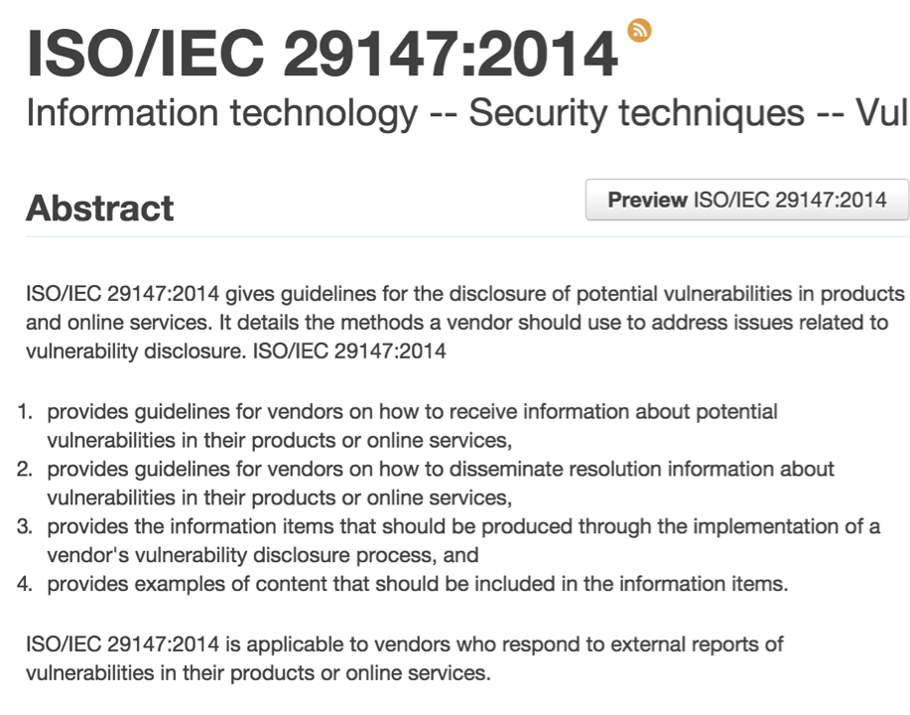
Respond Appropriately to Product Security Incidents
CERT PSIRT Development Course
This course will help your organization form a team that can:
manage the response to a vulnerability report
triage of multiple vulnerability reports
assignment of a CVE
coordination of the patch
development of the vulnerability patch note.
dealing with researcher personalities, public relations fallout, and vulnerability disclosure edge cases.
Notes:
SCALe is a package of static analysis tuned to identify secure coding violations.
CERT also works in the area of dynamic testing: fuzz testing and penetration testing. Trends are moving into platform testing, such as baseband/cellular communication platforms (smart phone processing platforms) and automotive communications platforms.

Slide 27

Institute Supply Chain Risk Management Review
Evaluate a supplier’s security commitment
Evaluate a product’s threat resistance
Evaluate product delivery mechanisms
Evaluate the capability to maintain attack resistance during use

Slide 28
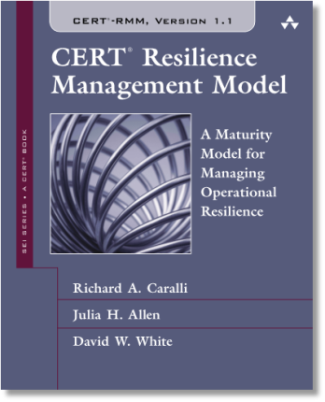
Manage and Assess for Resilience
CERT-RMM is a capability model for managing and improving operational resilience.
Guides implementation and management of operational resilience activities
Converges key operational risk management activities: security, IA, BC, DR, and IT operations
Enables measurement
Improves confidence in how an organization responds in times of operational stress
“…an extensive super-set of the things an organization could do to be more resilient.”
“…a way to organize security chaos.”
- CERT-RMM adopters
Notes:
I would position CERT-RMM as a “holistic” way to approach operational resilience by ensuring the organization has sufficient process maturity to focus on: the missions that matter, the cyber assets (people, information, technology, and facilities) that support those missions, and the processes needed to keep these missions and assets free from disruption or operating soundly when disruption occurs.

Slide 29

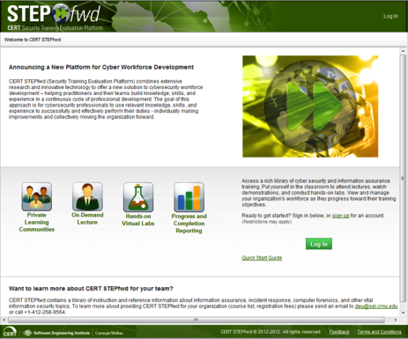
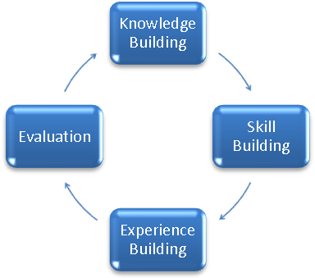
Develop Your Workforce: Recruit, Train, Educate, Retain
The development of cybersecurity aware professionals is not keeping pace with the exponential growth of cybersecurity challenges.
SEI Courses and Certificates
http://www.sei.cmu.edu/training
Software assurance competency defined by the IEEE endorsed Software Assurance Competency Model
Notes:
Because software is pervasive, cybersecurity experts are needed in all industries and sectors.
Cybersecurity education requires development of many competencies: both technical (ranging across software, systems, and network engineering disciplines) and managerial (governance, policy, regulation, practices)
Matriculation in computer science programs is decreasing
Focusing on national security problems is hindered by the number of available cybersecurity professionals who are US citizens.
Non-technical personnel who are decision makers and users also require training and education.
Retention is tough: lots of competition for a very limited pool.
Computer science is the only one of the STEM (science, technology, engineering and mathematics) fields that has actually seen a decrease in student participation over the last 20 years, from 25% of high school students to only 19%, according to a 2011 study by the National Center for Education Statistics.
In recent years more than half of U.S. engineering doctorates are earned by temporary visa holders. (“Science and Engineering Indicators 2012,” National Science foundation, www.nsf.gov/statistics/seind12/c0/c0s4.htm)

Slide 30
Engage with SEI CERT for Software Assurance Improvement

Slide 31

Contact Information
Carol Woody, Ph.D.
(412) 268-9137
cwoody@cert.org
Web Resources (CERT/SEI)
http://www.cert.org/cybersecurity-engineering/
http://www.sei.cmu.edu/

