Slide 1
Special Publication 800-171
Protecting Controlled Unclassified Information in Nonfederal Information Systems
and Organizations
Dr. Ron Ross
Computer Security Division
Information Technology Laboratory

Slide 2
Controlled Unclassified Information
Information that law, regulation, or governmentwide policy requires to have safeguarding or disseminating controls, excluding information that is classified under Executive Order 13526, Classified National Security Information, December 29, 2009, or any predecessor or successor order, or the Atomic Energy Act of 1954, as amended.
-- Executive Order 13556

Slide 3
Executive Order 13556 Controlled Unclassified Information November 4, 2010
The Order —
Established a governmentwide Controlled Unclassified Information (CUI) Program to standardize the way the Executive branch handles unclassified information that requires protection.
Designated the National Archives and Records Administration (NARA) as the Executive Agent to implement the CUI program.
Only information that requires safeguarding or dissemination controls pursuant to federal law, regulation, or governmentwide policy may be designated as CUI.

Slide 4
Nonfederal Organizations Some Examples
Federal contractors.
State, local, and tribal governments.
Colleges and universities.
Notes:
Make statement about ALL controls being monitoring – it is only the frequency that varies

Slide 5
The CUI Registry
www.archives.gov/cui/registry/category-list.html
Online repository for information, guidance, policy, and requirements on handling CUI, including issuances by the CUI Executive Agent.
Identifies approved CUI categories and subcategories (with descriptions of each) and the basis for controls.
Sets out procedures for the use of CUI, including but not limited to marking, safeguarding, transporting, disseminating, re-using, and disposing of the information.

Slide 6
The Big Picture
A three-part plan for the protection of CUI
Federal CUI rule (32 CFR Part 2002) to establish the required controls and markings for CUI governmentwide.
NIST Special Publication 800-171 to define security requirements for protecting CUI in nonfederal information systems and organizations.
Federal Acquisition Regulation (FAR) clause to apply the requirements of the federal CUI rule and NIST Special Publication 800-171 to contractors.

Slide 7
Purpose
To provide federal agencies with recommended requirements for protecting the confidentiality of CUI —
When the CUI is resident in nonfederal information systems and organizations.
Where the CUI does not have specific safeguarding requirements prescribed by the authorizing law, regulation, or governmentwide policy for the CUI category or subcategory listed in the CUI Registry.
When the information systems where the CUI resides are not operated by organizations on behalf of the federal government.

Slide 8
Applicability
CUI requirements apply only to components of nonfederal information systems that process, store, or transmit CUI, or provide security protection for such components.
The requirements are intended for use by federal agencies in contractual vehicles or other agreements established between those agencies and nonfederal organizations.

Slide 9
CUI Security Requirements
Basic and derived security requirements are obtained from FIPS 200 and NIST SP 800-53 initially — and then tailored appropriately to eliminate requirements that are:
Uniquely federal (i.e., primarily the responsibility of the federal government).
Not directly related to protecting the confidentiality of CUI.
Expected to be routinely satisfied by nonfederal organizations without specification.

Slide 10
Security Requirements 14 Families
Access Control.
Audit and Accountability.
Awareness and Training.
Configuration Management.
Identification and Authentication.
Incident Response.
Maintenance.
Media Protection.
Physical Protection.
Personnel Security.
Risk Assessment.
Security Assessment.
System and Communications Protection
System and Information Integrity.
Obtained from FIPS 200 and NIST Special Publication 800-53.

Slide 11
Structure of Security Requirements
Security requirements have a well-defined structure that consists of the following components:
Basic security requirements section.
Derived security requirements section.

Slide 12
Security Requirement
Configuration Management Example
Basic Security Requirements:
3.4.1 Establish and maintain baseline configurations and inventories of organizational information systems (including hardware, software, firmware, and documentation) throughout the respective system development life cycles.
3.4.2 Establish and enforce security configuration settings for information technology products employed in organizational information systems.
Derived Security Requirements:
3.4.3 Track, review, approve/disapprove, and audit changes to information systems.
3.4.4 Analyze the security impact of changes prior to implementation.
3.4.5 Define, document, approve, and enforce physical and logical access restrictions associated with changes to the information system.

Slide 13
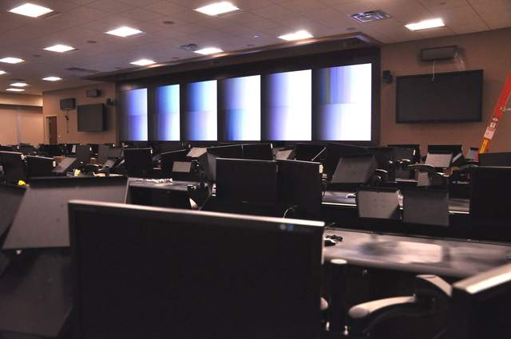
Mapping CUI Requirements to
ISO 27001 and SP 800-53 Security Controls
Mapping Tables.
Two important appendices.
Tailoring actions applied to moderate security control baseline.
Tailoring Criteria.

Slide 14
CUI
Find. Isolate. Protect.
MANAGE RISK…
Notes:
Make statement about ALL controls being monitoring – it is only the frequency that varies

Slide 15
CUI
The 110th Requirement.
TRANSPARENCY, TRACEABILITY, TRUST…
Notes:
Make statement about ALL controls being monitoring – it is only the frequency that varies

Slide 16
CUI
Move to the Cloud.
FEDRAMP MODERATE SATISFIES CUI REQUIREMENTS…
Notes:
Make statement about ALL controls being monitoring – it is only the frequency that varies

Slide 17
Contact Information
100 Bureau Drive Mailstop 8930
Gaithersburg, MD USA 20899-8930
NIST NARA/ISOO
Dr. Ron Ross Dr. Pat Viscuso
(301) 975-5390 (202) 357-5313 ron.ross@nist.gov patrick.viscuso@nara.gov
NIST NARA/ISOO
Kelley Dempsey Mark Riddle
(301) 975-2827 (202) 357-6864
kelley.dempsey@nist.gov mark.riddle@nara.gov
Comments: sec-cert@nist.gov Web: csrc.nist.gov

