Slide 1
NDIA Cyber DFARS Workshop: Countdown to Compliance
Cybersecurity Division
November 1, 2017

Slide 2
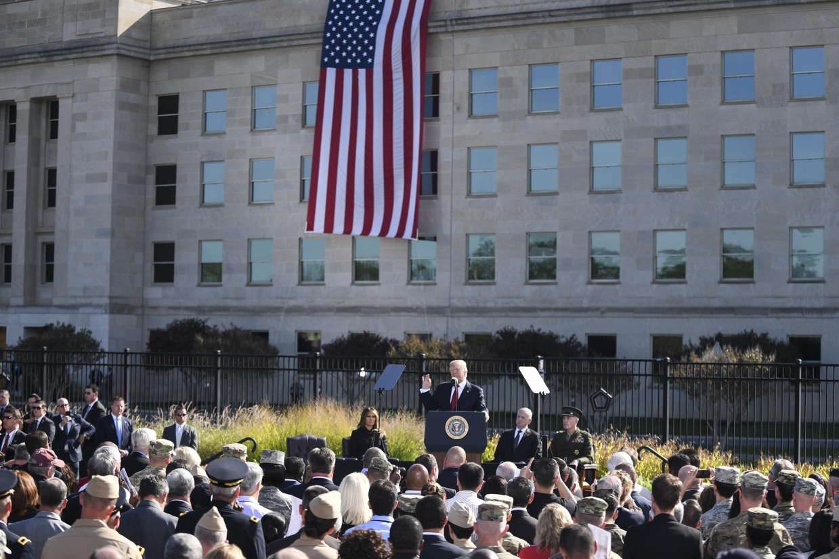
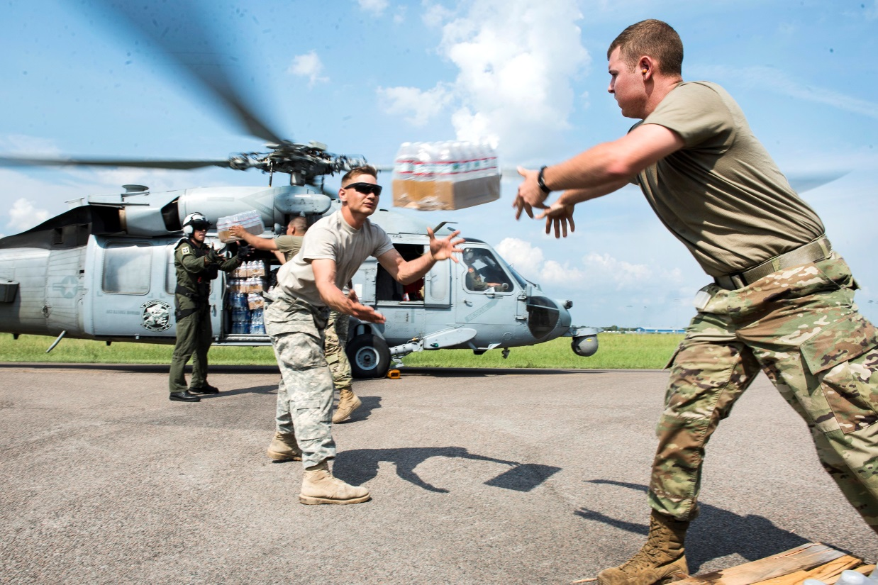
Serving the Defense Community since 1919
Aligning with Today’s Challenges
Putting the Warfighter First

Slide 3
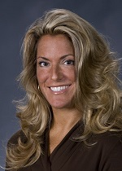
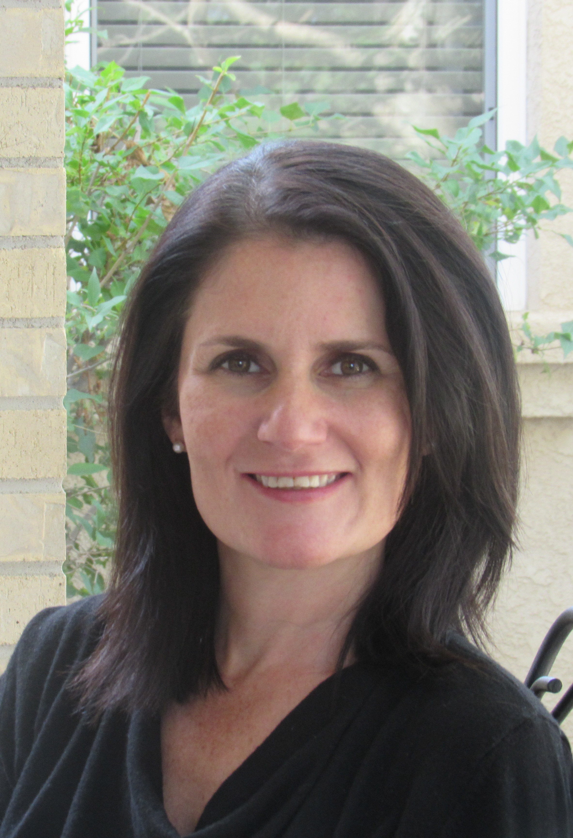
NDIA Cybersecurity Division
Committees
IoT
Policy/Legal/DFAR
Privacy
Supply Chain
Objective
The division’s primary objective is to contribute to U.S. national security by promoting communication and interaction between the industry, government and military on cybersecurity and cyber defense policy, legislation, requirements and technology
Ms Perri Nejib,
Northrop Grumman
Dr Dawn Beyer,
Lockheed Martin
Value of NDIA
A Neutral and Objective Framework for the Legal and Ethical Exchange of Information Between Government Stakeholders and Industry Members
http://www.ndia.org/divisions/cybersecurity

Slide 4
Workshop Schedule
0800-Welcoming Remarks Ms. Perri Nejib, Cybersecurity Division Co-Chair and NGC Host
0810-Workshop and DFARS Overview Rolando Sanchez, Sanchez PLLC and Susan Ebner, Fortney and Scott
0830-Cybersecurity Due Diligence for the Defense Industrial Base:
Complying with NIST 800-171 Dr. Ronald S. Ross Computer Scientist, NIST Fellow
0915-Panel 1- DoD Protection of CDI-What You Need to Know About Protecting Data
• Vicki Michetti, Director, Defense Industrial Base Cybersecurity Program, DoD CIO • Mary
Thomas OUSD (AT&L/DPAP) • Steffen Jacobsen, AWS • Charles Beard, PWC • Dr. Kenneth Sullivan, CEO, Micro Craft • Felipe Paez, Compliance Office, GE
1045-Panel 2- Scenario Discussion
• Brian Levine, DoJ • Bob Metzger-Outside Counsel • Felipe Paez, Compliance Officer, In-house
Counsel • Laurie Shive/Charles Beard, PWC • Vicki Michetti & Mary Thomas (DoD)
1145-Summary and Closing Comments Cybersecurity Division Committees • Dawn Beyer, Lockheed Martin • Perri Nejib, Northrop Grumman

