Slide 1
System Engineering Division
Monthly Meeting
September 22, 2022

Slide 2
AGENDA
Agenda:
11:00 AM EST Welcome & Announcements Dr. Patricia Griffin, NDIA SED Conference Chair
11:10 AM EST ATC Update Dr. Patricia Griffin, NDIA SED Conference Chair
11:30 AM EST Conference updates Dr. Patricia Griffin & Andrew Peters
11:40 AM EST Committee Reports All committee chairs & co-chairs
12:20 PM EST Wrap up and final comments

Slide 3
ATC Update
Dr. Patricia Griffin, Director Government Solutions, Astronics

Slide 4
Systems Engineering Division
Education & Training Committee
Systems Engineering Modernization (SEMod)
and Digital Acquisition Thread Report
August 22, 2022
Robert E. Raygan, Ph.D.
Committee Chair
DAU Professor of Engineering Management

Slide 5
Conference Updates

Slide 6
NDIA SED Committee Updates and Discussion
Education & Training Dr. Robert Raygan, DAU Professor of Engineering Management
Systems of Systems and Mission Engineering (SoS ME) Dr. Judith Dahmann, MITRE
John Daly, Booz Allen Hamilton
Jennie Horne, Raytheon
Richard Poel, Boeing

Slide 7
Systems Engineering Division
Education & Training Committee
NDIA Report
September 21, 2022
Robert E. Raygan, Ph.D.
Committee Chair
DAU Professor of Engineering Management

Slide 8
Committee
Name | Organization/Company | Email
Robert E. Raygan, Ph.D. | Defense Acquisition University (DAU) | robert.raygan@dau.edu
Dr. John Snoderly | Defense Acquisition University (DAU) | john.snoderly@dau.edu
Dr. Kenneth Nidiffer | Professor Emeritus of the DSMC Industry Advisor on George Mason’s Computer Science Education Committee | knidiffe@gmu.edu
Garry Roedler | Former INCOSE President Retired Senior Fellow at Lockheed Martin | gjrjar@gmail.com
Dr. Cliff Whitcomb | Cornell SE Professor INCOSE Editor Systems Engineering Former Chair Department of Systems Engineering
Mike Jones | Johns Hopkins University Applied Physics Lab | Michael.Jones@jhuapl.edu
Dr. Dale Moore | Founder and President, The Moore Group LLC Strategy, Innovation and Transformation Services | daleleemoore@gmail.com
Dr. Nicole Hutchison | Systems Engineering Research Center (SERC) Stevens Institute | Nlong@stevens.edu
Dr. Jim Roche | DAU (DE Credential Lead) | James.roche@dau.edu
Andrew R. Miller | Boeing and Architecture Committee | andrew.r.miller@boeing.com
Geoff Draper | L3 Harris | Geoff.Draper@L3Harris.com

Slide 9
“Exemplar Digital Acquisition Thread” Challenges and Results
Mission and Purpose | Desired Results | Stakeholders / Sponsors / Collaborators
Why “Exemplar Digital Acquisition Thread” project? SE Modernization (SEMod) pain points: Digital Processes and Products (Digital Acquisition / E-Programs) Enterprise Systems Engineering approach integrating: Key areas: DE/MOSA/SWE-CID/ME/CM Collaboration and Data Sharing challenges between Government and Industry Digital Tools / Methods Role of Reference Architecture Desired Result: A Digital Acquisition Thread Reference Architecture and Examples with Digital Artifacts for each RA Element. | GOALS: Create a government reference architecture for a cross-continuum digital acquisition thread. Collect exemplar reference architecture elements from mission partners, industry, and academia. Share exemplar acquisition thread with the community for education, training, and re-use. E-SEP: native digital systems engineering plan model with mission critical interfaces for data sharing SUCCESS STATEMENT: Deliver a digital acquisition thread reference architecture hosed on DoD web site and incorporated into training materials and workshops for the community. Reference architecture element models, formats, interfaces, etc. are collected and hosted on appropriate sources of truth. | Customer: OUSD R&E, Nadine Geier Who Benefits? DoD Acquisition Teams, ASD(A), DoD CIO Team: OUSD R&E, SERC, DAU, NDIA SED Committees, Mission Partners, and other DoD Agencies.
Measures of Success | Accomplishments
SERC SEMOD workshop pilot establishes survey questions and guidance for broader audience offering and feedback DoD ASoT owners are identified with interface APIs cataloged. (NDAA21 Tasker 804.c.) Digital Acquisition Thread Pilot with exemplar mission partners. NDIA Project Team & OUSD R&E iteratively develops Digital Acquisition Thread Reference Architecture NDIA delivers a digital acquisition thread reference architecture Collected exemplar digital artifacts are hosted by DoD for education, training, and re-use. NDIA SED M&SE Conference Panel Discussion on lessons learned and next steps for continuous improvement | SEMod Series added to DAU Events for webcasts and training reuse. Big challenge for DoD, work around for training provided by NPS sharing their GitLab for “DoD Reuse and Sharing Training Program Artifacts” Exemplar Mission Partners: AFSOC MAC, MCSC, AFC DE Cop, NAWCAD, PEO-IEWS, PEO-EIS, PEO-AVN, NAVWAR, ASA (ALT), ASN (RDA), DISA, … What needs work? DoD public sharing policy and process. (Update for digital artifacts) OMG UAF Working Group – Model Based Acquisition - RFP and Response plus NPS GitLab: To be shared – Skyzer, Silverfish, CUI WOSA.mdzip, MITRE 5000 model, DAU Bulldog What needs work? NDAA21 tasker: Were interface models considered rather than “documents? DAU ME and MOSA workshops created in response to mission partner requests, integrated into SEMod awareness. CM workshop in development

Slide 10
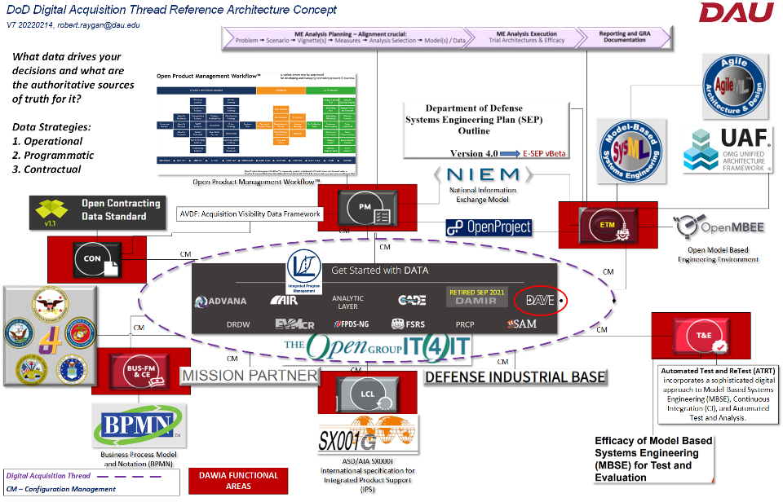

Concept: What are the cross-functional dependencies / interfaces for Systems Engineering Modernization Focus Areas?

Slide 11
Exemplar Digital Acquisition Thread Collaborators
ME Exemplar
WSE 028 ME Workshop
Key Collaborators
SERC
NPS
OMG
DE / MOSA Exemplar
WOSA RA/Model
CO MCSC
DCMA BAE (USA)
DISA EM (USA)
OSD DOD CIO (USA)
OSD OUSD A-S (USA)
OSD OUSD R&E (USA)
USAF AFRL
USAF AFSOC A5-8 (USA)
USAF AFSOC AFSOC A5-8-9/A8I1
USAF AFSOC AFSOC A5-8-9/A8IS
USAF HAF SAF/SAF/AQRE
USAF OSD OUSD R-E (USA)
USAF SAF/CN (USA)
USARMY DEVCOM C5ISR (USA)
USARMY PEO AVN (USA)
USARMY PEO EIS (USA)
USARMY PEO IEWS (USA)
USN (USA)
USN COMNAVAIRSYSCOM PAX (USA)
USN COMNAVSEASYSCOM DC (USA)
USN NAVAIRWARCENACDIV MD (USA)
USN NAVSUP WSS PHIL (USA)
USN NAWCAD (USA)
USN NIWC PACIFIC CA (USA)
DE/MOSA Exemplar
SATCOM RA
DE Exemplar
MAC Project / SysML Guidance
Project Sponsor
MOSA Exemplar
RFP Verbiage
MOSA Exemplar
RFP Verbiage
CID (agility) SCRUM Agile Webcast
MOSA Exemplar
PNT RA
WSE 027 MOSA Workshop
LSI Exemplars Gov and Organic LSI Webcast
WSE xxx LSI Workshop
WSE xxx EntCM Workshop
E&T Committee Email Domain Distro for Fridays at 1300 Eastern
From email domains

Slide 12
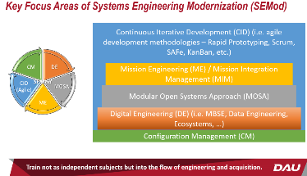
SEMod Collaborative Results
Digital Processes and Products (Digital Acquisition / E-Programs)
Enterprise Systems Engineering approach integrating:
  Key areas: DE/MOSA/SWE-CID/ME/CM
  Collaboration and Data Sharing challenges between Government and Industry
  Digital Tools / Methods
  Role of Reference Architecture (RA)
Get the integration framework into the flow down of policy and guidance to training.
ME, MOSA, and Agile need to be trained not as independent subjects but into the flow of engineering and acquisition.
Creating versions of that “bomb cyclone” model with accompanying narratives to describe this flow for different acquisition pathways as well as different functional areas.
Compiled a list of ~600 lessons learned from open literature at the detailed process level. This is not ready to be distributed yet but as SERC abstracts them upward they hopefully will provide more detail on the activities across the focus areas that are useful learning in a training setting.
Studying a digital ontology that relates military doctrinal language to acquisition language to systems engineering language. These are horribly disconnected right now. Hopefully this can also help with the background. (This includes the DAU definitions and taxonomy now but we are looking more broadly)
Collaborate with DAU on training how to define and contract for an appropriate digital infrastructure that looks forward toward the digital transformation.
OUSD(R&E)
DAU
SERC
NDIA
SEMod
MOSWG
Architecture,
Education & Training
Collaboration
Created “Systems Engineering Modernization,“ Webcasts Series
Created: WSE027 MOSA and WSE028 ME Workshops, Developing CM and Architecture Workshops
Delivered SEMod concept to Defense Acquisition Executives, Executive PMs, ACQ1700 Agile, WSA004 Cloud, ETM2020 Mission and Systems Thinking, ETM2070 Digital Literacy, ETM2080 Software Literacy and Army Agile / Software Pathway cross-functional teams.
Awareness and Sharing: AIR FORCE MATERIEL COMMAND (AFMC) , GUIDEBOOK FOR IMPLEMENTING MODULAR OPEN SYSTEMS APPROACHES IN WEAPON SYSTEMS, 12SEP22
Identified many exemplar programs and organizations across the community.
DoD CIO identified DISA native digital SATCOM RA created to publicly share - stimulating innovation and non-traditional industry contributions.
Identified DoD policy gap preventing public sharing of digital artifacts like DISA SATCOM RA
NDIA Cross-committee, cross-community collaborative project led by OMG UAF developing “Model Based Acquisition” digital artifacts and guidance

Slide 13
Conference Panel: Systems Engineering Modernization (SEMOD) Key Enablers for System Development on DoD Programs
Title: Systems Engineering Modernization (SE MOD) Key Enablers for System Development on DoD Programs
Short Summary: The OUSD(R&E) Systems Engineering Modernization (SE MOD) initiative focuses on identifying and integrating advances in SE that enable DoD programs to develop systems more quickly, effectively, at lower cost, with reduced risk. In this panel, Service leaders will share approaches and lessons learned.
Abstract: OUSD(R&E) presented systems engineering modernization "Pain Points" at the 2022 NDIA Systems Engineering Division (SED) annual kickoff meeting. The SED Education and Training (E&T) Committee initiated a joint project to address those pain points with DoD programs and organizations, the Defense Acquisition University (DAU), Stevens Institute of Technology Systems Engineering Research Center (SERC), Naval Postgraduate School (NPS), MITRE, and many other community collaborators. This panel has identified several programs and organizations as exemplars for their approaches and actions implementing policy and guidance for the SE MOD Focus Areas (Digital Engineering, Mission Engineering, Modular Open Systems Approach, Agile SE) as well as continuous iterative development and modern software acquisition practices.
Effective systems engineering practices and approaches are considered “enablers” in that they enable DoD programs to develop systems and solutions more quickly, effectively, at lower cost, and with reduced risk.
Dr. Robert Raygan of DAU, NDIA SED E&T Committee Chair, will moderate the panel.
Panelist
MOSA | PEO AVN | Stough, John T CTR USARMY PEO AVN (USA) Chief Architecture Officer (CAO), JHNA Supporting US Army PEO Aviation MOSA Transformation Office
DE | Air Force Institute of Technology (AFIT) | Richard Sugarman Dept Head – Systems & Software Engr Mgmt School of Systems and Logistics Air Force Institute of Technology
Agile & MBSE | AFSOC | BRANDON P. FROBERG, Maj, USAF Integration & Interoperability Branch AFSOC/A8II
ME & SoSE | Israeli Air Force | Maj Tzvika Kaminisky Chief System Engineer IAF Helicopter Programs Branch

Slide 14
Results
NDIA S&ME Conference E&T Comm. SEMod Panel Discussion: PEO AVN, AFIT, AFSOC, Israeli Air Force, …
NDIA Architecture Comm. MOSA Metrics integrating SEMod key enablers
DoD CIO identified DISA SATCOM Reference Architecture Exemplar and Public Sharing Policy GAP
OMG UAF “Digital Acquisition Model” project, ETA June 2023
Discovered and shared contracting language for MOSA with OUSD(R&E) Modular Open Systems Working Group (MOSWG), DAU workbooks, DSMC PMT-4020, WSE027, and NDIA.
AFRL MBSE exemplar illustrating challenges in sharing CUI WOSA model
AFSOC MC130J Amphibious Capability (MAC) DE, MBSE, CID, Rapid Prototyping exemplar
Exemplars: PEO IEW&S request for MOSA workshop / MCSC request for ME Workshop
DAU Created new Integrated Training Opportunities leveraging Customer Implementation Guidance, Mission Assistance, Webcasts, and Workshops
  WSE 027 Modular Open Systems Approach (MOSA) Awareness and Planning Workshop (dau.edu), MA request from PEO-IEWS to address ASA (ALT) and PEO implementation guidance. July first offering, November 17th next offering.
  WSE 028 Mission Engineering (ME) Awareness and Planning (dau.edu), MA request from Marine Corps Systems Command to define integrated Marine approach to both POM and Gaps Assessment mission engineering. October 20th next offering.
  WSE xxx Enterprise Configuration Management (ME) Workshop, MA request from NAVWAR / ASN (RDA) to train CM warrant holders and practitioners for the digital domain. Meeting every other Monday, August 15th next meeting.
DAU Created Systems Engineering Modernization (SEMod) - Defense Acquisition University (dau.edu) webcast series. Event Series (dau.edu)
  May 05, 2022 01:00 PM ET PEO-EIS “SCRUM Implementation for Army Lessons Learned”
  Jul 28, 2022 01:00 PM ET NAWCAD AIRWorks “Government Lead Systems Integrator: Benefits and Fundamentals”
  Sep 29, 2022 01:00 PM ET NAWCAD WOLF “organic Lead Systems Integrator (oLSI)”
  Oct 13, 2022 01:00 PM ET Lockheed “The Digital T’s - Threads, Twins, Technology and Transformation””
  Oct 27, 2022 01:00 PM ET Boeing “Industry Insights on Effective Data-Driven Product Sustainment ”
Data Item Descriptor for Digital Systems Model in ASSIST
  SERC created rapid prototype of models
  Army has used language in RFI/RFP
  LM recommended use of language to USAF

Slide 15
Configuration Management in Digital Domain?
SE Process Questions
What is the approach to model management (CM of models)?
What is the approach to merging branches and baselines? (i.e. cross-continuum of government/industry)
How does a program close out a (S&T) branch that may not be assimilated immediately?
REF.
SEP v4 Appendix E
Title: DIGITAL SYSTEM MODEL
Number: DI-SESS-82364 Approval Date: 20220201
NEXT
Space Force Collaboration
PEO Soldier Collaboration
NAVWAR Engineering & Technical Management CM Vignette Series Request:
Application of CM for Modeling
Application of CM for Cybersecurity
Application of CM in ITIL
Application of CM in PLM (What does that mean)
Application of CM in SETR/TA, what to expect?
Conducting a CM program/process self - assessment
Developing a CMP, It is not for the faint of heart!
What to expect in a CM Audit, Every 3 years the CM TWHs are coming for you!
Application of CM in the OSA pipeline/SECDEVOPS
Application of CM to Software & COTS Systems
Discuss the different paradigms; such as acquirer - supplier/product – platform/Data – Document/ SOS – FOS/Acquisition – Operational Paradigm/
CM Contract Language – what you need to know and how to accept those deliverables
Now you’re a CMGR and you have to get folks trained - Planning your CM Training
Moving from traditional CM (paper based) to Digital CM (data driven), what does that entail.
CM COI/COP – why join?
Configuration Identification - approaches to identification
Working through/Eliminating Roadblocks for CM Processes
Change Management (deviations, waivers and variances)
CM Process Assess and Improvement
How are government and industry teams doing this?

Slide 16
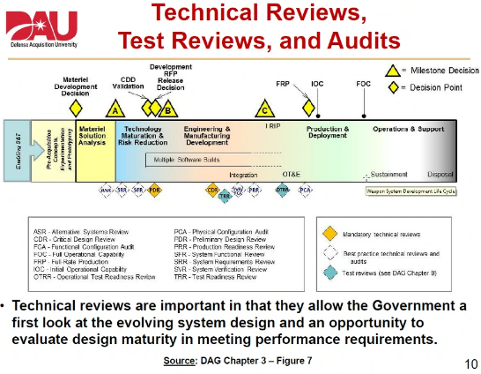
Handling Technical Reviews in Digital Environment?
Perhaps known locally but not to the broader community?
Current State “as is” Future State “to be”

Slide 17
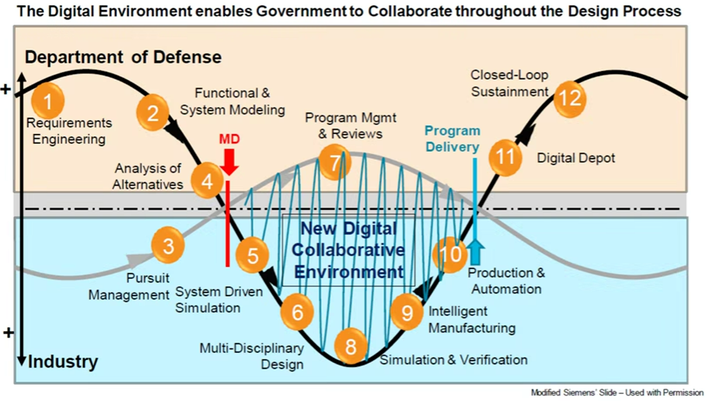
Is this close to your “new” System Development Life Cycle (SDLC)?

Slide 18
Product Life Cycle Management (PLM)?

Slide 19
Next Steps
Continue discovery of exemplar mission partners
Begin discovery of industry exemplar partners
Continue Education and Training collaboration with community
Invite SEMod webcast series presenters to share with the community and their organizations
Align MOSWG initiatives and guidance with WSE 027 MOSA Workshop – Provide feedback to MOSWG from WSE 027 Delivery
Request similar feedback loop with ME and DE

Slide 20
22 September
NDIA Systems Engineering Division (SED) Meeting
Systems of Systems and Mission Engineering (SoS ME)
Committee Report
Co-Chairs: Dr. Judith Dahmann, MITRE
John Daly, Booz Allen Hamilton
Jennie Horne, Raytheon
Richard Poel, Boeing

Slide 21
Updates
Mission Engineering Initiative
  Core team: Judith Dahmann, John Daly, Rick Poel, Jennie Horne, Chris Schreiber, Ed Moshinsky
  Survey of Industry
    Initial Survey Analysis is complete
    Core team is reviewing the results
    Plan is to present the results at the November System and ME Conference
    Anticipate a follow-up workshop on common issues and opportunities with industry and government probably in early 2023
  SE/ME Conference
    Planning for the ME panel is underway

Slide 22
Final Remarks
Holly Dunlap

