Slide 1
System Engineering Division
Monthly Meeting
March 23 2023

Slide 2
AGENDA
(all times EST)
10:00 Welcome & Announcements John Daly, NDIA SED Chair
10:15 Division Planning, feedback from Feb 24th Govn’t sessions John Daly/All
11:00 Digital Engineering/Acquisition Model Discussion Keith Siders USAF AFMC
11:45 Membership Discussion Patrick Baines
12:15-12:45 Break
12:45 Committee Reports Committee Chairs

Slide 3
Division Goals for 2023
Increase Division membership at all levels, and focus on Industry member employees
Partner with more government Services, and Agencies in systems engineering
Strengthen Committee membership and participation; Support Committee Chairs and Co-Chairs in visibility for their committee activities and collaboration across the Division
Build on the successful 2022 SE&ME Conference
Lead in digital transformation in systems engineering as practiced by our Industry and Government partners
Build strong relationships with other SE related professional organizations/societies (e.g.: INCOSE, SERC, SISO, OMG etc.)

Slide 4
Feedback from Senior Government Addresses to SED February 2023

Slide 5










SE&A Overview
INITIATIVES
Advance engineering practices with 20+ initiatives, including:
SE Modernization
Digital Engineering (DE)
MOSA implementation
Human Systems Integration
Software Modernization
ASSIST Modernization
POLICY
Lead for 12 engineering policies and partner on 2 T&E policies
GUIDANCE
Lead for 32 engineering guidance documents and partner on 22 T&E guidance documents
WORKFORCE DEVELOPMENT
Lead 2 acquisition functional areas
Engineering & Technical Management (ETM)
Test & Evaluation (T&E)
Lead 2 DoD-wide functional communities
Engineering (Non-Construction)
Quality Assurance
STANDARDS
Manage and guide DoD standards
Lead Standardization Activity for 3 standardization areas (300+ documents)
Systems Engineering & Architecture
TECHNOLOGY/PROGRAM SUPPORT
Support includes the following
Integrated Sensing and Cyber
Ground Based Strategic Deterrent (GBSD)
Joint All-Domain Command & Control (JADC2)
Hypersonics
SECDEF/CONGRESSIONAL/GAO
TASKING
FY20 NDAA – Section 230
Talent Mgt of Digital Expertise & SW Professionals Secretary of Defense
Civilian Harm Mitigation and Response Report
COLLABORATION (LEAD)
Over 30 steering groups/working groups, including:
Modular Open Systems Working Group
Systems Engineering Research Center (SERC)
Digital Manufacturing Working Group
Standardization Management Group
ETM Functional Integration Team
COLLABORATION (PARTICIPANT)
Over 90 working groups including:
JADC2 Data & Architecture WG
DoD S&T SW Modernization SSG
DoD Data Council
Distribution Statement A. Approved for public release. Distribution is unlimited.

Slide 6
NDIA SED Plans: USD(R&E) - SE&A
Architecture, M&S Committees very active here
SED Action: Invite for address to SED/collaboration:
  Nadine Geier – SE Transformation
  Daniel Hettema - DE & M&S
  Michael Heaphy (DSPO) - Standards
  Chris DeLuca - Specialty Systems Engineering

Slide 7
Opportunities for DoD and Industry Collaboration
Engineering Cyber Resilient Weapon System (CRWS) Initiatives
  SCRE white papers, standards, practices, education and training
  CRWS Workshop 12
  Engineering CRWS Body of Knowledge authoritative sources
  Collaboration with INCOSE
Program Protection Plan update standardization
Hardware Assurance Tabletop for Integration of microelectronics in DoD Systems
Secure Software Supply Chain Initiatives
Joint Federated Assurance Center
  Software assurance tools, standards, practices
Critical Program Information guidance and tools
Controlled Technical Information webinar
Continue to improve the communication between government, industry, and operational stakeholders
NDIA SED – SysSec Input
Feb 24, 2023
Distribution Statement A: Approved for public release. DOPSR case #23-S-1306 applies. Distribution is unlimited.
7

Slide 8
NDIA SED Plans: USD(R&E) - DCTO(S&T)
Systems Security Committee very active here
SED Action: Support SED SSC in working with DCTO(S&T) and foster involvement with other SED Committees

Slide 9
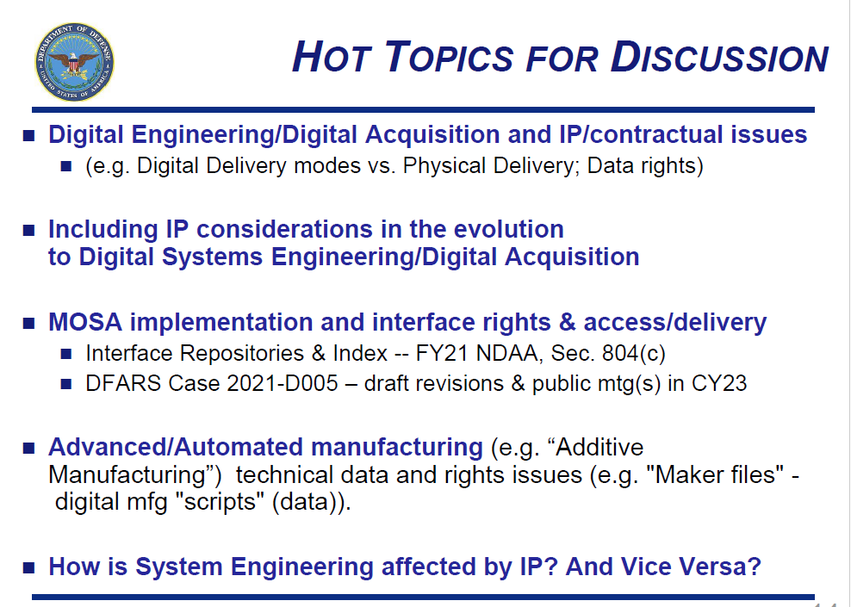

Slide 10
NDIA SED Plans: USD(A&S) – IP Cadre
Division leadership engaged now – focused on IP related to systems engineering
SED Action:
  Assign a NDIA leadership team member to liaison:
    With IP cadre
    With A&S for broader engagement (software, acquisition etc..)
  Engage IP Cadre on a potential workshop/event at SE/ME Conference on digital IP issues ( digital delivery, licenses, technical “trade secrets” etc..)

Slide 11


AF DIGITAL
Transformation
NDIA
Feb 24, 2023
Ongoing Efforts
“Digital Guide” – enablers, templates, resources, etc for programs (public facing digital guide: https://wss.apan.org/af/aflcmc/default.aspx)
Tailorable contracting language and Data Item Descriptions (DIDs)
DE Platform as a Service (DEPaaS)
Government Referent Architecture (GRA) coordination and development
Acquisition and Sustainment Data (seeks to develop data architecture needed for digital lifecycle of our systems; including test)
Digital Engineering Consortium
Training and Functional Engagement
Ongoing challenges include: Data rights considerations, Multi-level security, Authorities to Operate, distributed workforce, and continued access to tools and authoritative data

Slide 12
NDIA SED Plans: USAF - AFLCMC/EN
SED primarily engaged – part of DE focus
SED Action:
  Continued collaboration with USAF on digital SE transformation and digital acquisition
  Continued collaboration with USD(A&S) on IP/DE with USAF
  Potential Systems Security collaboration
  Potential DE tools User Group Workshop and SE/ME Conference activity
  Potential Government Referent Architecture (GRA) collaboration

Slide 13

NDIA SED Plans: OMG MBAcq
Possibly a NDIA SED organizational stake in this effort?

Slide 14
Division Goals for 2023
Increase Division membership at all levels, and focus on Industry member employees
  Focus begins with presentation/discussion today
Partner with more government Services, and Agencies in systems engineering
  Find right Army, Navy, USMC POC’s, and agencies (DISA,MDA,?)
Strengthen Committee membership and participation; Support Committee Chairs and Co-Chairs in visibility for their committee activities and collaboration across the Division
  Theme monthly SED meetings on committee interest areas
  Strengthen cross-committee efforts (e.g. DE/DA)
Build on the successful 2022 SE&ME Conference
  Early, proactive planning by CC with two year focus
Build strong relationships with other SE related professional organizations/societies (e.g.: INCOSE, SERC, SISO, OMG etc.)
  - Need to develop plan for this leveraging committee leadership

Slide 15
Digital Engineering/Acquisition Model Discussion
Keith Siders USAF AFMC

Slide 16
NDIA SED Membership Discussion
Patrick Baines

Slide 17
“Value Proposition” for NDIA SED membership
Focus on Industry member employees and professional development opportunities in interaction with USG in committee functions
  Enhanced opportunities for interaction with peers in other companies
  Opportunity to take leadership role in SE
  Opportunity to publish and be recognized
  Resume polishing
Opportunity to interact directly with USG in functional SE areas
Know the latest technology/practice in SE as used in DoD/Industry
Take advantage of NDIA
  NDIA Connect
  Conferences/seminars

Slide 18
NDIA Membership
Joining as an Employee of NDIA Corporate Member
Systems Engineering Division
March 2023

Slide 19
Value Proposition: Why Join NDIA?
Joining NDIA offers many benefits:
Professional development. Build specific skillsets by joining a community of subject matter experts
Networking. Meet and build relationships with professionals outside of your organization
Presentation Opportunities. NDIA provides multiple opportunities each year to present your work at conferences
Collaboration. Actively participating in a committee provides opportunities to comment on working documents that are shared with NDIA for review

Slide 20
NDIA has more than 1,800 corporate members. If your organization is already a member of NDIA, you don't need a separate membership to enjoy all of NDIA's benefits. Simply join your corporate roster and begin taking advantage of our member benefits today.
The step-by-step process for joining your corporate roster is detailed in the following slides.

Slide 21
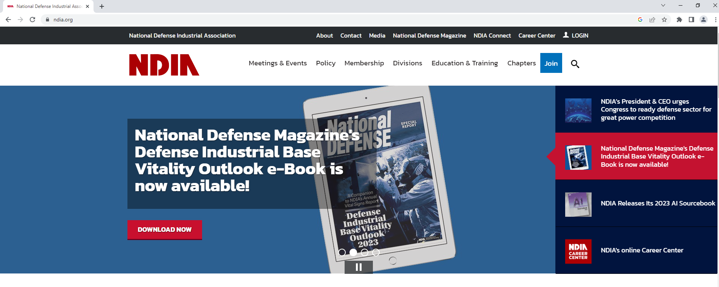
1) Visit www.ndia.org
2) Select “Membership” in the banner across the top

Slide 22
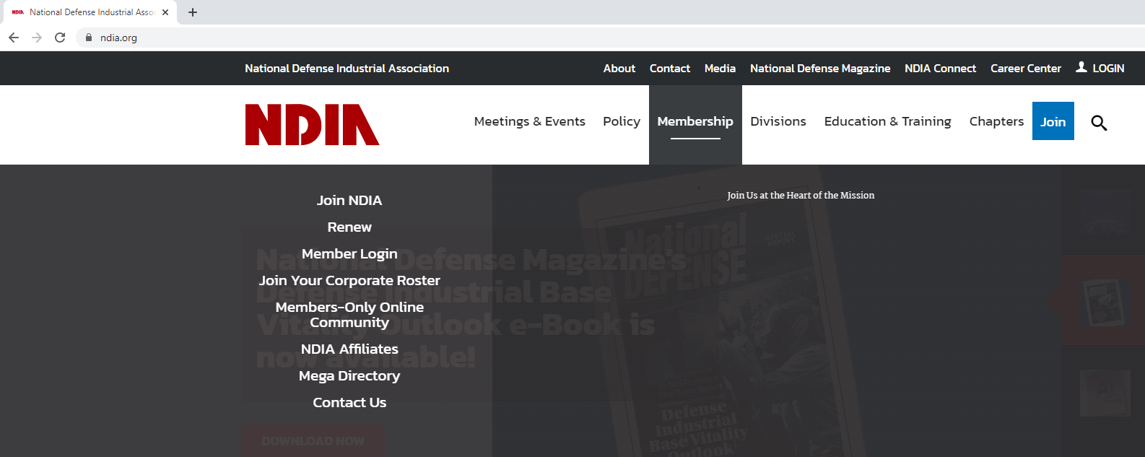
3) Select “Join Your Corporate Roster” from the drop down

Slide 23
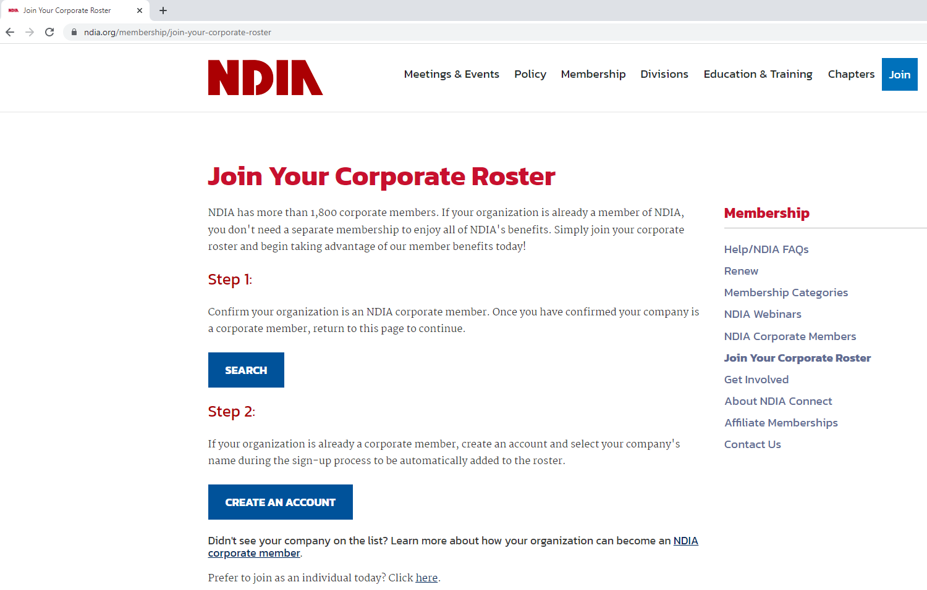
4) If you want to verify your company is a corporate member, select “SEARCH”

Slide 24
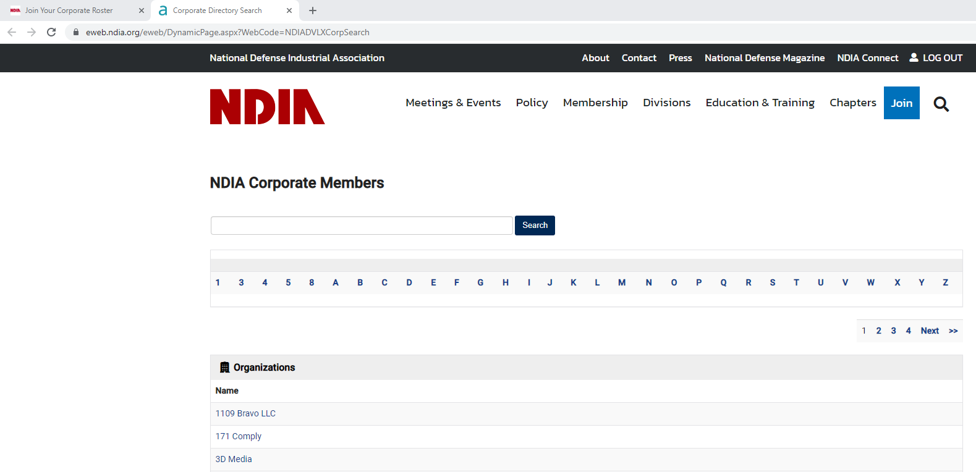
5) Type your company name in the search bar and click “Search”

Slide 25
6) After confirming your company is a corporate member, select “CREATE AN ACCOUNT”

Slide 26
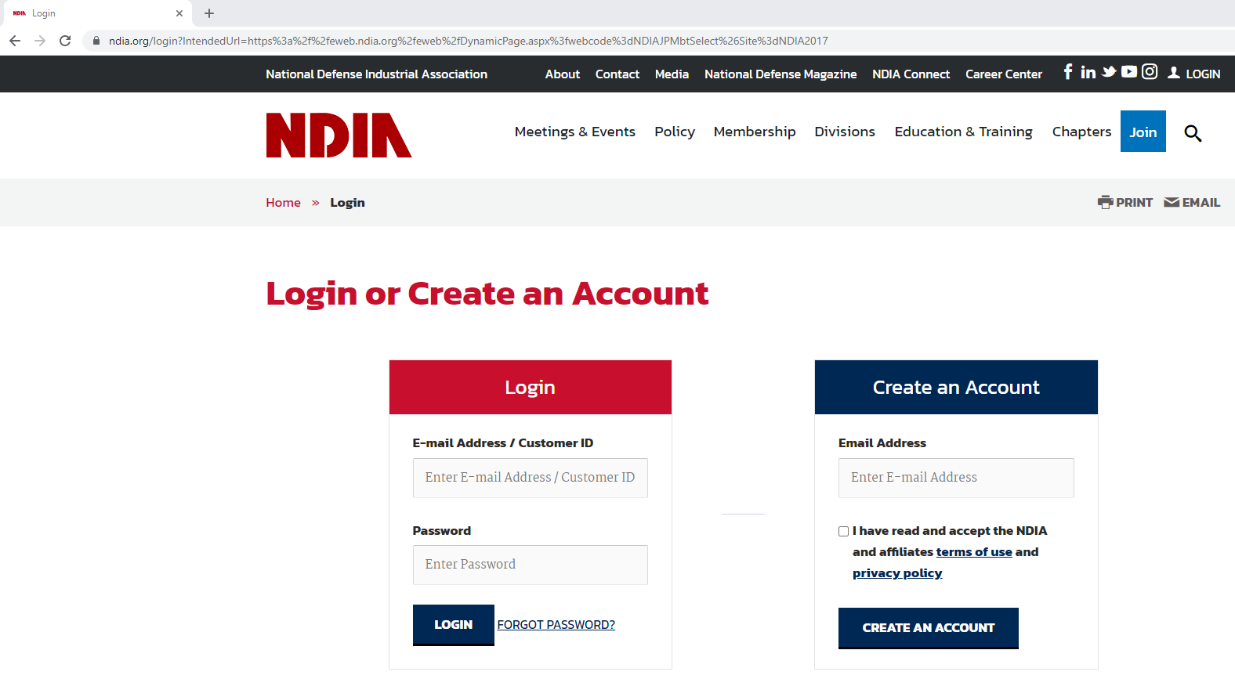
7) Enter the email address you would like to use for your NDIA account
8) Check the terms of use and privacy policy box, then select “CREATE AN ACCOUNT”

Slide 27
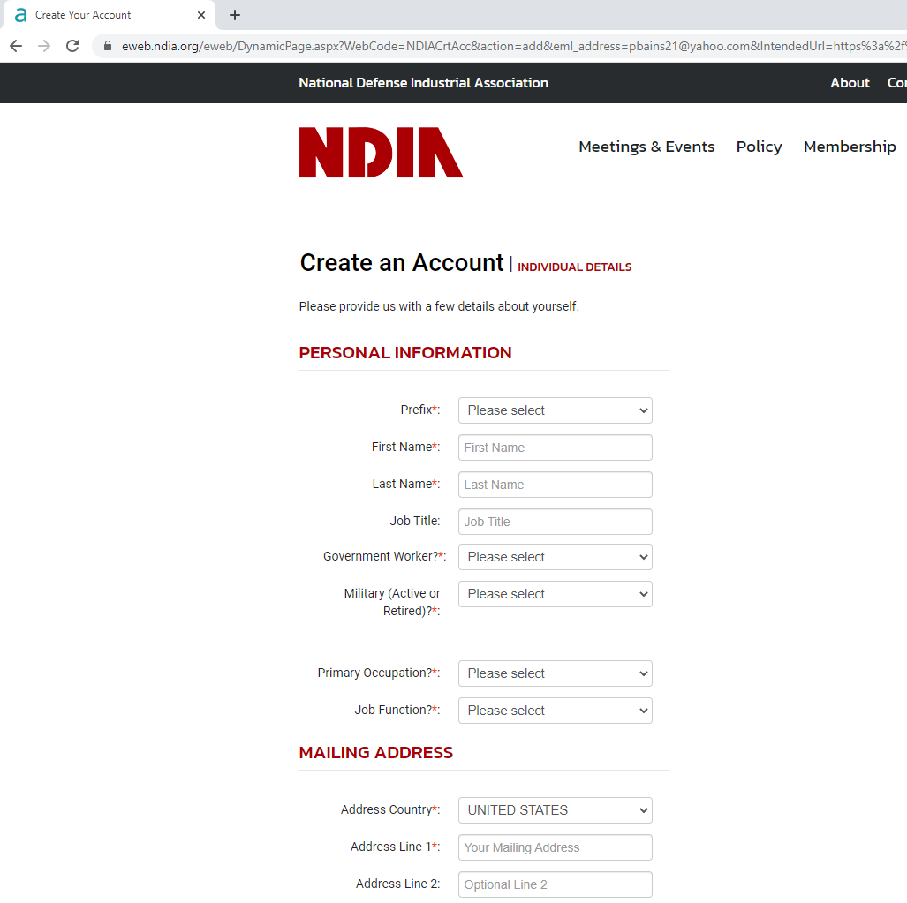
9) Fill in your account information

Slide 28
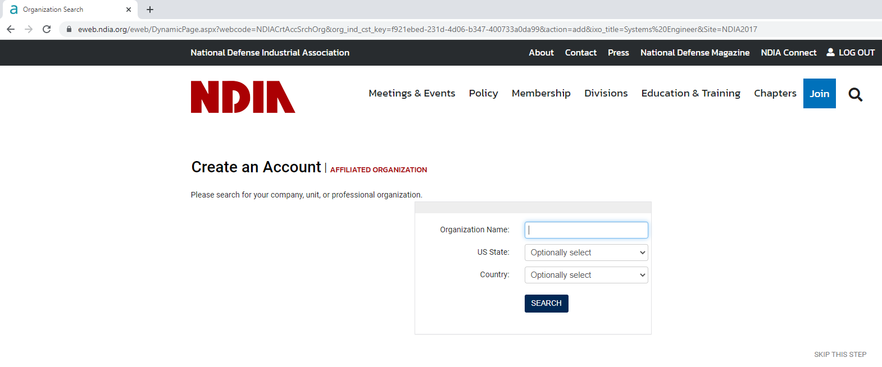
10) Search for your company

Slide 29
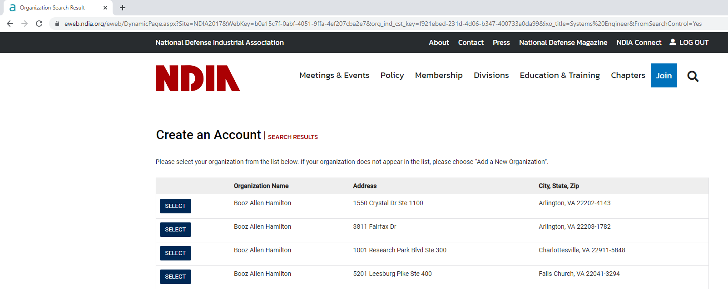
11) Select your company from the list. This will link your account to your company’s corporate membership.

Slide 30
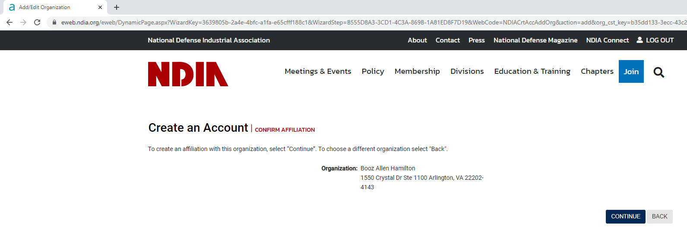
12) Select “CONTINUE” this will link your account to your company’s corporate membership

Slide 31
Following these steps will automatically add you to your company’s corporate roster. You can now exit the “Create An Account” process or continue to fill out additional optional information. Logging in with your account information will now give you member access. It is not necessary to purchase an individual account.

Slide 32
“Value Proposition” for NDIA SED membership
Focus on Industry member employees and professional development opportunities in interaction with USG in committee functions
  Enhanced opportunities for interaction with peers in other companies
  Opportunity to take leadership role in SE
  Opportunity to publish and be recognized
  Resume polishing
Opportunity to interact directly with USG in functional SE areas
Know the latest technology/practice in SE as used in DoD/Industry
Take advantage of NDIA
  NDIA Connect
  Conferences/seminars

Slide 33
BREAK
(Meeting Reconvenes at 12:45 PM EST)

Slide 34
Committee Reports

Slide 35
NDIA Systems Engineering Division (SED) Meeting
Committee Report
Co-Chairs: Bob Scheurer, Boeing
Ed Moshinsky, OUSD(R&E)SE
March 2023

Slide 36
SoS ME Committee 2023 Goals & Objectives
Primary
MOSA Metrics Development
  MOSA Metrics Implementation Guide (Incl. Tailoring Guidance of Metrics)
  MOSA Metrics List, Parameters, and References
On-Going Involvement w/Modular Open Systems Working Group (MOSWG) & Tiger Teams (as Relevant)
“Growing an Architect” Initiative
  Skills/Competencies
  Tool/Automation Support
  Training
  Career Roadmap
2023 NDIA SE Conference Involvement: Improvements to Arch. Tracks
Expand Involvement w/OMG’s Model-Based Acquisition (MBAcq.) Reboot
Secondary
Engage w/INCOSE Arch. Working Group
  Sharing of Best Practices & Learnings
  Participate in Each Other’s Meetings
Define Architecture’s Role in Digital Engineering
Define Architecture’s Role in Mission Engineering
Identify Relevance of Architecture in Agile Hardware/Software
Assess Committee Work/Outputs for Relevance to Various Stakeholders (i.e., Acquirers, Contractors/Suppliers, Other)

Slide 37
Key Actions
Hold Bi-Weekly Meetings of Full Architecture Committee
Create Special Sub-Committees to Work Focus Topics
By April 2023: Issue Follow-On Report to 2020 MOSA Whitepaper: Barriers and Opportunities with MOSA Implementation in Industry
Identify Individual MOSA Metrics
Draft MOSA Metrics Implementation Guidebook
Participation w/MOSWG Tiger Team Meetings and Artifacts Development: Particularly Relating Industry Perspective
Joint Meetings and Activities w/Other NDIA Divisions (e.g., Human Systems) and Societies (e.g., INCOSE Architecting Working Group)

Slide 38
Future Events
Special Guest Presenters to Architecture Committee Meetings
Architecture Track at NDIA SE Conference

Slide 39
NDIA Systems Engineering Division (SED) Meeting
Committee Report
23 March 2023
Co-Chairs:
  Judith Dahmann
  John Daly
  Jennie Horne

Slide 40
SoS ME Committee Goals & Objectives
Provide a forum where government, industry, and academia can
  share lessons learned,
  promote best practices,
  address issues, and
  advocate for systems engineering for Systems of Systems (SoS) and mission engineering
  Identify successful strategies for applying systems engineering principles to systems engineering of SoS and missions.
Lead mission engineering efforts for the SE Division
  The National Defense Authorization Act (NDAA) for Fiscal Year 2017, Section 855, directed DoD to establish Mission Integration Management (MIM) as a core activity within the acquisition, engineering, and operational communities to focus on the integration of elements that are all centered around the mission.
  ME is the technical sub element of MIM as a means to provide engineered mission-based outputs to the requirements process, guide prototypes, provide design options, and inform investment decisions.
  ME uses systems and SoS in an operational mission context to inform stakeholders about building the right things , not just building things right , by guiding capability maturation to address warfighter mission needs

Slide 41

Completed 2022 SoS/ME Actions
SoS Engineering Collaborators Information Exchange (SoSECIE)
  The SoS Committee offers biweekly webinars through the SoSECIE with support provided by The MITRE Corporation.
  Contact SoSECIE@MITRE to receive webinar announcements. Recordings of the over 100 past webinars can be accessed through MITRE at the following link: https://mitre.tahoe.appsembler.com/blog.
  Continue to increase mission engineering content in webinars
2022 Systems and Mission Engineering Conference
  Offered a keynote (Roman), a panel and a day-long track

Slide 42
Completed 2022 ME Actions
Create a cross NDIA SE Division ME Initiative
  Engaged not only SoS/ME (Dahmann), but also DE (Daly), M&S (Schreiber), Architecture (Scheurer), SE Modernization (Moshinsky)
Focus on several areas
  Inputs to the update of the Mission Engineering Guide
    R&E has begun an update of the ME Guide and are interested in industry inputs
    The NDIA ME core team requested inputs as from the division and provide a composite industry set of comments to the R&E
  Industry implementation of ME
    Question: Can we develop an understanding of how industry is current implementing mission engineering including the motivation, their methods, processes, and tools, and how they use the ME results?
    Conducted a survey of SE Division members on Industry experience with ME and provided out brief to Systems and Mission Engineering Conference
    SED Report on survey results is in preparation

Slide 43
Future Events
Continue SoSECIE webinars - Continued focus on Mission Engineering as well as SoS
Industry Input to Updated ME Guide
ME presentation to SED Meeting
Possible Mission Engineering Workshop
  Led by SoS ME committee but would engage multiple committees
  Outgrowth of the Industry ME Survey where industry respondents indicated an interest in a follow-on workshop with Government
  Candidate topics:
    Mission Engineering Methodology
    ME tools - Use of DE/Operational Simulation to Conduct ME
    ME data identification access and sharing
    ME training and education
    Government/Industry Cooperation on ME
Potential Dates:
25-27 July 2023
MITRE, Mc lean VA
In-Person/Virtual
Is there interest in supporting an Industry-Government ME Workshop?

Slide 44
NDIA Systems Engineering Division (SED) Meeting Committee Report
System Security Engineering
March 2023
Cory Ocker
NDIA SSE Committee Chair
Cory.L.Ocker@rtx.com

Slide 45
SSE Committee 2023 Goals & Objectives
Goals
  Advance SSE technical and business practices within the aerospace and defense industry.
  Focuses on improving delivered system security performance including survivability, resiliency, and affordability.
  Promote and emphasize excellence in systems security engineering throughout the program life cycle and across engineering and non-engineering disciplines required for a holistic approach to system security and program protection.
Objectives
  Lead projects in areas that challenge the role and responsibility unique to System Security Engineering.
  Support security specialty projects and initiatives by providing a system security engineering perspective that directly effects and interfaces with system security engineering.
  Encourage and promote the advancement, education, and skill development of the role of system security engineering.

Slide 46
Key Actions
Hardware Assurance (HwA) Tabletop Exercise on Microelectronics Quantifiable Assurance (MQA)
  OSD(R&E) continue development of exercise
SBOM DID
  OSD(R&E) seek comments from DHS CISA, then staff for approval to publish in DLA Assist Database
  Committee coordinate with USAF/NAVAIR to update guidebook RFP language for SBOMs and DID tailoring
CPI Identification
  Industry provide 5 Whys
  OSD(R&E) provide update on USG CPI Identification WG
OMB Memo on Secure Software Development Framework (SSDF)
  Hold follow up mtg w/ DHS CISA once FAR Clause published (report currently due 5 April)
CTI Tabletop
  Identify WG members to begin drafting CUI Sanitization guidance
  Develop training material to deploy at DAU
PPIP DID
  OSD to provide briefing on updates to committee
CRWS Workshop
  Identify priorities for CRWS 12 this fall

Slide 47
Future Events
April Meeting – Focus on Workforce - DoDI 8140, Cyberspace Workforce Management Update from OSD CIO; CITAG Workforce Development Outbrief
May Meeting – Focus on USG Updates - CPI Identification WG Update from OSD; PPIP DID Update; NAVAIR SSE Guidebook; DEVCOM AvMC Weapon System Assurance
CRWS 12 – Fall 2023

Slide 48
NDIA Systems Engineering Division (SED) Meeting
Education and Training Committee Report
Co-Chairs:
  Robert E. Rayan, Ph.D.
  Dr. Dale Moore

Slide 49
E&T Committee 2023 Goals & Objectives
The mission of the Systems Engineering Division Education and Training (E&T) Committee is to champion the widespread use of systems & software engineering processes in the Engineering of Defense Systems within the Operation of the Defense Acquisition System to achieve affordable, supportable, and interoperable weapon systems that meet policy requirements, the needs of warfighters and to provide the United States a technological advantage.
In addition to supporting the open exchange of ideas and concepts between government, academia, and industry, the committee works for a holistic understanding of an integrated systems engineering process to affect the formation of policies, guidance, initiatives, and investments.
The stakeholders of the committee are the members of the Defense Industrial Base, DoD, Academia, and the Military Services.
The primary liaison with OSD is Nadine Geier, OUSD R&E.
The committee also collaborates with other SE Committees, INCOSE, AIA, OMG, and the DoD Modular Open Systems Working Group (MOSWG).
It has over 85 members from government, industry and academia, and holds bi-weekly meetings with sub-committee/working group meetings as required.
Objectives:
Support engineering education and training needs of OUSD(R&E), OUSD(A&S), and DoD CIO with SE technical & business practices
Explore excellence in the SE program lifecycle & across all disciplines
Educate and train to transform & modernize SE practices while maintaining SE principles
Explore improvements of SE processes & practices to deliver system performance
Explore SE boundaries to push for system development & ensure efficient lifecycle management
Capture industry perspective for government partners and advocate for SE policy & guidance improvements

Slide 50
Key Actions
Joint NDIA and DAU Capital Northeast Region “Engineering and Technology” and “Systems Engineering Modernization (SEMod)” Webcast Series
  HSI collaboration with NDIA HS Div, Dr. Kent Halverson
    Defining HSI language for acquisition artifacts (i.e. SOW, SOO, RFI, RFP, …) project for Chris DeLuca with LCDR James Reilley, USCG lead. (result of web event)
  Agile at the Systems Level, ADAPT Comm. April 17th
  Reliability & Maintainability Engineering | AI and R&M Aug 23rd collaboration GMU / NDIA Cyber Division
Digital Acquisition Thread Project Exploring Cross-Functional Awareness, Needs, and Exemplars within Government and Industry
SE Modernization with Nadine Geier, OUSD(R&E) SE Director
  DoDI 5000.95 Human Systems Integration – Outreach to industry, “Exemplar language, best practices, for HSI inclusion on DoD Acquisition Programs”
Participating in DoD’s MOSA (MOSWG) and Tiger Team(s)
Exploration of cross-domain sharing of digital artifacts, Reference Architectures and Reuse of Digital Artifacts with Naval Post Graduate School, DAU, Industry, and Cornell Systems Engineering Department
  Continued NPS GitLab Research & Development
  USAF Digital Adoption and Sustainment Office (DASO) (CUI) Government Reference Architecture (GRA)
Participating in Architecture Committee MOSA Metrics Working Group Activities
Digital Engineering Enterprise Architecture exploration with Cornell University, Johns Hopkins University, and MIT, Cliff Whitcomb and Mike Jones Lead

Slide 51
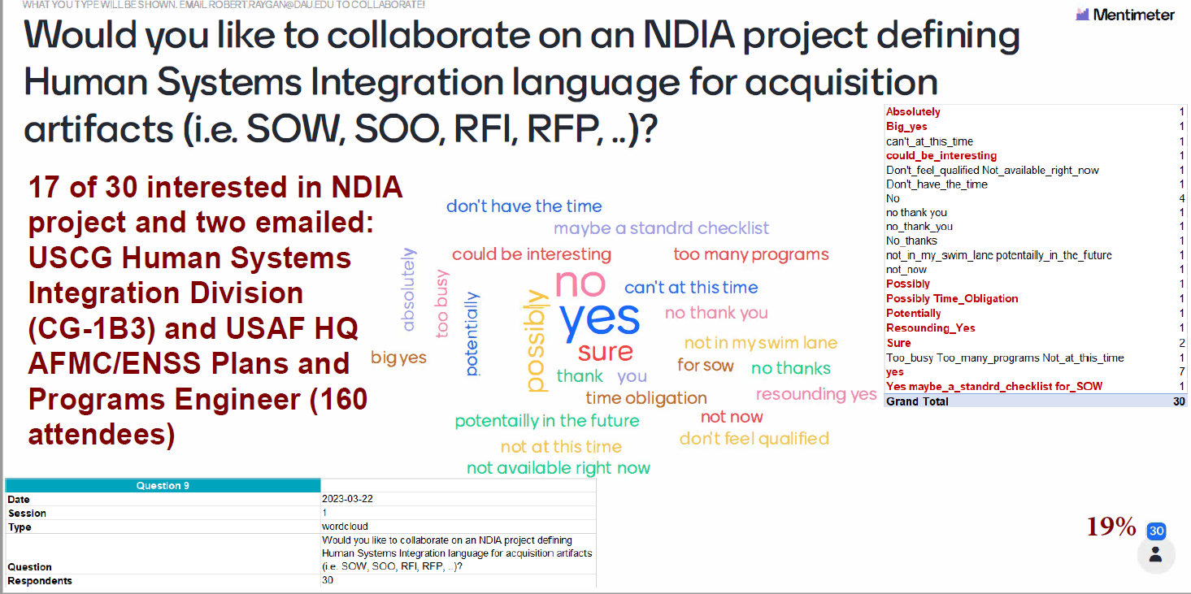
New DAU tool for interactive survey’s, Mentimeter
Averaged 158 Attendees

Slide 52
Future Events
Date | Event | Topic / Note | Partners
March 22, 2023 1300-1430 | Web Event: OUSD(R&E) Chris DeLuca / NDIA Human Systems Division Dr. Kent Halverson | Human Systems Integration (HSI): DoD Policy and Guidance and FY23 updates on HSI Capabilities-Based Assessment | NDIA HS Division Dr. Kent Halverson Aptima, Inc.
April 17, 2023 1100-1200 | Web Event: NDIA SED ADAPT Committee Robin Yeman / Gordon Kranz | Agile at the Systems Level | NDIA SED ADAPT Comm. Robin Yeman, Gordon Kranz
April 26, 2023 1300-1430 | Web Event: OUSD(R&E) Chris DeLuca | Manufacturing and Quality Engineering During Early System Development | Manufacturing Div (Mr. Gary Fleegle / Mr. Mark Gordon) DAU Capital Northeast Region
May 24, 2023 1300-1430 | Web Event: OUSD(R&E) Chris DeLuca | Reliability & Maintainability Engineering | DE in R&M | Technical Information Div: Mr. Dan McCurry / Mr. Dan Christensen DAU Capital Northeast Region
June 21, 2023 1300-1430 | Web Event: OUSD(R&E) Chris DeLuca | Manufacturing & Quality | Producibility Guidance | Manufacturing Div (Mr. Gary Fleegle / Mr. Mark Gordon) DAU Capital Northeast Region
August 23, 2023 1300-1430 | Web Event: OUSD(R&E) Chris DeLuca | Reliability & Maintainability Engineering | AI and R&M | Lt General (Ret) Bob Elder, D.Engr Research Professor, George Mason University Jim Keffer <jim.h.keffer@lmco.com>
September 20, 2023 1300-1430 | Web Event: OUSD(R&E) Chris DeLuca | System Safety Engineering | AI and System Safety | SED - Safety and Environmental Engineering DAU Capital Northeast Region
6 month HSI project | Report and conference presentation | Defining Human Systems Integration language for acquisition artifacts (i.e. SOW, SOO, RFI, RFP, ) | LCDR James Reily, USCG HPS&T Team Lead Human Systems Integration Division (CG-1B3)

Slide 53
2023 & 2024
Systems & Mission Engineering
Conference

Slide 54
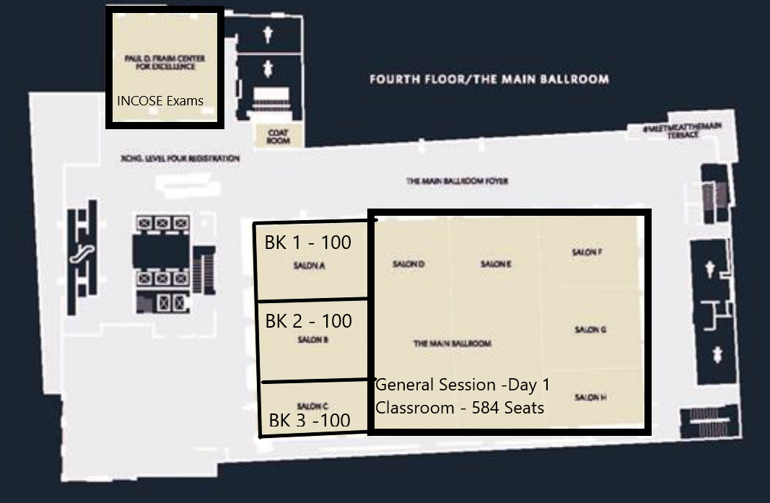
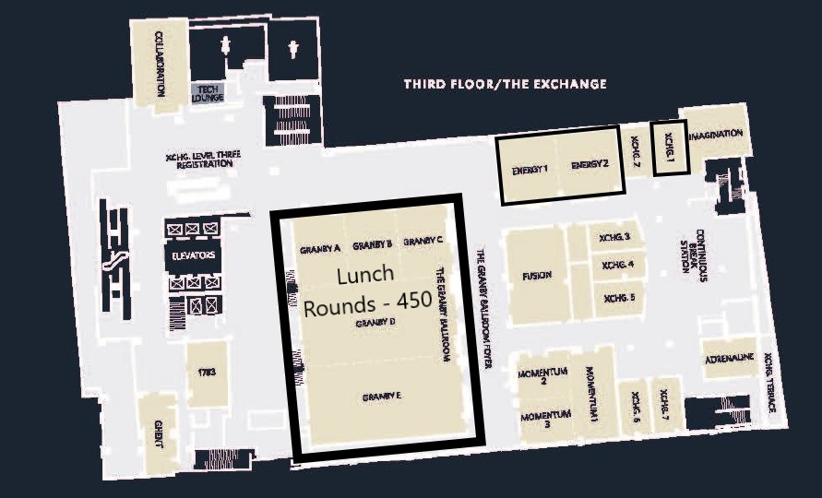
Norfolk, VA – Hilton Norfolk The Main
  Room Block
    2023 - Sunday, October 15, 2023 – Thursday, October 19, 2023
    2024 - Sunday, October 27, 2024 – Thursday, October 31, 2024
Day 1 configuration

Slide 55
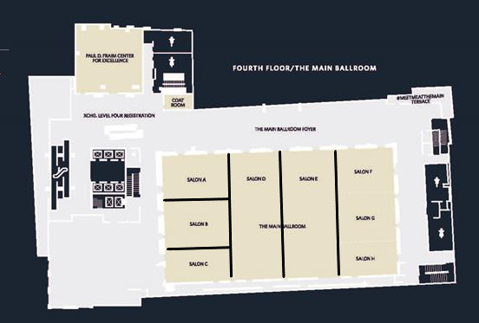
2023 Hilton Norfolk The Main Space – Day 2 & 3
6 Breakout Rooms
Room Sizes
  Three seat 100
  Three seat 225
Exhibits
  23 Tabletops
  U shaped space in aisles around breakout rooms
  Growth space available for 2024
BK 1
BK 4
BK 5
BK 6
BK 2
100
BK 3
100
225
225
225
100
* Breakout capacity is based on classroom style

Slide 56
2023 Conference Planning Committee
  Planning Committee: Dr. Pat Griffin, Dr. Suzette Johnson, Annette Beacham, Mike Franco, Jeff Bilco, and Dave Chesebrough
  Seeking Early Guidance from SED Steering Committee.
    Keynote Speakers, Presenters from their Organizations, Sponsorships, and Marketing of Conference
  Ten Conference Tracks (Topics) in 2022
    System Engineering, Test & Evaluation, and Program Management Divisions.
  Getting Suggestions now for 2023 Topics.
    Workshop idea: Align Presentations with Exhibitor Tools – Leads are John Daly and Patrick Baines
    Workshop idea: Host a Digital Engineering (DE) “Debate” - Lead is Jon Backhaus
    2022 largest track was DE. Focus DE on typical System Engineering activities.
      Augmentation: model scripting, AR/VR, NLP, AI/ML.
      Process, Methodology, and Governance: modeling patterns, model reuse, ontologies.
      Digital Thread: inter-model associativity, data exchange, data transformation.
      Digital Twin: model execution, physics-based modeling.
    Align Tracks Differently?
      Separate MOSA track?
      Modeling & Simulation track?
      Complex Adaptive Systems Implementation: AI, Machine Learning, and other emerging complex systems.

Slide 57
2023 Conference Planning Committee
  Track Chairs: Were assigned last week. We will flex with topic submissions, as necessary.
  Digital Engineering – John Daly & Patrick Baines
  Architecture/MOSA – Bob Scheurer & Ed Moshinsky
  Mission Engineering (ME) / Systems Of Systems (SOS) – Dr. Judith Dahmann
  Systems Security Engineering (SSE) – Cory Ocker
  ADAPT Engineering – Dr. Suzette Johnson & Robin Yeman
  Education & Training – Dr. Robert Raygan
  Specialty Engineering/Safety & Environmental Engineering (SE/SEE) – Kate Harris & Tim Sheehan
  Physics-based Modeling and Simulation – Jon Backhaus & David Allsop
  Test & Evaluation – Jeff Bilco
  Program Management – Linda Adams & Stewart Tague
  Abstracts: Call for Abstracts will be published by the end of March. NDIA will train us on a new system for easy and early access to abstracts.
  Interaction with Authors: Track chairs and co-chairs will interact early with authors to answer questions, obtain slides, and assist.
  Steering Committee – Dr. Suzette Johnson leading this effort to increase communication with this group of advisors and to obtain marketing assistance.
  2022 Attendees and Authors – John Daly reaching out to this group seeking members and interaction.
  Looking for SWAG – If your organization would like to provide logo items, please contact Pat Griffin.

Slide 58
Final Remarks

