Slide 1
System Engineering Division
Monthly Meeting
June 22, 2023

Slide 2
AGENDA
(all times EST)
1000-1015 Welcome/Conference Update John Daly/Dr. Pat Griffin
1015-1100 Digital Transformation of the Department of the Air Force Update
Ms. Kristen Baldwin, Deputy Assistant Secretary of the Air Force Science, Technology, and Engineering, Office of the Assistant Secretary of the Air Force for Acquisition, Technology, and Logistics
1100-1200 National Defense Science and Technology Strategy
Ms. Monique Ofori, Lead SE Contractor Support, (OUSD) R&E SE&A
1200-1245 Agile and Systems Engineering, ADAPT
Mr. Gordon Kranz, President, Enlightened IPM
1245 Wrap-up/Adjourn

Slide 3
Division Goals for 2023
Lead in digital transformation in systems engineering as practiced by our Industry and Government partners
Increase Division membership at all levels, and focus on Industry member employees
Partner with more government Services, and Agencies in systems engineering
Strengthen Committee membership and participation; Support Committee Chairs and Co-Chairs in visibility for their committee activities and collaboration across the Division
Build on the successful 2022 SE&ME Conference
Build strong relationships with other SE related professional organizations/societies (e.g.: INCOSE, SERC, SISO, OMG etc.)

Slide 4
2023
Systems & Mission Engineering
Conference
Norfolk, VA – Hilton Norfolk The Main
16-19 October 2023
Dr. Pat Griffin
NDIA Systems Engineering Division Conference Committee Chair

Slide 5
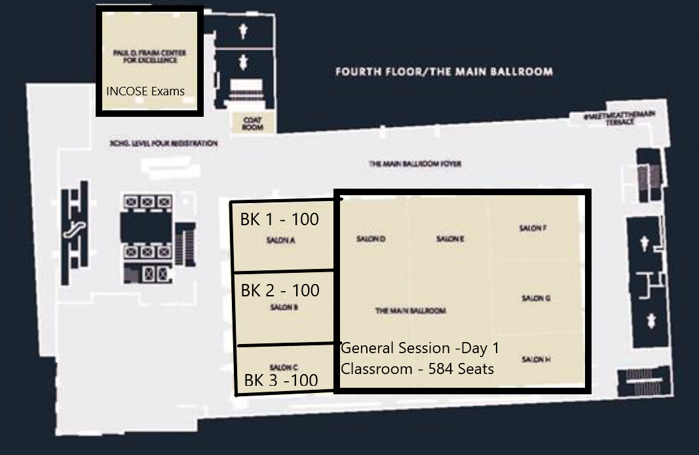
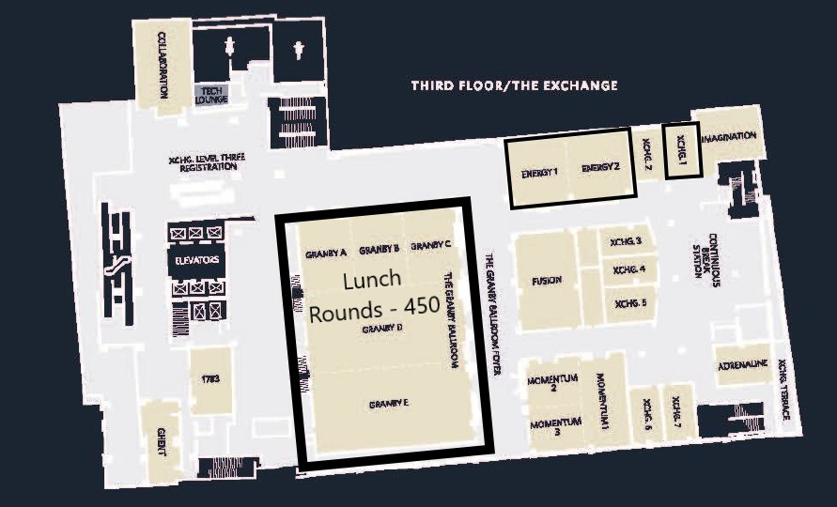
Norfolk, VA – Hilton Norfolk The Main
  Room Block
    2023 - Sunday, October 15, 2023 – Thursday, October 19, 2023
  Conference Dates
    10/16 Monday PM – up to 4 workshops; 10/17-10/19 Conference
Day 1 configuration

Slide 6
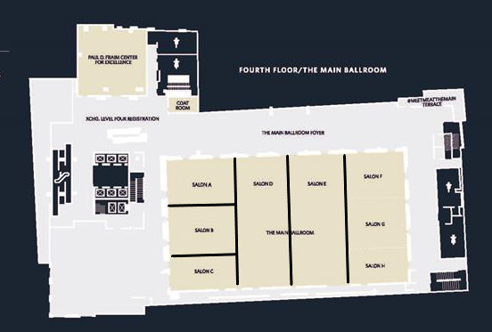
2023 Hilton Norfolk The Main Space – Day 2 & 3
6 Breakout Rooms
Room Sizes
  Three seat 100
  Three seat 225
Exhibits
  23 Tabletops
  U shaped space in aisles around breakout rooms
  Growth space available for 2024
BK 1
BK 4
BK 5
BK 6
BK 2
100
BK 3
100
225
225
225
100
* Breakout capacity is based on classroom style

Slide 7
2023 Conference Details
  Call for Abstracts Ended
    Received 195 submittals. Track chairs and SED leadership completing review and selection NLT 25 June with author notification NLT 30 June. All Track chairs and co-chairs have access to the NDIA abstract platform to complete the review, selection, and author notification.
  16 October, Monday Afternoon, Available for Workshops
    Four rooms available with 80-100 seating.
    SED Committees are deciding on topics.
  17 October, Tuesday Morning Welcome and Keynotes
    Sessions begin after lunch.
  18 and 19 October
    Wednesday, Abstract Presentations
    Thursday, TBD but might be - Future of Digital Engineering Tools.
  Keynote Speaker Search
    Committee is seeking DoD speakers. Some requests have been submitted, requests to speak are being reviewed, and a few requests are in process.
  Presentations and Awards
    Six tracks with 192 presentation time slots. Some presentations will be On-demand and panels will consume two time slots.
    There is an option to move awards to the Tuesday or Wednesday luncheon if time is needed for the Keynote presentations.

Slide 8
2023 Conference Planning Committee
  Planning Committee:
  Please reach out to any of us or SED senior leadership if you have suggestions, questions, or need information.
  Dr. Pat Griffin pat.griffin@astronics.com
  Dr. Suzette Johnson suzette.johnson@ngc.com
  Ms. Annette Beacham mary.a.beacham.ctr@mail.mil
  Mr. Mike Franco mike.franco@boeing.com
  Mr. Jeff Bilco jeffrey.s.bilco@boeing.com
  Mr. Dave Chesebrough dchesebrough@definedbusiness.com

Slide 9
Digital Transformation of the Department of the Air Force Update
Ms. Kristen Baldwin
Deputy Assistant Secretary of the Air Force Science, Technology, and Engineering, Office of the Assistant Secretary of the Air Force for Acquisition, Technology, and Logistics

Slide 10
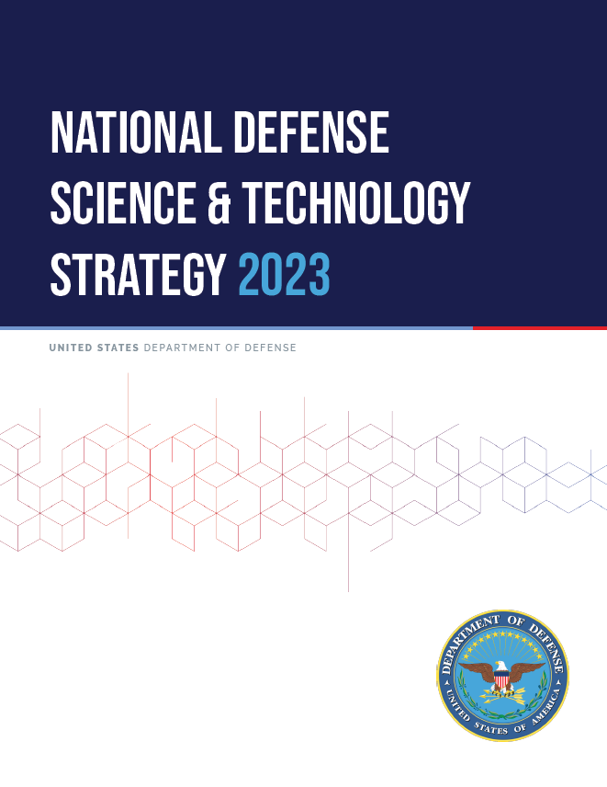
National Defense Science & Technology Strategy 2023
Key Points for Systems Engineering & Architecture
Discussion for NDIA SE Division Meeting
22 June 2023
Monique Ofori – (OUSD)R&E SE&A (Lead SE Contractor Support)
Ed Moshinsky – (OUSD)R&E SE&A (SE Contractor Support)

Slide 11
Background
2023 National Defense Science and Technology Strategy https://media.defense.gov/2023/May/09/2003218877/-1/-1/0/NDSTS-FINAL-WEB-VERSION.PDF
In alignment with:
  2022 National Security Strategy https://www.whitehouse.gov/wp-content/uploads/2022/10/Biden-Harris-Administrations-National-Security-Strategy-10.2022.pdf
  National Defense Strategy (NDS) https://media.defense.gov/2022/Oct/27/2003103845/-1/-1/1/2022-NATIONAL-DEFENSE-STRATEGY-NPR-MDR.PDF
Focus: “leverage asymmetric American advantages: our entrepreneurial spirit and our diversity and pluralistic system of ideas and technology generation that drive unparalleled creativity, innovation, and adaptation.”

Slide 12
The Defense Science and Technology Challenge
New realities of global technology development; our adversaries are developing capabilities faster, threatening our technological advantages.
DoD must adjust its approaches to counter this
  More proactive with private sector to make the right investments in emerging technologies
  Preempt adversaries by protecting critical and emerging technologies early in the development cycle
  Solve increasingly complex security challenges that involve science and technology.
Approach
  New DoD processes to engage technological innovation base and Industry to address emerging strategic competition
  New mechanisms for supporting R&D with more effective pathways for acquisition and sustainment
  Divest outdated legacy systems and risk-averse processes.
Strategic Lines of Effort
  Focus on the Joint Mission
  Create and field capabilities at speed and scale
  Ensure the foundations for research and development

Slide 13
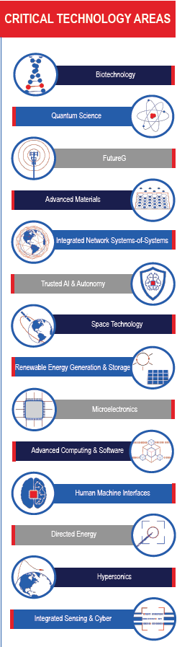
Focus on the Joint Mission
Invest in information systems and establish processes for rigorous, threat-informed analysis to better enable DoD to make informed choices in its S&T investments.
“Make the right technology investments” (Critical Technology Areas)
Rigorous Analysis at the Mission Level
  Campaign-level system-of-systems models and simulations
  Integrating physics-based models into campaign-level system-of-systems models
  M&S coupled w/ technology monitoring to inform future critical technology investments
Joint Experimentation
  Continuous and iterative joint experimentation
  Collaboration between DoD, Services, and Industry
  Emphasis on prototyping and experimenting with capabilities

Slide 14
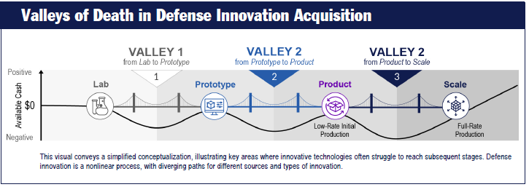
Create & Field Capabilities at Speed and Scale
Foster vibrant defense innovation ecosystem, accelerate transition of new technology into field, communicate effectively inside/outside DoD.
Defense Innovation Ecosphere to overcome “Valleys of Death”
  Increased partnerships w/ current and non-defense orgs (academia, FFRDCs, UARCs, national laboratories, Services’ Innovation Centers, non-profits, commercial industry, other Govt. agencies, international allies/ partners)
  Innovate Industrial Processes thru Manufacturing Innovation Institutes
  Continuously Transitioning Capabilities thru prototyping and experimenting
    Collaboration among R&E, A&S, Services, and acquisition & Sustainment communities.
  Clear Communications – DoD Innovation Steering Committee (ISG); enhanced DoD outreach to industry, academia, and other Gov’t agencies.
  Robust technology protection paradigms

Slide 15
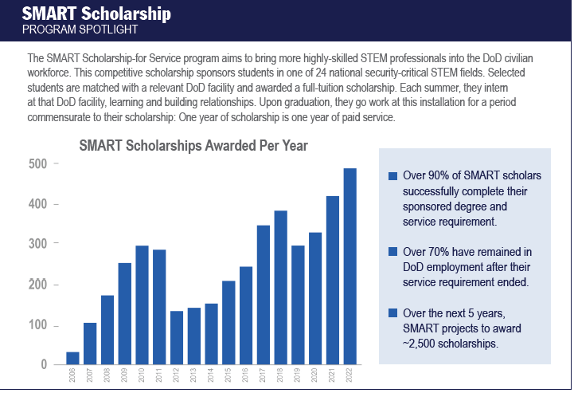
Ensuring the Foundations for Research & Development
Recruit, retain, and cultivate talent; revitalize our physical infrastructure; upgrade our digital infrastructure; and nurture stronger collaboration across all stakeholders.
Enhance Lab and Test Infrastructure
Upgrade Digital Infrastructure to improve information sharing and knowledge management
Cultivate the Current Workforce
  Empower our scientists and engineers to grow their knowledge and skills
  Increase collaborative efforts with private sector (e.g. Defense Ventures Fellowship)
  Align w/ FFRDCs, UARCs & Industry (e.g. Engineer & Scientist Exchange Program (ESEP))
  Modernize training to address needed technical skills
Invest in the Workforce of Tomorrow
  Focused STEM programs (Defense STEM Education Consortium (DSEC), National Defense Education Program (NDEP), Science, Mathematics Research for Transformation (SMART) Program)

Slide 16
Agile and Systems Engineering, ADAPT
Mr. Gordon Kranz,
President, Enlightened IPM

Slide 17
Final Remarks

