Slide 1
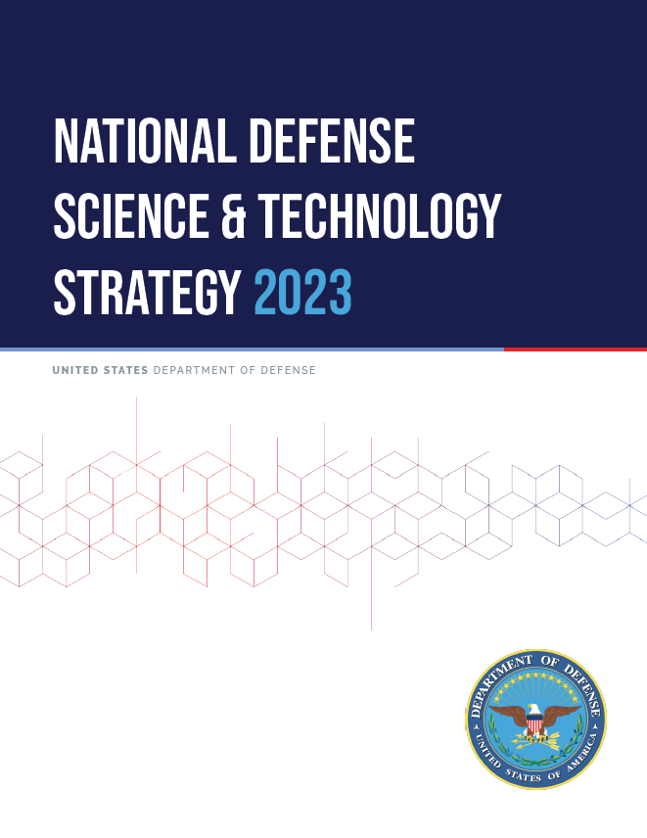
National Defense Science & Technology Strategy 2023
Key Points for Systems Engineering & Architecture
Discussion for NDIA SE Division Meeting
22 June 2023
Monique Ofori – (OUSD)R&E SE&A (Lead SE Contractor Support)
Ed Moshinsky – (OUSD)R&E SE&A (SE Contractor Support)

Slide 2
Background
2023 National Defense Science and Technology Strategy https://media.defense.gov/2023/May/09/2003218877/-1/-1/0/NDSTS-FINAL-WEB-VERSION.PDF
In alignment with:
2022 National Security Strategy https://www.whitehouse.gov/wp-content/uploads/2022/10/Biden-Harris-Administrations-National-Security-Strategy-10.2022.pdf
National Defense Strategy (NDS) https://media.defense.gov/2022/Oct/27/2003103845/-1/-1/1/2022-NATIONAL-DEFENSE-STRATEGY-NPR-MDR.PDF
Focus: “leverage asymmetric American advantages: our entrepreneurial spirit and our diversity and pluralistic system of ideas and technology generation that drive unparalleled creativity, innovation, and adaptation.”

Slide 3
The Defense Science and Technology Challenge
New realities of global technology development; our adversaries are developing capabilities faster, threatening our technological advantages.
DoD must adjust its approaches to counter this
More proactive with private sector to make the right investments in emerging technologies
Preempt adversaries by protecting critical and emerging technologies early in the development cycle
Solve increasingly complex security challenges that involve science and technology.
Approach
New DoD processes to engage technological innovation base and Industry to address emerging strategic competition
New mechanisms for supporting R&D with more effective pathways for acquisition and sustainment
Divest outdated legacy systems and risk-averse processes.
Strategic Lines of Effort
Focus on the Joint Mission
Create and field capabilities at speed and scale
Ensure the foundations for research and development

Slide 4
Focus on the Joint Mission
Invest in information systems and establish processes for rigorous, threat-informed analysis to better enable DoD to make informed choices in its S&T investments.
“Make the right technology investments” (Critical Technology Areas)
Rigorous Analysis at the Mission Level
Campaign-level system-of-systems models and simulations
Integrating physics-based models into campaign-level system-of-systems models
M&S coupled w/ technology monitoring to inform future critical technology investments
Joint Experimentation
Continuous and iterative joint experimentation
Collaboration between DoD, Services, and Industry
Emphasis on prototyping and experimenting with capabilities

Slide 5
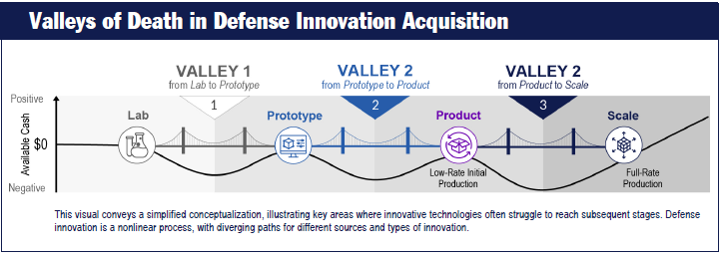
Create & Field Capabilities at Speed and Scale
Foster vibrant defense innovation ecosystem, accelerate transition of new technology into field, communicate effectively inside/outside DoD.
Defense Innovation Ecosphere to overcome “Valleys of Death”
Increased partnerships w/ current and non-defense orgs (academia, FFRDCs, UARCs, national laboratories, Services’ Innovation Centers, non-profits, commercial industry, other Govt. agencies, international allies/ partners)
Innovate Industrial Processes thru Manufacturing Innovation Institutes
Continuously Transitioning Capabilities thru prototyping and experimenting
Collaboration among R&E, A&S, Services, and acquisition & Sustainment communities.
Clear Communications – DoD Innovation Steering Committee (ISG); enhanced DoD outreach to industry, academia, and other Gov’t agencies.
Robust technology protection paradigms

Slide 6
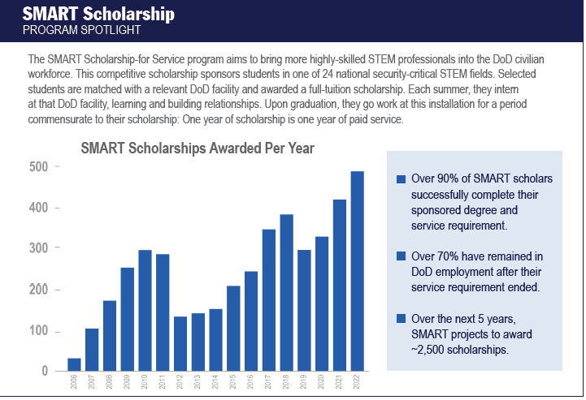
Ensuring the Foundations for Research & Development
Recruit, retain, and cultivate talent; revitalize our physical infrastructure; upgrade our digital infrastructure; and nurture stronger collaboration across all stakeholders.
Enhance Lab and Test Infrastructure
Upgrade Digital Infrastructure to improve information sharing and knowledge management
Cultivate the Current Workforce
Empower our scientists and engineers to grow their knowledge and skills
Increase collaborative efforts with private sector (e.g. Defense Ventures Fellowship)
Align w/ FFRDCs, UARCs & Industry (e.g. Engineer & Scientist Exchange Program (ESEP))
Modernize training to address needed technical skills
Invest in the Workforce of Tomorrow
Focused STEM programs (Defense STEM Education Consortium (DSEC), National Defense Education Program (NDEP), Science, Mathematics Research for Transformation (SMART) Program)

