Slide 1
Department of the Air Force
Digital Transformation
Kristen Baldwin
Deputy Assistant Secretary of the Air Force, Science, Technology & Engineering
14 June 2023

Slide 2
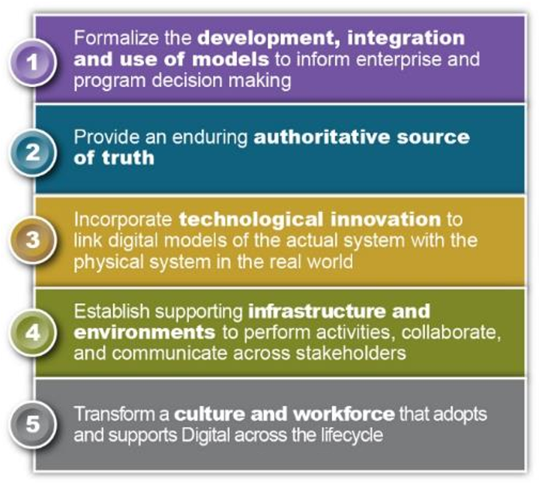
DAF Digital Engineering - Strategic Foundation
Department of the Air Force Implementation: A digitally-empowered Department equipped with an agile workforce, state-of-the-art technologies, and intuitive processes that drive model-based enterprise decision-making, enable automation, institutionalize open architectures, and leverage authoritative models and data to ensure seamless stakeholder collaboration across the lifecycle.
DAF Digital Transformation is a USAF and USSF combined effort

Slide 3
Strategic Priorities – Digital Acquisition
AQ Digital Acquisition Priority
AFMC Digital Materiel Management Priority
Implement Open Systems Standards and Reference Architectures
Ensure Programs Are "Born Digital" or Digitally Adapt over the Lifecycle
Expand Enterprise Solutions and Embrace Cloud-based Collaborative Environments
Institutionalize Processes for Agile Software Development and Software-Intensive Systems
Structure and Secure our Data
Train our Digital Workforce
Provide Access to DMM Tools
Develop Digital strategies
Instill a digital-first culture
Modernize IT infrastructure
Aligned for Enterprise Digital Dominance

Slide 4
DAF Digital Engineering Vision
A transformative digital ecosystem, coordinated across the USAF and USSF, where tools and authoritative data are used to rapidly inform decisions
Unprecedented Government and Industry collaboration where we can quickly achieve objectives and optimize cost, schedule and performance while maintaining a healthy respect for our shared interests
Digital Materiel Management lifecycle connecting research, development, test, sustainment through a digital thread - from the concept to end of design life
Knowledge is no longer “disposed”; it is enduring and evolves, informs, and translates to new opportunities and capabilities
Notes:
Briefer
Ashley

Slide 5
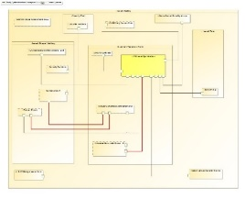
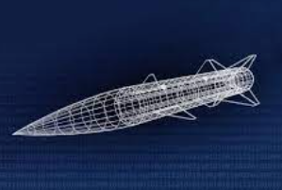





Digital Lifecycle Ecosystem
(Continuous Process)
HAF
AF FUTURES
MAJCOMS
Air Force Design
Gaps
Opportunities
MBSE System Architecture
Required Capabilities
Enterprise Operations Analysis
Experimentation Activities
S&T
Requirements
Vanguards
AFWIC
Force Design LOE’s
Open Standards, Data,
Government Reference Architecture
System design model,
integrated design environment
Product Lifecycle Management model supporting O&S
S&T, Prototyping, Mission Modeling
Tradespace &
Operations Analysis
Requirements & System Specifications
System
Development
System
Lifecycle
AF and SF Futures
MajorCommands
FieldCommands
Air Force Research Lab
RFP
SOW/PWS
CDRLS/DIDs
SRD/TRD
Technical Reviews
Agile Development
Finance, Risk, & Log Mgt
Test & Certs
Supply
Maintenance
Product Support
Operations
Modifications
Standards
Reference Architecture Models
Training
Tools
Data Architecture
Digital Ecosystem Enabled By
PLM / FENCES / CloudONE / PlatformONE

Slide 6
DAF Accomplishments Toward this Vision
Established a Digital Campaign and developed a “Digital Guide” to provide programs and practitioners with resources and best practices
900-member Digital Campaign Community of Practice provided contributions to the Digital Guide
Published a Digital Building Code to set expectations that programs should plan for and incorporate digital acquisition practices in their programs
Program Executive Officers and Engineering Centers taking action
Next updates will include more prescriptive language to enforce programs embracing digital either over their lifecycle or from birth
Implemented a Digital Maturity Assessment tool to baseline organizations’ digital capabilities; developing goals and objectives for transforming processes and measuring return
Stood up Digital Transformation Office (DTO) to serve as a focal point for acquisition transformation and collaboration

Slide 7
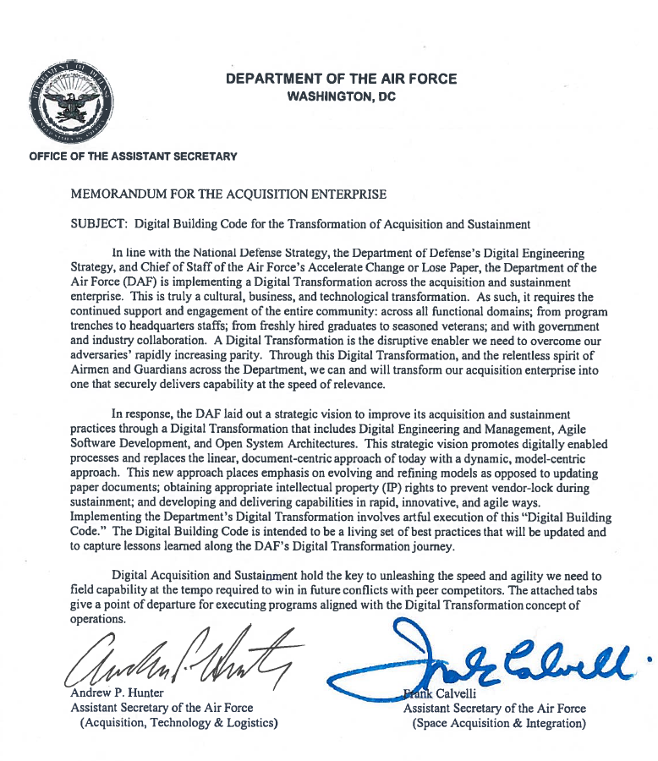
DAF Digital Building Code
The Digital Building Code is a living set of practices that guide USAF and USSF programs to implement Digital Transformation:
Digital Engineering
Open Systems Architecture
Agile Software Practices
DIGITAL ENGINEERING AND MANAGEMENT
1. Develop digital models of systems
2. Develop a digital twin and digital thread
3. Implement an integrated digital environment
4. Employ a tailored digital strategy for contracting with industry
5. Ensure organizational readiness for Digital Engineering
6. Implement Digital Acquisition
7. Track Digital Maturity
New programs are “born” digital while existing or legacy programs implement practices that can provide value

Slide 8
DAF Digital Building Code
OPEN SYSTEMS ARCHITECTURE
1. Implement an Open Systems Architecture
2. Leverage Open Standards
3. Designate, empower, resource, and train System Architects in Program Offices
4. Track and report architecture performance metrics
AGILE SOFTWARE
1. Implement DevSecOps software development methodology and reference design
2. Adopt the following common enterprise services and tooling standards
3. Implement the following organization staffing, leadership, and training guidance
4. Start tracking performance metrics for software factories and Agile teams
A cultural, business and technological transformation

Slide 9
Digital Thread Benefits
Operational concepts, assessment, training, and familiarization can be accomplished in parallel and iteratively to provide early and relevant feedback to the system.
Distributed teams, across multiple disciplines work in parallel enabling early insights, and informed decisions.
Interfaces are standardized, and can be evaluated virtually, within systems, and across systems of systems to reduce interoperability risk.
Digital models and artifacts directly inform certification requirements in a much more impactful way, and more efficiently than today’s paper contract deliverables, checklists and silo’d experts.
Manufacturability is factored in early on including incorporating advanced manufacturing technology that can create new design options for our systems.
Sustainment activities are informed and modeled while development progresses to delivery, enabling lifecycle efficiencies.

Slide 10
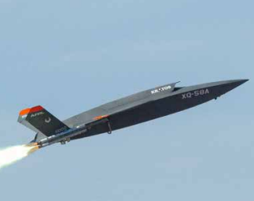

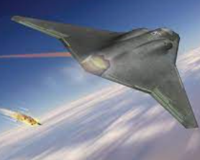
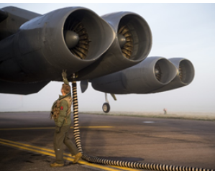
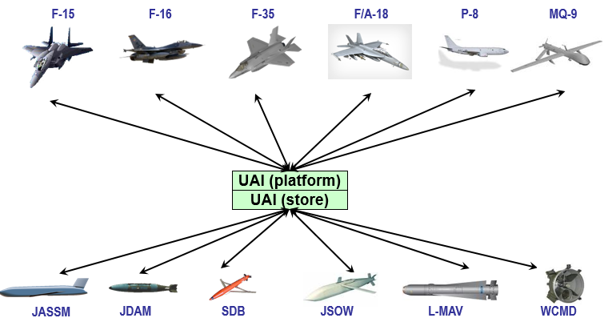
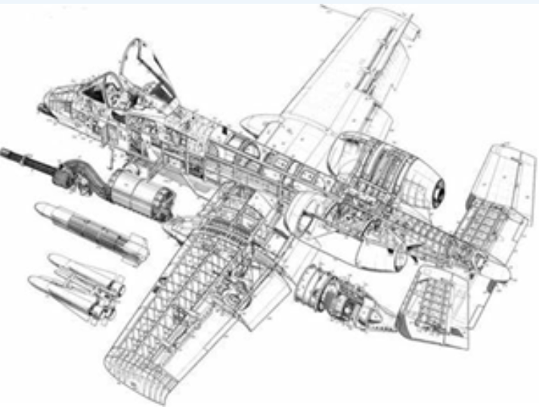
Digital Transformation Deliver Better Capability, Faster
Research
Develop
Test
Sustain
Maintain
Design
Supply
Retire
Prototype
Requirements
Analysis
DT & OT
SLEP
Modernize
DMSMS
Skyborg
Sentinel
NGAD
B-52 CERP
UAI
A-10 Re-Wing
First flight in 36 mo from concept dev.
Modularity enables >10 variations
Digital models enables rapid design/test/validate cycles w/warfighter feedback
>6B design variants analyzed to optimize performance
~6 month reduction in time to SRR
VR based training for operators/MX
Months → Days for software development & release
1000's of high fidelity design iterations
Months → Weeks prep time for acq. reviews
Pivot w/evolving threat
>60 day reduction in time to PDR w/shared digital tool environment
Months saved in virtual validation of assembly & MX
Virtual training opportunities for crews/MX
>2 yrs, $2M saved in ICD dev’t and SIL testing for F-15/SDB II integration
For NATO munitions: 19 & 15 months saved on wpn integration compared to 5 year nominal avg
~1 yr saved in design qualification
~60% reduction in sustainment eng response time
2000 hrs or A/C downtime reduced to 700 hrs
Model Based System Engineering (MBSE)
Threat Informed Mission Modeling
Acquisition Data Management
Open Standards
Reference Architectures
Automated Certification Processes
Authoritative Sources of Truth (ASoT)
Enterprise Tools
PLM & linkage to Log-IT
Foundational Supporting Capabilities
Robust IT Infrastructure
Workforce Training
Enterprise Policy & Governance
Digital Culture
Overcoming silos and enabling enterprise scale requires enterprise investment

Slide 11
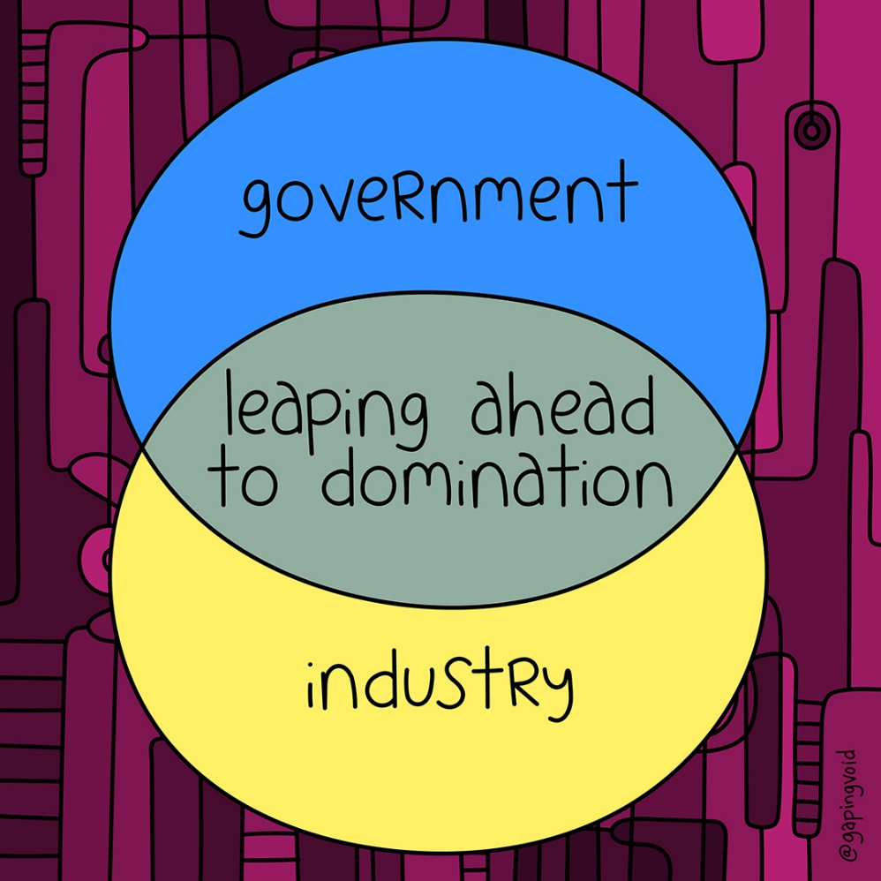
Digital Consortium Areas for Continued Coordination
Multi-level security and cross domain solutions for integrated digital environments
Data sharing and exchange (e.g., intellectual property, data rights)
Data and model curation, verification, validation (over time)
Scaling enterprise solutions to integrate digital engineering across programs, DoD, & Industry
Transitioning legacy artifacts, processes, & best practices
Technical barriers & policy inhibitors

Slide 12
Digital Consortium Notional Scope
Stakeholders: DAF leaders, industry partners, FFRDC/UARC/others
Notional Topics: Data standards/formats, modeling practices, policy or process inhibitors, risks/opportunities around digital tool sets, & best practices
Potential WGs: Style Guide development, tool interoperability best practices, DID/CDRL/contracting language development and recommendations, IT architecture, & cross-domain solutions/multi-level security (CDS/MLS) activities
The Digital Consortium will provide opportunity for joint, collaborative efforts

Slide 13
Questions?

