Slide 1
A unique collaborative DoD UARC
(University Affiliated Research Center)
www.SERCuarc.org
www.acqirc.org
Executive Overview
AIRC | SERC

Slide 2

Collaboration network
A multi-University Affiliated Research Center, reporting to the Undersecretary of Defense for Research and Engineering.
A collaboration platform for engaging stakeholders within the extended DoD Acquisition and Engineering Enterprise, thought leaders from across the nation, and researchers across academia.
AIRC | SERC

Slide 3
SERC SE/DE Research
DE Enterprise Transformation
DE as the Enabler
SE Modernization
Data & Analytic Strategies
DE Adoption
DE Benefits & Metrics
Digital
Model-Centric Engineering
Augmented Engineering
Open, Modular
“Model-Everything” Pilots,
Digital Workflow
Ontologies & Semantic Technologies
Enabling DE Environment
Trust and Resilience
Agile
DE Workforce & Competencies
SoS/ Mission Driven
Continuous Iterative Development
DE Competency Model
Digital Literacy
Model-based Experience

Slide 4
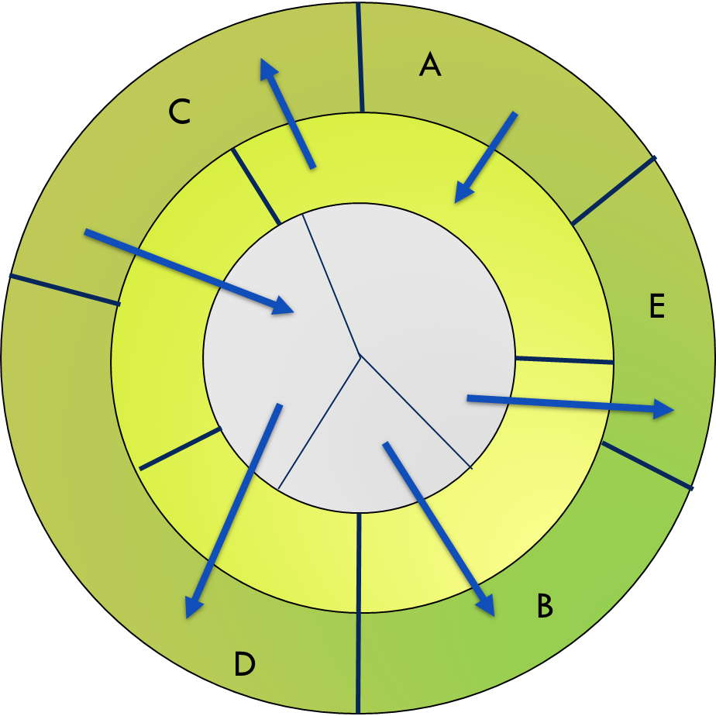
SE Mod: Revised Mental Model
SE Process Models
VELOCITY & AGILITY
Life Cycles are:
Adaptable
Efficient
Predictable
Measurable
DIGITAL &
DATA-DRIVEN
Shared & Authoritative Data Model
Interoperable Data/ Tool Ontologies
Seamless & Integrated Workflow
Learn
Digital Artifacts
Views
Models
AUTOMATED
Data
Build
MODEL-BASED
System Model Manages Disciplinary Models & Meta-Process Models
Reviews & Signoffs in the Models
Measurable
with SE RIGOR
Reusable Reference Architectures
Process Meta-models
Consistent Data across Specialized Tools
Transform
Analyze
Measure
Decide

Slide 5
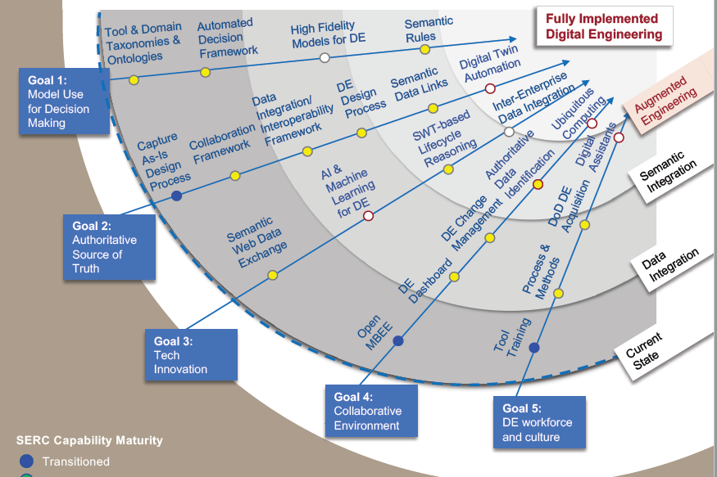
Data and Model Ontology (System)
Richer degree of semantics, automation
Adopt semantic technologies & tools
Formalize information related to domain & disciplinary ontology
Create interoperability across domains & disciplines
Automated reasoning to support decision making
Continue to do this across the product lifecycles
6
3
4
5
2
1
* https://sercuarc.org/wp-content/uploads/2020/01/ROADMAPS_2.3.pdf

Slide 6
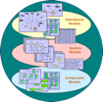

Skyzer Demonstrates Modeling Methods for SET Framework Elements at Different Abstraction Levels
Element 1
Operational Models
Other Business Models
Personnel, support, training, etc.
Operational
Data & Models
System Model is Authoritative Requirements Source (e.g. Gov’t Specification)
Warfighter
SoS
Level
User Capability Model
(aka Mission Model)
Element 2
Acquisition
Agreement
Tech Stack: data, models, tools, & training
System Model
System
Data & Models
Initial System Model
Final System Model
Main
Contract
Acquirer
System
Level
Functional Baseline
Element 3
Prime Contractor
Sub-System 1 Model
Sub-System 2 Model
Sub-System n Model
Sub
Contracts
Sub-System
Level
Disciplinary Specific Data & Models
Allocated Baseline
Discipline-Specific Models
(Mechanical, Electrical, SW)
Sub Contractors
Element 4
Component 1 Model
Component 2 Model
Component n Model
NAVAIR Public Release 2017-892. Distribution Statement A – “Approved for public release; distribution is unlimited”

Slide 7
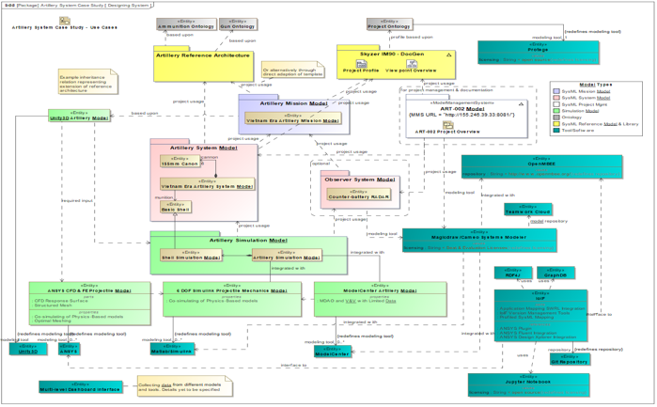
DEVCOM Example Reference Architecture for “Full Stack” with Tools
Digital Ontologies
Used
Tools:
Protegé
Unity 3D
Reference Architecture
Digital Signoff
Mission Model
Graphical CONOPs
View Editor
OpenMBEE
System Models
Magicdraw/
Cameo
Analysis Models
IoIF
ANSYS
Matlab/Simulink
Jupyter
Notebook
ModelCenter
Distribution Statement A: Approved for public release. Distribution is unlimited.

Slide 8
“Full Stack” of Skyzer Models
Enables Acquisition Analysis
Generalization of
Previous Mission/Systems
Reference models characterize reusable information and process
NAVSEM
Process Model
Airworthiness
Model
CBT&E / MBTD Model
Cyber
Model
Using and Tailoring
Reference Models
Mission
Reference
Models
Reliability and
Maintainability
Cost
Model
More…
NAVSEM Compliant
“Full Stack”
System
Reference
Models
Skyzer
Stakeholder Analysis Models
Mission
Model
Instance of
CBT&E / MBTD Model
Criteria focused on Capability-based Test & Evaluation (CBT&E) and Mission-based Test Design (MBTD)
Project
Usage
L&R Sys
Model
Skyzer
System
Model
Instance of
Airworthiness Model
Criteria needed and evidence provided for getting a flight clearance
Contractor
RFP Response
Model
Instance of
Cost Model
Cost Modeling approach based on using MBSE artifacts
Avionics
Model
}
Airframe
Model
Surrogate
Cost Equations
OR
Program X
Cost Equations
Substitute
Cost Equations
Landing-Gear
Subsystem Model
…
How to model to develop Authoritative Source of Truth
Notes:
SETR: Systems Engineering Technical Review
ASRM: Acquisition System Reference Model
CDRL: Contract Data Requirements List
CBT&E: Capability-based Test and Evaluation
RFP: Request for Proposal
SRR: Systems Requirement Review
KPP: Key Performance Parameters
MBTE: Model Based Test Engineering
SFR: System Functional Review

Slide 9
Problem Statement: Engineering Resilience
Add resilience to the engineering trade space
  Characterize benefits and costs (including operational impacts)
  Determine when we have enough resilience
Decompose high-level systems property to derive testable requirements
Challenges
Resilience is a dynamic property of the system and unfolds in the context of operations and missions.
How do we reason about systems, operational tasks, and missions so far to the left?

Slide 10
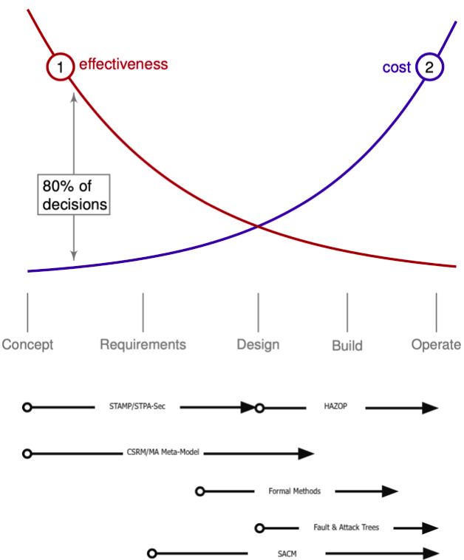
Resilience and Assurance Methodologies:
Full System Lifecycle
Effectiveness
Cost
80% of decisions
Loss/Dependence Risk/Vulnerability
CTT’s
STPA-Sec
Assurance Cases
Fault & Attack Trees/Hazard Analysis
CSRM/Mission Aware Meta-model
Formal Methods
FOREST Meta-process model

Slide 11
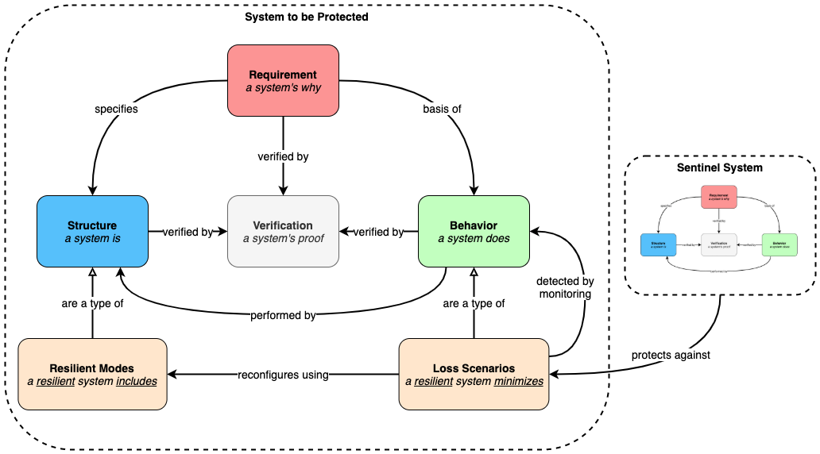
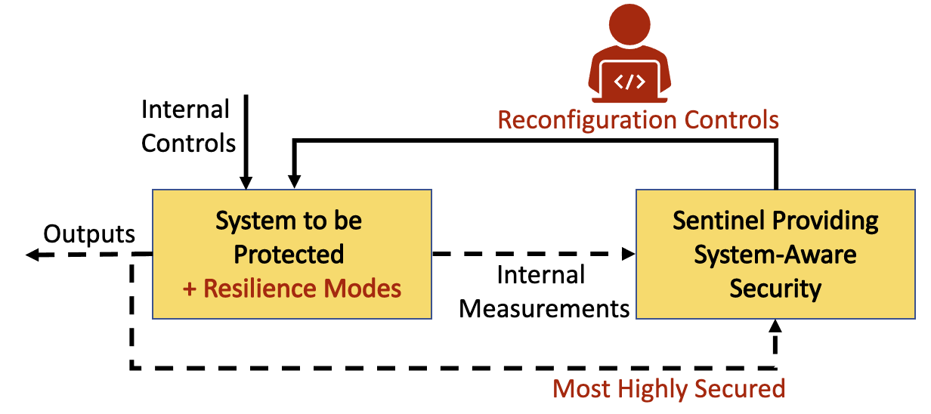
Sentinel-based Resilience Concept and Meta-Model
A Resilience Mode is a distinct and separate method of operation of a component, device, or system based upon a diverse redundancy or other design pattern.
A Sentinel is a pattern responsible for monitoring and reconfiguration of a system using available Resilience Modes. The Sentinel functions are expected to be far more secure than the system being addressed for resilience.

Slide 12
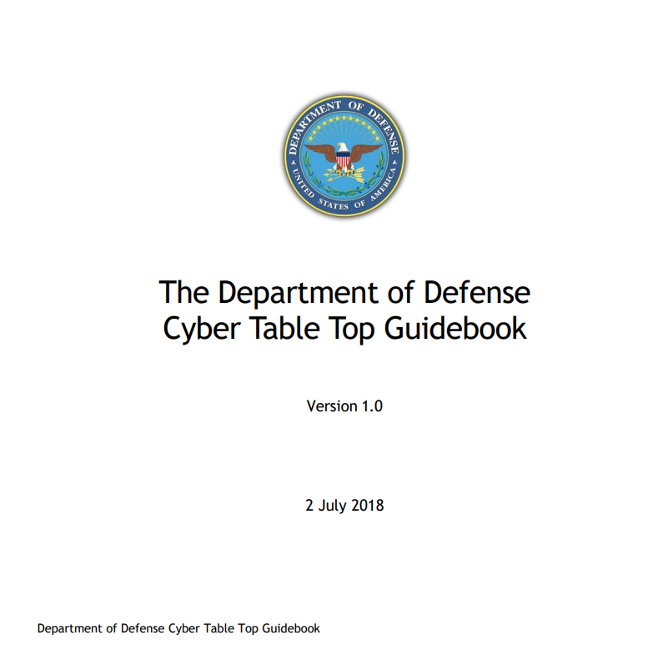
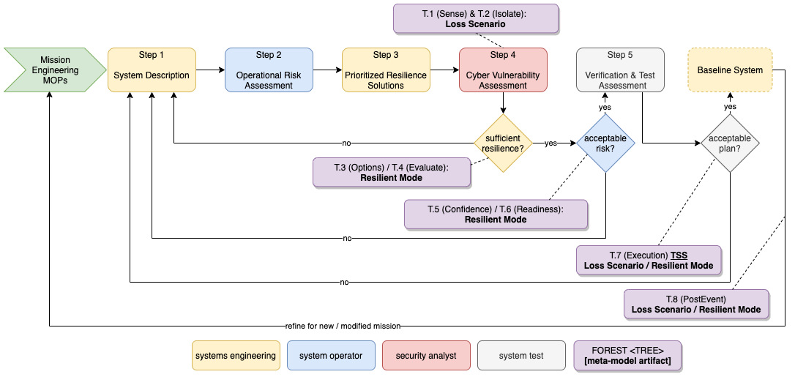
“FOREST” SE Process

Slide 13
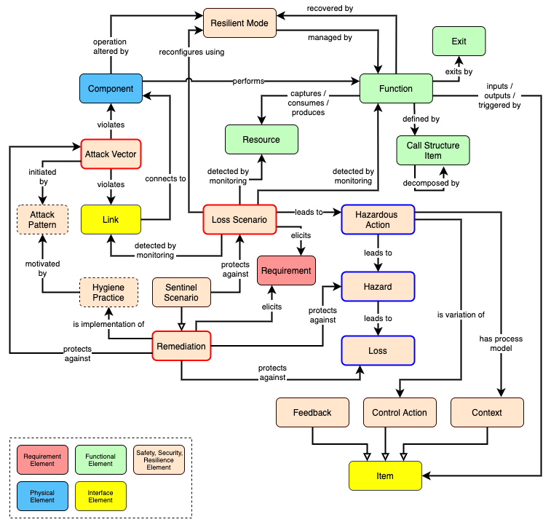
Mission Aware Meta-Model: Detail View

Slide 14
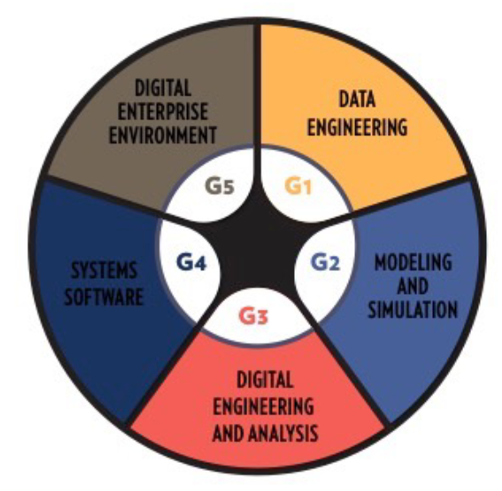
Digital Engineering Competency Framework
Data Engineering | Data Governance & Management
Modeling/Simulation | Modeling, Simulation AI/Machine Learning Data Visualization & Analytics
Systems Software | Software Construction Software Engineering
Digital Enterprise | Digital Environment Development, Management, Operations & Support, Security
Digital Systems Engineering | Digital Architecting, Requirements Modeling, Verification & Validation, MBSE Processes
Engineering Management | Digital Model-Based Reviews, Project & Program Management, Organizational Development, Policy & Guidance, Configuration Management

Slide 15

SERC DE Training
Ontology
DE Metrics
Model-Centric
Engineering
Process
DAU Model Environment
Curriculum Materials
Curriculum Development
Faculty Mentoring/ Coaching
Course Analysis
Skyzer and Spacer Model Pilots
Case Study Simulations
Assessment Metrics
Silverfish & Pipeline Model Pilots
Secure Cyber Resilient Engineering
DAU ETM Model/ Assessments
DECF Model/ Assessments
Training Course Evaluations
SE Competencies

Slide 16
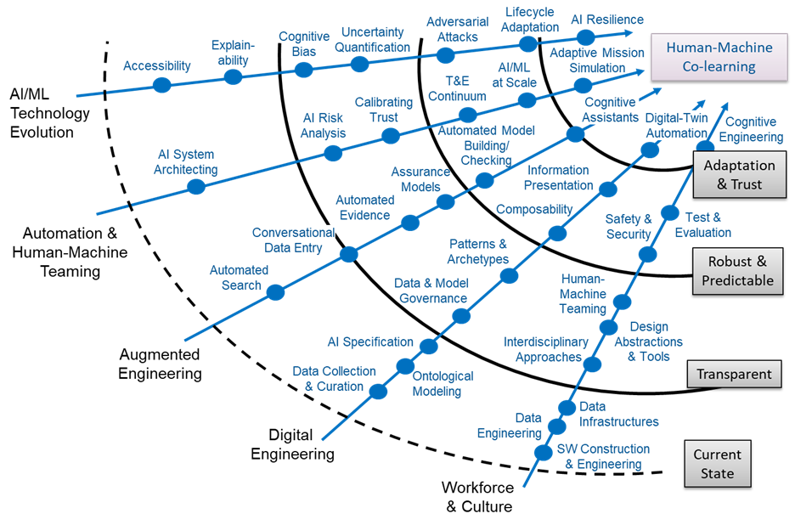

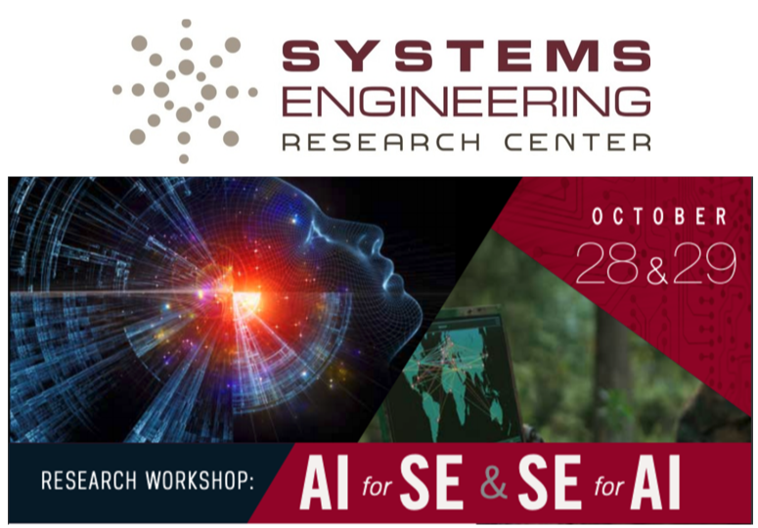
Revised AI Roadmap

Slide 17
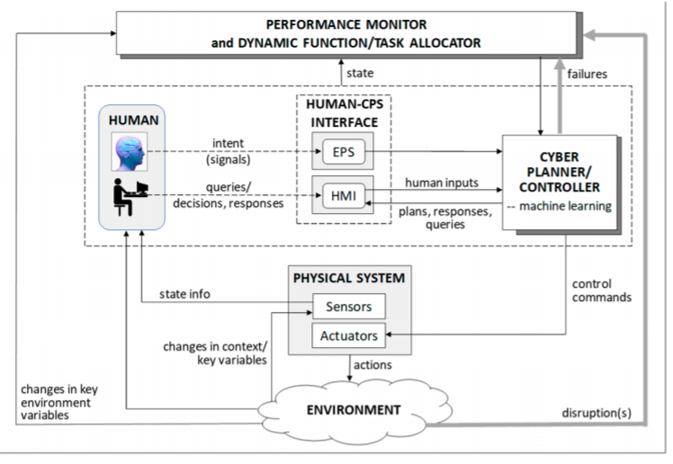
Testbeds
Capturing human behavior models
Evaluating time varying processes in human and machine contexts
Human cognitive & emotional state determination
Dynamically allocating tasks and functions based on contextual change
Madni and Madni, Architectural Framework for Exploring Adaptive Human-Machine Teaming Options in Simulated Dynamic Environments, Systems 2018, 6, 44

Slide 18
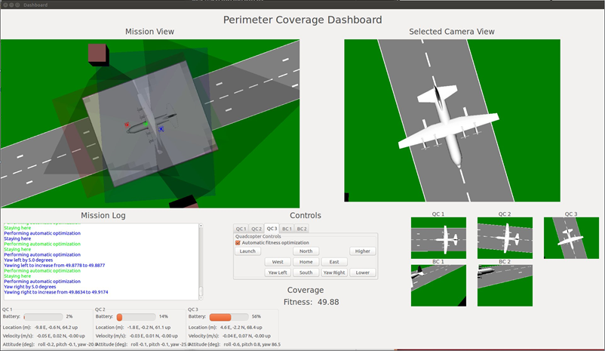
Virtual Testbed project
Your Mission: protect this asset
Standard Vehicle: quadcopter; software automates network communication
Smart dashboard: monitoring, visualization and control of simulation
Scenario builder: modeling, scripting, and import
Control Model: using same commands for physical vehicle and virtual model
Digital twin: creation and use of virtual model of system in simulation
Data collection: from vehicle mounted sensors for post hoc analysis
Execution trace: scenario execution audit trail display on dashboard
Goal: optimize asset usage
Collected results: human-machine co-learning

Slide 19
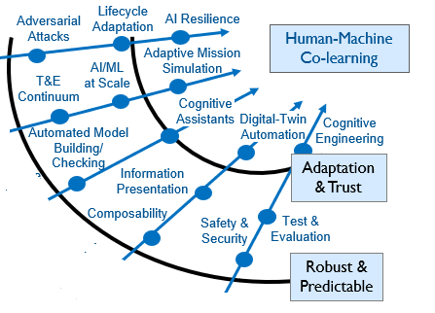
Challenges for Test & Evaluation of AI
Testing & Evaluation is a continuum
  Information accumulates over time
  across varying operating envelopes
  does not end until the system retires
All AI areas need testbeds
Operational relevance is essential
Data Management is foundational
AI systems require a probabilistic risk-based approach
Previous test metrics apply, but may have different interpretations
  Task & mission level performance, course of action, non-functional requirements
An expanded definition of external context is necessary
The T&E workforce and culture must evolve
Freeman, L. (2020), Test and Evaluation for Artificial Intelligence. INSIGHT, 23: 27-30.

Slide 20

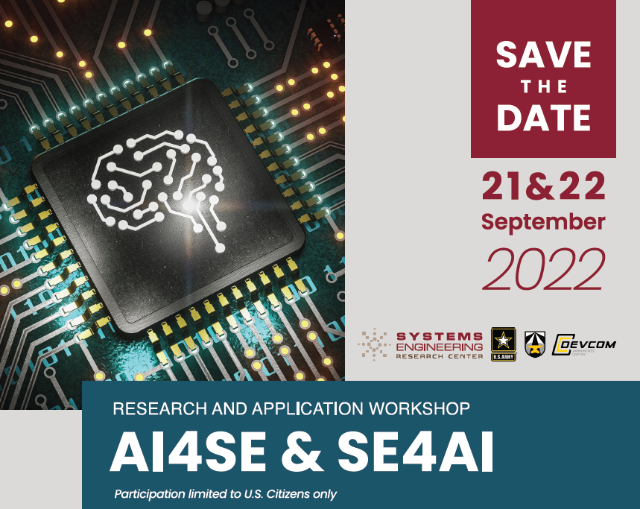
Key AI/Autonomy Research Goals
AI4SE: AI/ML to support the practice of SE
  Support scale in digital model construction
  Create confidence in design space exploration
SE4AI: SE approaches to systems with AI/ML
  Principles of learning-based systems design
  Models of life cycle evolution, Model curation methods
Systems Lifecycles for AI:
  AI-related agility: new SE methods and tools that
  anticipate adaptation
  Technical and management policies for assurance
Systems Validation of AI:
  Early visibility for deployment, validation of post-deployment changes
  System level testbeds – to study systems, not just data & algorithms

Slide 21
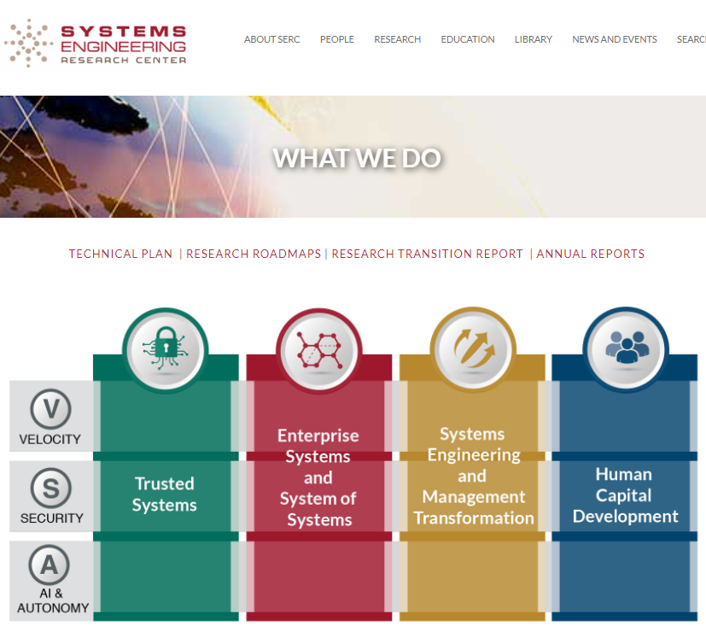

Further Information
www.sercuarc.org
www.acqirc.org

