Slide 1
System Engineering Division
Monthly Meeting
July 27, 2023

Slide 2
AGENDA
(all times EST)
1000-1015 Welcome/Conference Update
1015 -1035 Discussion of Federal Government Digital Engineering forum in October
Mr. Daniel Hettema; Director of Digital Engineering, Modeling and Simulation (DEM&S), Office of the Under Secretary of Defense for Research and Engineering
1035-1055 Call for participation in working group (potentially with SISO) on V&V of AI/ML models/applications in systems engineering/acquisition
Mr. Patrick Bains; NDIA SE Division
1055-1110 Committee Updates / BREAK
1110-1145 Discussion on MOSA Metrics
Mr. Steve Henry, NDIA SE Division Architecture Committee
1145-1200 Call for participation in the Government and Industry Modular Open System Approach (MOSA) Summit and Expo MOSA Industry Summit, September 2023
Mr. Ed Moshinsky, NDIA SE Division Architecture Committee
1200 Adjourn

Slide 3
Division Goals for 2023
Lead in digital transformation in systems engineering as practiced by our Industry and Government partners
Increase Division membership at all levels, and focus on Industry member employees
Partner with more government Services, and Agencies in systems engineering
Strengthen Committee membership and participation; Support Committee Chairs and Co-Chairs in visibility for their committee activities and collaboration across the Division
Build on the successful 2022 SE&ME Conference
Build strong relationships with other SE related professional organizations/societies (e.g.: INCOSE, SERC, SISO, OMG etc.)

Slide 4
Discussion of Federal Government Digital Engineering forum in October
Mr. Daniel Hettema
Director of Digital Engineering, Modeling and Simulation (DEM&S), Office of the Under Secretary of Defense for Research and Engineering

Slide 5
Call for participation in working group (potentially with SISO) on V&V of AI/ML models/applications in systems engineering/acquisition
Mr. Patrick Baines
NDIA SE Division

Slide 6
AI/ML Software Capabilities
Artificial Intelligence (AI) and Machine Learning (ML) software capabilities are “models, simulations, and associated data” as defined in DODI 5000.61 (“DoD Modeling and Simulation Verification, Validation, and Accreditation (VV&A))”, and as specified in Military Standard 3022 (“Documentation of Verification, Validation, and Accreditation (VV&A) for Models and Simulations”).
AI/ML capabilities once validated, can have many different Training Data Sets (TDS) employed with the model within its valid domain. Use of AI/ML capabilities requires knowledge of, and documentation/availability of, these TDS, as they define the “training” the AI/ML capability has experienced when initialized with a specific TDS.

Slide 7
Backround
AI/ML capabilities are a special case of Modeling and Simulation (M&S) as AI/ML software applications are models and simulations using heuristic algorithms (e.g Bayesian neural networks) that gain inference or “learn” from input data. Thus, the AI/ML model or simulation’s performance and output are dependent on the input data sets the AI/ML capability used to gain that inference; or was “trained” using – herein defined as Training Data Sets (TDS).
The validity for use of an AI/ML capability requires knowledge of the TDS used to initially “train” the AI/ML algorithms and validate the AI/ML capability as per DODI 5000.67; as well as any additional/subsequent TDS used to continue training the AI/ML capability and changing its performance within that valid domain.
These AI/ML capabilities are current used without this rigor, and use in SE/Acquisition processes require the requisite rigor vs. “Wild West” simple “innovation”

Slide 8
AI/ML TDS Documentation/Pedigree
Documentation of the V&V of the AI/ML capability, and the associated TDS used to validate these capabilities formally in a certain domain, for a stated use, is required to determine if a proposed additional TDS and use fall within the AI/ML capability’s valid domain.
Documenting all TDS used with an AI/ML capability will provide a basis for valid use of these AI/ML capabilities as modified by all the TDS used with it, and deliver a basis for valid use of the TDS-modified AI/ML capability, as well as assist potential re-use/unanticipated use within the Department of Defense, other government agencies, and Allied Nations.

Slide 9
Proposal
NDIA SE Division work with any interested partners
(e.g. Simulation interoperability Standards organization (SISO) to:
Raise awareness of this AI/ML V&V issue and existing pathways to address the problem under DoD policy and guidance already in place- via a NDIA report product
Study this problem (in conjunction with interested organizations) for possible standardization products/technical guidance to assist in better long term management of these AI/ML capabilities and use- via a study group in 2023/24
Develop guidelines for use of AI/ML capabilities and their “pedigree” for use in SE/Acquisition.

Slide 10
Next Steps
Call for interested persons from Industry/Governement to help address this problem from NDIA SED perspective
  Initiate NDIA SED-led actions (informal WG)
  Other actions?
Liaison with SISO and other interested Standards organizations to look at this problem and potential standards/guidance products to assist.
  Possible formal SISO study Group
  Other actions?
If interested contact John Daly/ Patrick Baines:
  (Daly_John@bah.com/Bains_Patrick@bah.com )

Slide 11
Discussion on MOSA Metrics
Mr. Steve Henry
NDIA SE Division Architecture Committee

Slide 12
Call for participation in the Government and Industry Modular Open System Approach (MOSA) Summit and Expo MOSA Industry Summit, September 2023
Mr. Ed Moshinsky
NDIA SE Division Architecture Committee

Slide 13
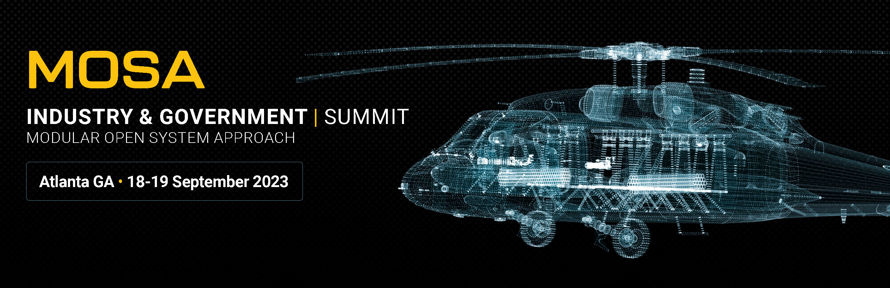
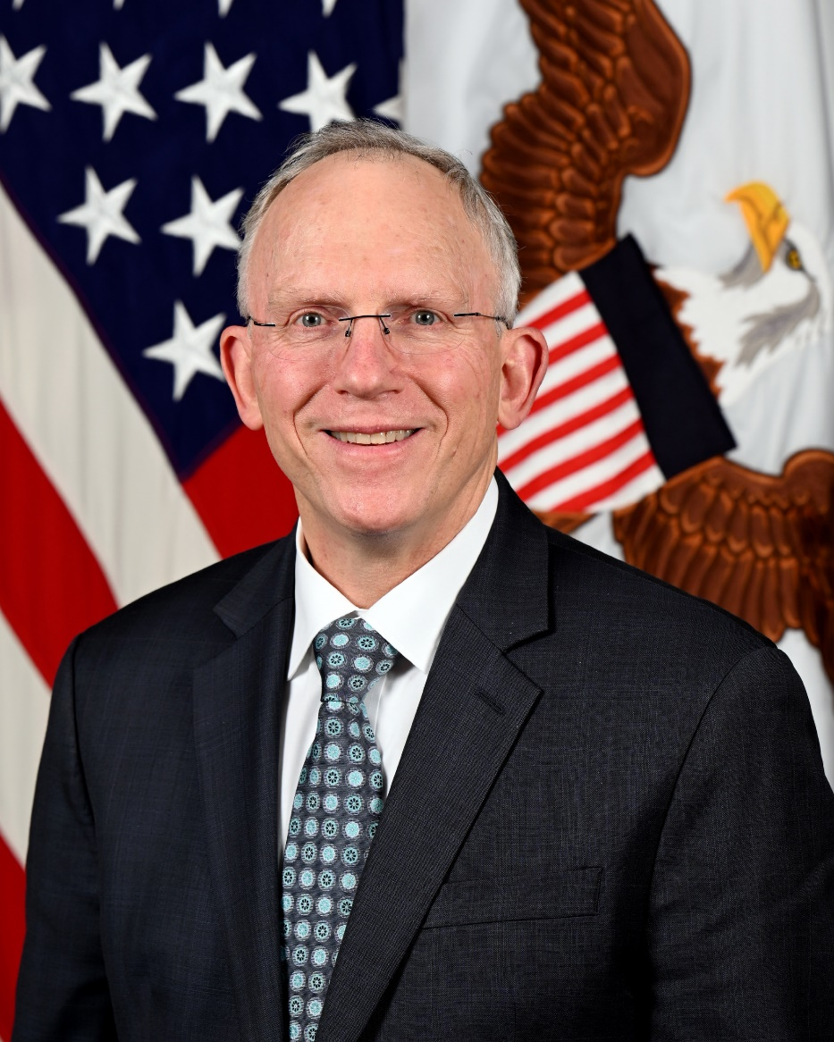

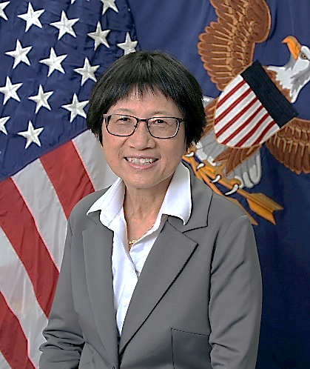
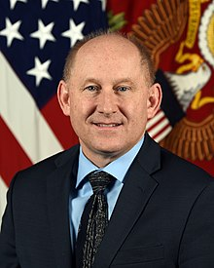
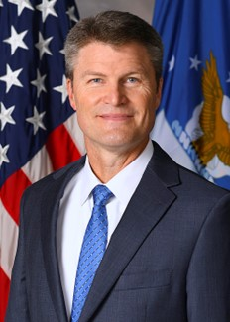
HON. NICKOLAS H. GUERTIN
Distinguished Keynote
Distinguished Keynotes
& EXPO
& EXPO
HON. NICKOLAS GUERTIN
HON. HEIDI SHYU
MODULAR OPEN SYSTEMS APPROACH
GEORGIA WORLD CONGRESS CENTER
GEORGIA WORLD CONGRESS CENTER ATLANTA
COMPLIMENTARY PASS
https://events.techconnect.org/MOSA_2023/
COMPLIMENTARY PASS
https://events.techconnect.org/MOSA_2023/
HON. JOHN WHITLEY
Mr. CHRISTOPHER GARRETT

