Slide 1
2023 Event Theme: Acquire Like You Fight
“You Fight like You Train” – Gen G. Patton Premise: in the past, train like you fight was critical. In the future, that will still be necessary yet insufficient in light of an evolutionary threat. To advance at the pace of technology relevance, we must now implement MOSA across DOD to Acquire in the way we expect the future Fight (modular, agile, across domains, and fast).

Slide 2
Keynote Speaker Slide

Slide 3
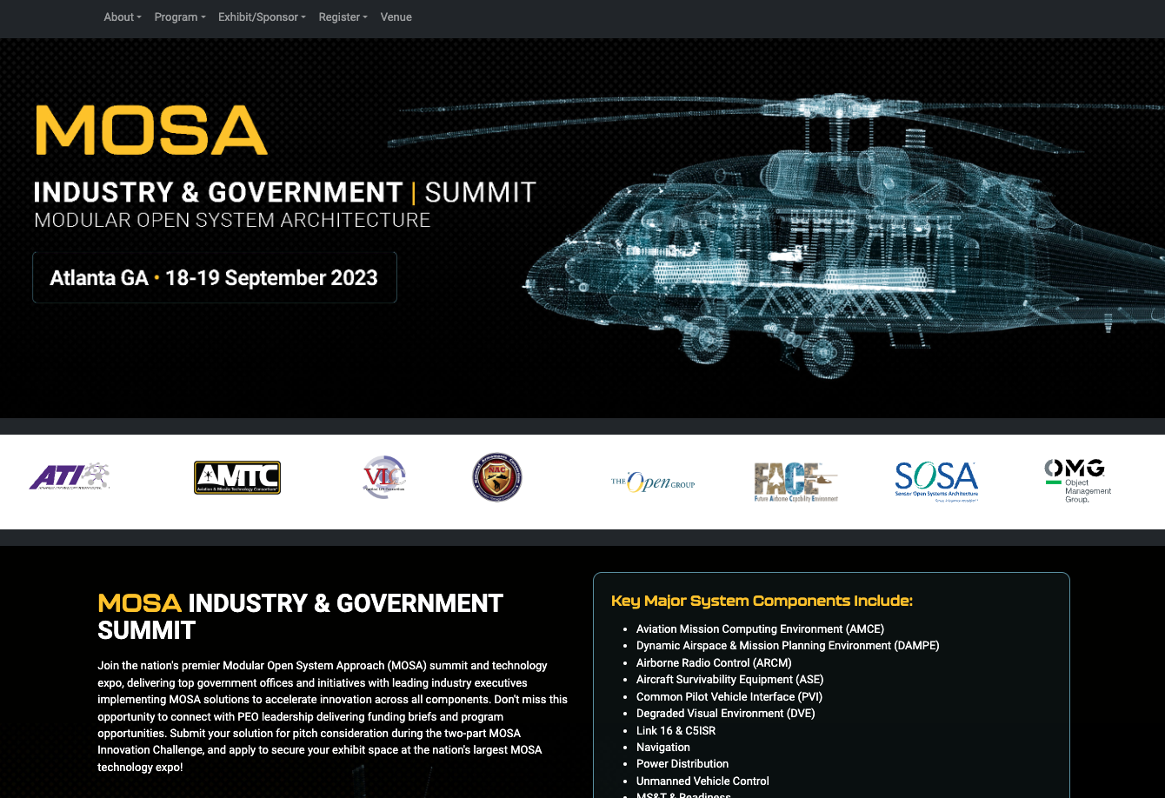
Registration Via Website
Government MOSA Demos and Exhibit Space (free 10x10 for Consortia members)
Individual Registration Free
Corporate Sponsorship is OK
Innovation Challenge
Technical Paper Tracks
Working Group Tracks

Slide 4
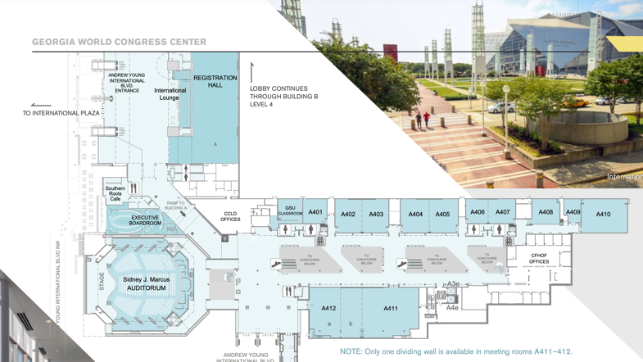
Venue: Georgia World Congress Center, Atlanta
Main Auditorium for Keynote
2 floors available with breakout rooms
Additional Expo Floor space available
Reception / food and beverage provided

Slide 5
Catalyst: Army Aviation
History of Open Systems Demos and Program Adoption
MOSA Transformation as a PEO Enterprise Initiative
Expanding to All Domains

Slide 6
Modular Acquisition
Sharable Models
Budget Flexibility
Component Level Specifications
Program Lifecycle Alignment
Vendor Ecosystem Involvement

Slide 7
What’s Next?
Volunteer for Agenda Planning Team!
Tiger Teams to support (affect real policy changes actionable this cycle)
Technical Tracks (Avionics, Communications, Computing Environments)
Plan for travel to Atlanta (Tech SMEs, Sr. Leaders, PM & Deputies, etc.) SEND MULTIPLE PEOPLE (parallel tracks)
Industry Voice: Sr. Leader Engagement on actionable policy changes, get your industry partners / CEOs there (BD is secondary here)
Product Presence: 10’x10’ Exhibit Hall Tables FREE Booth* for sponsoring consortia members and government organizations!

Slide 8
Questions?

