Slide 1
OMG Model-based Acquisition (MBAcq) User Group: A Government & Industry Collaboration Reference Architecture and Patterns NDIA Brief 2/22/2024
Laura E Hart laura.e.hart@lmco.com
MBAcq UG co-chair/OMG UAF co-chair
Jan 28, 2024

Slide 2
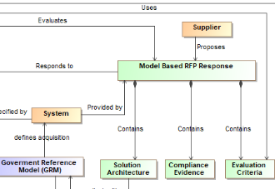
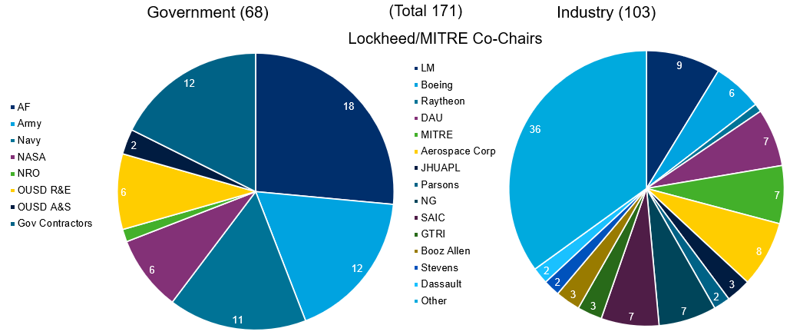
Model-Based Acquisition (MBAcq) User Group Introduction
About MBAcq
Why MBAcq Matters
Model-based acquisition is the Technical approach to acquisition that uses models and other digital artifacts as the primary means of information exchange, rather than document-based information exchange.
Customers are increasingly specifying MBSE in RFPs
Customers are increasingly requiring models in proposals
Lack of standardization raises proposal learning curves & compliance risk
Model Based Acquisition will be disruptive
Increased interest to organize around the MBAcq UG to define and standardize approach
Broad government and industry participation
Gov & Industry have an opportunity to shape future MB Acquisitions & Compliance together
Participation
Expected Timeline
OMG MBAcq User Group
2022: Formed Team & Framework
2024: Q2 Govt Ref Arch
2024: Q4 Acquisition Users Guide
Q2/3 DAU Acquisition Training
Q4 Acquisition Model Example
Ongoing: Curate and Create Reusable Content
(Reference Architectures, Domain Overlays, …)
Is a broad industry body with participation from OMG, INCOSE, Armed Services, OUSD, DoD CIO, NDIA, DAU, FFRDCs and many industry suppliers such as Boeing, Northrop Grumman, Lockheed Martin, etc. working together to create the standards and guidance to successfully deploy MBAcq to the larger community.
Last updated 6/9/2023
For more information contact:
laura.e.hart@lmco.com
rahaselden@mitre.org
toni.m.nolder@aero.org
Full lifecycle should be addressed during Acquisition!
Notes:
OMG MBAcq User Group, is a broad industry body with participation from OMG, INCOSE, Armed Services, OUSD, DoD CIO, NDIA, DAU, FFRDCs and many industry suppliers such as Boeing, Northrop Grumman, Lockheed Martin, etc. working together to create the standards and guidance to successfully deploy MBAcq to the larger community.
There is value in the thinking itself and the resulting discovery/decisions aside from the value of the results that manifest in the artifact (e.g. the architecture model)
Most would recognize this in the creative process / innovation, discovery of new ideas, rationale for decisions, including:
The intellectual analysis and synthesis of the core solution concepts and characteristics long before they are synthesized into an architecture model.
The rationale behind any decision, especially the selection of a specific solution concept or product/technology
To not embrace the value of this eliminates the ability to recognize one of the key sources of change – when one of the reasons for the selection changes – say mission circumstances/threats or technologic behavior
When they change the solution often has to adapt or change
Model-based acquisition is the Technical approach to acquisition that uses models and other digital artifacts as the primary means of information exchange, rather than on document-based information exchange.
MBAcq incorporates modeling in acquisition, improving evaluation, engineering, and governance, leading to better system solutions
Voice Track: Weapon systems are becoming too complex and too fluid to describe through traditional means (i.e. requirements specs). Also, systems need to interoperate, so their structure and interfaces need to be specified as well. MBAcq is not just a proposal packaging choice.

Slide 3
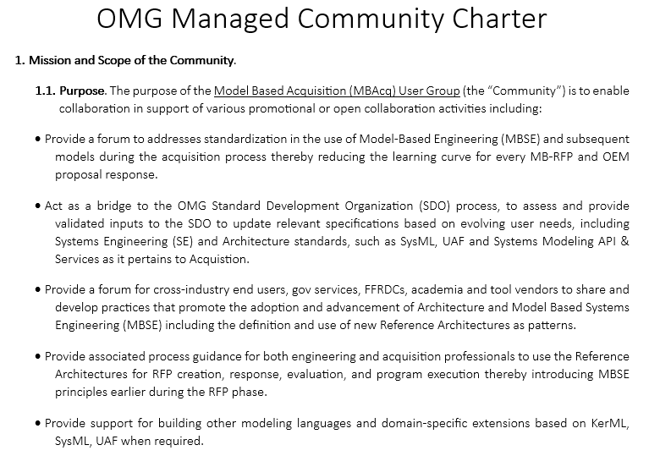
MBAcq User Group is an OMG Managed Community
Approved by the OMG BOD 26 September 2023 as an enduring OMG Entity
Founding Members
Lockheed Martin (Laura Hart)
The MITRE Corporation (Rae Anderson)
The Aerospace Corporation (Toni Nolder)
Approved by the OMG BOD 9/26/2023

Slide 4
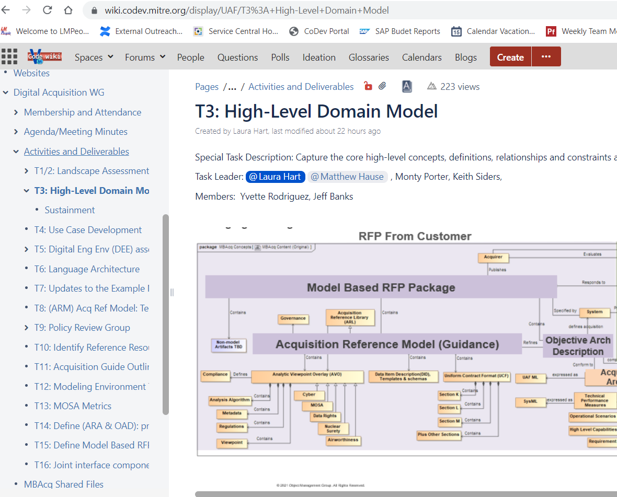
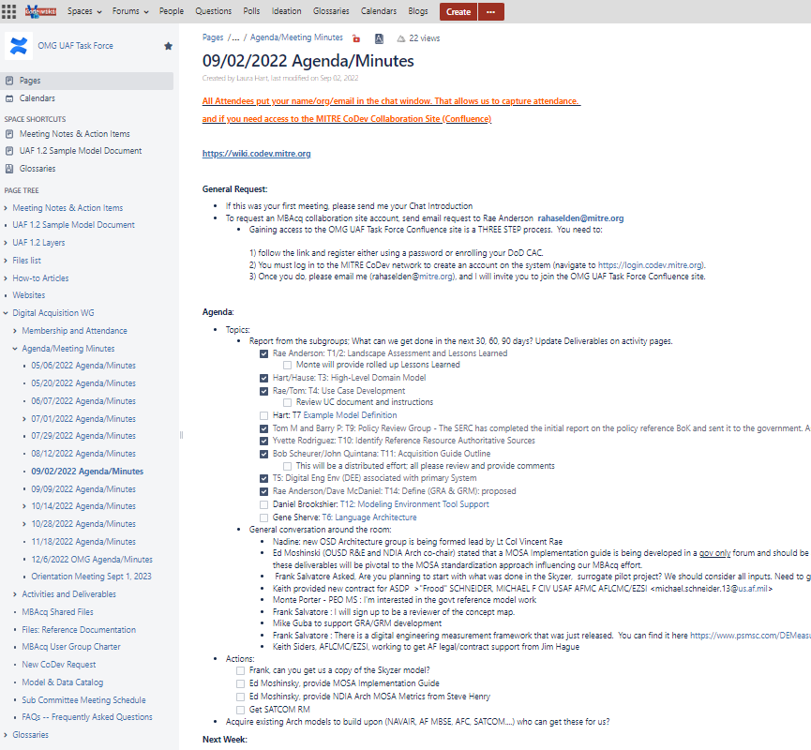
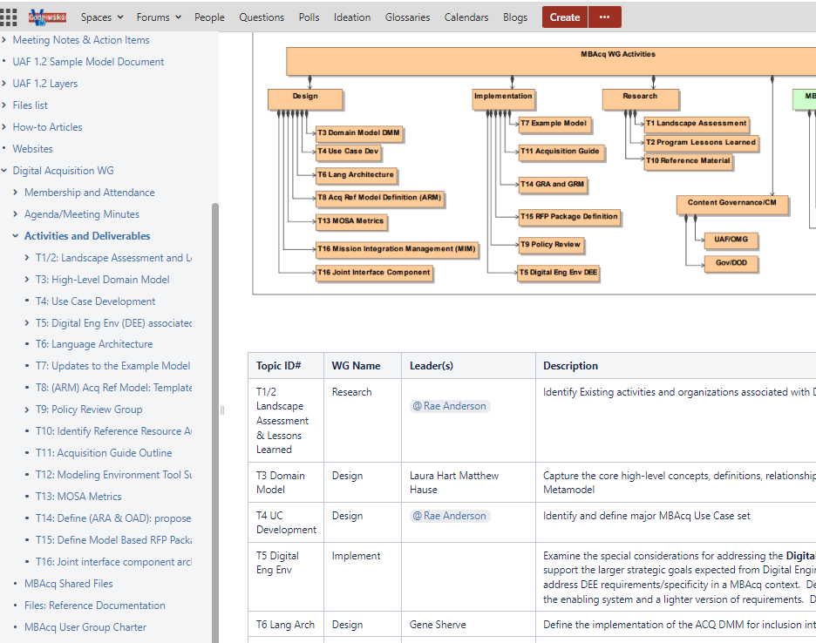
Collaboration and Transparency in an Open Env
Transitioning Knowledge Repository to OMG MC Platform

Slide 5
https://communities.omg.org/workgroup/index
Object Management Group Announces Model-Based Acquisition User Community Community influences the future of Model-Based Systems Engineering specifications and architectures -January 18, 2024
https://www.omg.org/news/releases/pr2024/01-18-24.htm
OMG Q1 Conf in Reston VA 3/18- 3/22 https://www.eventbrite.com/e/omg-model-based-acquisition-user-group-community-q1-2024-meeting-registration-817420204837
UAF Summit (Free) 3/20 https://www.omg.org/events/2024Q1/special-events/UAF-Summit.htm
Notes:
Please be sure to register for the Monday MC meeting. If you are also attending the OMG SDO meeting, you still should register but get a special code to attend without charge. https://www.eventbrite.com/e/omg-model-based-acquisition-user-group-community-q1-2024-meeting-registration-817420204837
MBAcq will be meeting Monday, 3/18/2024 at OMG. Link to MBAcq Agenda was just provided. I will update this week: https://communities.omg.org/wg/MBAcq/dashboard
Wed is UAF summit https://www.omg.org/events/2024Q1/special-events/UAF-Summit.htm

Slide 6
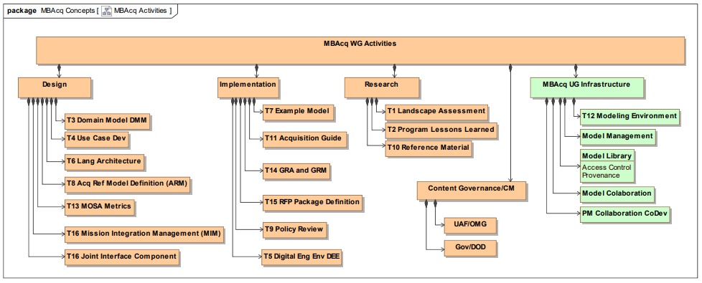
MBAcq – UG Activities

Slide 7
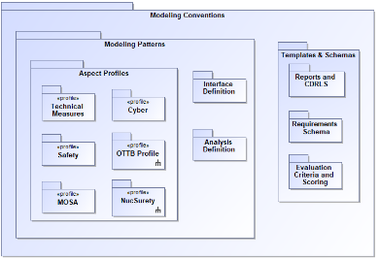
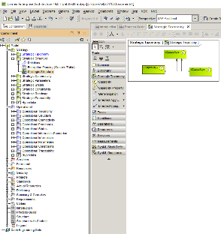
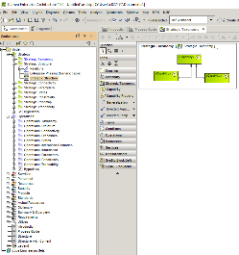
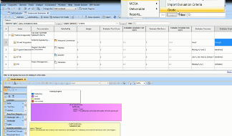
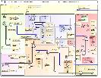
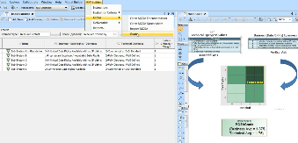
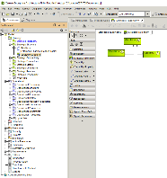
Model-Based Acquisition
1. Architecture Acquisition Guidance (AAG)
2. Objective Architecture Description (OAD)
3. Model-based RFP Package
Domain Overlay Profiles
AAG &
(OAD)
Populated with Program
& contract Data
← 4. Unified Architecture Framework (UAF) Process Guide for Acquisition →
Supports DoDAF
1. The AAG provides model structure for RFP content and evaluation tools:
Modeling Patterns
DO Profiles (i.e. MOSA, Data Rights, certs )
Interface & Analysis Definitions
Templates & Schemas
Evaluation Criteria & Scoring (Section K, L, M)
Reports & CDRLS
2. The OAD is a descriptive model containing the program requirements, constraints and context
High-level Capabilities, mapped to Operational scenarios, traced to requirements (e.g. CDD, SRD, Conops)
Technical performance measures (i.e. KPPs, KSAs, MOEs..)
Any required architectural partitioning including structural and functional
(Based on UAF acquisition process guide and template)
3. The Model-based RFP model contains the populated OAD&AAG providing RFP evaluation content, CDRL definitions for documentation generation and scoring tools for solution validation and evaluation
4. UAF Process Guide provides the Acquisition Guidance for using the OAD and AAG template to create, respond and evaluate a Model-based RFP.
® 2021 Object Management Group. All Rights Reserved.
SOURCE: Laura Hart, MITRE 2017

Slide 10
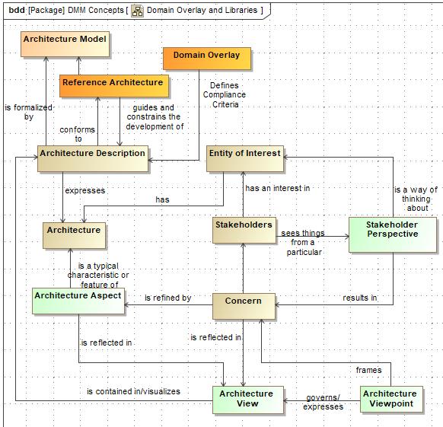
Standardized Concepts for Reusable Content
ISO 42042 Concepts(in work)
Additional Concepts
ISO 42010 Concepts

Slide 11
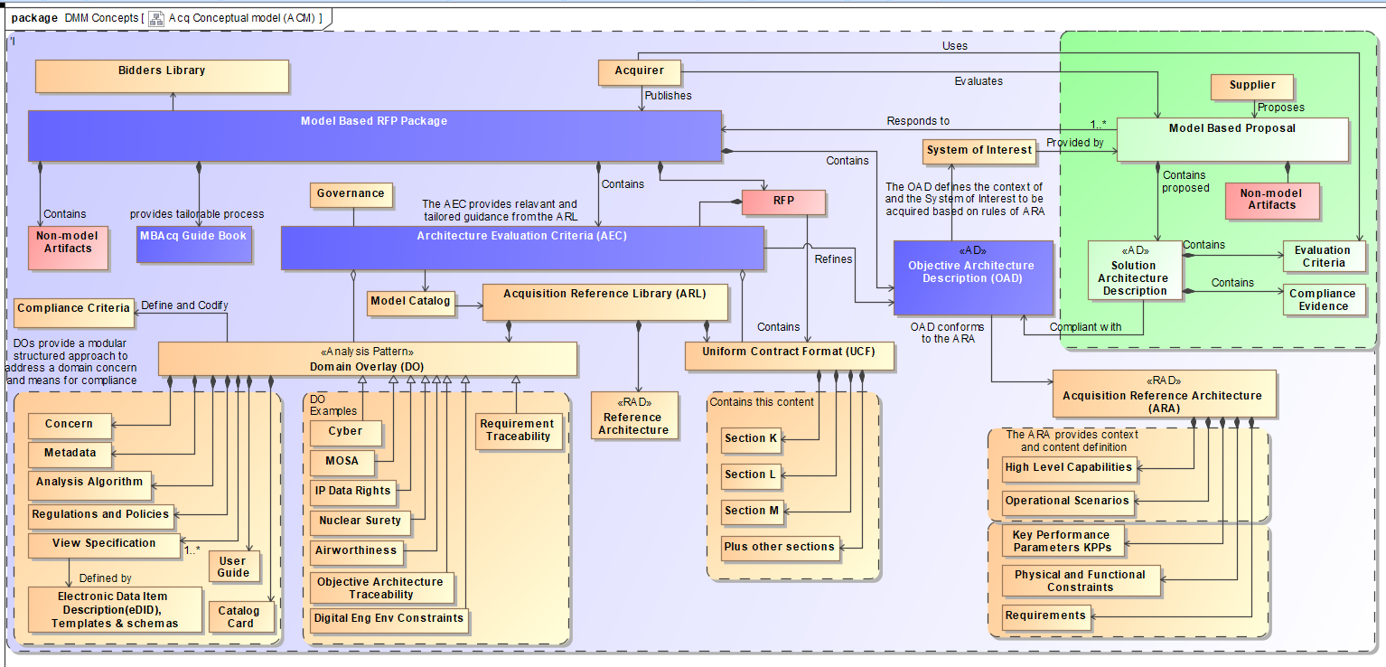
MBAcq Future State
Bringing it all together!
RFP from Acquirer
Response from Supplier
The OAD is the GFI model & Logical AD that will be referenced as a specification
A Domain Overlay is a modular structured approach to address a domain concern and means for compliance
These are examples of DOs
The ARA defines the information required by any particular OAD
Sections of the ARA could reference other specialized RADs (i.e. air veh RAD)

Slide 12
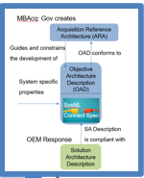
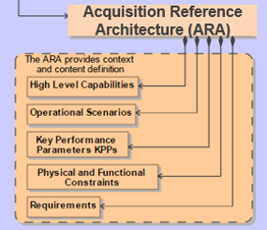
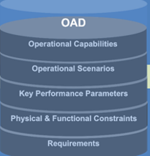
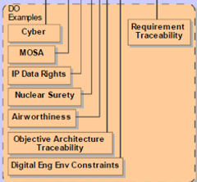
Usage of Standardized Concepts (2)
The OAD is the GFI model & Logical AD that will be referenced as a specification
Library of Product Ref Architecture Descriptions used to guide solution AD response
<<RAD>> Product Ref Arch
1..*
<<RAD>> Product Ref Arch
<<RAD>> Product Ref Arch
<<RAD>> Product Ref Arch
The ARA defines the information required by any particular OAD
A Domain Overlay is a modular structured approach to address a domain concern and means for compliance
Sections of the ARA could reference other specialized RADs (i.e. air veh RAD)
Example, AF AV RAD

Slide 13
Definitions
We make a distinction between a Reference Architecture Description and an Architecture Description that is being “referenced” such as the OAD.
A reference architecture description (RAD) is a set of templates, models, or document sets that provides common concepts, vocabulary, reusable designs, best practices, and standards for a domain or a category of solutions¹²³⁴⁵. It is used to organize and guide how to apply specific patterns and/or practices to solve particular classes of problems related to domain concepts²⁴. It defines the fundamental components of the domain and the relations between them⁴⁵.
Summarized from 5 sources and the web with modifications leh-10/2/2023
Acquisition Reference Architecture (ARA:) (Description) Common guidance and constraints to start the development of a specific (OAD) Objective Architecture Description. Set of reusable model conventions, patterns, profiles, schemas, and templates used to govern model-based RFP activities, artifacts, and system lifecycle. Think of it as the rules for providing the system specific properties for defining an OAD.
Objective Architecture Description (OAD): Descriptive model containing the requirements and constraints for the system to be acquired as tailored from the Acquisition Reference Architecture (ARA) and a chosen set of Domain Overlays. Tailored integrated set of model patterns a program provides in a request for proposal and on contract, in model form, that they want responded to in model form, as a solution architecture description, including digital traceability back to the OAD.
Domain Overlay (DO): A pattern and collection of constructs needed to support analysis of a domain specific concern using a standardized approach.

Slide 14
Using the General Concepts

Slide 15
Standardized Concepts for Reusable Content
Model Libraries
Reference Architecture
Domain Overlay

Slide 16
Domain Overlay (DO) Lifecycle - animated
Framing the Analysis
Why & What is needed
Creating the DO
Package for reuse
1
2
Identify the concern
Create new stereotypes, properties and associated value types to label architecture elements
Certification of a nuclear system, cert plan, verification
<<Critical Function >> {Authorize, SW, high}
Define View specification content
Create a new extended requirement type with additional properties used for reasoning
Identify the associated compliance documents.
(AFI 91-107, AFI 91-118, AFI91-119…)
<<Nuc Surety Requirement>>
Parse and Import as extended requirement elements. Provide additional extended data
Identify the properties needed to support analysis
Critical Functions, Safety Category, SW/HW/FPGA/Operational
Parametric diagrams, constraint blocks, and scripts can be used to capture the rules on how various SW, HW, firmware, and processes are evaluated, tested, and certified.
Identify the logic or processing needed to support analysis
Create View specifications (electronic DID for visualization)
Using a Packaged DO
acquire/supplier may use differently
Nuc Surety test plan, Validation Matrix
3
Create documentation & Users Guide on DO usage
Apply DO stereotypes to Architecture Model as directed
Evaluating the Results
<Critical Function>> Launch Console
Provide additional attribute values
4
Execute analysis, review populated views. Follow guidance for success criteria.
Crtitical function = Launching
Type=SW; Safety=3
*DO is a pattern for creating modular profiles
Notes:
Identify the concern; in this case, the certification of a nuclear system
Identify the associated compliance documents. (AFI 91-107, AFI 91-118, AFI91-119…)
Identify the additional properties needed to support analysis.
Critical Functions, SW/HW/FPGA/Operational, Safety Category..)

Slide 17
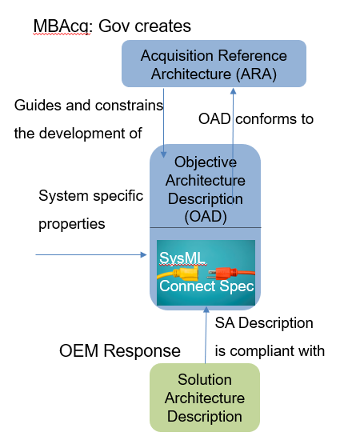
Defining Guidance!

Slide 18
MB Acquisition Summary
MBSE can be inserted earlier in the acquisition lifecycle to facilitate agile response to change during the acquisition lifecycle and beyond.
Government enterprises can respond to opportunities and risks grounded in well-formed models based on data driven decisions
Formalize the development, integration, and use of models to inform enterprise and program decision making.
Existing processes will need to be examined to determine where and how MBE/MBSE can be inserted, adopted and improved.
Prototype processes to determine which work best, find issues, and socialize results.
Stable mature patterns can be incorporated into existing standards/frameworks such as UAF, SysML
New patterns can be considered as an independent standards
MBAcq is not just a Proposal Packaging Choice. It’s about applying Effective SE practices!
Focus on Solutions Instead of Reinventing Modeling and Process!
Moving towards “Born Digital”

Slide 19
Reusable Assets and Model Curation

Slide 20
Standardized Concepts for Reusable Content
Model Libraries
Reference Architecture
Domain Overlay

Slide 21
Model/Asset Reuse: The Problem
So, we need to share, search for, find (hopefully), reuse, publish, update, notify, trust, protect, etc.:
Models
Model Libraries
Reference Architectures
Components
Interfaces
Types
Patterns
Keywords
Solution Elements
Etc.
What is the solution to this?

Slide 22
Model Curation
“If we build it, they will come.” Field of Dreams
However, “they” need to know that “it” exists.
For a library to be of any use, people need to know where it is, be able to enter it, search through a catalog system, check out the elements that they need, and suggest new items to be added. Regarding model reuse, most organizations have a hidden library that few people know about, with no doors, card catalogue or search capability, where you can’t check out or add any objects. We need a solution for model curation.
Notes:
The OMG RAS was published in 2005 and provides a means of categorizing assets for reuse.
The PTC Asset Library is the only implementation the authors are aware of that is still in use. It does not provide a complete curation solution.
Other Solutions?

Slide 23
A Few Requirements – NOT A COMPLETE LIST!!
Standard API – Extended SysML v2 API?
Multiple libraries with access control
Permissions at multiple levels - Library, Element, etc.
Role-based permissions – Curator, user, creator, owner, etc.
Configuration management of libraries, elements, patterns, ref architectures, etc.
Search capabilities using keywords, types, purpose, domain, etc.
Support for Vendor independent/dependent data formats
Support for UML, SysML, UAF, etc.
Support for non-UML tools (future?)
Local, Department, Enterprise, Global, etc. hosted libraries
Black box & White box sharing
Interest registration
Update notifications
Global element ID’s – the same component in multiple models has the same ID
Etc.

Slide 24
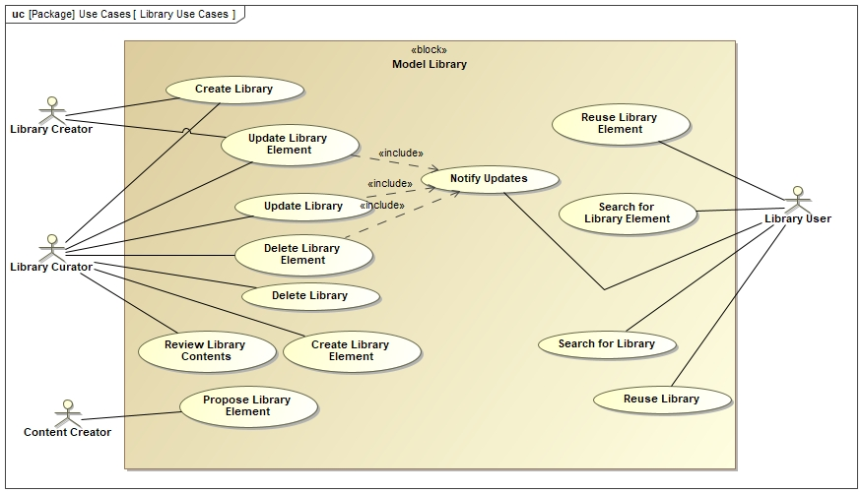
A Few Model Library Use Cases – NOT A COMPLETE LIST!!

Slide 25
Modeling Concerns as Requirements: Another Example
Example of model library content creation

Slide 26
Airworthiness Domain Overlay
Example of Standards Alignment

Slide 27
Airworthiness Domain Overlay
Providing clarification

Slide 28
Questions?

Slide 29
Backup

Slide 30
MBAcq: RFP Preparation and Planning
RFP Preparation
RFP Response
Contract Execution
Operational
RFP Evaluation
RFP
Award
During RFP Preparation and Planning phase, the acquirer (GOV) can use MBAcq process to:
Get a clear understanding of the system being acquired through the creation of the Objective Arch Description (OAD) addressing:
Operational context, capabilities, requirements, constraints…
Determine what information will be needed for evaluation & validation of a supplier response such as:
MOSA, Certification properties, Data Rights, KPPs
Determine and codify the supplier instructions expected for a model based response in the Arch Evaluation Criteria (AEC)
Use of gov furnished profiles (Domain Overlays), and supplier guidance
Determine any implications to contract language (i.e. Tagging a component with certain data rights)
Communicate the RFP content unambiguously to the supplier with a precise RFP Model (handoff or collaboratively)
Identify what is needed, know where to find it, how to use it and how to evaluate it!

Slide 31
MBAcq: RFP Response by Suppliers
RFP Preparation
RFP Response
Contract Execution
Operational
RFP Evaluation
RFP
Award
During the RFP Supplier Response phase, the supplier will use the MBAcq process to:
Get a clear understanding of the system being acquired within the operational environment context
Respond to the RFP with supplier value added approach supporting analysis
Get a clear understanding of expected modeling response using the provided Arch Evaluation Criteria (AEC)
Utilize built-in self evaluation methods to support compliance
Focus is on Response and less on process mechanics

Slide 32
Modular Open Systems Approach (MOSA) Evaluation
Modular Open Systems Approach
NDIA Paper July 1, 2020
Notes:
The MOSA attributes are still being defined. Table driven properties make it easy to modify or add additional metrics. Will update these metrics based on final outcome of NDIA Architecture working group.

Slide 33
MBAcq: Evaluation (Supplier/Gov)
RFP Prep
RFP Response
Contract Execution..
Operational
RFP Evaluation
RFP
Award
During RFP Evaluation phase, the Supplier & GOV can use MBAcq process to:
Assist the evaluation process for compliance and scoring using built in evaluation criteria
Assist in the assessment of key concerns such as MOSA, Security, survivability though the use of Domain Overlays(DOs) provided in the Arch Evaluation Criteria (AEC)
Capture scoring and rational with standard metrics for future evidence
Grading Rubrics and Scoring are captured in the Model

Slide 34
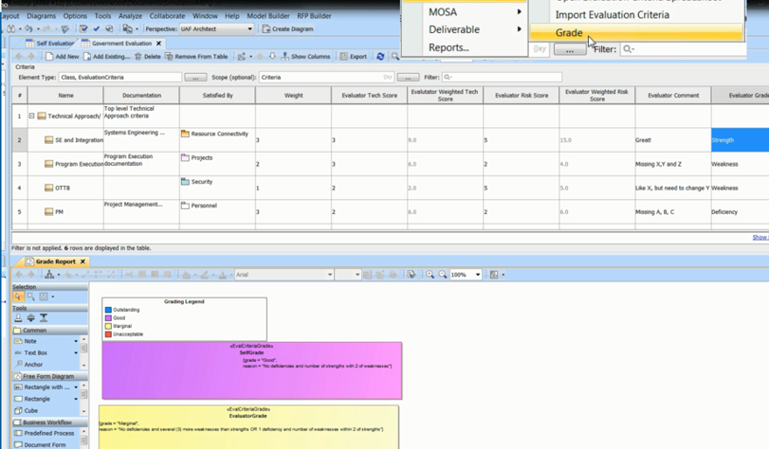
Evaluation Criteria are Represented as Model Elements and Graded

Slide 35
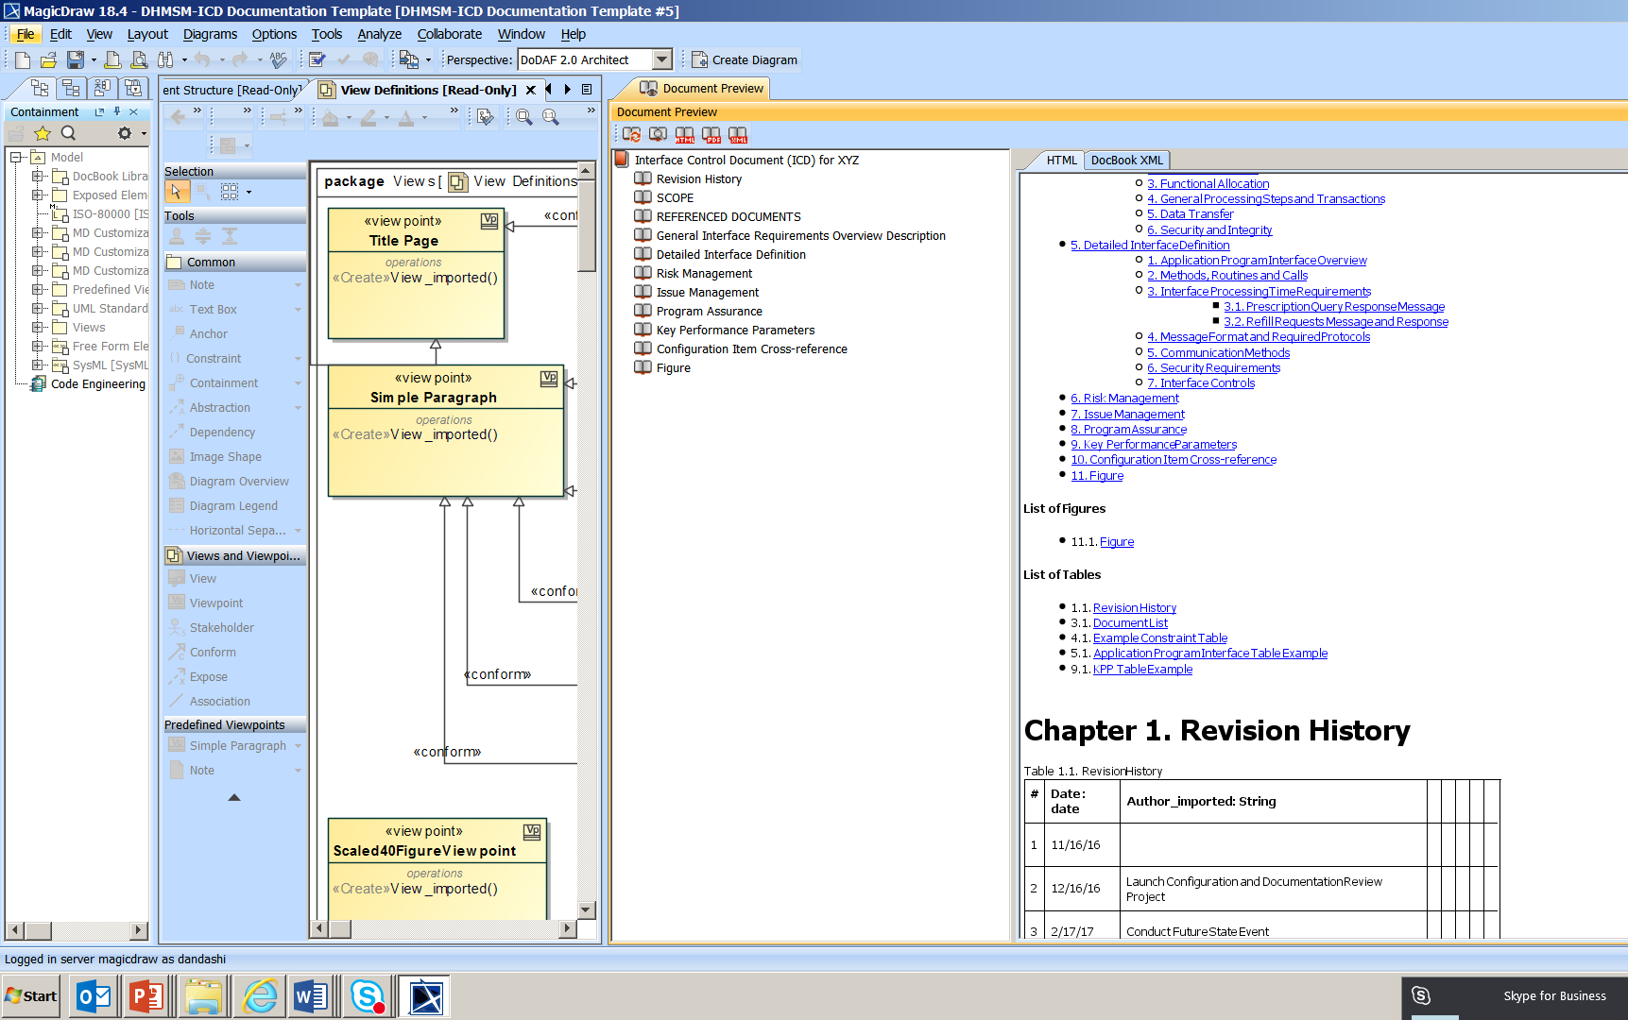
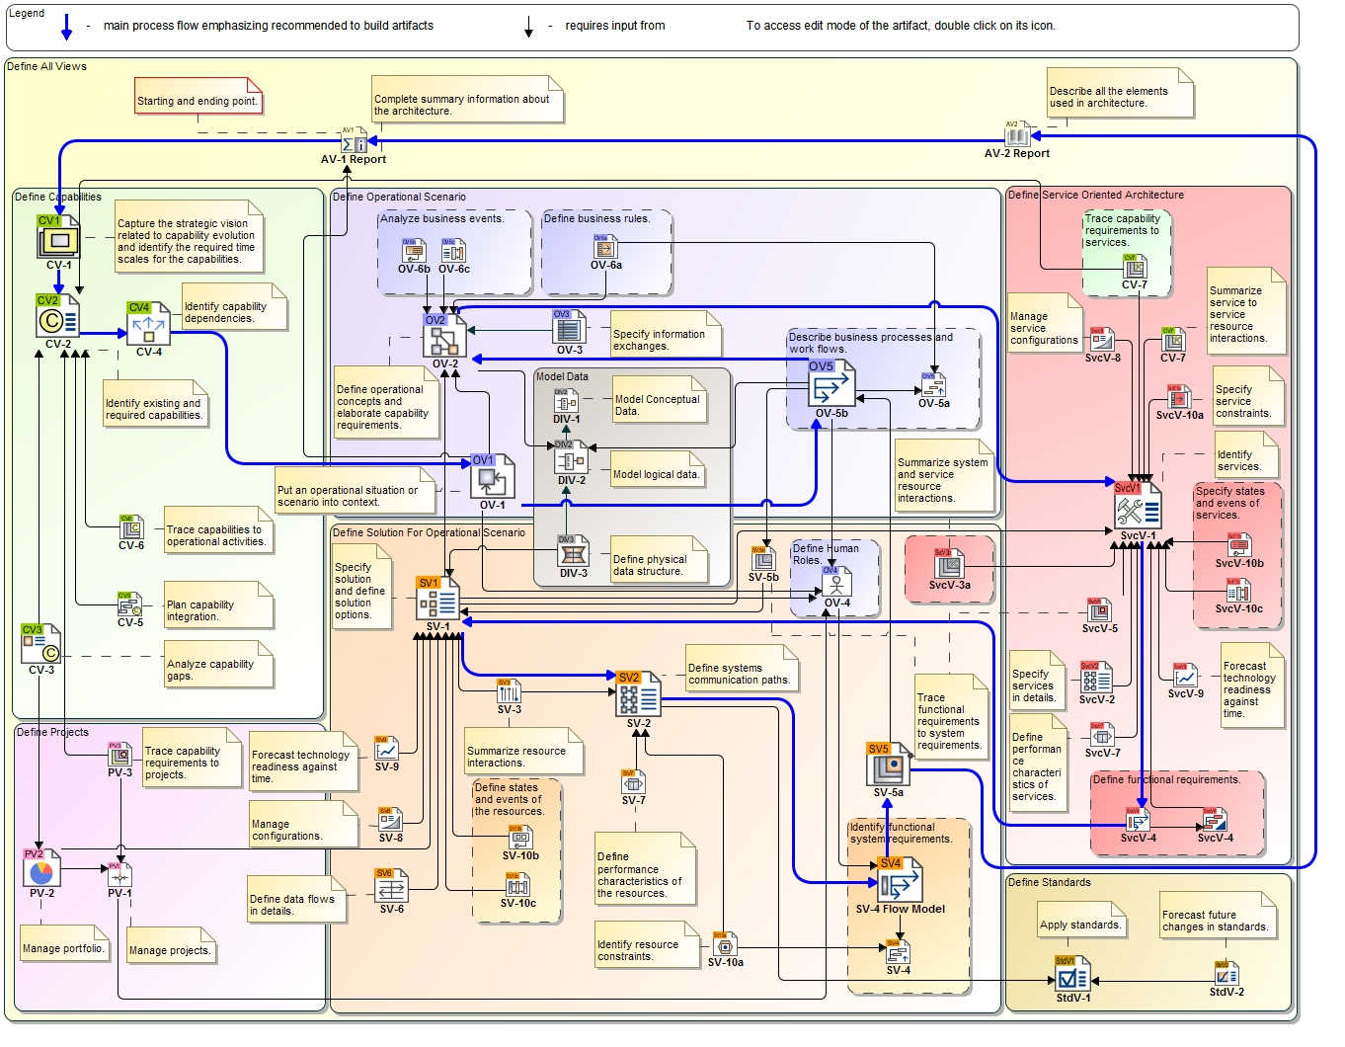
Document Generation from Model
Define Reusable document templates (CDD, AoA Plan…)
Generate Required Documents
and Reports
Copyright © 2016, No magic
(Source: Laura Hart, MITRE 2017)

Slide 36
Document Generation

Slide 37
Generated Document Content

Slide 38
MBAcq: Contract Execution
RFP Prep
RFP Response
Contract Execution
Operational
RFP Evaluation Contractor/Gov
RFP
Award
During the RFP Contract Execution phase, the GOV will use the MBAcq process and evolving model(s) to:
Collaboration with suppliers
Monitor progress, maturity
Assess change impact and manage risks
The evolving model is a source of collaboration

Slide 39
MBAcq: Operational System
RFP Prep
RFP Response
Contract Execution..
Operational
RFP Evaluation Contractor/Gov
RFP
Award
During the Operational phase, the GOV and supplier will use the matured evolving set of models to:
Support knowledge management and training
Assess change impact and manage risks
Provide the foundation for a digital twin
Living Knowledge Repository Supporting Data-driven decisions

