Slide 1
System Engineering Division
Monthly Meeting
February 22, 2024

Slide 2
AGENDA
(all times EST)
1000 -1005 Welcome
1005 -1030 Digital Engineering Ontology (Dr. Jason Cook, U.S. Army DEVCOM)
1040 -1115 Artificial intelligence in SE (SED AI Working Group)
1115 – 1200 Model-Based Acquisition Update (Laura Hart, MBAq Working Group)
1200 – 1245 2024 Systems/Mission Engineering (SED Conference Committee)
Conference
1245 – 1300 Other/New Business/Adjourn

Slide 3
Division Goals for 2024
Lead in digital transformation in systems engineering as practiced by our Industry and Government partners
Increase Division membership at all levels, and focus on Industry member employees
Partner with more government Services, and Agencies in systems engineering
Strengthen Committee membership and participation; Support Committee Chairs and Co-Chairs in visibility for their committee activities and collaboration across the Division
Build on the successful 2023 SE&ME Conference
Build strong relationships with other SE related professional organizations/societies (e.g.: INCOSE, SERC, SISO, OMG, USAF/UAS DMM IAC etc.)
Work cooperatively and partner with other NDIA Divisions

Slide 4
Digital Engineering Ontology
Dr. Jason Cook, U.S. Army DEVCOM

Slide 5

U.S. ARMY COMBAT CAPABILITIES DEVELOPMENT COMMAND
ARMAMENTS CENTER
Armaments Center Digital Engineering Maturation:
An Ontology Based Approach
18 October 2023
Controlled by:
DEPARTMENT OF THE ARMY
Controlled by:
DEVCOM ARMAMENTS CENTER
CUI Category:
NONE
Distribution Statement:
A – APPROVED FOR PUBLIC RELEASE
POC:
JASON COOK, 973-724-4587
ENTERPRISE SYSTEMS INTEGRATION CENTER | DR. JASON l. COOK

Slide 6
Agenda
DE Background
Armaments Center DE Strategy
  Current State
  DE Maturity
  Objective solution
Army Ontology based approach
  Ontology overview (what and why)
  Introduction to Military Systems Ontology
  Army plan for MSO
  Proposed OSD adoption of MSO

Slide 7
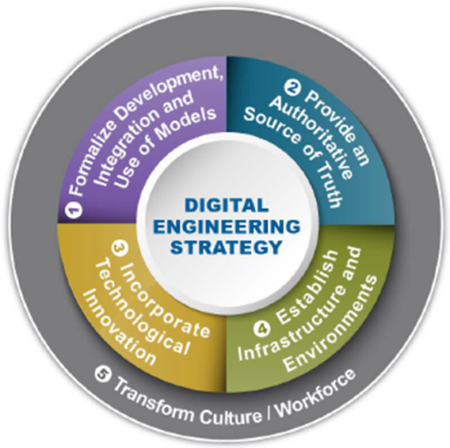
Applicable Law/Guidance
Public Law
National Defense Authorization Act (NDAA) for FY20, Section 231 (Public Law 116‐92) directs the Secretary of Defense to…establish a digital engineering capability…for the development and deployment of digital engineering models for use in the defense acquisition process…
DOD Policy & Guidance
DOD Digital Engineering Strategy, June 2018
  https://ac.cto.mil/wp-content/uploads/2019/06/2018-Digital-Engineering-Strategy_Approved_PrintVersion.pdf
DOD INSTRUCTION 5000.DE Digital Engineering Implementation, DRAFT Dec 2021
DA Policy & Guidance
Army Directive 2019-29 (Enabling Readiness and Modernization through Advanced Manufacturing), 18 Sept 2019
  Responsibilities for the ASA(ALT) include:
  Develop a digital engineering implementation plan that aligns with DoD's digital engineering strategy
  Work with the commander, AMC and Commander, AFC to write requirements for a digital thread to support system development from concept through production and sustainment, which will be developed using the Business Capability Acquisition Cycle (BCAC) process and DoD Instruction 5000.75 (Business Systems Requirements and Acquisitions)
  Assign an office of primary responsibility for the digital thread problem statement(s)
Army Digital Engineering Vision, 24 Aug 2020
Implementation of Digital Engineering throughout the ASA(ALT) Enterprise, DRAFT Nov 2021
AFC Digital Engineering Community of Practice (DE CoP): AFC OP-ORD 045-21, Aug 2021

Slide 8


Other Guiding Documents
The DoD vision for digital engineering is to modernize how the Department designs, develops, delivers, operates, and sustains systems. DoD defines digital engineering as the integrated digital approach that uses authoritative sources of system data and models as a continuum across disciplines to support lifecycle activities from concept through disposal.
Using models is not a new concept; however, digital engineering emphasizes continuity of the use of models across the lifecycle.
Expected benefits of digital engineering include better informed decision making, enhanced communication, increased understanding of and confidence in the system design, and a more efficient engineering process.
The system model should include, but not be limited to, parametric descriptions, structure, definitions of behaviors, design assumptions, internal and external interfaces, cost inputs and traces from operational capabilities to requirements and design constructs.
The system model should be captured digitally to create an integrated set of authoritative technical data, information and knowledge, generated and used by all stakeholders throughout the system life cycle.
The PM and Systems Engineer should establish, manage, control, and maintain integrated sources of all relevant models, simulations, data and other artifacts that describe what the system is and does. These data sources also should contain descriptive system information that could be used to feed other models, simulations and acquisition efforts.

Slide 9
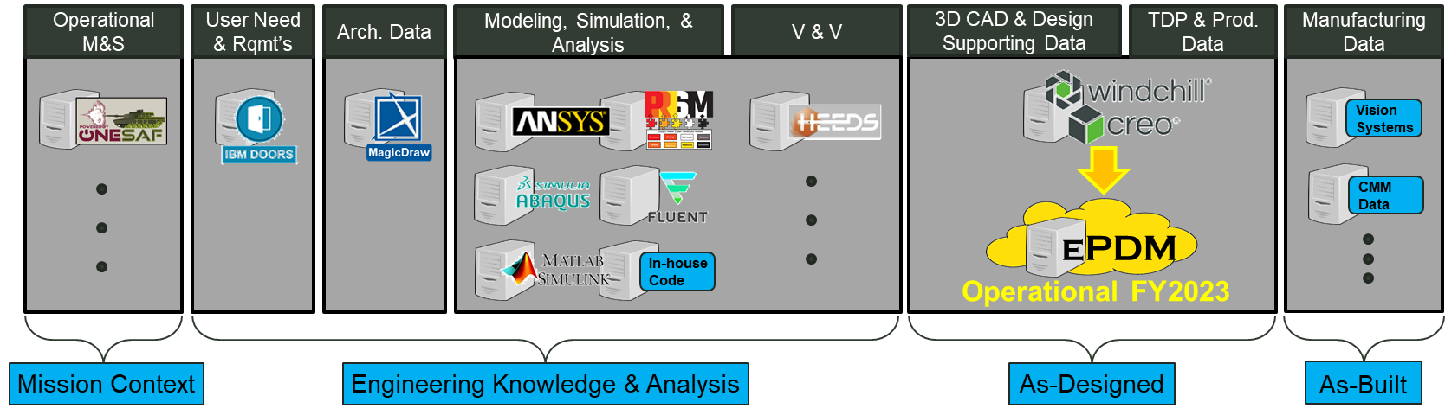
DE Ecosystem – Present State
Stove-piped engineering activities and data
Manual handoffs of engineering data and key parameters between activities and tool sets
Legend
Exploring Data Integration
Existing Data Integration
Cameo
Aras
Inefficient
  Inaccessible Data
  Inefficient Use of Time
Error Prone
  Data Transcription
  Data Validity
Ill-informed Decision Making
The Armaments Enterprise is currently exploring DE Ecosystem COTS and R&D Solutions to create a Digital Thread
Notes:
We are currently investigating three solutions:
Syndeia which completed its demo in October of this year. This demo was sponsored by the Armaments Center but via cost share, we added production specific use cases to this demo to see what the tool can do for the AAP mission
Interoperability and Integration Framework (IoIF), sponsored by the Armaments Center and developed by the SERC/Stevens, is based upon Semantic Web Technologies and Ontologies. This is the least mature as a SW product but has the most potential for long term scalability due to its open architecture. The demo is currently scheduled for January of 2023.
ARAS Innovator which is another COTS solution. We are specifically demonstrating a configuration of ARAS developed by SAIC called ReadyOne. Armaments Center has access to this via DOTC to SAIC. The demo is not currently scheduled but is targeted for late January or February of 2023.

Slide 10
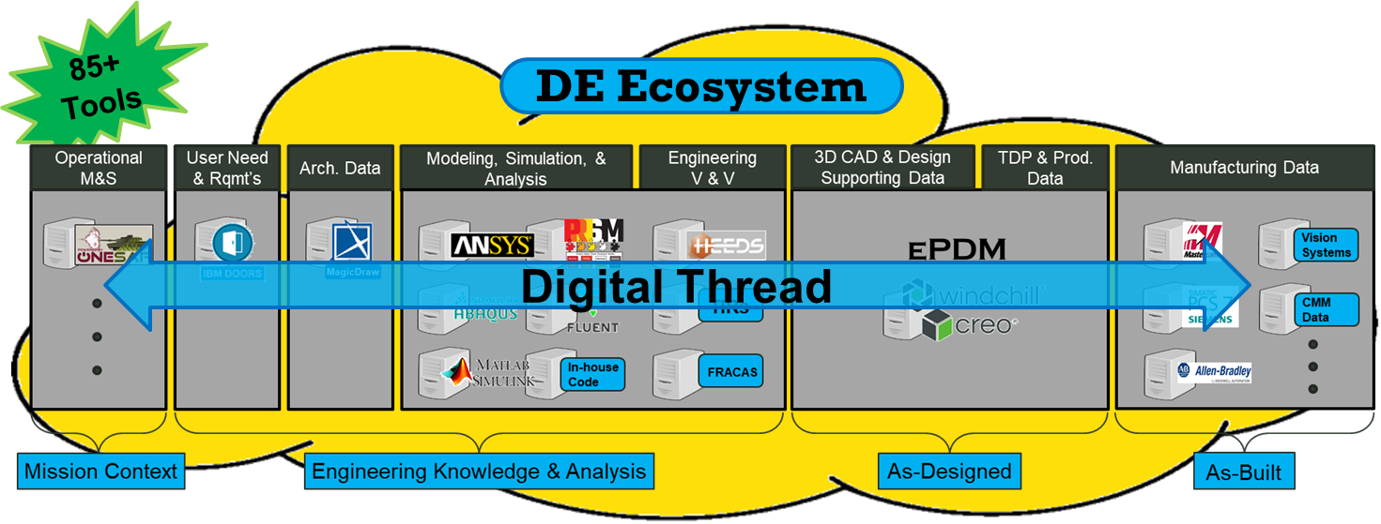
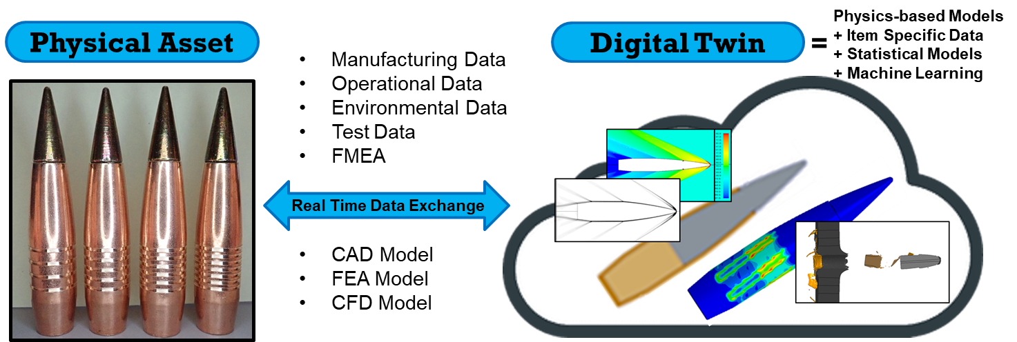
DE Ecosystem – End State
Integrated model-based approach with data, data sources, and models linked through a Digital Engineering Ecosystem providing authoritative sources of truth across the lifecycle creating a Digital Thread from requirements through “As-designed” and “As-Built” to “As-Fielded/Supported” enabling bi-directional Traceability/Impact Analysis and the Digital Twin for better informed and more efficient decision making
  Enables an unbroken flow of information that will help IPTs gain crucial insights that can inform decisions.
  Ability to trace back through the lifecycle e.g. tracing critical information from and to requirements, engineering analysis, design specifications, production data, and parts.
  Perform automated impact analyses to assess proposed changes in requirements or design.
Benefits:
Shorter cycle times & reduced cost
Improved communication & collaboration
Fewer errors, less risk

Slide 11
DE Maturity Model Levels
Standardized (2)
Automated (4)
Analog (0)
Integrated (3)
Intelligent (5)
Operations and- information is digital. Equipment is digitally controlled. Data and documents are digitized and can be searched.
Operations and information is standardized. Processes are conducted in a repeatable fashion resulting in a predictable outcome that can be reliably processed.
Equipment, tools and data are integrated. Work and information can flow between or be used concurrently by multiple process steps without manual transfer/re-entry or recreation.
Operations are automated. Information passes and triggers automated processes that result in accurate outputs to down stream processes or stakeholders
Equipment, tools and processes can perform functions automatically, discover or pre-populate new information based upon existing/aggregated information.
Digital (1)
Operations and information are analog. Drawings are flat images, documents are scanned and not searchable except for titles, authors, keywords. Data is silo’d.

Slide 12
DE Maturity Threads
Customer
Requirements elicitation
Technology
Tool usage
Internal Operations
Requirements
External Operations
Contracting
Culture
Workforce compliance
Data
Data Management
Product feedback
Training
Data Authority
Data Collection
Data Access Control
Tool integration
Tool acquisition
Support Infrastructure
Learning (AI/ML)
Security
Licensing/Maintenance
Digital Twin
Model V&V
Collaboration
Architecture Design
Detail Design
Integration
Prototyping
MSA tools
V&V
Product support
User Interface and Visualization
Production
Operations
Support
Governance
Tool diversity
Org support of Change management
Organizational processes
Worforce development
Usage strategy and practice

Slide 13
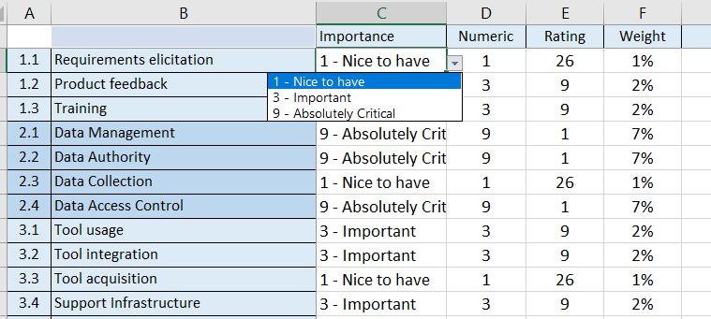
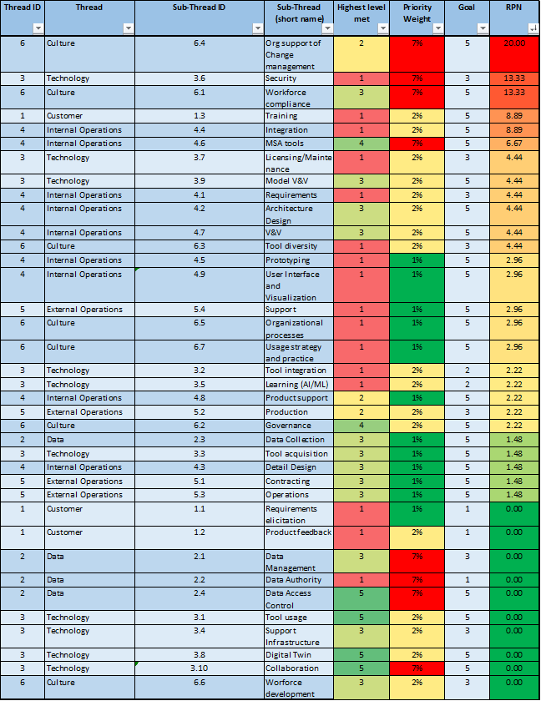
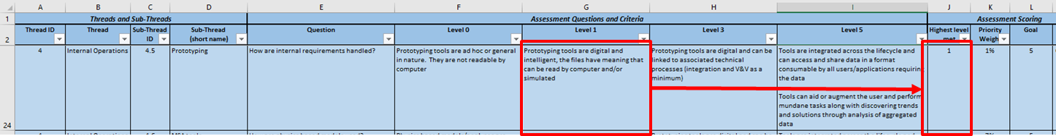
Assessment Methodology
1
Tailor criteria as needed
Assess Priorities for each criteria
Assess Current and Goal State
Review Heat Map
2
4
3

Slide 14
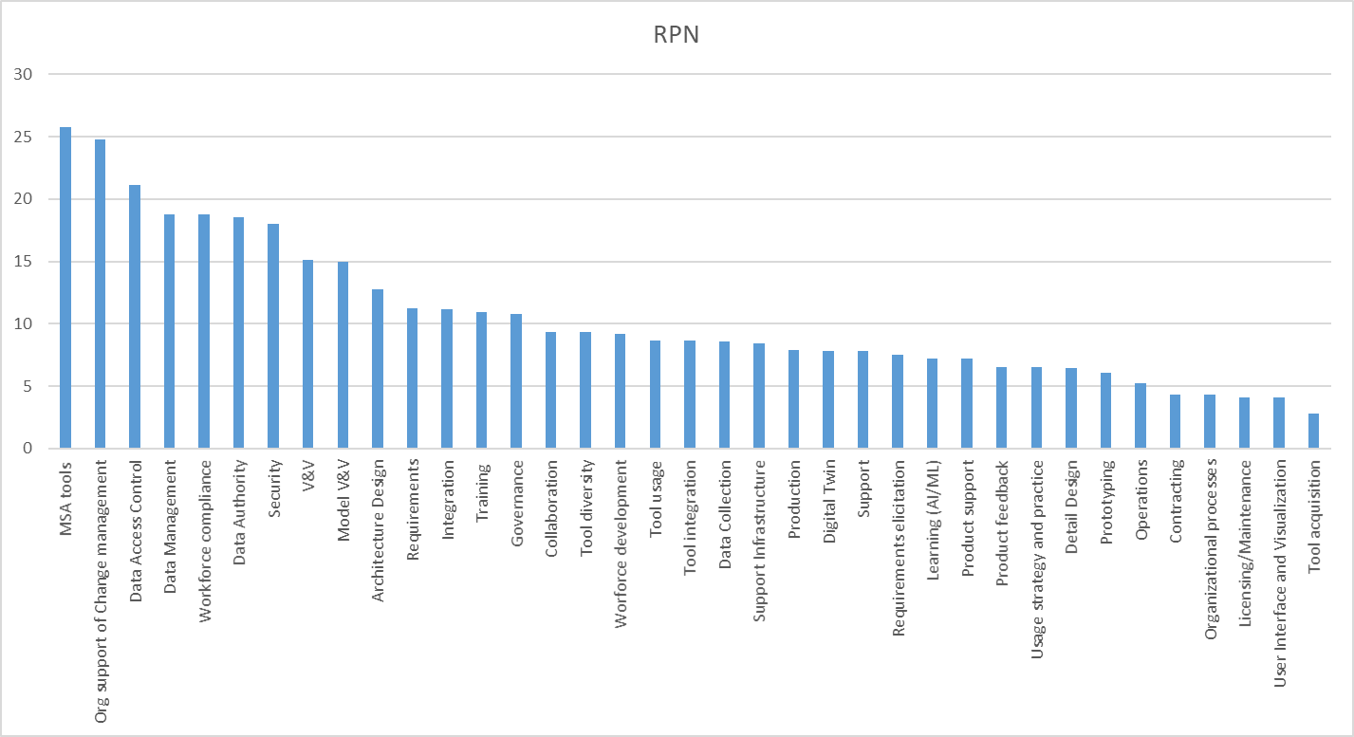
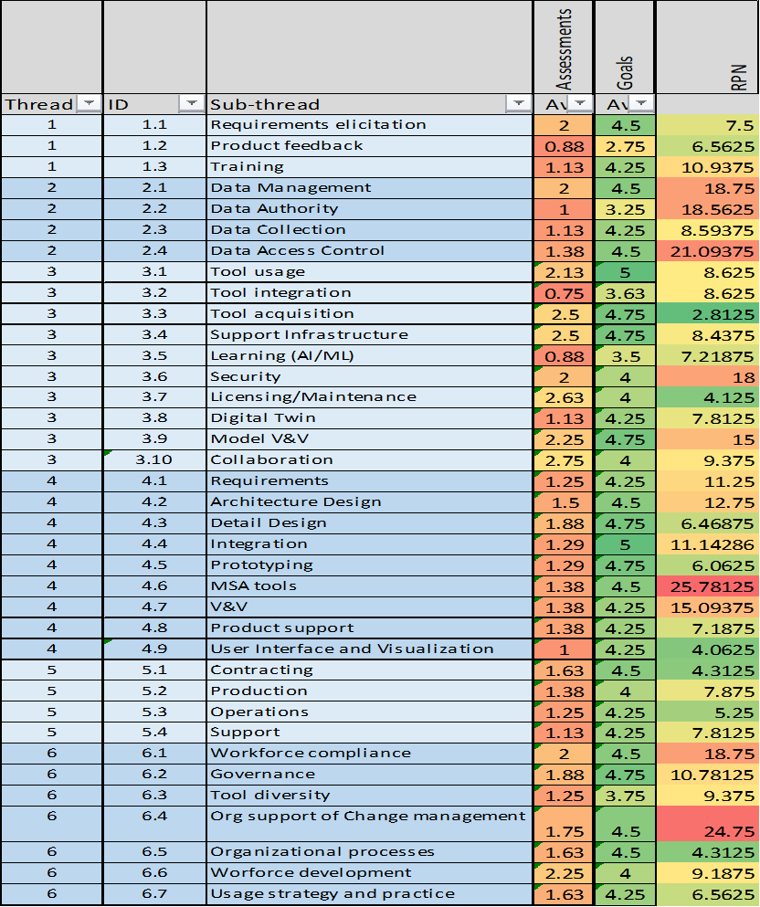
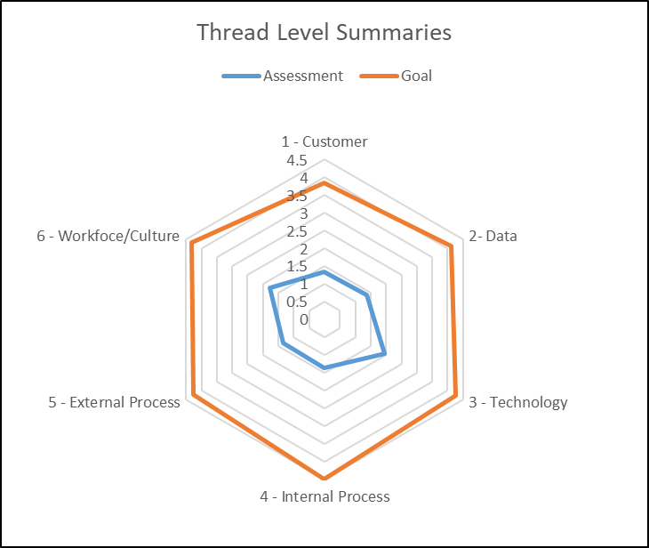
AC DE Maturity Assessment

Slide 15
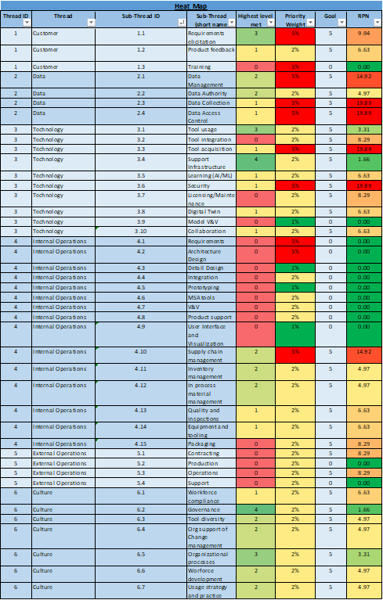
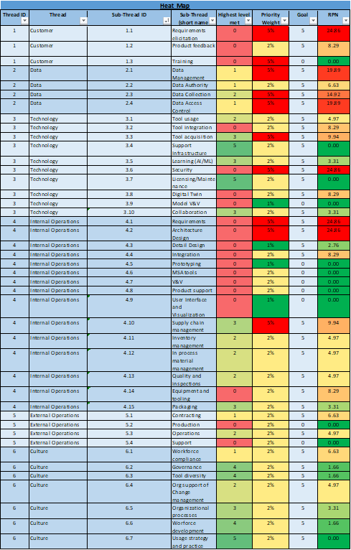
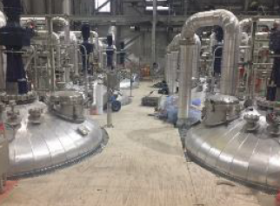
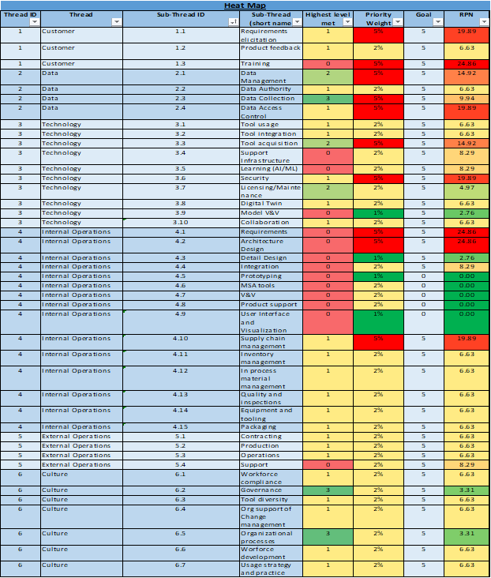
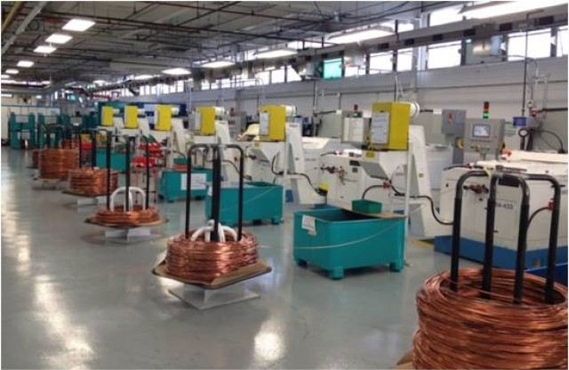
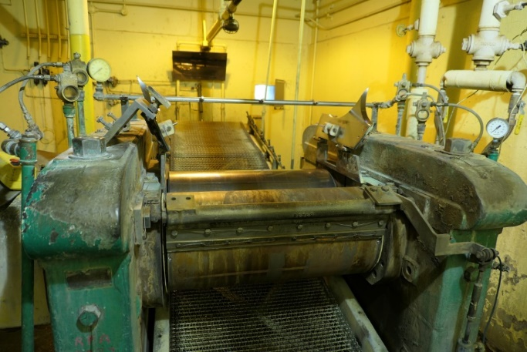
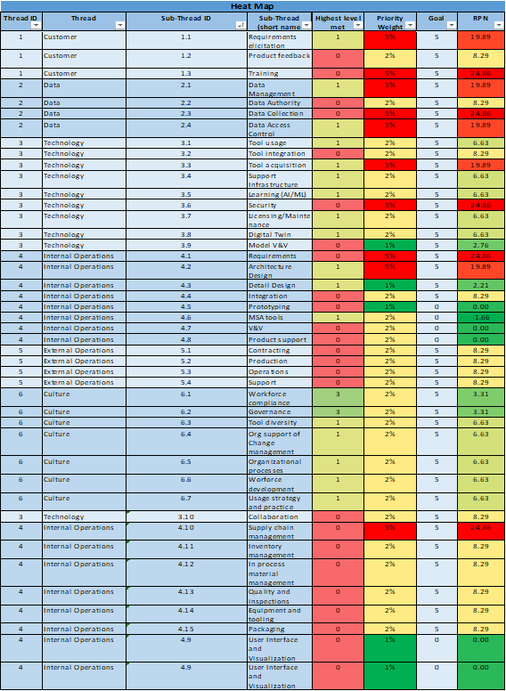
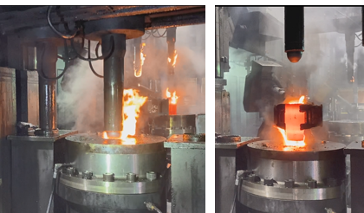
Army Ammunition Plant: DEMM Summary
Assessed Current State
5
Path Forward
HSAAP
LRPA-PF*
NGFOA*
Scranton Upgrade*
Integration with engineering and sustainment tools and models
RFAAP
3
NC Facility
Steam Facility
Integration of process and product data for advanced analytics
IAAAP
SCAMP Lines
Digitized process controls and data capture
IAAAP M795 Line
1
LCAAP
Standardized/documented processes
Automated/instrumented equipment
HSAAP Explosive Lines
RFAAP Propellant Lines
SCAAP
Product Serialization
Continuous variable inspections
Digitization of inspection data
SCAAP M795 Line
0
*goal levels

Slide 16
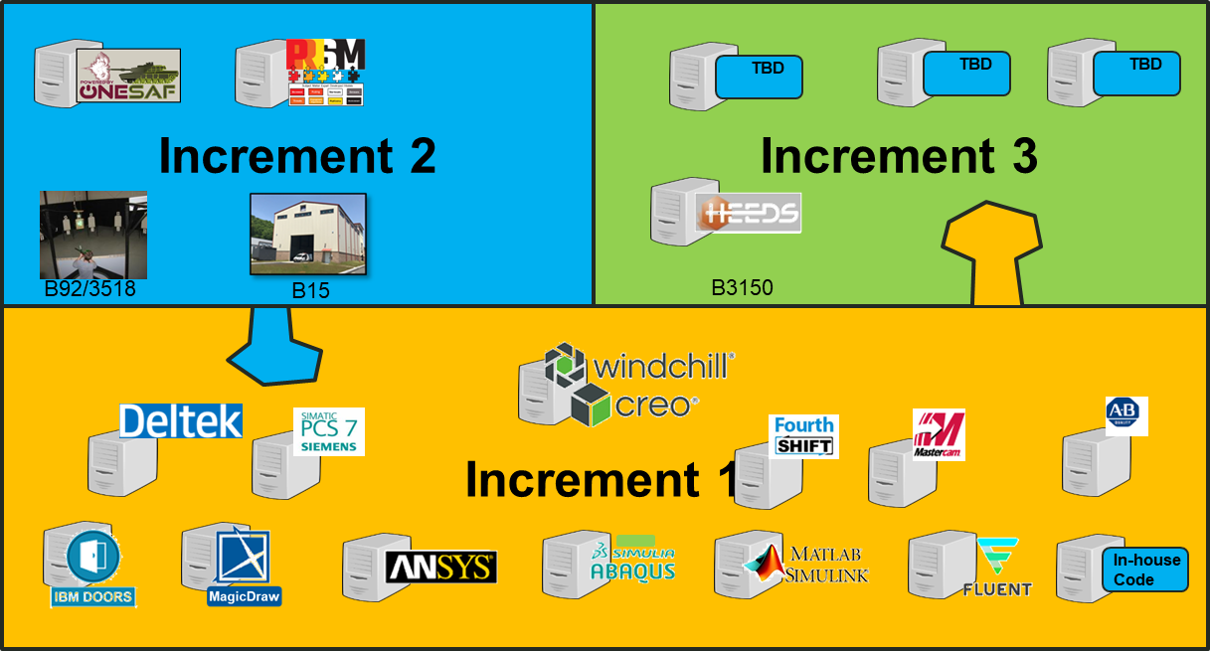
Incremental Growth Strategy
Increment 1 (Initial Digital Thread and Twin):
  Establish single 3D TDP format and single (federated) repository to form ASOT
  Integrate systems models, requirements to provide functional context Integrate physics models to establish engineering linkage to system performance
  Integrate manufacturing tools to facilitate prototyping and transition to production
  Integrate inspection data to increase fidelity of to as-built digital twin
Increment 2 (Extended Thread and Twin):
  Integrate T&E data to train and validate models
  Integrate operational models to establish linkage to military utility
  Integrate decision analytics to enable better decision making
  Integrate experimentation laboratories to enable virtual constructive capabilities
Increment 3 (Digital Sustainment)
  Integrate ILS tools to more efficiently create/update log products
  Integrate PSM tools for optimized sustainment
  Integrate system telemetry/diagnostics data to realize true RCM/CBM
Increment 3
Increment 2
Increment 1
A
B
C
Materiel
Solution
Analysis
Technology
Maturation & Risk Reduction
Engineering &
Manufacturing
Development
Production &
Deployment
Operations &
Support

Slide 17
DE Platform Evaluation
“Competitive Prototype Evaluations”
 | Option 1 | Option 2 | Option 3 | Option 4 | Option 5 | Option 6 | Option 7
Linkage to {PLM}
Linkage to {RM}
Linkage to {SysML}
Linkage to {FEA}
Linkage to {M&S}
IA Compliance
Scalability
User Interface
 | Requirement Fully Met
 | Requirement Partially Met
 | Requirement Not Met
Concerns:
Marketing vs Reality: all claim some compatibility with 3rd party software but usually not without development and maintenance ($$$)
Security / Network: work done successfully in a vendor development environment (security concerns), doesn’t necessarily translate to Government production environment

Slide 18
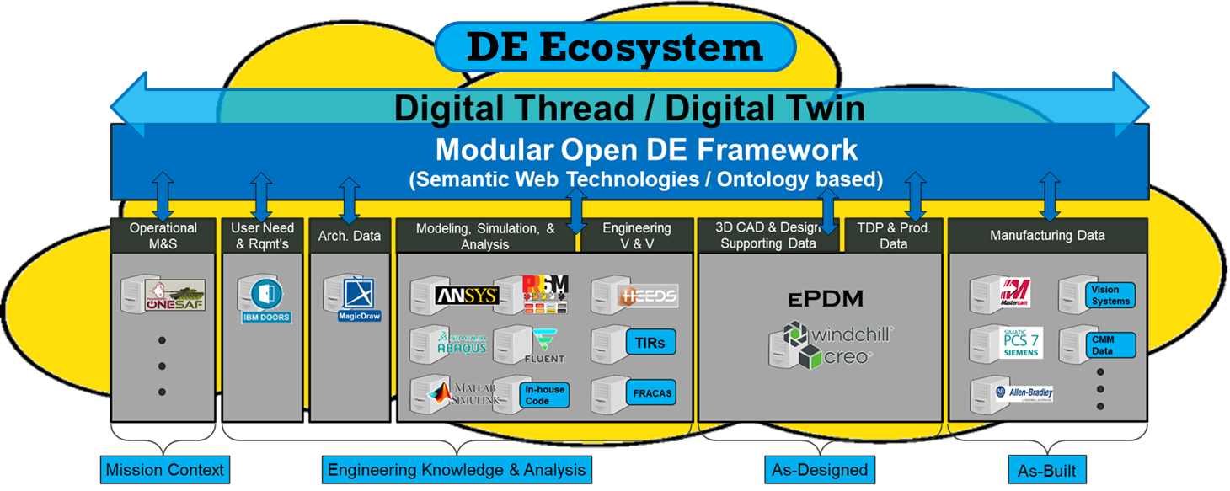
Objective Capability
Objective Capability
Ontology based, open architecture
Maximum scalability / growth potential
Not Prescriptive for A&A industry
Enables AI/ML enhancements
Key Activities:
Evaluating available and emerging options
- Industry (SBIR)
- Academia (UARC)
Developing OWL-based Ontology
Development of workforce KSA’s
Enables concurrent engineering with reduced risk
Data captured in Authoritative Sources of Truth - accessible to all stakeholders / users
Enables AI/ML enhancement
Database is accessible for statistical analysis, reinforcement learning, and making predictions from the available data
AI / ML enhancements grow exponentially as more data is populated
Risks
IA compliance
User Interface / experience
Makes Armaments System data searchable, accessible, and actionable by applying Armament-specific domain ontologies allowing for more comprehensive analysis and informed decision making

Slide 19
Ontology Background
Ontology Definition:
  the branch of metaphysics dealing with the nature of being
  a set of concepts and categories in a subject area or domain that shows their properties and the relations between them
Development of a comprehensive ontology to document a domain area
  establishes a standard taxonomy that can be used for data, repositories, and software tools
  is a foundational element to enable Digital Engineering
  supports interoperability between systems

Slide 20
Why Ontologies? Data in Context
One data point
Another data point
Another data point
Janice
has sister
Joe
Michael
has mother
has daughter
Anne
Joe
Nancy
Another data point
Another data point
Another data point
Michael
Joe
Same
Anne
Nancy
has father
has brother
has sibling
Michael
*Names are illustrative only

Slide 21
Why Ontologies? Data in Context
 | Janice | Joe | Michael | Sam | Anne | Nancy
Janice
Joe | has Mother |  |  |  |  | has Daughter
Michael |  | has Father |  | has Brother | has Sister
Sam |  |  | has Brother
Anne
Nancy |  |  |  |  | has Sibling
What we have been told →
Ontology Definition: a set of concepts and categories in a subject area or domain that shows their properties and the relations between them.
Ontology concepts
Mother is subtype parent where sex = female
Father is subtype parent where sex = male
Child is inverse Parent
Son is subtype Child where sex = male
Daughter is subtype Child where sex = female
Sibling where value parent(s) is =
Sister is subtype Sibling where sex = female
Brother is subtype Sibling where sex = male
Grandparent is Parent of Parent
Grandfather is subtype GrandParent where sex = male
Grandmother is subtype GrandParent where sex = female
Grandchild is inverse of Grandparent
 | Janice | Joe | Michael | Sam | Anne | Nancy
Janice | is female | has Son | has Grandchild | has Grandchild | has Grandchild | has Grandchild
Joe | has Mother | is male | has Son | has Son | has Daughter | has Daughter
Michael | has Grandmother | has Father | is male | has Brother | has Sister | has Sister
Sam | has Grandmother | has Father | has Brother | is male | has Sister | has Sister
Anne | has Grandmother | has Father | has Brother | has Brother | is female | has Sister
Nancy | has Grandmother | has Father | has Brother | has Brother | has Sister | is female
← What we know, now!

Slide 22
Why Ontologies? Data in Context
One Govt dB
Another Govt dB
Another Govt dB
9326055
2D464
GDOTS
has PartNumber
has Cage Code
has CageCode
M795 shell
9326055
2D464
Another Govt dB
Another Govt dB
Another Govt dB
SCAAP
has part
Rotating Band
M795
Shell
XYX Inc
has operator
Rotating band
GDOTS
has supplier

Slide 23
Why Ontologies? Data in Context
2D464
GDOTS
M795 shell
has Cage Code
has CageCode
Is Manufacturer
has PartNumber
has operator
SCAAP
9326055
Is Supplier
has part
XYX Inc
Rotating band
has supplier

Slide 24
Computationally Enabled
Ontology
Elements of a computationally enabled ontology:
Based on a formal language (OWL)
Developed in a compliant editor (Protégé)
Expanded from accepted standards (BFO, Common Core)
What’s related (a good start) but not an ontology:
A data schema or dictionary
MS Office documents (word, excel)
A visio diagram
A SysML profile or library

Slide 25
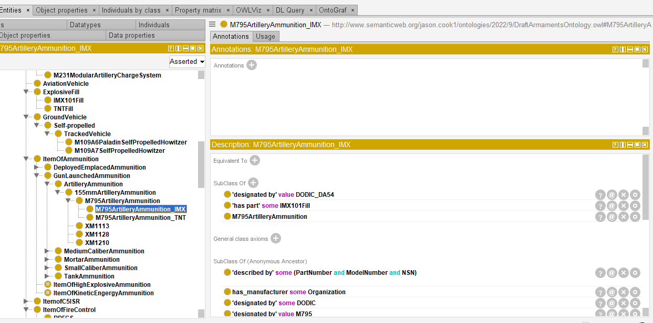
Protégé Ontology Editor
Class/Subclass hierarchy
Axioms

Slide 26
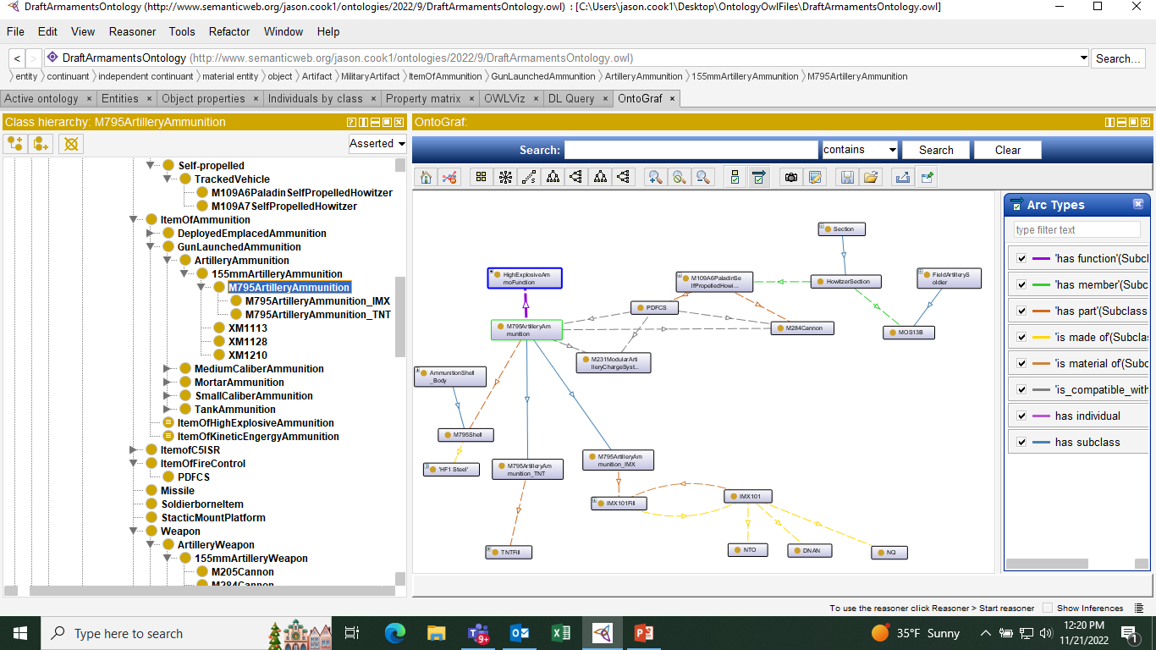
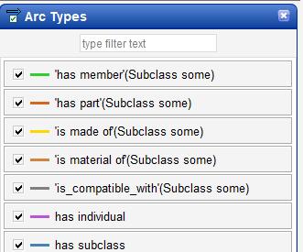
Graph Visualization

Slide 27


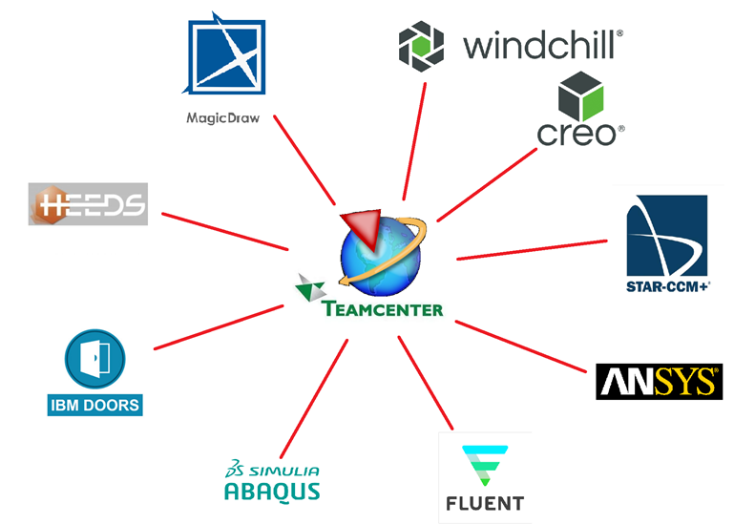

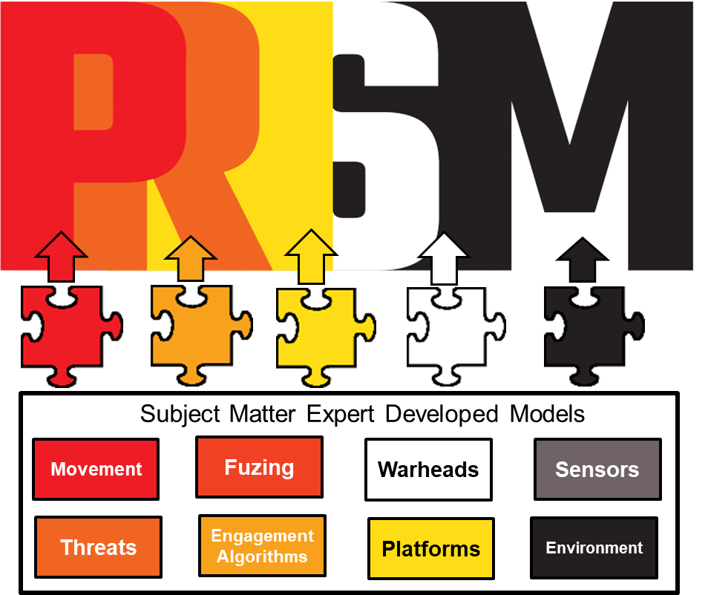







Scope of
Military Systems Ontology
End Item
designated by
Manufacturer
Unit
produces
compatible with
CFT
CageCode
designated by
End Item
used by
has member
has role
and realization
designated by
Soldier
Production Line
has output
has part
Model Number
has part
Component
realizes
realized by
agent in
designated by
Process
described by
has function
Machine
Attribute
Function
is made of
designated by
Material
Part Number
MOS
has input
Production Models
Product Models
Operational Models
Integrated M&S (Digital Twin)

Slide 28

Semantic Web Use Case
IoIF
Change to target
Change to range rqmt
Update to range value
Range Value updated
Trace to rubber band
Spring constant
Adjust design
Change to spring constant
Updated spring constant value
Re-run ballistic model
Updated range result
Update TDP in PLM and rebaseline
Update Manufacturing process

Slide 29
Additional DE Use Cases
DE Use Cases (Some not all)
Conduct Armaments trade study: Concept exploration and down select
Analyze proposed changes (design, process, material, supplier, etc).
Automation/AI studies (safety, efficiency and effectiveness improvements)
Process request for waiver or deviation
Rapidly conduct root cause analysis of failed/malfunctioned item
Accurately identify bottle necks and single points of failure
Conduct Supply chain scenarios analyses (e.g increased demand)
Implement CBM+ (for the system and/or equipment that builds it)
Accurately simulate integrated armaments technology functions and behavior

Slide 30
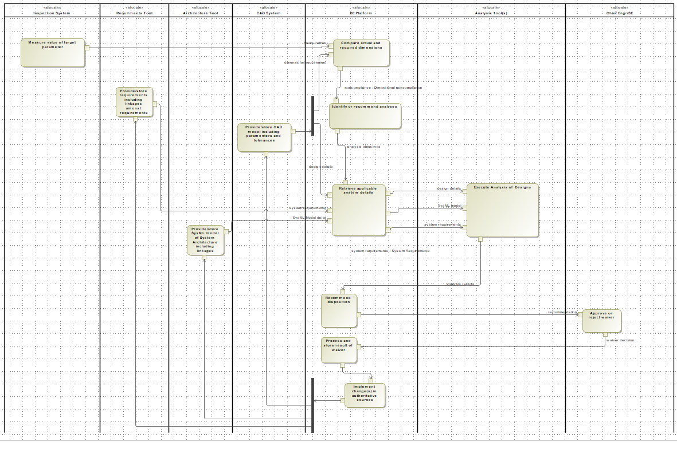
DE Use Cases Modeling
Request for Waiver Example
The DE Platform shall have the following interfaces:
Receive input from specified manufacturing tools
Receive parametric details from CAD tool(s)
Receive system functions, allocations and linkages from Architecture tool(s)
Receive Analysis results from M&S tool(s)
Receive requirements from Requirement tool(s)
Push changes to CAD tool(s)
Push changes to Architecture tool(s)
Push changes to Requirements
The DE Platform shall perform the following functions:
Compare measured and required parameter values
Identify analyses associated with impacted parameters
Obtain and provide appropriate system information from authoritative sources to conduct applicable analyses
Receive results of analyses and recommend disposition based upon impact to requirements
Accept the decision of the decision maker.
Store decisions made
Provide changes back to authoritative sources as a result of decisions
Retain history of all above functions and information exchanges.
The DE Platform shall have expose following data elements:
Mechanical design parameters and tolerances
System requirements with applicable parameters
System functions with applicable parameters
Parametric results of M&S (e.g stress, strain, range)

Slide 31
Military Warfighter Systems Ontology
Basic
Basic Formal Ontology
Common Core Ontology
Middle
Military Warfighter Systems Ontology
Joint Doctrine Ontology
UJTL
Armaments
Aviation Vehicles
Missiles
Ground Vehicles
Soldier Systems
C5ISR
Chem/Bio
Army MOS
FC
CHAMP PLC
AUTL
Design
Maintenance
Manufacturing
Tool
Testing
Measurement
Weapons
Common Parts
Materials
JCA
Domain
Ammo
JCFSL
Products
Operations
Lifecycle
Application
SYSML/DODAF/UAF
Planned
Baselined
In Development

Slide 32
Ontology Development Plan
Identify priority use cases
Develop activity diagrams
Extract concepts, terms and relationships
Add to ontology
Verify additions (run reasoner)
Demonstrate using IoIF and Catapult data
Repeat for each use case

Slide 33
Ontology Governance Plan
CM Process
  Ontologies hosted on cArmy Gitlab
  Organizational reps each with access to develop branches and commit changes
  Armaments Center will serve as CMO and approve merges to the MSO and supporting ontologies
  Domain area representatives responsible for their ontologies

Slide 34
Semantic web pathfinder projects
Prototype Integration Facility Condition Based Maintenance
  Build ontology based connector to MT Connect based data collection
  Synthesize data from lathe and associate with product quality inspection
  Train algorithm for reliability centered maintenance of lathe tooling
Section 806 Determination (Supply Chain Risk assessment Process)
  Build assessment flow diagram and decision logic
  Build ontology based connectors to various input sources
  Employ Bayesian methodology to assess risk

Slide 35
Resources & References
“DoD Digital Engineering Strategy”, June 2018
https://ac.cto.mil/wp-content/uploads/2019/06/2018-Digital-Engineering-Strategy_Approved_PrintVersion.pdf
"Digital Engineering Strategy“, USD(R&E) Memo for Secretaries of Military Departments, June 25, 2018
https://ac.cto.mil/wp-content/uploads/2019/06/USA001511-18-MIL.pdf
"Digital Engineering Strategy“, USD(R&E) Memo for Deputy Secretary of Defense, July 2, 2018
https://ac.cto.mil/wp-content/uploads/2019/06/USA001603-18-DSD.pdf
Defense Acquisition Guidebook (DAG), Chapter 3, 3–2.4.2 Modeling and Simulation, 2017
https://www.dau.edu/pdfviewer?Guidebooks/DAG/DAG-CH-3-Systems-Engineering.pdf
Transforming the Engineering Enterprise: Applications of Digital Engineering and Modular Open Systems Approach. Journal of Defense Modeling and Simulation, February 2018
https://journals.sagepub.com/doi/full/10.1177/1548512917751964

Slide 37
Glossary
The following definitions relating to digital engineering are drawn from the Defense Acquisition University (DAU) and the Defense Federal Acquisition Regulation Supplement (DFARS):
Digital Artifact: The artifacts produced within, or generated from, the digital engineering ecosystem. These artifacts provide data for alternative views to visualize, communicate, and deliver data, information, and knowledge to stakeholders. (DAU Glossary)
Digital Engineering: An integrated digital approach that uses authoritative sources of systems' data and models as a continuum across disciplines to support life cycle activities from concept through disposal. (DAU Glossary) (Defense Acquisition Guidebook)
Digital Engineering Ecosystem: The interconnected infrastructure, environment, and methodology (process, methods, and tools) used to store, access, analyze, and visualize evolving systems' data and models to address the needs of the stakeholders. (DAU Glossary)
Digital System Model: A digital representation of a defense system, generated by all stakeholders, that integrates the authoritative technical data and associated artifacts, which defines all aspects of the system for the specific activities throughout the system life cycle. (DAU Glossary)
Digital Thread: An extensible, configurable, and component enterprise-level analytical framework that seamlessly expedites the controlled interplay of authoritative technical data, software, information, and knowledge in the enterprise data-information-knowledge systems, based on the Digital System Model template, to inform decision makers throughout a system's life cycle by providing the capability to access, integrate, and transform disparate data into actionable information. (DAU Glossary)
Digital Twin: An integrated multiphysics, multiscale, probabilistic simulation of an as-built system, enabled by Digital Thread, that uses the best available models, sensor information, and input data to mirror and predict activities/performance over the life of its corresponding physical twin. (DAU Glossary)
Technical Coherence: The logical traceability of the evolution of a system's data and models, decisions, and solutions throughout the life cycle. (DAU Glossary)
Technical Data: Recorded information, regardless of the form or method of the recording, of a scientific or technical nature (including computer software documentations). The term does not include computer software or data incidental to contract administration, such as financial and/or management information. (DFARS 252.227-7103(a)(15))

Slide 39
Artificial intelligence in SE
SED AI Working Group

Slide 40

Artificial Intelligence in Systems Engineering and Architecting
NDIA Systems Engineering Division

Slide 41
AI in Systems Engineering and Architecting Subcommittee
NDIA Systems Architecture Committee recognized the need for addressing emerging Artificial Intelligence and Machine Learning capabilities in the context of Systems Engineering and Architecture
New subcommittee organized in January 2024, eager to:
  Serve as a forum to exchange news on emerging technologies
  Demonstrate capabilities and limitations
  Foster discussion among interested stakeholders
  Produce artifacts to steer and guide in unchartered territory

Slide 42
Subcommittee Organization
NDIA Systems Engineering Division
Excited to collaborate and explore adjacencies with working groups and internal/external organizations
  MOSWG
  SERC
  AIRC
All are invited to participate, contribute, and help us collectively push our knowledge, capabilities, and awareness forward!
Please contact:
  Yash Parmar, yash.parmar@baesystems.us
  Mark Vriesenga, mark.vriesenga@baesystems.us
NDIA Systems Architecture Committee
AI in Systems Engineering and Architecting Subcommittee

Slide 43
Subcommittee Objectives - 2024
Produce Systems Engineering Guide for integrating AI/ML-enabled capabilities into defense systems
  Define considerations/guidance for algorithm selection
  Supplier considerations
  Risks and opportunities, challenges, metrics
  How to implement AI within a modular architecture?
  Impact to acquisition policy?
  Ethical and legal implications?
Alignment to frameworks and standards (ISO, IEEE, SysML…)
Alignment to technical and business strategies (MOSA…)
Explore use cases, success stories, and lessons learned for AI assistance in Systems Engineering tasks

Slide 44
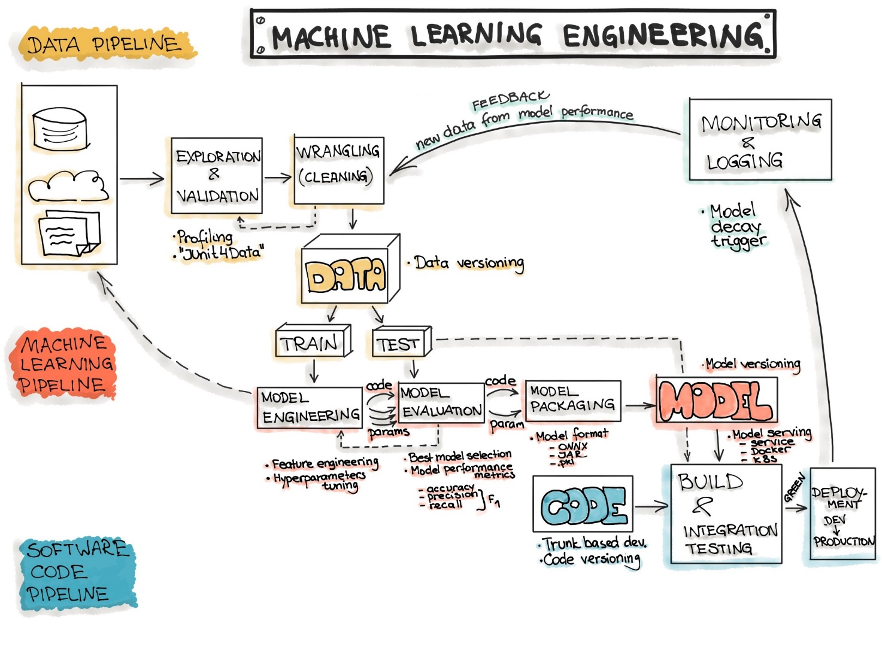
Systems Engineering Challenges with AI/ML Algorithm Integration
The following challenges represent a few of the design considerations addressed by the AI/ML working group
      AI/ML Requirements Specification
      AI/ML Trades and Algorithm Selection
      AI/ML Data Quality and Availability
      AI/ML Explainability and Transparency
      AI/ML Verification and Validation
      AI/ML Ethics, Regulatory Compliance, and Safety
      AI/ML Security and Privacy
      AI/ML Monitoring and Adaptation

Slide 45
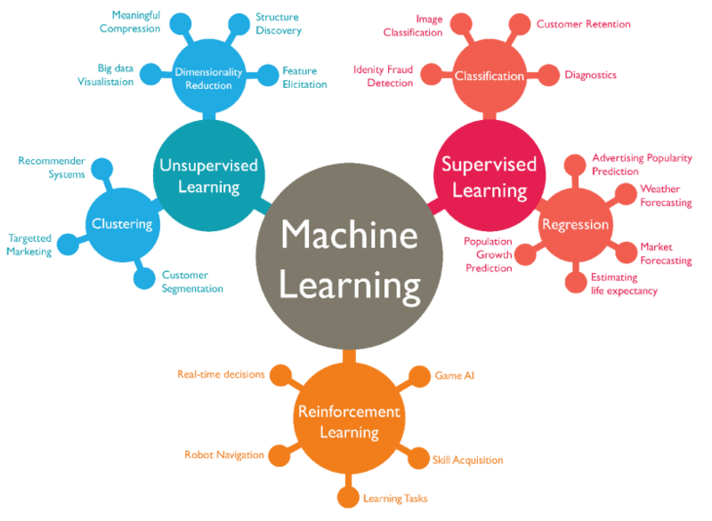
SE Challenge #1: AI/ML Requirements Specification
The specification of requirements for Artificial Intelligence/Machine Learning (AI/ML) capabilities is a complex task that necessitates the creation of detailed functional and performance requirements.
Government acquisition offices must:
      Have a clear understanding of which system functions are feasible with AI/ML algorithms, including the limitations inherent to AI/ML technology.
      Define precisely the functions they expect the AI/ML algorithm to perform.
      Specify the performance benchmarks that the AI/ML algorithm must meet, including:
        Required training timelines and associated data needs.
        Desired operating speeds, ranging from real-time to near real-time.
        Expected accuracy levels, such as maintaining 96% accuracy across all operational conditions and inputs.

Slide 46
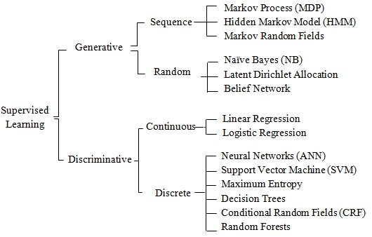
SE Challenge #2: AI/ML Trades and Algorithm Selection
AI/ML algorithms are often chosen prematurely based on partial information, availability of code, or individual biases, which can lead to problems later in the project.
      A common mindset might be, "I prefer neural networks, so regardless of the actual needs, we'll use a neural network."
With a plethora of AI/ML algorithms at our disposal, it's important to recognize that:
      Each algorithm is designed to solve specific mathematical problems.
      Different algorithms offer different capabilities.
      There are unique prerequisites for using each algorithm.
Systems engineers must navigate through this array of to match the algorithm to the job's requirements, ensuring a fit-for-purpose solution.

Slide 47
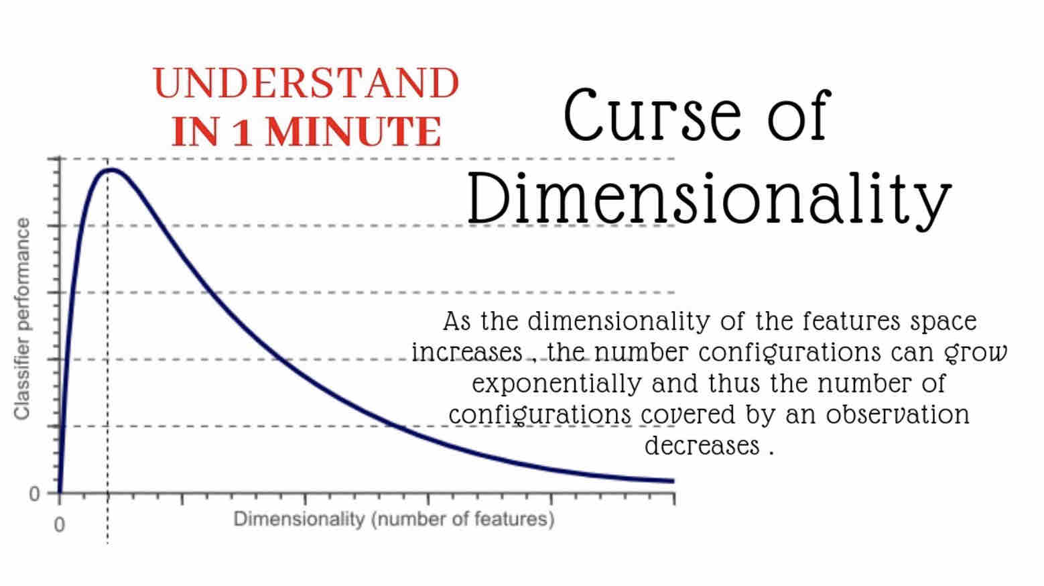
SE Challenge #3: AI/ML Data Quality and Availability
More than half of the effort is dedicated to Data Operations (DataOps) in AI/ML development.
      Locating datasets that are relevant to the task at hand.
      Cleansing the data and filling in missing values.
      Analyzing the data to identify and extract useful subsets.
      Conducting feature engineering to simplify the AI/ML algorithm and reduce its computational demands.
      Creating datasets for training, testing, as well as for the verification and validation processes.
If an AI/ML algorithm's data requirements are not met, it cannot be effectively used.
      This is related to the Curse of Dimensionality, where an AI/ML algorithm typically needs between 10 to 100 data points for each variable to function optimally.
      Overcomplicating the model with unnecessary input variables can lead to poorer performance.

Slide 48
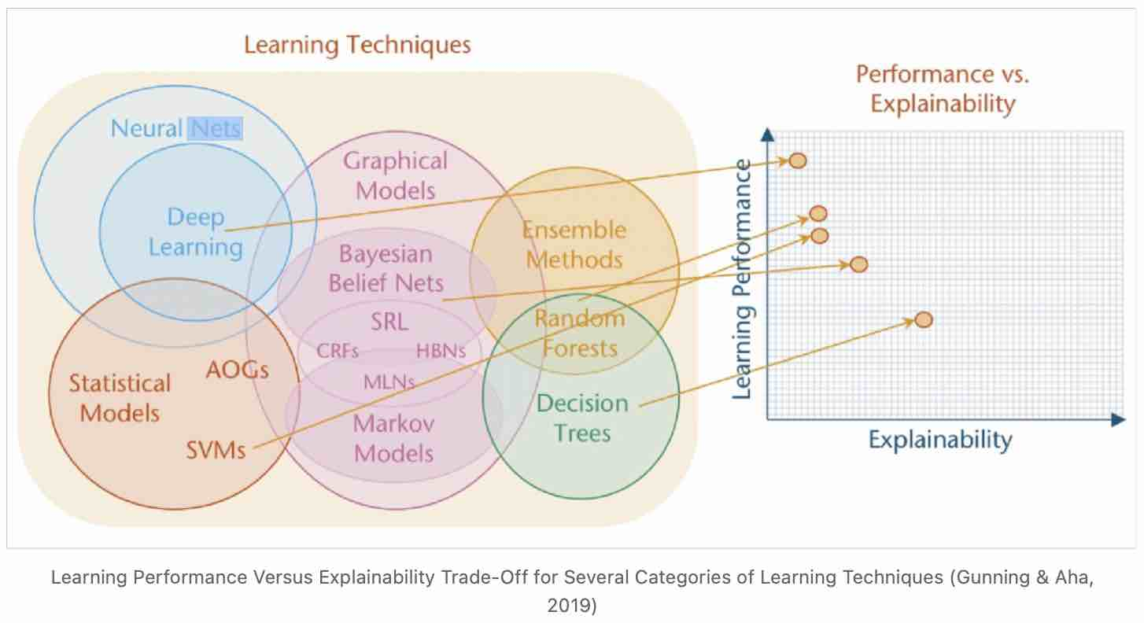
SE Challenge #4: AI/ML Explainability and Transparency
Many AI/ML algorithms are characterized by their low explainability, meaning that the reasoning behind their decision-making processes is not easily understood.
      As such, these algorithms are not guaranteed to be completely safe for deployment in mission-critical systems where failures could have severe consequences.
Systems engineers need to thoughtfully consider the ramifications of incorrect decisions.
      Suitable applications might include object classification, anomaly detection, and the generation of feedback control.
      However, the use of AI/ML in areas such as missile guidance, autonomous weaponry, and commercial self-driving systems raises significant safety and ethical concerns due to the potential for critical errors.

Slide 49
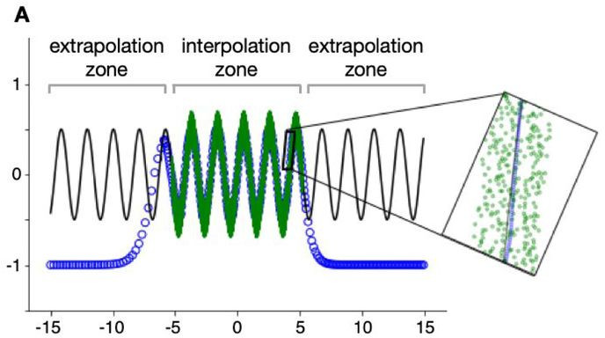
SE Challenge #5: AI/ML Verification and Validation
Effective verification and validation (V&V) of AI/ML algorithms must include tests for both standard scenarios (interpolation) and unexpected cases (extrapolation).
The V&V process should confirm the algorithm's efficacy with familiar data while also defining its performance boundaries to identify scenarios where it is inapplicable. Key questions to address include:
      The algorithm's proficiency in handling data it has encountered before.
      The reliability of the algorithm when analyzing new, unseen data.
      The range of conditions under which the algorithm meets the set requirements.
      The thresholds beyond which the algorithm's use should be discontinued.

Slide 50
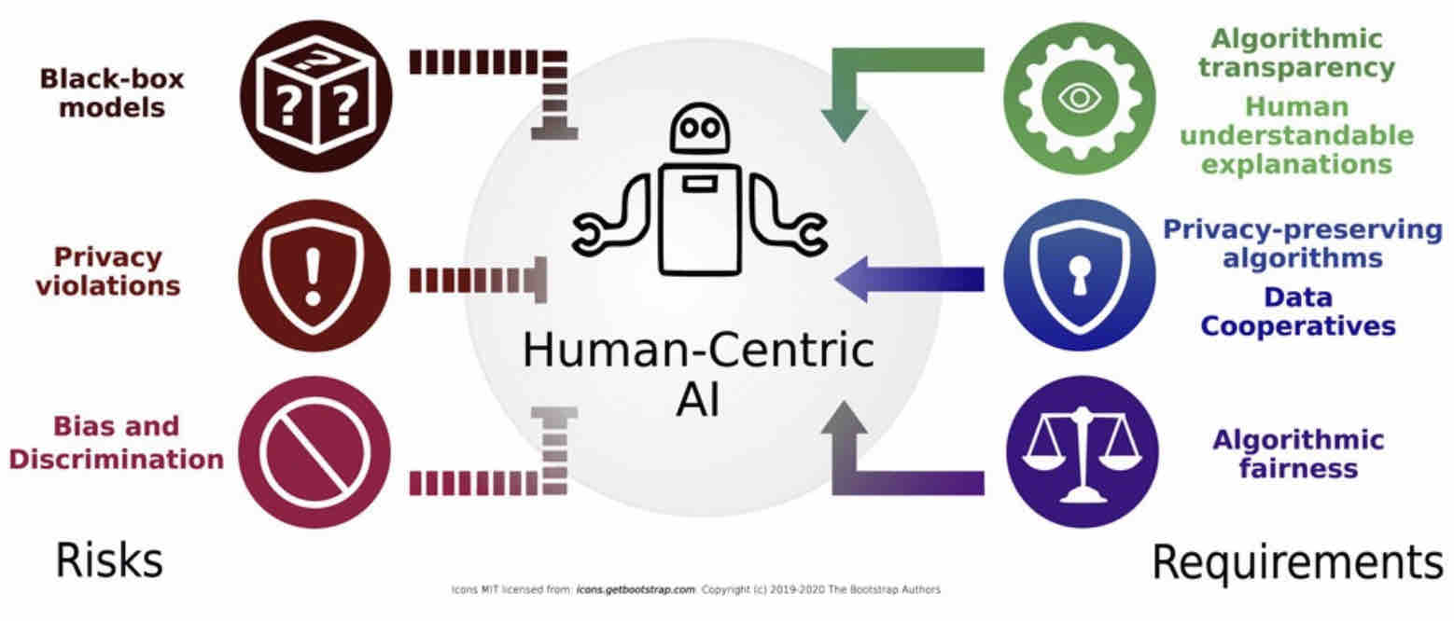
SE Challenge #6: AI/ML Ethics, Regulatory Compliance, and Safety
AI/ML algorithms designed for autonomous decision-making must adhere to societal norms and the established laws of armed conflict.
Determining the types of decisions that AI/ML systems can make reliably and establishing clear trust boundaries are critical aspects of their design.
      For instance, while AI/ML systems might be used to identify potential targets on the battlefield, human intervention—such as a designated targeteer—is essential to review and confirm these choices before any further action like weaponeering and engagement is taken.

Slide 51
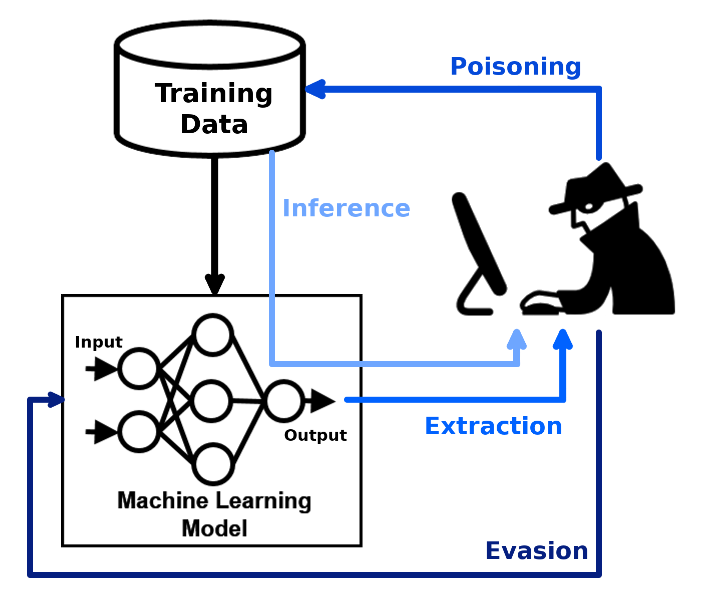
SE Challenge #7: AI/ML Security and Privacy
AI/ML algorithms typically embed their training data within their framework, which may contain sensitive information necessitating classification or privacy protections.
Systems engineers need to be vigilant about the potential for data extraction from AI/ML algorithms.
      Implementing cybersecurity and anti-tamper technologies is essential to thwart unauthorized access and tampering with AI/ML systems, serving as a vital component of system design.
Furthermore, the process for the certification and accreditation of AI/ML algorithms remains complex and is not yet fully established or understood.

Slide 52
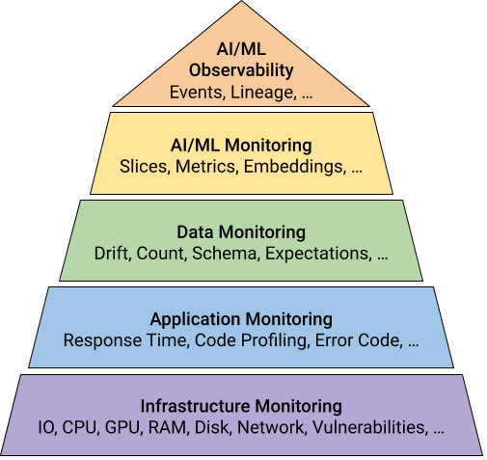
SE Challenge #8: AI/ML Monitoring and Adaptation
AI/ML algorithms excel when their training data is a close match to the data encountered during operation. However, discrepancies between these data sets can result in decreased reliability and accuracy, potentially causing system failures.
Systems engineers can address these issues by embedding monitoring and adaptive mechanisms in AI/ML systems.
      These mechanisms serve as a safeguard, ensuring the systems function correctly.
One strategy for implementing such mechanisms is to encase AI/ML algorithms within input/output monitors.
      These monitors perform ongoing assessments of operational data against training data benchmarks, detecting and signaling any deviations or anomalies that arise.

Slide 53
Model-Based Acquisition Update
Laura Hart, MBAq Working Group

Slide 54
2023 Systems and Mission Engineering Conference
SED Conference Committee

Slide 55
2024
Systems & Mission Engineering
Conference
Norfolk, VA – Hilton Norfolk The Main
28-31 October 2024
22 Feb 2024 Division Meeting

Slide 56
Overview – Who to Ask
NDIA Staff
  Logistics: Sarah Komar, Raven LeMay
  Exhibits & Sponsorships: Abby Abdala
  Program/Divisions: Jae Yu, Carizza Gutierrez, Tommy Kienzle
  Division Leads
  Division Chair: John Daly
  Division Vice Chairs: Laura Hart, Dr. Suzette Johnson
  Conference Chair: Dr. Pat Griffin
  2024 Conference Planning Committee: Dr. Pat Griffin, Dr. Suzette Johnson, Jeff Bilco (T&E Division Chair), Annette Beacham, Cory Ocker, LaMont McAliley

Slide 57
Norfolk, VA – Hilton Norfolk The Main
  Conference Dates
    Monday, October 28, 2024 – Thursday, October 31, 2024 (Monday workshops)
  Room Block
    2024 - Sunday, October 27, 2024 – Thursday, October 31, 2024
  Show your badge program (local vendor discounts)
  Parking - daily ($1.50/hr) & overnight rates ($20/night)
  Open items - Hotel pricing? Number of Government Rooms?

Slide 58
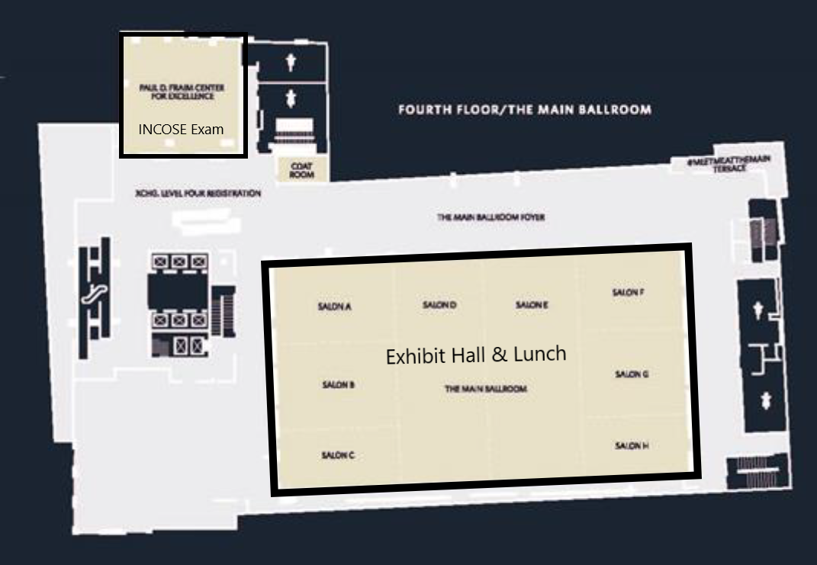
2024 Hilton Norfolk The Main Space Exhibits

Slide 59
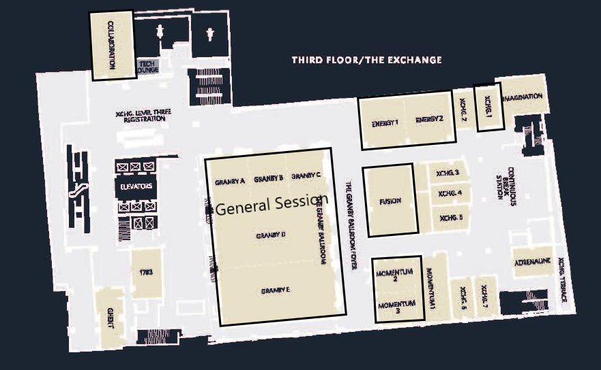
2024 Hilton Norfolk The Main Space – Day 1
Breakouts
  Energy 1
  Energy 2
  Fusion
  Momentum 2
  Momentum 3
  Granby Ballroom
- Other
  Collaboration – Staff Office
  Xchb.1 – Speaker Ready room

Slide 60
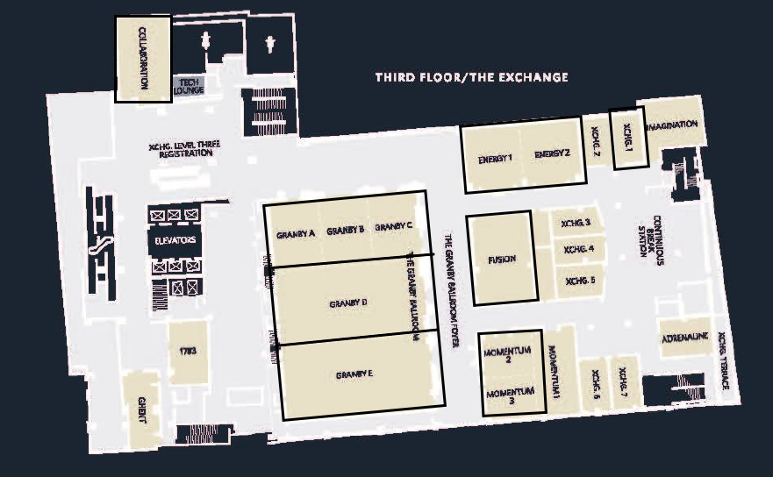
2024 Hilton Norfolk The Main Space – Day 2
Breakouts
  Granby A – C – 120*
  Granby D – 130*
  Granby E – 130*
  Energy 1 & 2 – 80*
  Fusion – 48*
  Momentum 2 & 3 - 90**
- Other
  Collaboration – Staff Office
  Xchb.1 – Speaker Ready room
*Classroom seating
**Theater seating

Slide 61
SME 27 | 29-31 Oct | Norfolk, VA
Strategic Decisions
Division/Client Input (Mission/Vision/Strategy)
Budget
Event Structure
Location/Date
Theme/Image
Registration Strategy
  Industry
  Govt/Active Duty
  Speakers
MARCOM Strategy
Metrics for Success
Operational Actions
RFP/Venue/Contract
Save the Date Announcement/Schedule at a Glance
Exhibits/Sponsorships/Advertising
Event Website
Attendance & Justification Letters
Call for Abstract
Invite Keynote Speakers
Draft Develop Program
Publish Draft Program
Open Registration
Registration
Open
Abstract Portal Open
Theme/
Image
Develop
Program
Publish
Program
MARCOM
Nov
Dec
Jan
Feb
Mar
Apr
May
Jun
Jul
Aug
Sep
Oct
Nov
Dec
Jan
Feb 25
Required Near Term Actions:
Review registration fees and open registration
Publish event page
Keynote Invites
MARCOM Campaign

Slide 62
2024 Conference Goals (Feb/Mar)
Pulling dates to the left for quicker “Save the Date”, Call for Abstract notices.
  All members Vote for conference theme NLT 23 Feb from 4 choices.
  “Save the Date” – Publish by 3/1/24. Content sent to NDIA on 2/22/24.
  Sent graphic idea to NDIA 2/22/24.
Increase registration numbers from 2023 (425). Define target number.
Increase exhibitor/sponsorships from 2023 ($ 41K). Define target number.
  Identify Volunteer to work with Exhibitors, Abby (NDIA), Pat, and John.
Start to identify Keynote speakers.
  Spread Keynote Speakers to include Tuesday and Wednesday. Lunch?
Game show was a huge success – add one? Have same on Thursday AM?
Designate Awards Board and send solicitations for all awards.
Create Conference Agenda Shell.
NDIA to research and present 2025 location options.
Identify Track Chairs. Emphasize Track Chair ability to select, approve presentations, and notify authors early before Abstract 30 April deadline.

Slide 63
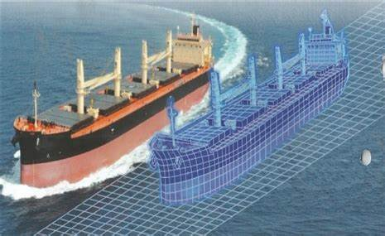
2024 Conference Goals (Feb/Mar)
Graphic idea for 2024
  US Flag watermark for background.
  Foreground has three or four vehicles - aircraft/UAV; land, and ship and or 4th - Space. All 3-4 look like physical vehicle then moving from one end to another the vehicle morphs into its digital representation.
Theme for 2024
  Vote for 1
  1) Enabling Digital Transformation for Speed and Agility Across the Lifecycle
  2) Linking Design, Test, and Sustainment for Mission Success: Air, Land, and Sea
  3) Digital Engineering in the Secure System Development Lifecycle
  4) Linking Design, Test, and Sustainment across the Lifecycle

Slide 64


2024 Conference Goals (Feb/Mar)
Save the Date on NDIA website
  Mark your calendars and plan to join us for NDIA’s 27th Annual Systems and Mission Engineering Conference, scheduled for October 28 – 31, 2024 in Norfolk, VA. This event brings together defense community members from industry, government, and academia to highlight ways for improving defense acquisition and system performance. We provide an interactive forum for program managers, systems engineers, chief scientists, specialty engineers and managers. It is not to be missed!
Coming soon - the Call for Abstracts!
Link to 2023 save the date- https://www.magnetmail.net/actions/email_web_version.cfm?ep=e3L6qHr2AbqxYTtXN395raMjg88j261mzZyAXez--XbatHaa-dSdLrAUxfJrZAQFe978379UTZzYl_vYh4PU7nxr_o0MyaToPJU1nLZVtNzHDHLDhLvODYYx6itljxSY
Abstract Topics
  Added AI
Enabling Agile Throughout the Lifecycle
Mission Engineering / System of Systems
Actionable Architecture / MOSA Impact
Model Based Systems Engineering (MBSE)
Artificial Intelligence (AI)
Test & Evaluation
Digital Engineering Environment (DEE)
Digital Twin
Physics-Based Modeling & Simulation
System Security Engineering (SSE)
Specialty Engineering (Human Systems Engineering)
Specialty Engineering (Safety and Environmental Engineering (SEE))
Program Management
Education & Training
Other Topics related to the above

Slide 65
2024 NDIA S&ME Conference Timeline (1/2)
Feb 2024
  Identify volunteer to work with exhibitors and Abby to solicit sponsorships, SWAG, coffee breaks, wifi, et al. and work with John to identify real world applications for workshops or presentations.
  Exhibitor meeting with details/Discussion on conference to increase participation.
  Place a "Save the Date" on the NDIA website.
  Decide on Conference Theme and Graphic.
  Call for Presentations posted/sent by email – CFP open immediately. The CFP will be for presentations to be:
    presented live at the conference
    and/or On-Demand.
    We will specifically note priority for live acceptance is on a first come basis and the deadline is April 30, 2024
  Conference Theme posted with CFP and conference location/times on NDIA website and a shell conference agenda.
  Start the Keynote speaker search process.
  Call for workshop participation on first day of conference (by invitation).
  Awards Planning Process starts. Awards Board designated (SED Chair/Vice Chairs, ad hoc members)
  Define target numbers for exhibitors and participants.
March 2024
  Basic conference process rules in place, including track operation, presentation acceptance, scheduling time slots etc.
  Basic agenda for conference updated with general time blocks, speakers if known, and awards etc.. by day.
  Appeals for presentations with CFP sent to key SED partners and targeted organizations based on theme
  Committees/SED leadership continue to emphasize early submission of abstracts
  Workshop planning begins: Track chairs assigned, and operating rules formalized and provided to all Track leadership
  NDIA staff will identify and train track chairs on presentation process software/tools to be used in 2024.
  Exhibitor planning ongoing, monthly meetings and updates
  Solicitation for Ferguson Award goes out via website and email (Due 15May2024)
  NDIA start 2025 location search and present options.

Slide 66
2024 NDIA S&ME Conference Timeline (2/2)
April 2024
  Track Chairs begin accepting presentations in general (Live and/or On-Demand) as received with acceptance emails to authors weekly
  Conference agenda is developed with updates on keynotes, special events etc. as they become available (updated once a week on website until conference)
  Exhibitor planning ongoing, monthly meetings and updates
May 2024
  Track Chairs allocate the time slots for live presentations and then to authors. Authors initially selected for live presentation will be notified of acceptance and dates of track they are assigned to.
  Actual day of presentation will be provided in June when all the planning/scheduling information is available
  Panels and special events identified by Conf Committee and Track Chairs, and placed in schedule
  Awards Board meets end of May (SED Chair, Vice Chairs, ad-hoc members)
June 2024
  Conference basic agenda created: blocks for Tracks, keynotes, events, and awards etc. Distributed via website and mass emails
  Presentation acceptance for live presentations with target dates provided
  Awards Winners announced NLT 30 June 2024
July/August 2024
  Finalized agenda produced and posted. Authors are notified of times of presentation on day previously identified
  In August final presentation due to Track chairs for review
September 2024
  Track Chairs communicate with authors, finalize presentations by 30 Sept 2024-upload to NDIA site. Further changes to presentations by exception only

Slide 67
2024 Conference Planning Committee
  Planning Committee:
  Please reach out to any of us or SED/T&E/IPM senior leadership if you have suggestions, questions, or need information.
  Dr. Pat Griffin pat.griffin@astronics.com
  Dr. Suzette Johnson suzette.johnson@ngc.com
  Mr. Jeff Bilco jeffrey.s.bilco@boeing.com
  Ms. Annette Beacham mary.a.beacham.ctr@mail.mil
  Mr. Cory Ocker Cory.L.Ocker@rtx.com
  Mr. LaMont McAliley lmcaliley@techpromanagers.com

