Slide 1
OMG Model-based Acquisition (MBAcq) User Group A Government & Industry Collaboration Update
Laura E Hart laura.e.hart@lmco.com
OMG UAF co-chair/MBAcq UG co-chair
Feb 24 2023

Slide 2
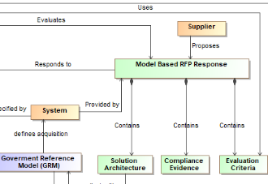
BLUF: Model-Based Acquisition (MBAcq)
About MBAcq
Why MBAcq Matters
Model-based acquisition is the Technical approach to acquisition that uses models and other digital artifacts as the primary means of information exchange, rather than document-based information exchange.
Customers are increasingly specifying MBSE in RFPs
Customers are increasingly requiring models in proposals
Lack of standardization raises proposal learning curves
MBAcq standardization minimizes acquisition risk while improving communication across industry
OMG MBAcq User Group
Expected Timeline
Is a broad industry body with participation from OMG, INCOSE, Armed Services, OUSD, DoD CIO, NDIA, DAU, FFRDCs and many industry suppliers such as Boeing, Northrop Grumman, Lockheed Martin, etc. working together to create the standards and guidance to successfully deploy MBAcq to the larger community.
2022: Formed Team & Framework
2023: Q4 Govt Ref Arch
2024: Q2 Acquisition Users Guide
Q2/3 DAU Acquisition Training
Q4 Acquisition Model Example
Notes:
OMG MBAcq User Group, is a broad industry body with participation from OMG, INCOSE, Armed Services, OUSD, DoD CIO, NDIA, DAU, FFRDCs and many industry suppliers such as Boeing, Northrop Grumman, Lockheed Martin, etc. working together to create the standards and guidance to successfully deploy MBAcq to the larger community.
Model-based acquisition is the Technical approach to acquisition that uses models and other digital artifacts as the primary means of information exchange, rather than on document-based information exchange.
MBAcq incorporates modeling in acquisition, improving evaluation, engineering, and governance, leading to better system solutions
Voice Track: Weapon systems are becoming too complex and too fluid to describe through traditional means (i.e. requirements specs). Also, systems need to interoperate, so their structure and interfaces need to be specified as well. MBAcq is not just a proposal packaging choice.

Slide 3
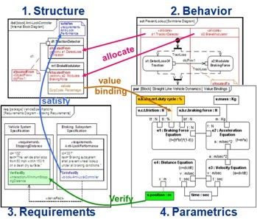
Descriptive vs Analytical Models
System Architecture Model (SAM)
Descriptive in nature
Emphasizes how pieces fit together into a consistent whole
Provides context for analysis
Requirements
Program Management
Product Support
Analysis Models and Simulation Models
Emphasize specific aspects of performance, consistent with the Architecture Model.
Mathematically-based computation or simulation
Reduces risks thru analysis, validation and optimization of:
MOE, MOP, KPP, TPM timing, probability of hit/survival reliability/availability, MTBF cost, total cost of ownership
A vehicle to solve some
problem or verify a solution
Traceability,
rational
Analysis Models & Simulation (Matlab, Simulink,Network, DE Simulation, Custom)
Analyze
needs
System Architecture Model
Verification Model
Analysis
Spec
Test
Plan
Performance
estimates
Manufacturing
Software Models
(UML)
Mechanical & Electrical Models
(CAD, Zuchen)
RFP Prep
RFP Award
Execution..
Operational
3
Change over time →
SAM provides a “hub” for data integration and transformation across the product lifecycle
Notes:
A Systems Architecture Model provides a “hub” for data integration and transformation across the product lifecycle
Provides the ability to link analysis through the systems model to provide insight into architectural and system level decisions

Slide 4
What’s in the System Architecture Model
A System Architecture Model is an Integrated Structured Representation of the Requirements, Behaviors, Structure, Properties, and Interconnections
Requirements
What are the mission operations, stakeholders’ goals, purposes, and success conditions for the system?
Behavior
What the system needs to do to meet requirements
Transformation of inputs to outputs
Responses to External stimulus
Structure
The parts of the system that are responsible for the behaviors
The component hierarchy, elements and stores
Properties
The performance, physical characteristics and governing rules that constrain the structure and behaviors
Interconnections
The ability of the structured elements to exchange information and achieve their required behaviors
System Model
Document Specifications
Primary use of the system model is to enable the design of a system that satisfies its requirements
Notes:
Model-based Engineering moves the record of authority from documents to digital models including M-CAD, E-CAD, SysML and UML managed in a data rich environment
Shifting to model-based enables engineering teams to more readily understand design change impacts, communicate design intent and analyze a system design before it is built

Slide 5
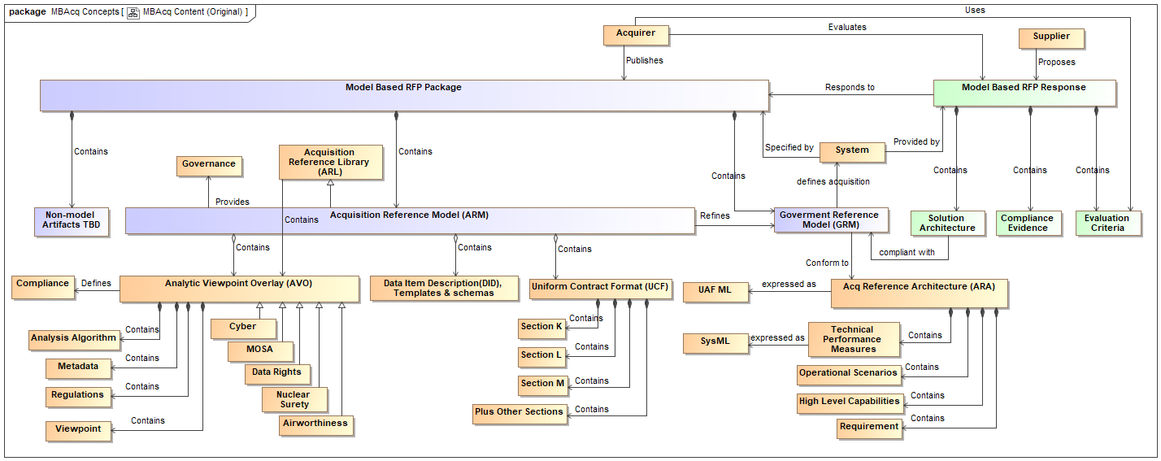
MBAcq Future State
Bringing it all together!
RFP From Customer
Response From OEM
Model Based RFP Package
Model Based RFP Response
Architecture Acquisition Guidance (AAG)
Objective Arch Description
Domain Overlay
Acquisition Ref Architecture
Notes:
Standardizing approaches across the acquisition agencies
Standard models also enables federation of models into a system of systems integrated portfolio
The (GRA) Gov Reference Architecture has been renamed to (ARA) Acquisition Reference Architecture and defines the data content-and structure for specifying a specific (OAD) Objective Architecture Description. Think of it as the rules for defining an OAD.
The (GRM) Gov Reference Model has been renamed to (OAD) Objective Architecture Description and contains the program architectural specification applicable to the specific objective system being acquired.

Slide 6
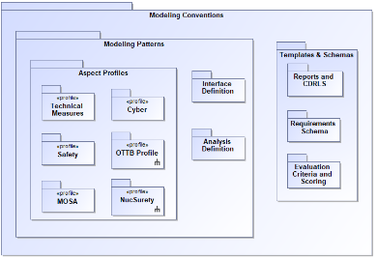
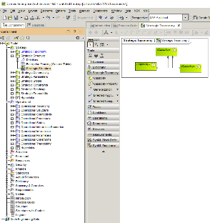
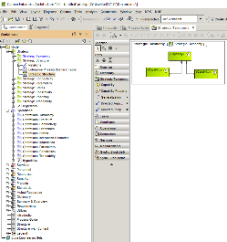
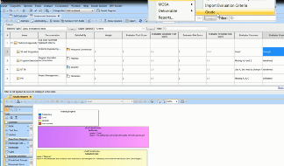
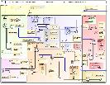
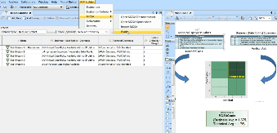
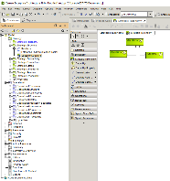
Model-Based Acquisition
1. Architecture Acquisition Guidance (AAG)
2. Objective Architecture Description (OAD)
3. Model-based RFP Package
Domain Overlay Profiles
AAG &
(OAD)
Populated with Program
& contract Data
← 4. Unified Architecture Framework (UAF) Process Guide for Acquisition →
Supports DoDAF
1. The AAG provides model structure for RFP content and evaluation tools:
Modeling Patterns
DO Profiles (i.e. MOSA, Data Rights, certs )
Interface & Analysis Definitions
Templates & Schemas
Evaluation Criteria & Scoring (Section K, L, M)
Reports & CDRLS
2. The OAD is a descriptive model containing the program requirements, constraints and context
High-level Capabilities, mapped to Operational scenarios, traced to requirements (e.g. CDD, SRD, Conops)
Technical performance measures (i.e. KPPs, KSAs, MOEs..)
Any required architectural partitioning including structural and functional
(Based on UAF acquisition process guide and template)
3. The Model-based RFP model contains the populated OAD&AAG providing RFP evaluation content, CDRL definitions for documentation generation and scoring tools for solution validation and evaluation
4. UAF Process Guide provides the Acquisition Guidance for using the OAD and AAG template to create, respond and evaluate a Model-based RFP.
® 2021 Object Management Group. All Rights Reserved.
SOURCE: Laura Hart, MITRE 2017

Slide 7
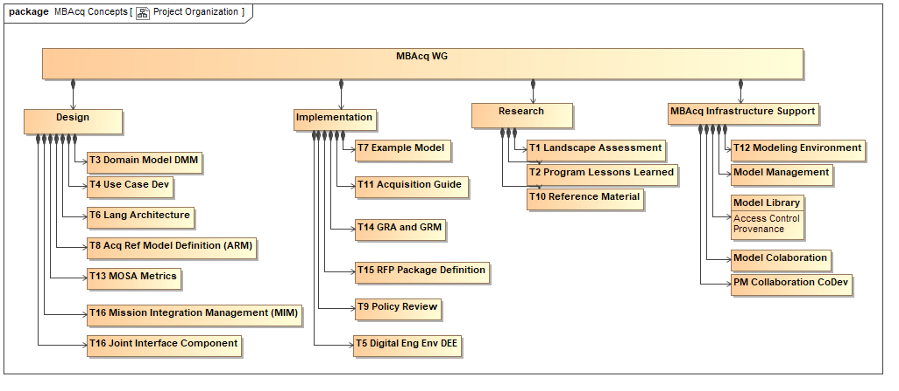
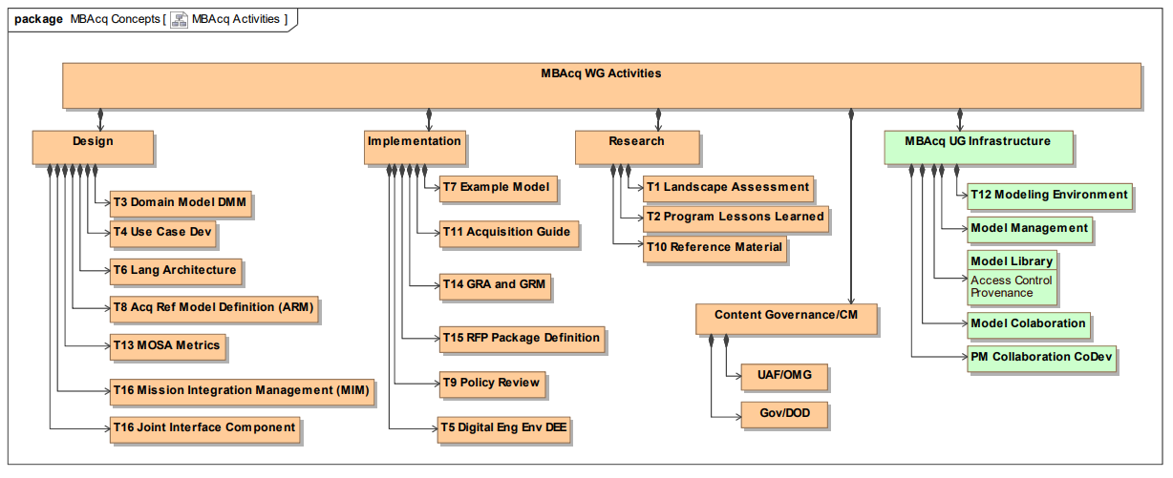
UAF MBAcq UG Activities

Slide 8
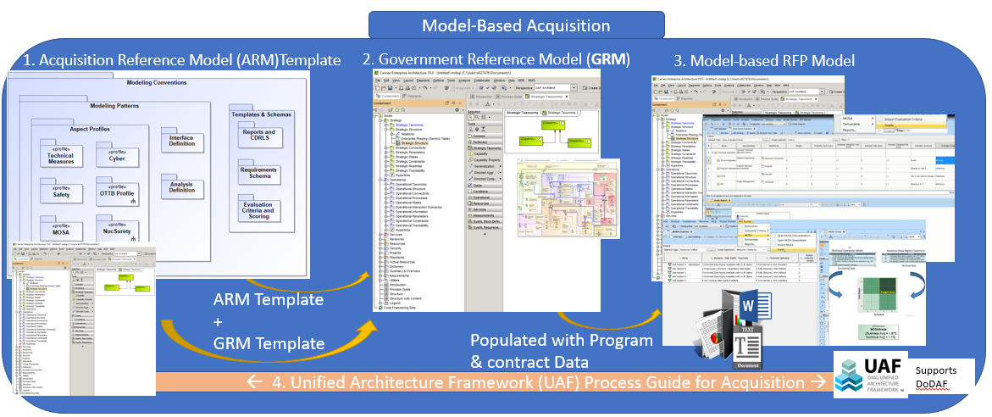
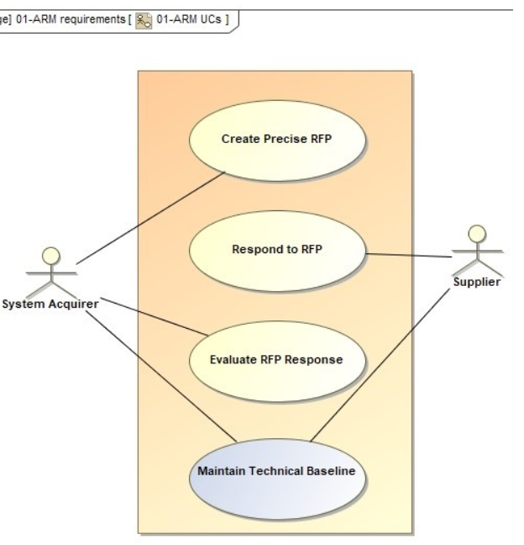
What’s the Architecture Acquisition Guidance (AAG) (previously ARM)
Slide Subject Title
AAG is a set of reusable model templates, and guidance used to augment a model-based RFP based on standards to support data driven decisions beginning with acquisition which can be maintained throughout the complete lifecycle of program.
Use Cases:
Create Precise RFP
Respond to RFP
Evaluate RFP Response
Contractor Self Evaluation
Government Evaluation
Maintain Technical Baseline
Model evolves over time and represents the technical baseline
In a Standardized Format
GOV
Focus on Unified Contract Format: Sections K, L, & M
SOURCE: Laura Hart, MITRE 2017
® 2022 Object Management Group. All Rights Reserved.

Slide 9
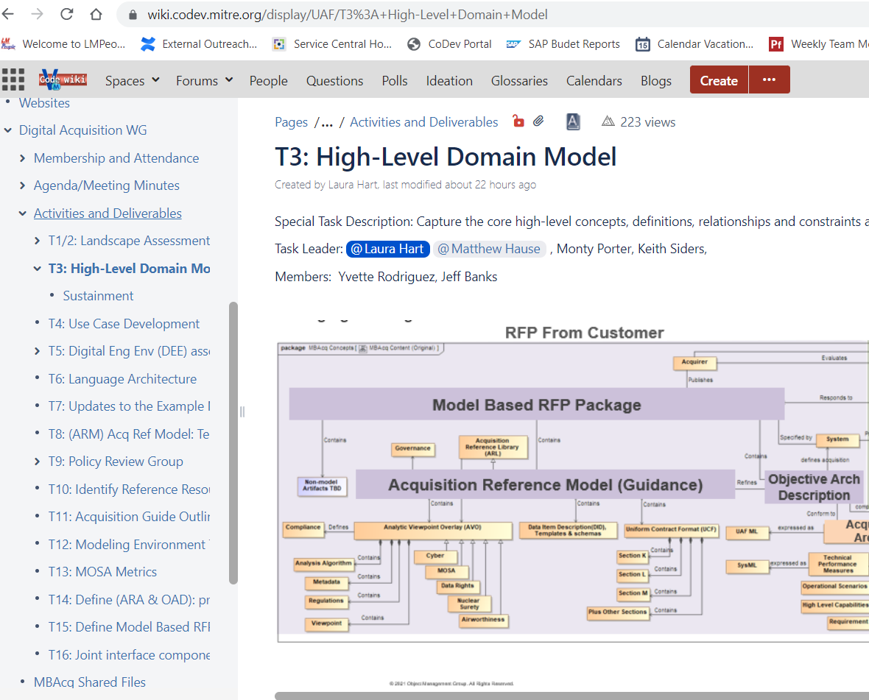
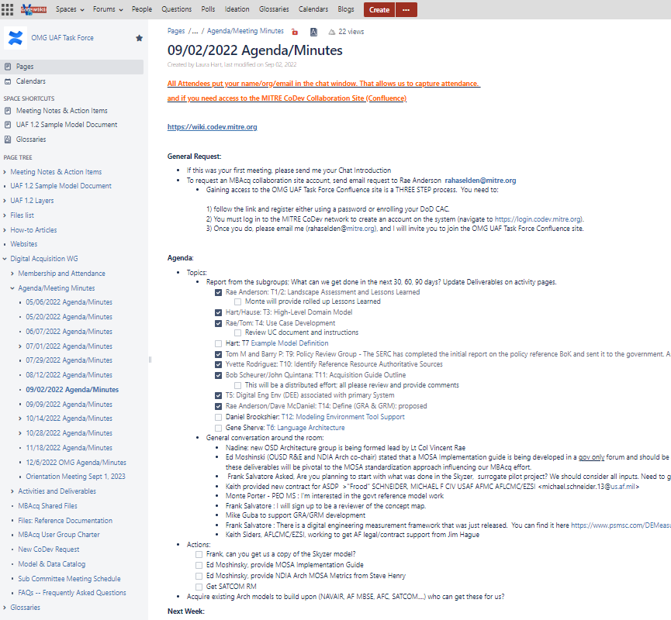
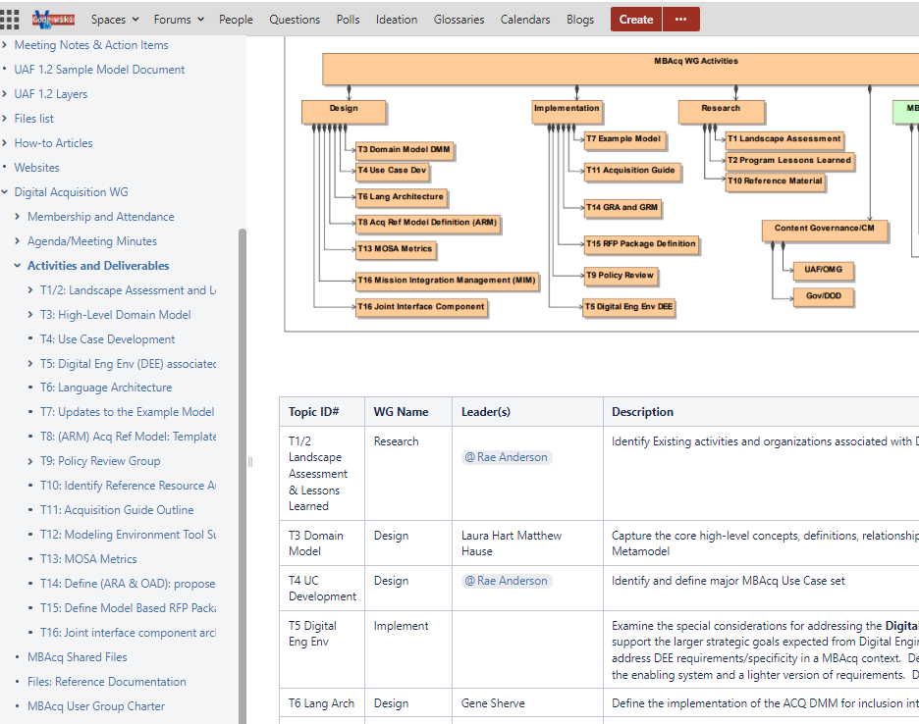
Collaboration and Transparency in an Open Env

Slide 10
UAF MBAcq Planned Deliverables
Slide Subject Title
AAG templates and guidance (how to specify model-based DIDs, CDRLs)
OAD template and guidance (includes guidance for how NOT to over-specify a system)
Sample model (as part of UAF sample model)
UAF Process Guide for Acquisition will:
define the CONOPS for how a program office will use all the models they will receive over the lifetime of a system
how to make models available for reuse for other/new systems
portfolio management for models/programs
provide process and guidance that describes how to integrate MBSE approaches into pre-acquisition (before request for proposal release), request for proposal, contract award, and contract execution steps
Impact to existing policy with recommendations for change
Descriptions of what Sections K, L, and M could look like for model delivery
Taxonomies with precise definitions for concepts and terms
® 2022 Object Management Group. All Rights Reserved.

Slide 11
Upcoming events
March 20-24th Q1 OMG meeting in Reston OMG Technical Meeting in Reston, VA | Object Management Group
UAF RTF working meeting/MBAcq F2F
March 22, 2023 - Unified Architecture Framework Summit (Free Hybrid Event) ACTIONABLE ARCHITECTURE IN THE 21ST CENTURY The detail agenda can be found here and is still being updated. https://www.omg.org/events/2023Q1/March-2023-UAF-Summit.pdf

Slide 12
Recorded Session
Associated DAU recording of this material was presented on 2/9 as part of the DAU “Let’s Be Modular and Open Webinar” Series. The session Link (~30 min presentation and 30 min Q&A) : https://www.dau.edu/event/Lets-Be-Modular-and-Open-Webinar-Model-Based-Systems-Engineering-In-Acquisition
Questions?
For more information on MBAcq User Group, Contact:
Laura Hart laura.e.hart@lmco.com
Rae Anderson rahaselden@mitre.org
Steve MacLaird maclaird@omg.org

Slide 13
Backup

Slide 14
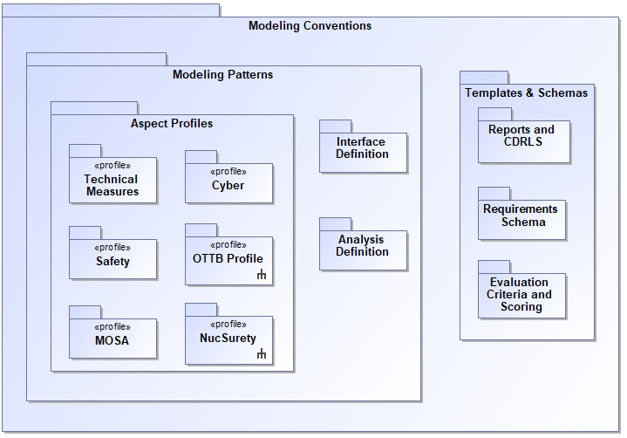
Architecture Acquisition Guidance (AAG)
1. The Architecture Acquisition Guidance (AAG)
provides model structure for RFP content and evaluation tools:
Modeling Patterns
Domain Overlays (i.e., MOSA, Data Rights, certs )
Interface & Analysis Definitions
Templates & Schemas
Evaluation Criteria & Scoring (Section K, L, M)
Reports & CDRLS
Additional Contractual Data
Organization and Modularity is key to reuse and standardization
Notes:
Attributes of AVOs
Guidance for both acquisition and engineers
How to describe a CDRL
Evaluation tools and process
AAOs important to acquisition
Outputs
Modeling Convention, AVOs, Libraries
AVOs instructions
Digital Acquisition Guide (user’s guide)
Updated Sample problem (Upgrade to Search and Rescue example)

Slide 15
Domain Overlays (DOs)
Domain Overlay (DO) Description: A collection of constructs needed to support analysis for a domain specific concern using a standardized approach. Typical construct elements include:
A set of regulations, constraints, rules…. driving the analysis (i.e. MOSA, safety, certification, airworthiness, Space …)
A set of Data/Metadata required to address or support analysis, compliance or fit-for-purpose. Implementation example (Domain model/profile)
Logic/algorithm needed to perform analysis using the metadata and regulations
A set of Viewpoints to support various analysis (Certification plan, coverage, design trades, schedule and resources…)
Characteristics
Usually has associated regulations, governance that can be treated as pseudo requirements or constraints
Cross-cutting both viewpoints/rows & aspects/columns
Supports specific analysis associated with a Domain-Specific concern
Can be created independent of a specific solution architecture description
Can be applied or removed from a specific architecture description without impacting the AD, hence an overlay
Based on NDIA Actionable Architecture Using Aspect Modeling, L Hart 2018
Pattern for ARM profile standardization
® 2021 Object Management Group. All Rights Reserved.
Notes:
Attributes of AVOs
Guidance for both acquisition and engineers
How to describe a CDRL
Evaluation tools and process
AAOs important to acquisition
Outputs
Modeling Convention, AVOs, Libraries
AOs instructions
Digital Acquisition Guide (user’s guide)
Updated Sample problem (Upgrade to Search and Rescue example)

Slide 16
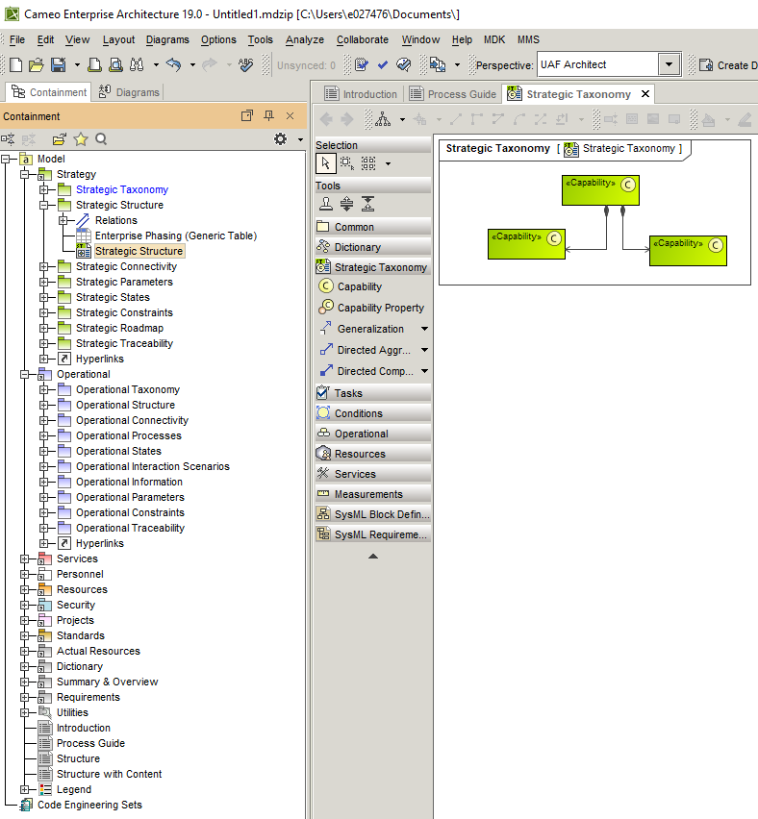
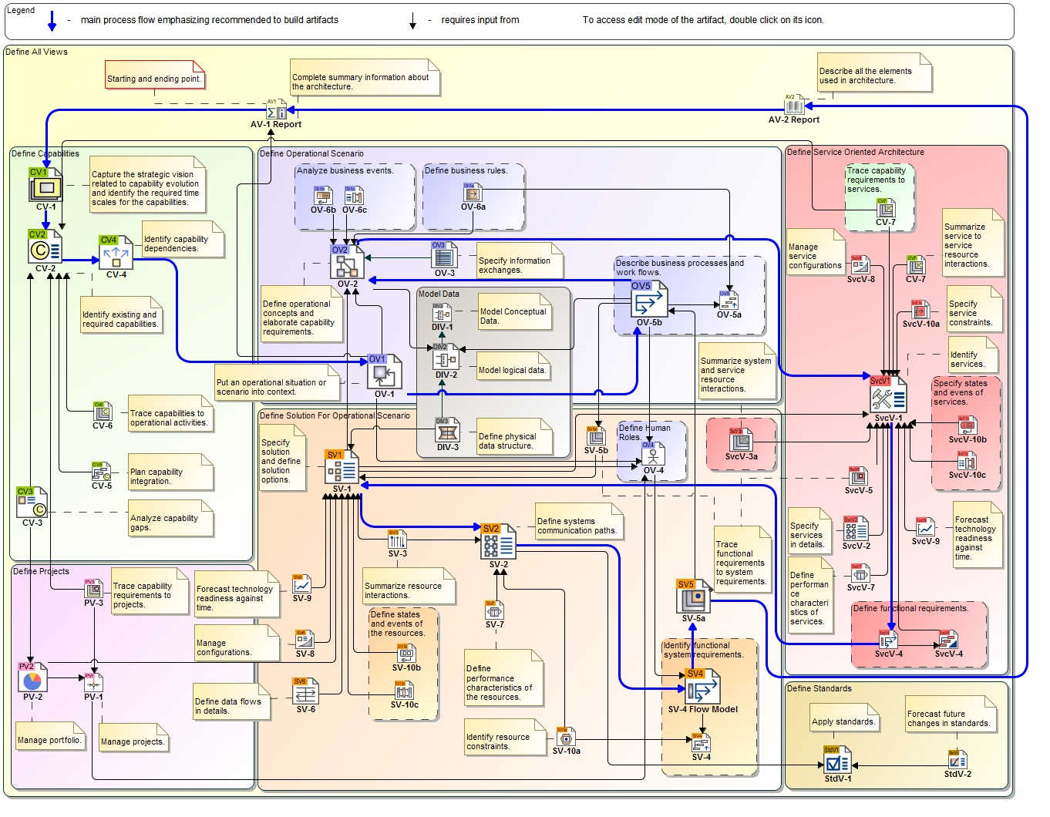
Objective Architecture Description
2. The OAD is a descriptive model containing the program requirements, & constraints for the system to be acquired as required by the Acq Reference Architecture.
High-level Capabilities, mapped to Operational scenarios, traced to requirements (e.g. CDD, SRD, Conops)
Technical performance measures (i.e. KPPs, KSAs, MOEs..)
Any required architectural partitioning including structural and functional
(Based on UAF acquisition process guide and template)
Objective Architecture Description (OAD)
® 2021 Object Management Group. All Rights Reserved.

Slide 17
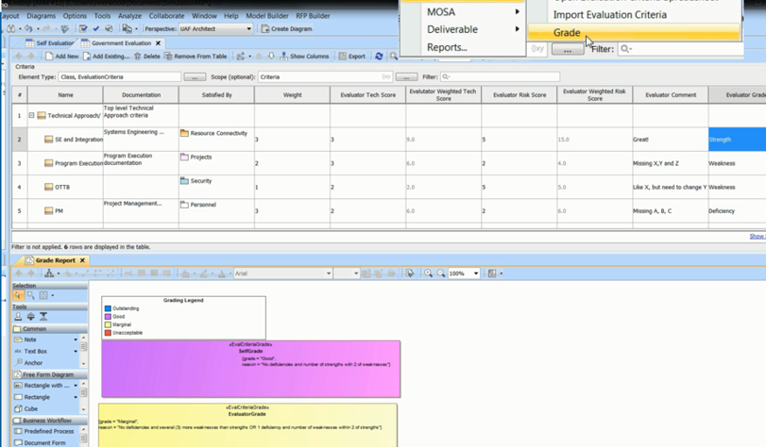
Model-Based RFP Package
3. Model-based RFP Model
3. The Model-based RFP Package contains the populated OAD and AAG template providing RFP system requirements, evaluation content, CDRL definitions for documentation generation, scoring tools for solution validation and evaluation.
® 2021 Object Management Group. All Rights Reserved.
Notes:
Attributes of AVOs
Guidance for both acquisition and engineers
How to describe a CDRL
Evaluation tools and process
AAOs important to acquisition
Outputs
Modeling Convention, AVOs, Libraries
AOs instructions
Digital Acquisition Guide (user’s guide)
Updated Sample problem (Upgrade to Search and Rescue example)

Slide 18
UAF MBAcq Process Guide
4. UAF MBAcq Process Guide provides the Acquisition Guidance for applying the UAFML to create, respond and evaluate a Model-based RFP including the creation of the OAD and AAG. It will address various roles (acquisition, engineering, supplier, acquirer)
← 4. Unified Architecture Framework (UAF) Process Guide for Acquisition →
Supports DoDAF

