Slide 1
Systems Engineering and Architecture Organization Overview
Tom Simms, ED, SE&A (Acting)
February 24, 2023
Distribution Statement A. Approved for public release. Distribution is unlimited.

Slide 2
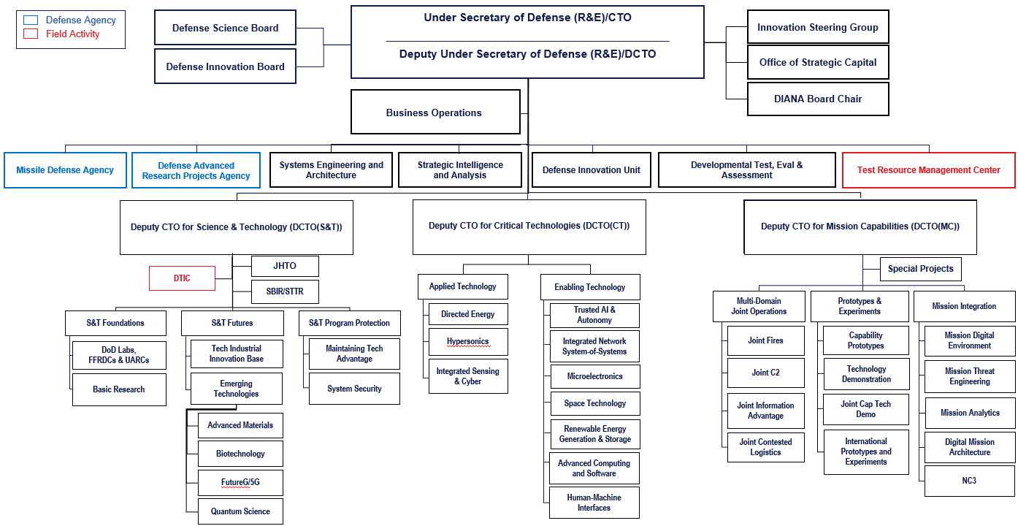
OUSD (R&E) Organizational Structure
Distribution Statement A. Approved for public release. Distribution is unlimited.

Slide 3
Systems Engineering & Architecture (SE&A)
SE&A applies engineering expertise to achieve system of system capabilities and advance the engineering practice within the DoD
Systems Engineering & Architecture
Digital Engineering Modeling & Simulations
Software
Engineering
Lines of Effort
Advance the Engineering Practice
Connect & Strengthen the Technical Community
Develop the Workforce
Advance and Manage Standards
Provide Independent Engineering Assessments
Provide Systems of Systems (SoS) Architectures Guidance
Specialty Engineering
Defense Standardization Program Office
Policy & Workforce
Systems Engineering*
Joint Architectures for Capabilities & Systems
*Includes Modular Open Systems Approach (MOSA)
Distribution Statement A. Approved for public release. Distribution is unlimited.

Slide 4
SE&A Overview
INITIATIVES
Advance engineering practices with 20+ initiatives, including:
SE Modernization
Digital Engineering (DE)
MOSA implementation
Human Systems Integration
Software Modernization
ASSIST Modernization
POLICY
Lead for 12 engineering policies and partner on 2 T&E policies
GUIDANCE
Lead for 32 engineering guidance documents and partner on 22 T&E guidance documents
WORKFORCE DEVELOPMENT
Lead 2 acquisition functional areas
Engineering & Technical Management (ETM)
Test & Evaluation (T&E)
Lead 2 DoD-wide functional communities
Engineering (Non-Construction)
Quality Assurance
STANDARDS
Manage and guide DoD standards
Lead Standardization Activity for 3 standardization areas (300+ documents)
Systems Engineering & Architecture
TECHNOLOGY/PROGRAM SUPPORT
Support includes the following
Integrated Sensing and Cyber
Ground Based Strategic Deterrent (GBSD)
Joint All-Domain Command & Control (JADC2)
Hypersonics
SECDEF/CONGRESSIONAL/GAO
TASKING
FY20 NDAA – Section 230
Talent Mgt of Digital Expertise & SW Professionals Secretary of Defense
Civilian Harm Mitigation and Response Report
COLLABORATION (LEAD)
Over 30 steering groups/working groups, including:
Modular Open Systems Working Group
Systems Engineering Research Center (SERC)
Digital Manufacturing Working Group
Standardization Management Group
ETM Functional Integration Team
COLLABORATION (PARTICIPANT)
Over 90 working groups including:
JADC2 Data & Architecture WG
DoD S&T SW Modernization SSG
DoD Data Council
Distribution Statement A. Approved for public release. Distribution is unlimited.

