Slide 1
NDIA System Security Engineering Committee
July 2020
Holly Dunlap
Raytheon
NDIA SSE Committee Chair
Holly.Dunlap@Raytheon.com
Cory Ocker
Raytheon
NDIA SSE Committee Co-Chair
Cory.Ocker@Raytheon.com

Slide 2
SSE Committee Feb – July Summary
Accomplishments:
  IEEE NDIA INCOSE System Security Symposium, 6-9 April 2020
    Transitioned to Virtual On-Demand Presentations
  AF Weapon System Program Protection / System Security Engineering Guidebook
  INCOSE Fuse System Security Charter & Collaboration
  NIST 800-53 Review & Comment

Slide 3


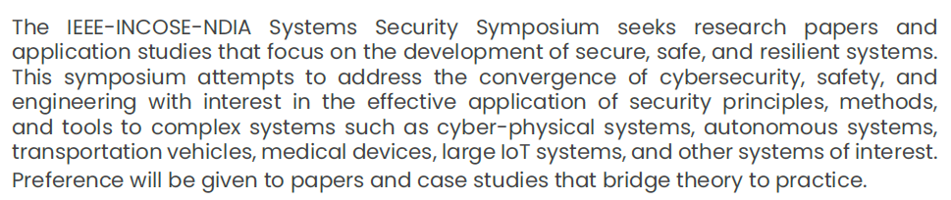
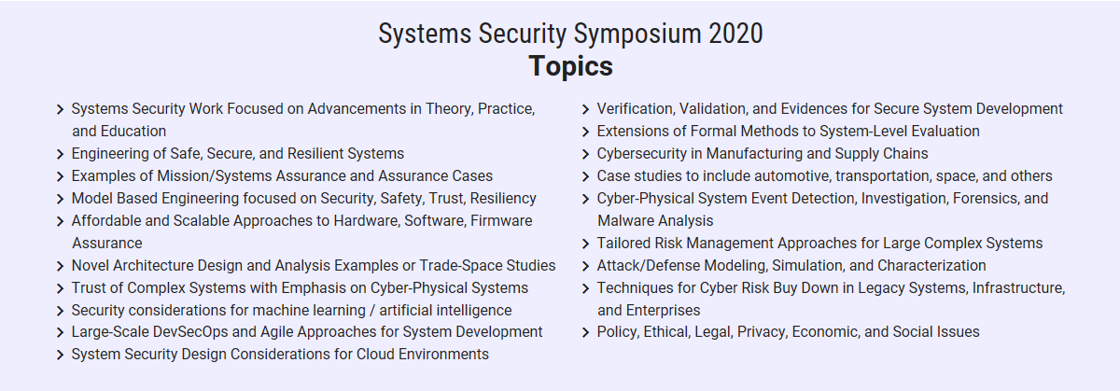
IEEE NDIA INCOSE
System Security Symposium
April 6-9, 2020
Virtual On-Demand Presentations July 1 – August 1st.
http://www.ieeesystemssecuritysymposium.org
IEEE/NDIA/INCOSE Systems Security Symposium 2020 will now be held as a virtual on-demand conference of recorded paper presentations to be held July 1 – August 1, 2020. Plenary session speakers and panels as well as track session panels will be rescheduled for 2021. We will be offering a virtual presentation option for all of our SSS 2020 authors. The papers of all approved authors will be sent to IEEE with intent to publish in the IEEE XPLORE Library, and the presentations of all who present virtually will be available on the conference website. All authors and attendees will receive a 50% discount on all conference registration fees.

Slide 4
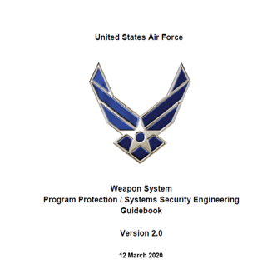
AF Weapon System Program Protection / System Security Engineering Guidebook
Multi-year collaboration with the AF Cyber Resiliency Office of Weapon Systems
Currently the most comprehensive SSE / PP Guidebook
The guide includes:
  USAF Weapon System PP / SSE Process
  USAF Process Guide for Critical Program Information and Critical Component Identification
  USAF SSE Acquisition Guidebook
  Examples
  Templates
  Tools
Highly recommend using this guide as the preferred reference and encourage the community to continue to improve and mature.
The AF CROWS continues to be open to feedback.
The USAF SSE Acquisition Guidebook was the primary focus for the SSE Committee
The document is available within the anti-tamper (AT) homepage link: ( The documents are located under “resources” tab under “policy” folder. Then click “Air Force” and our documents are located there).
https://at.dod.mil/

Slide 5

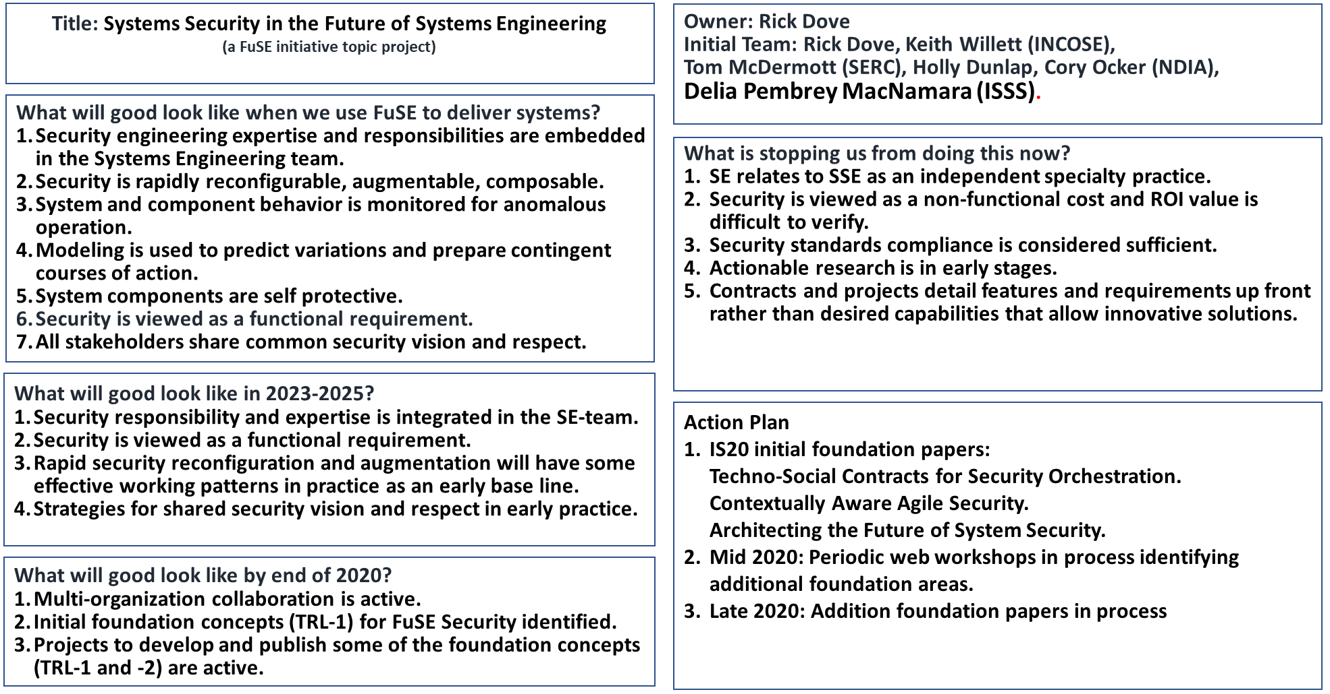
FuSE System Security Charter v200725

Slide 6
Foundation Topics By Close of Workshop #7
Security expertise, competencies, and roles in the SE team.
Trusted security modeling.
Agile security (composable and resilient).
Capability-based engineering approach to security.
Security orchestration (for cyber-relevant threat response).
Techno-social contract (design, management, and operation mechanisms).
Product line security architecture.
Loss driven engineering.
Critical Systems Thinking for stakeholder alignment (includes harmonious security and social contract among those involved, and maybe policy inertia and ethical decision making).
Security as a functional requirement.
Education and competency development.

Slide 7
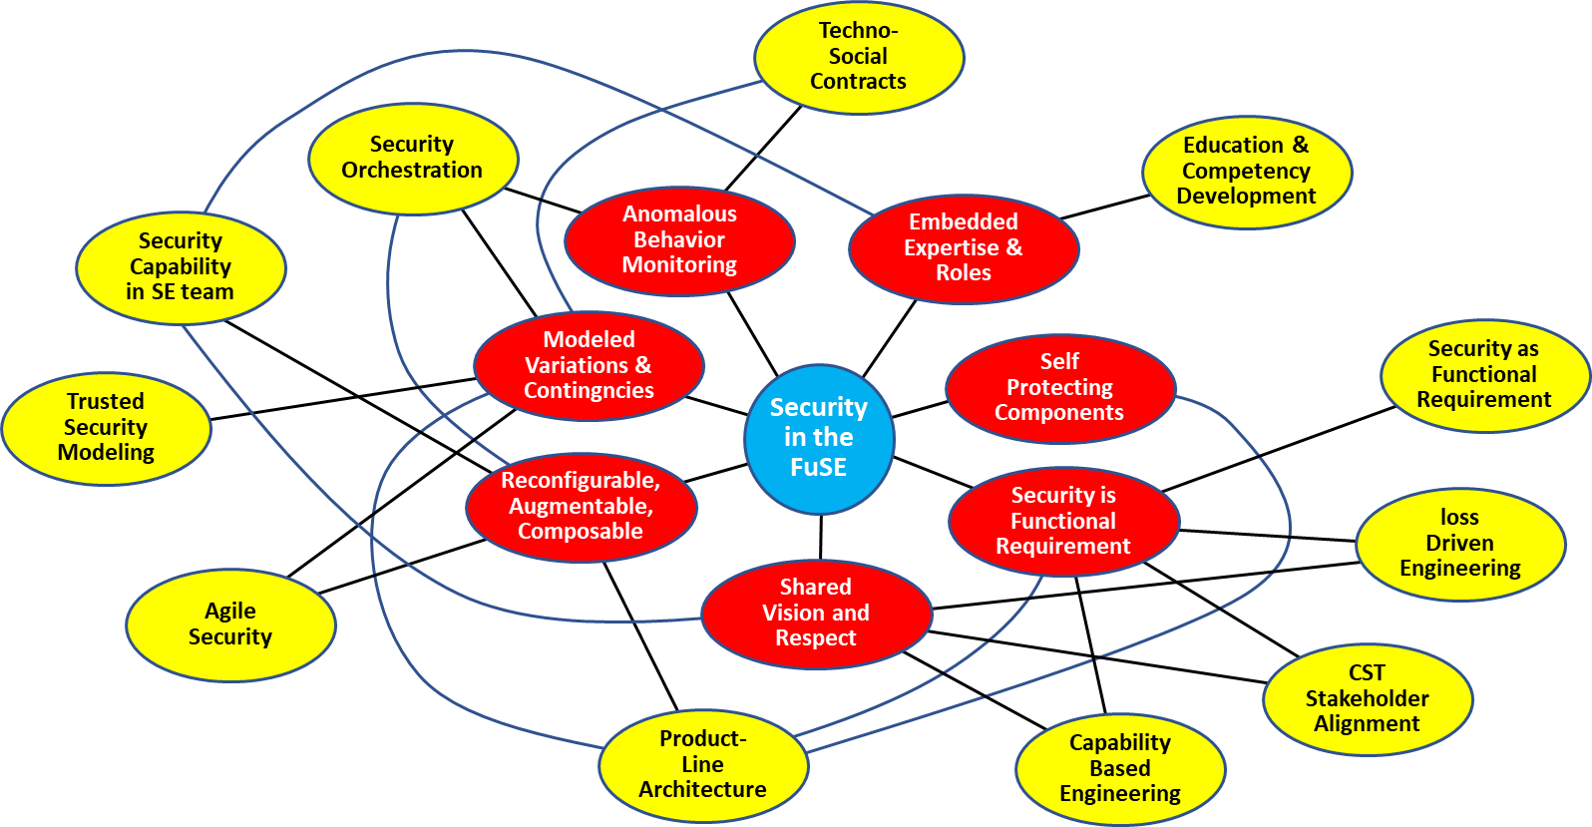
Activity Web
Goals
Embedded Expertise & Roles
Reconfigurable, Augmentable, Composable
Anomalous Behavior Monitoring
Modeled Variations & Contingencies
Self-Protecting Components
Security is Functional Requirement
Shared Vision & Respect
Topics to Goals
Security expertise, competencies, and roles in the SE team, 1-2-4-7
Trusted security modeling, 4
Agile security, composable and resilient, 2-4
Capability-based engineering, 6-7
Security orchestration, 2-4-5
Techni-social contracts, 3-4-5
Product-line security architecture, 2-4-5-6
Loss driven engineering, 6-7
Critical systems thinking for stakeholder alignment, 6-7
Security as a functional requirement, 6
Education and competency development, 1

Slide 8
NIST SP 800-53 Revision 5
Table 1: Top Industry Concerns – NIST SP 800-53 Revision 5
Topic | Concern | Recommendation
Security and Privacy Engineering Principles | If the current level of detail in the SA-8 controls is placed on contract, the USG will be directing “how” to design verses allowing contractors to use these principles and identify strengths within their system designs. If a checklist / compliance approach is used, this control will be extremely difficult to evaluate. | Provide clarifying statement at the SA-8 control level addressing concern
Integration of other Special Publications | While some references to other SPs are included 800-161, 800-160, etc, there is not clear direction on the interconnection between the policies | Add front matter discussing how the Special Publications are interconnected. When referencing another SP from a control, reference the specific section within that SP that applies. Not the entire document.
Cyber Resilience / System Survivability | Cyber resilience and System Survivability were introduced in the updated front matter, but seem like a hanging chad. | Highlight controls that support resiliency and survivability and add additional details in the supplemental guidance.
SCRM Tracing | Need to understand what controls in other families are related to the SCRM controls | Add trace of SCRM controls to controls in other families that support SCRM
Clarify definition of “domains” | The terms “cross-domain” and “different security domains” are used throughout the document. | Need to clarify the differences between the two terms to prevent confusion.
Anti-Tamper | Need to clarify differences between Tamper and Anti-Tamper, which has additional connotations | Update definitions. Reference other USG publically available policies and offices that specialize in Anti-Tamper
Call for comments went out on 22 April
CRMs submitted and collated
Committee meeting to review comments and select top concerns held on 19 May
Approved for Public Release

Slide 9
Backup

Slide 10
2020 Plans / Events / Milestones
Primary Focus: IEEE NDIA INCOSE System Security Symposium, 6-9 April 2020
Collaboration/engagement with NNSA, JFAC, Services, OSD
Support OSD Standardization Efforts – Data Item Descriptions, Work Breakdown Structure, etc
Help establish a Software Assurance Committee in conjunction with JFAC
SCRM Community of Interest awareness and participation
Provide recommendations based on recent NDIA Survey on SCRM
Air Force policy review to minimize compliance activities
Advocate for a program perspective on CDI – implementation and impacts
Standards review, comment, and analyze as appropriate:
  NIST 800-53 Rev 5 Security and Privacy Controls for Federal Information Systems and Organizations
  SAE G32 Cyber Physical Systems
  Cybersecurity Maturity Model Certification
  NIST Special Publication 800-161 - Supply Chain Risk Management Practices for Federal Information Systems and Organizations
  NISTIR 8276 - Key Practices in Cyber Supply Chain Risk Management
  DoDI & DoDM 8140 Cyberspace Workforce Management
Review and consider SSE related impacts of 5000.02 update

Slide 11
System Security Engineering Committee
Mission / Purpose | Stakeholders / Sponsors / Collaborators
To promote System Security Engineering integration into the Systems Engineering and Mission Assurance processes in the Department of Defense (DoD) acquisition of weapon systems. Chair: Holly Dunlap Co-Chair: Cory Ocker | Stakeholder: OSD (R&E) Government Liaison: Melinda Reed Collaborating organizations: AF CROWS, NAVAIR 4.0, JFAC, NNSA, SAE, INCOSE, IEEE
2019 Accomplishments | 2020 Plans / Events / Milestones
Accomplishments (see chart 4): Projects & Initiatives Information Exchange Committee Chair Representation Events: 20+ SSE Track Briefings at NDIA Systems & Mission Engineering Annual Conference Publications reviewed: 4 standards/guidebooks/policies reviewed and commented on | Planned Activities Collaboration with OSD, Services, JFAC, NNSA SCRM Community of Interest AF Policy Review to minimize compliance activities Planned Events IEEE, NDIA, INCOSE System Security Symposium April 2020 Planned Publications Standardization – DIDs, WBS 5000.02 Review OSD Org Chart with SSE Swim Lanes

Slide 12
Mission / Purpose
To promote System Security Engineering integration into the Systems Engineering and Mission Assurance processes in the Department of Defense (DoD) acquisition of weapon systems. To foster the development of System Security Engineering methods, tools, techniques, and processes required for the role of System Security Engineers. To provide a forum for the open exchange of ideas and concepts between government, industry, FFRDC and academia. To develop a new understanding of System Security Engineering and the critical role it plays to ensure system survivability in a cyber contested environment.

Slide 13
Goals
The System Security Engineering (SSE) Committee seeks to:
Advance SSE technical and business practices within the aerospace and defense industry.
Focuses on improving delivered system security performance including survivability, resiliency, and affordability.
Promote and emphasize excellence in systems security engineering throughout the program life cycle and across engineering and non-engineering disciplines required for a holistic approach to system security and program protection.

Slide 14
Objectives
Lead projects in areas that challenge the role and responsibility unique to System Security Engineering.
  Projects may include but are not limited to providing a system security engineering industry perspective on draft or current System Security Engineering relevant government policies, government instructions, industry standards, industry best practices, customer requirements, risk management, etc.
Support security specialty projects and initiatives by providing a system security engineering perspective that directly effects and interfaces with system security engineering.
Encourage and promote the advancement, education, and skill development of the role of system security engineering.

Slide 15
How do we operate?
NDIA Systems Engineering Division (SED) Planning meeting in December.
  Attended by OSD & Services Executive Leaders & NDIA SED Committee Chairs
  OSD & Services communicate their plans and priority needs for the next year.
Committee Chairs work with their committee to draft a list of priority challenges & candidate projects.
1st meeting of the year, present both the Government SSE challenges and Industry SSE challenges.
The Committee then reviews and proposes projects to address the challenges / needs.
This process establishes the plan for the year. However as opportunities and needs are presented throughout the year, the committee has the opportunity to consider updating the plan.
The SSE Committee typically meets the afternoon of the NDIA Systems Engineering Divisional meetings which are posted on the NDIA Systems Engineering website. We also send out an e-mail to NDIA SSE Committee members so please let us know if you’d like to be added to the committee email list.
We welcome and encourage participation at all skill levels.
Welcome and highly encourage committee members to lead projects and foster collaboration with other security specialty committees and working groups.
*** The number of projects, workshops, collaborations etc. along with the depth, quality, and level of rigor is dependent on the committee members commitment.

Slide 16
2019 Accomplishments
Activity | Title
Projects & Initiatives | USAF Weapon System Program Protection and System Security Engineering Process Guidebook NDIA Critical Program Information (CPI) Assessment and Identification Guide (CAIG) DoD DRAFT Software Acquisition Pathway Policy Guidance Cyber Secure & Resilient Approaches for Feature Based Variation Management IEEE, NDIA, INCOSE System Security Symposium April 2020 NDIA Systems & Mission Engineering Annual October Conference NIST SP 800-160 Developing a Cyber Resilient Systems Vol 2: A Systems Security Engineering Approach
Information Exchange | DASD(R&E) Sponsored SEI SwA Products, PM & Designer Guide DoD Cyber Workforce Management SAE G32 Cyber Physical Systems ASD(R&E) Cybersecurity Challenges – Protecting DoD Unclassified Information NAVAIR CyberSafe AF CROWS Program Protection and System Security Engineering Tools ASD(R&E) CRWS Workshop Series
Committee Chair Rep. | SecNav Cybersecurity Advisory Panel Meeting Collaboration on Quality in the Space & Defense Industries Forum, March 2019

