Slide 1
System Engineering Division Monthly Meeting
March 24, 2022

Slide 2
AGENDA
1100-1115 Welcome & Announcements
1115-1145 USAF call for input on Guidance
1145-1215 ADAPT Committee Overview/Discussion
1215-1230 SE/ME Conference Call for Papers
and Discussion
1230-1300 Digital Systems Engineering Initiative
1300- 1330 Committee Updates and Discussion
John Daly, NDIA SED Vice-Chair
ZACHARY MILAM, C NH-04 USAF AFMC AFLCMC/EZSI
NDIA SED ADAPT Committee
Chris Schreiber, NDIA SED Vice-Chair/Pat Griffin
Conference Committee Chair
John Daly, NDIA SED Vice-Chair
All

Slide 3
NDIA SED USAF Call for Input

Slide 4
NDIA ADAPT Working Group Agile Delivery for Agencies, Programs, and Teams
Scott Sinclair
Robin Yeman, Catalyst Campus
Suzette Johnson, Northrop Grumman

Slide 5
What is ADAPT?
Community of Interest focused on the adoption of Agile principles and practices in DoD and other federal agencies
Educate, inform, and promote adoption
Identify barriers to adoption and propose solutions
Subject Matter Experts with similar interests
Government organizations looking to change
Industry practitioners (consultants, tool vendors, solution developers)
FFRDC/Academia investigating adoption of agile
Collaboration to advance Agile adoption in government and industry
Bi-weekly calls for planning events and responses to DoD/Federal policy
Sponsor of the annual Agile in Government Summit since 2010
Periodic Workshops to address specific challenges and opportunities

Slide 6
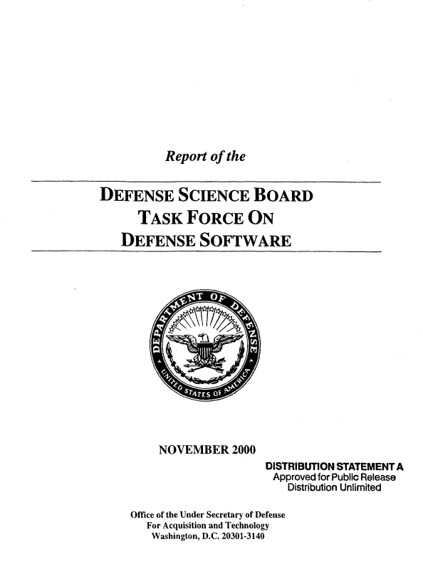
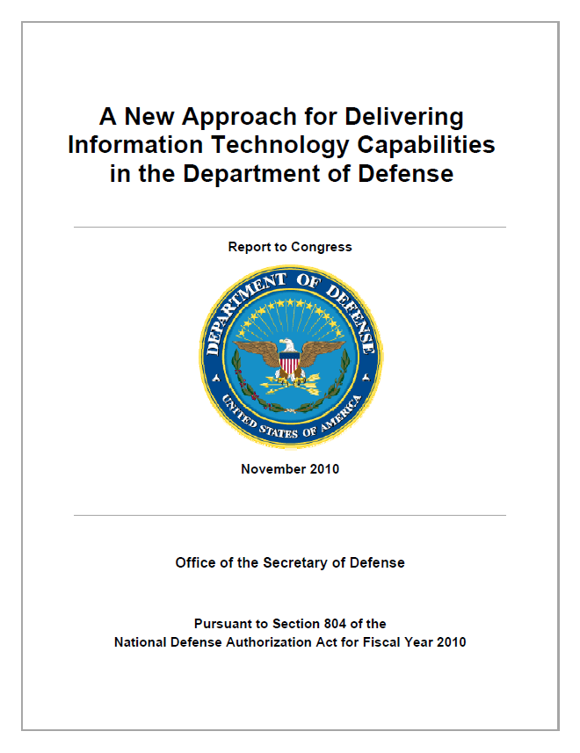
Purpose
Formation
Section 804 Task Force
DoD Agile Development Conference, December 2011
Established Agile Defense Adoption Proponents Team (ADAPT) as a Working Group under NDIA affiliate organization AFEI
Recognition that people, process, technology, and the way we work are impacted by adoption of Agile methods
Rebranded ADAPT in 2014 as Agile Delivery for Agencies, Programs, and Teams to embrace the growing Agile community across federal agencies
Purpose
Facilitate industry-government interaction on Agile principles in programs, projects and procurements
policy, legislative, legal and technical areas
understanding, assessing and implementing agile methods
management/governance, processes, contracts
Create forums for sharing successes and identifying challenges and potential solutions

Slide 7
Objective
Contribute to the national security of the United States by promoting communication and interaction between industry, government, military services, and academia on the adoption of agile methods in IT and software and systems engineering, acquisition, legislation, requirements and technology.
Build a community of practitioners and proponents of Agile methods in the DoD and Federal Agencies to include the acquisition arena and to showcase proven techniques, and associated concepts, tools and training.
Promote understanding of Agile methods and their implications, adoption requirements, and benefits.
Host Agile workshops that focus on bringing together recognized experts in the Agile domain to address specific adoption challenges in the Defense acquisition system and make the outcomes publicly available.
Embed Agile methods in Defense Acquisition curricula.

Slide 8
Who is ADAPT?
Scott Sinclair | Suzette Johnson Northrop Grumman | Robin Yeman Catalyst Campus
Richard Cheng Excella Consulting | Mark Fabian PMI | Will Hayes Carnegie Mellon University Software Engineering Institute
Geoff Draper L3Harris Technologies | Stosh Misiaszek Scaled Agile | Dan Weikart Cprime
Dennis Ebersole Perspecta | Ken Mills Digital.ai | Eileen Wruble Carnegie Mellon University Software Engineering Institute

Slide 9
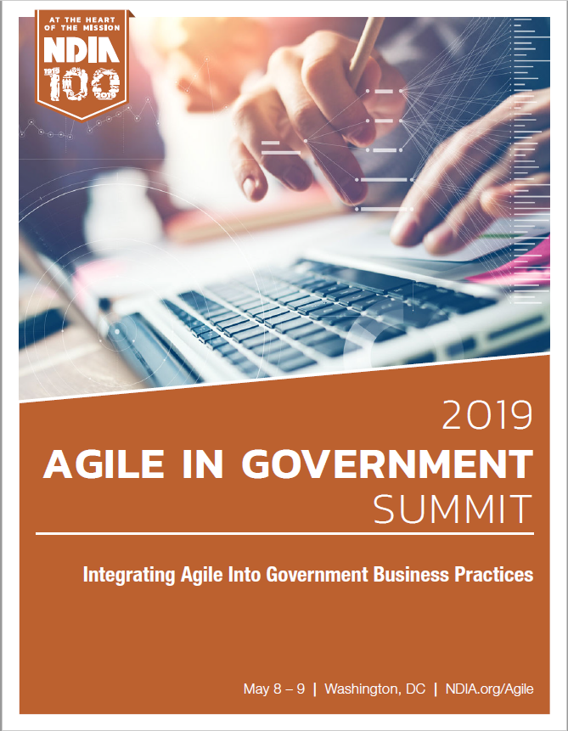
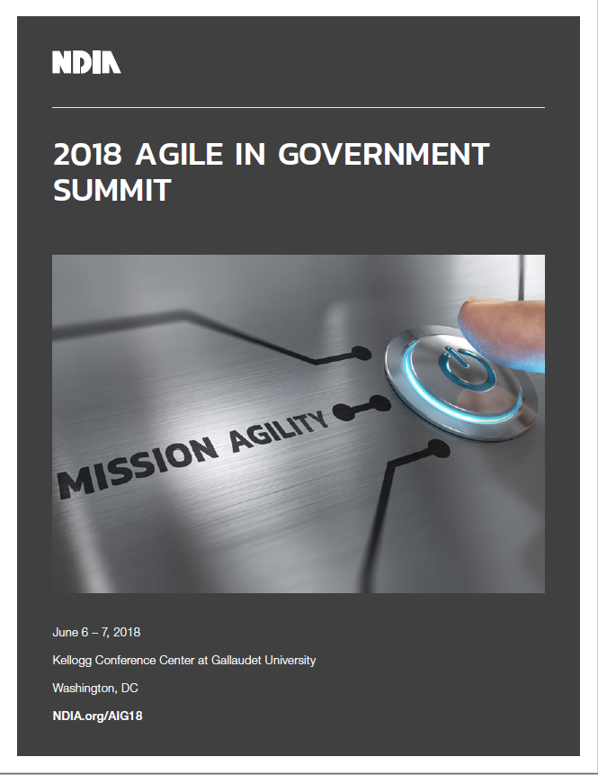
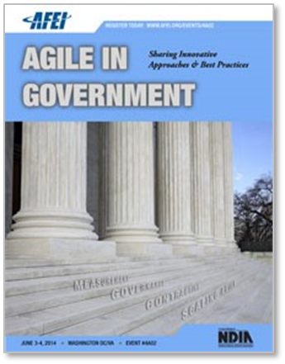
Agile in Government Summit
Previous Summit Highlights
2019: Integrating Agile into Government | Maj Gen Patrick Higby, SAF/AT&L Dr. Jeff Boleng, OUSD (A&S) Sean Brady, DAU | Multiple Tracks
2018: Mission Agility | Maj Gen Sarah Zabel Dr. George Duchak, DASD (C4&NBS) | VADM Joseph Dyer (Ret) Dr. Matt Kennedy, Treasury
2017: IT & Beyond | Leonel Garciga, JIDO Dr. Don Reinertsen, Author | Dr. Steve Mayner, Scaled Agile DevOps in the IC Panel
2016: Enterprise DevOps | Gene Kim, Author Mark Schwartz, CIO, USCIS | Gary Bliss, OUSD (PARCA) James McConnell, NNSA

Slide 10
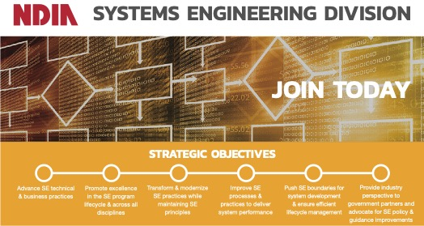
NDIA Systems Engineering Division
Committees
ADAPT
Architecture Committee
Automatic Test Committee
Education and training Committee
Safety and Environmental Engineering
Government Liaison
Human Systems Integration
Modeling Simulation Committee
System of Systems Engineering Committee
Systems Security Engineering Committee

Slide 11
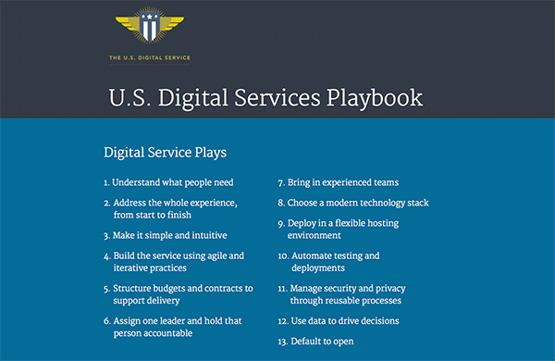
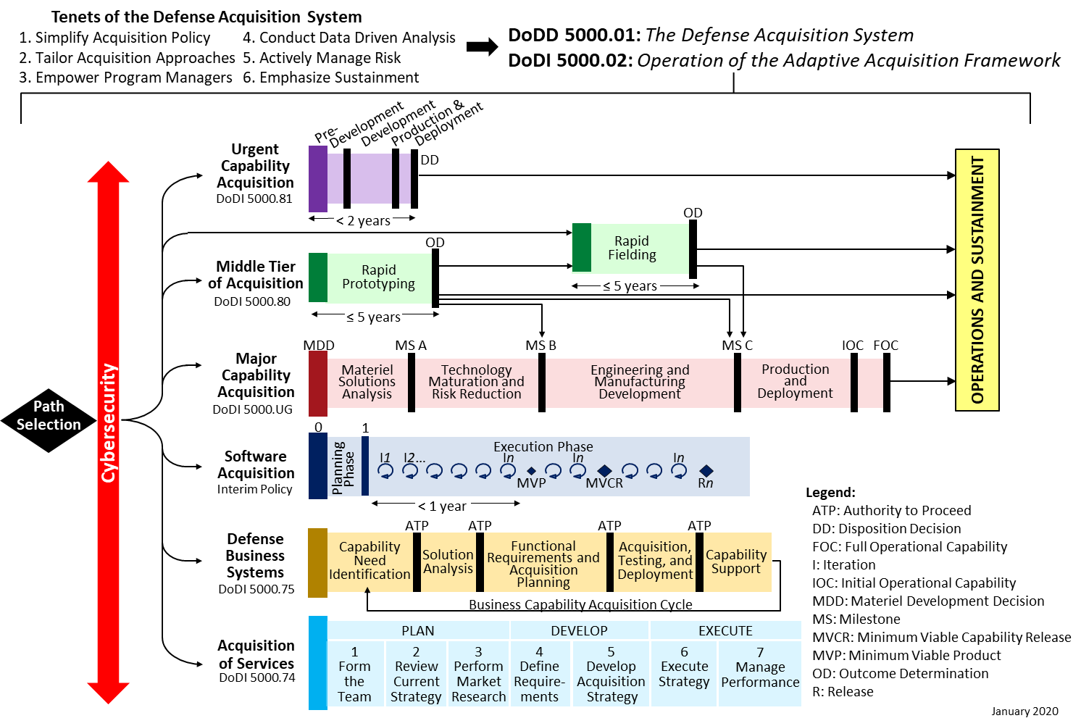
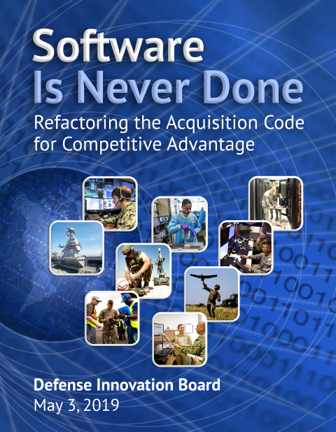
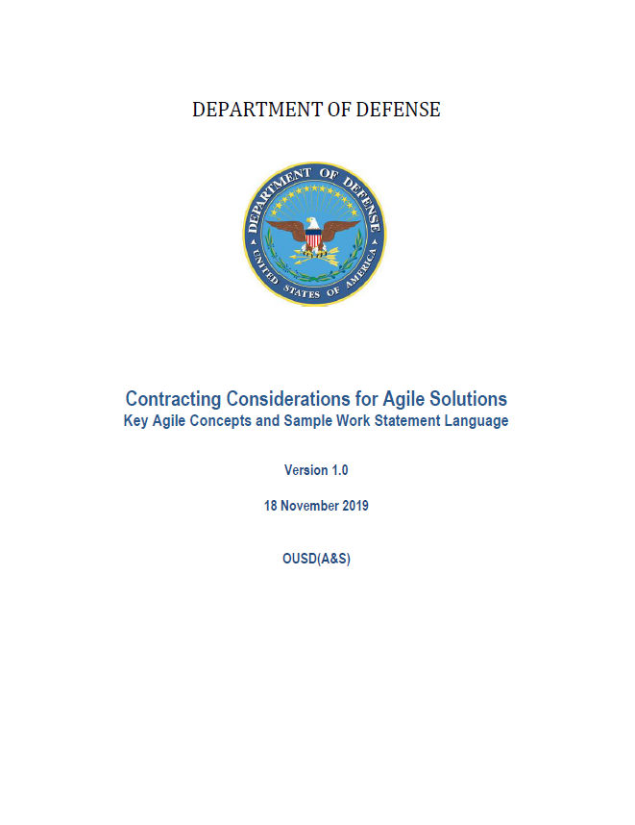
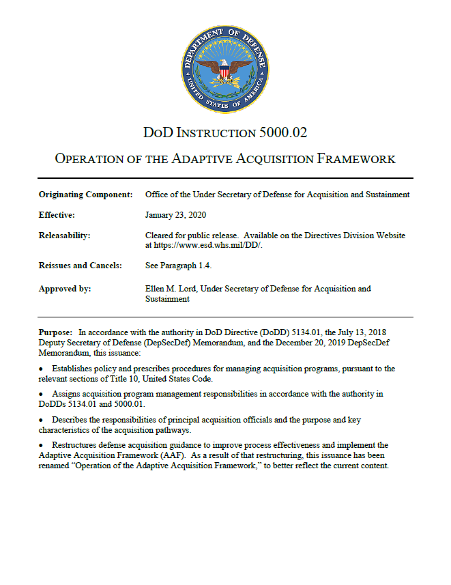
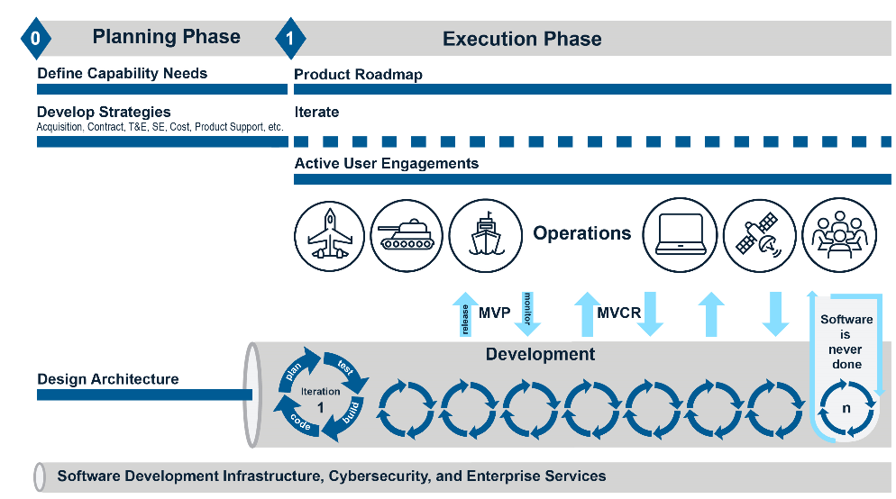
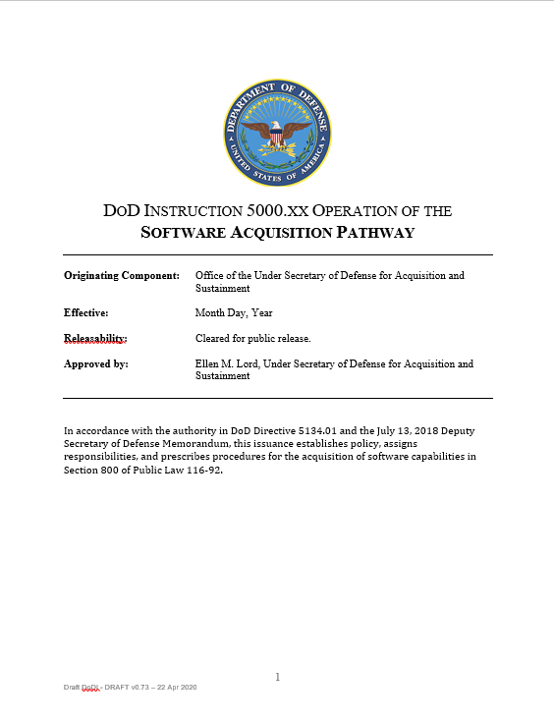
Federal/DoD adoption has passed a tipping point and is now becoming mainstream

Slide 12
COVID-19
Workshops / Conferences halted
Government Leadership cycled
Membership waned
Moved within SE division

Slide 13

















ADAPT DE Value Stream
Software
Factory
Cyber
Begins with a need
Virtual
Reality
Digital Value Stream begins with Customer and User empathy
Move from predictive to empirical planning increasing mission agility
Need to be iterative and incremental to minimize rework and maximize value
Increase or ability to innovate with minimal risk
Identify patterns and trends in data to improve decision making.
Moves data from text to a story
Enhances speed, precision, and effectiveness of human efforts.
Use modeling to learn quickly
Augments human performance by seamlessly connecting them to the machine
Decrease Latency while increasing efficiency
Mission and resource safety
Dojos enable guardians to learn faster and retain more.
To optimize value delivery its important to understand the Digital Engineering Value Stream
Another tool in digital engineering toolbox to reduce lead time.
Allows teams to deliver capabilities faster, consistently, and securely with minimal risk
Bridges the gap between virtual and physical world further improving common understanding.
AI/ML
Provide immersive experience to improve common understanding.
Requirements
And
Discovery
Human
Machine
Interface
Edge
Planning
Digital Twin
Data
Aggregation
Modeling
3D
Printing
Augmented
Reality
Data
Visualization
Ends with value
To warfighter
Immersive
Education

Slide 14







Space Force Hypothetical Vignette
Threat
Identified
Virtual Threat
Conference
Short Term /
Long Term
Enduring
Solutions
T - 0
T + 2H
T + 36H
T + (6-28)D
Fused Intel from AI Engine Identifies a potential threat
Alerts are sent to joint community
Participants engage with via immersive VR
Wargame scenario results inform tiered COA
Sat Com SW updated to implement TTP
Develop C2 changes to formalize adhoc TTP
Longterm solutions investigated
Federated models reviewed to assess ramifications to baseline
Reuse and rapid aquision completed
T + 5M
T + 12H
T + 5D
Enterprise Scheduling System identifies stakeholder availability and meeting times
Experts develop threat models
Senior Leaders Monitor Status
COAs Initiated, tasking sent
Realtime Data exchange and collaborative decisions made through DEE
Requirements reviewed
Software Developed
Models updated
Digital Twins updated
Documentation updated
Contingent
Response
Guardians Take
Action
Digital Solutions
Developed
Identification to enduring solution in weeks

Slide 15


ADAPT Roadmap FY22
Q1
Q2
Q3
Q4
MILESTONE
MILESTONE
MILESTONE
MILESTONE
Review and Update ADAPT FY22 Goals and Website Updates/
Enhancements
Linked In Page updates
Collaborate with Incose Agile across the value stream
Prepare article for LinkedIn or NBI
Interact with other NDIA Functions for potential support (ex. IPMD)
Collaborate with DAU on for upskilling workforce
Support Navelx workshop
Prep S&ME Conference
Linked-In Blog and paper
Revisit ADAPT FY22 Goals
Begin Breakfast Talk
again
S&ME Conference
Prepare article for LinkedIn or NBI
Notes:
https://www.ndia.org/divisions/systems-engineering/committees/adapt

Slide 16
NDIA SED SE/ME Conference Call for Papers Discussion

Slide 17
NDIA SED Digital Systems Engineering (DSE) Initiative
March 8th – Held initial Brainstorming meeting with NDIA SED Committee chairs and co-chairs
Key initiatives in this DSE area are being pursued today in SED Committees
E&T Committee: Digital Acquisition
Architecture Committee: MOSA and Digital Engineering/Architectures
M&S Committee: Modeling and Simulation and Digital Engineering
Mission Engineering/SoS: Digital Engineering in Mission Engineering and SoS vice System emphasis in DSE
ADAPT Committee: Agile and Digital Engineering
Others?
Planning for this Digital cross-cutting effort discussed with Committee Chairs/SED leadership. Plans made for Kickoff open to all of SED and invited SME’s 1st week in April

Slide 18
NDIA SED Digital Systems Engineering (DSE) Initiative (2)
Basic plan is for a once monthly SED working group (with sub-groups as required) to:
Hear from each committee plans in DSE – related digital activities: ME/SoS, M&S, Architecture, E&T, and ADAPT and others
WG review of SED ongoing activities and look for synergy points, and gaps. Synergy will be enhanced as visibility/participation is increased between committees, analysis for gaps
Recommend a way forward:
any required SED organization changes to synchronize this digital transformation
identified key gaps (if any)
Develop a “Vision”/”Future State” for how we see this digital transformation evolving in our Division, with input/collaboration from our member companies, and USG partners
Brief out a summary for the 2022 SE Conference, and provide to member companies and the USG partners

Slide 19
NDIA SED Committee Updates and Discussion

Slide 20
24 March 2022 NDIA Systems Engineering Division (SED) Meeting Safety and Environmental Engineering Committee (SEEC) Report
Industry Chair: Mr. Tim Sheehan, Raytheon Technologies
Government Liaison: Mr. Sherman Forbes, SAF/AQRE
20

Slide 21
NDIA SEEC 2022 Priorities
1. Integrate specialty engineering disciplines risks and requirements management (such as safety and environmental) into Digital Engineering/Model-Based Systems Engineering
2. Provide an opportunity for Industry to provide inputs to the DoD Joint System Safety Standards Working Group (JSSSWG) efforts to evaluate Non-Governmental Standards (NGSs) for system safety to determine if one or more NGSs could meet the requirements for DoD Programs' management of mishap risks and should be adopted to replace MIL-STD-882E; and if not, then proceed with updates to MIL-STD-882E
3. DoD and Industry Hazardous Materials Management joint efforts
4. Continue to expand Industry Safety and Environmental Engineering Subject Matter Experts (SMEs) participation in the SEEC
21

Slide 22
27 April 2022 SEEC Meeting
SEEC meeting at 1030-1200:
Audio: Dial-in - 800-300-3070, Access Code - 645 999 200#
APAN (Slides): https://connect.apan.org/ndia-see-committee/
Agenda:
Designing for Safety in MBSE
Mr. Michael Hurley of BAE Systems, Inc.
Head of Product Safety, Electronic Systems Sector
Chair, Product Safety & Environmental Working Group
Global Engineering Fellow
DoD and Industry Hazardous Materials Management Update
Mr. Tim Sheehan of Raytheon Technologies
JSSSWG Status
Mr. Forbes, SAF/AQRE
22

Slide 23
NDIA System Security Engineering Committee March 24, 2022
Cory Ocker
Raytheon
NDIA SSE Committee Chair
Cory.L.Ocker@Raytheon.com

Slide 24
NDIA SE Architecture Committee Report March 24, 2022
Bob Scheurer
Ed Moshinsky

Slide 25
SE Architecture Committee
Mission / Purpose | Stakeholders / Sponsors / Collaborators
Mission: Grow Relevance, Usefulness, and Awareness of System Architecting and Architectures in National Defense Systems and Applications Purpose: To Facilitate Acumen and Successful Outcomes from System Architecting and Architectures Leadership: Bob Scheurer, Boeing; Ed Moshinsky, OUSD(R&E) | Stakeholders: Defense Industrial Base Members, DoD, & Services Sponsor: Nadine Geier, OSD R&E Collaborators: INCOSE, AIA, DoD MOSWG; Membership: 110+ members from government/services, industry, and academia. Business Rhythm: Bi-weekly telecons; sub-committee/ working groups/focus teams as needed.
Accomplishments | 2022 Plans / Events / Milestones
On-Going Bi-Weekly Full Committee Meetings On-Going Bi-Weekly Sub-Committee Meetings (e.g., MOSA Metrics) and Special Meetings, as Needed Participating in DoD’s MOSA (MOSWG) and Tiger Team(s) Participated with NDIA Manufacturing Division / Supply Chain Network Committee: Ethan Plotkin, Chair, “Helping OSD Do Sustainment Better” Participated in PSM’s Digital Engineering (DEWG) Working Group: Functional Completeness and Volatility Metric Participated in Paul Jonas Army MOSA Metrics Working Group Activities/Surveys (They are now also participating in our NDIA SE Architecture Committee metrics work) MOSA White Paper and Supporting Briefings | Focus on MOSA Metrics / Metrics Sub-Committee MOSA Metrics Guidebook Development MOSA Metrics Use Cases MOSA Metrics Candidates Superset & Selection Process Individual MOSA Metrics (via PSM Method) Contracting Language Joint NDIA Effort on Agile MOSWG & Tiger Teams Support: MOSA Outreach, et Digital Engineering Working Group Support Mission Engineering Working Group activity Modularity & Openness Partitioning and Representations in Architecture Models Other Relevant Plans/Support Areas SE Modernization w/Nadine Geier, OUSD(R&E) SE Director Reference Architectures

Slide 26
Architecture Committee March 2022 Activity Status Summary
INCOSE IW2022 Participation (Jan 2022)
New SE Guidebook Review (Feb 23 Meeting)
MOSA Metrics Use Cases ID and Guidebook Development (On-Going)
OSD Tiger Teams Participation (On-Going)
AIA Collaboration on Digital Engineering (On-Going)
Digital Engineering Metrics (On-Going V0.95 - Draft Guide Comments Review)
Mission Engineering Guide V2.0 Update Support
Joint NDIA Committee Projects
Agile Working Group (Bob Scheurer, Ed Moshinsky, et. al.)
Exemplar Digital Acquisition Thread Pilot (Robert Raygan, et. al.)
Digital Systems Engineering Working Group (John Daly, et. al.)
SE Modernization Support (Paused)

Slide 27
Backup & Reference

Slide 28

MOSA Implementation Recommendations* (Items Underlined and Marked in Green Represent Current Follow-On Focus Efforts)
1) Develop MOSA strategy and objectives early in the acquisition process
2) Define MOSA implementation approach (acquirer and supplier roles)
3) Define interfaces within the System of Systems in terms of MIL-STD-881D Taxonomy Levels of Detail and leverage existing Open System Architectures for lower levels of detail
4) Apply MOSA in software architectures at appropriate levels of abstraction and complexity
5) Implement MOSA as part of a larger and more robust Digital Engineering strategy
6) Incorporate cybersecurity strategy in a MOSA application at the time of initial design, not as a later addition
7) DOD and industry work together to define how to evaluate MOSA
8) Develop and implement enablers with appropriate investment to affect culture change required for successful widespread adoption of MOSA
9) Create Library of MOSA Systems and Interfaces
10) Define a means for comparing and specifying standards and interfaces for a MOSA-enabled environment.
* From NDIA Systems Engineering Division Architecture Committee White Paper Dated July 1, 2020

Slide 29
Architecture Committee Products
MOSA Recommendations & White Paper Folder on Committee’s Collaboration Site hosted by Mitre
External Links to MOSA White Paper Public Resources
White Paper
Presentation

Slide 30
DoD Initiatives Support by NDIA Architecture Committee
DoD Initiative | Prime DoD Objectives | NDIA Architecture Committee
Modular Open Systems Approach (MOSA) | Enduring Platform Relevance Improved Capabilities | MOSA White Paper: Acquirer and Supplier Recommendations MOSA Metrics / Application Guidance Joint Approach Definition w/DoD
Digital Engineering (DE) | Accelerate Developments Generate Cost/Schedule Efficiencies | DE Metrics Initiative
Mission Engineering (ME) | Optimize Mission Outcomes of SoS Identify Capability Gaps | Contributor to ME Phase II Study (2019) Monitoring Aligning Focus: SoS Architectures
Systems Engineering (SE) Modernization | Digital Engineering Mission Engineering MOSA Agile Software/Systems | Monitoring Collaborating on Joint NDIA Initiative

Slide 31
NDIA Test & Evaluation Division
2021 S&ME Conference provided strategic value to the T&E Division
Honorable Nickolas H. Guertin confirmed as Director, DOT&E
Industrial Committee on Test & Evaluation (ICOTE) meets on 3/25
2022 Division Focus: Model Based Systems Engineering
Capabilities Based Test and Evaluation Acquisition Guide Status
2022 S&ME Conference Collaboration / Partnership

