Slide 1
Implementing Continuous Iterative Development and Acquisition
Executive Summary
NDIA Systems Engineering Division
in partnership with INCOSE and PSM
22-Apr-2019

Slide 2
Background
Defense Science Board (DSB) released a report in Feb-2018 containing seven recommendations regarding software design and acquisition. Section 868 of NDAA 2019 mandates implementation of these recommendations within 18 months.
The Defense Innovation Board (DIB) Software Acquisition and Practices (SWAP) study group has also provided many insightful and largely compatible recommendations.
NDIA, INCOSE and PSM support the DSB and DIB concepts and the opportunities they offer to DoD and the defense industry.
  NDIA offers the recommendations herein to ASD(A&S) and ASD(R&E) representing an “industry perspective” on path forward.
  NDIA appreciates the opportunity to partner with DoD on implementation.

Slide 3
DSB SW Task Force Recommendations
Software Factory – A key evaluation criteria in the source selection process should be efficacy of the offeror’s software factory.
Continuous Iterative Development – DoD and defense industrial base partners should adopt continuous iterative development best practices for software, including through sustainment.
Risk Reduction and Metrics for New Programs – For all new programs, starting immediately, implement best practices in formal program acquisition strategies (multiple vendors and down-selects, modernized cost and schedule measures, status estimation framework)
Current and Legacy Programs in Development, Production, and Sustainment – for ongoing development programs, PMs/PEOs should plan transition to a software factory and continuous iterative development.
Workforce – The U.S. Government does not have modern software development expertise in its program offices or the broader functional acquisition workforce. This requires Congressional engagement and significant investment immediately.
Software is Immortal: Software Sustainment – RFPs should specify the basic elements of the software framework supporting the software factory… reflected in source selection criteria
IV&V for Machine Learning – Machine learning is an increasingly important component of a broad range of defense systems, including autonomous systems, and will further complicate the challenges of software acquisition.
The NDIA working group developed consensus recommendations responding to each of the 7 DSB findings:
Assumptions
Picture of Success (End State)
Current State
Description
Obstacles
Path Forward
This briefing is an executive summary of those recommendations. Detailed report provided separately.

Slide 4
Framing Assumptions
Continuous iterative development (CID) methods have cross-functional implications. The scope includes not just SOFTWARE but also SYSTEMS ENGINEERING and supporting disciplines.
Software Factories include people, processes, and tools – not just a tool chain.
Funding and contracts must be aligned to support implementation and/or migration to SW factories with life cycle sustainment.
A collaborative approach to Intellectual Property (IP) across the entire acquisition life cycle will be developed that meets both Government and Supplier needs.
A business case can be made for the effective deployment and maintenance of integrated tool chains to build capability throughout the life of the system.
Traditional waterfall-based processes, tools, and measures are generally not well suited to CID.
A skilled SW-informed workforce cadre is available or can be developed across functions
(e.g., software, acquisition, PMs, sustainment).
Cross-cutting assumptions. Refer to the separate detailed report with assumptions specific to each DSB recommendation area.

Slide 5
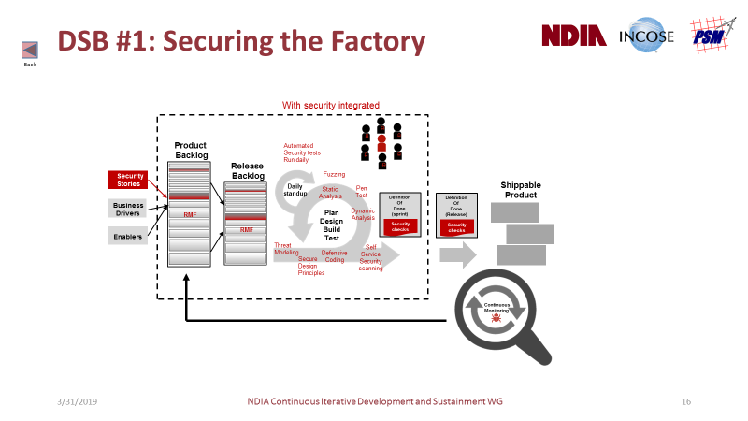
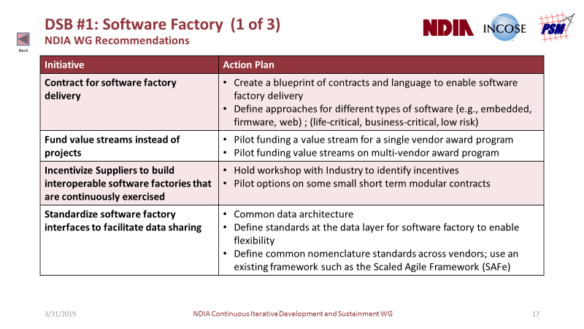
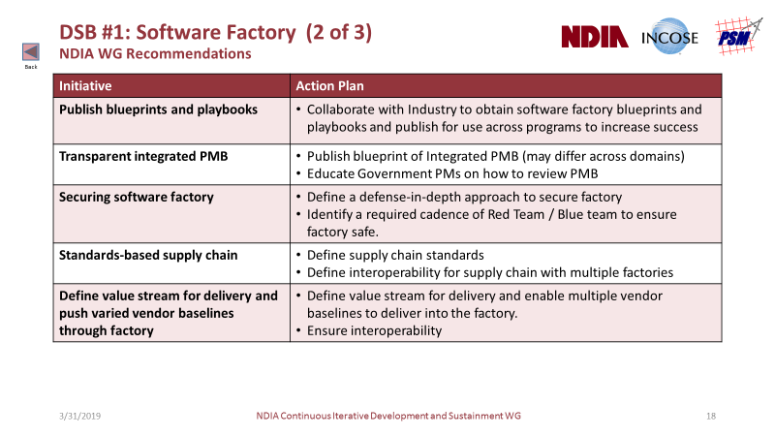
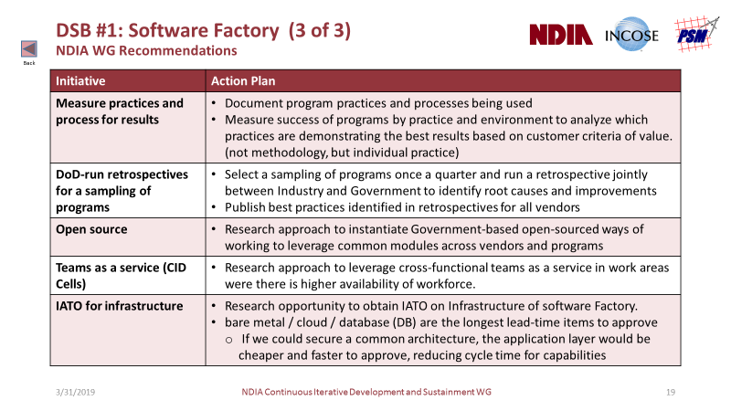
DSB #1: Software Factory
NDIA WG Recommendations
Picture of Success (end state)
People | Qualified factory workforce | Continuous learning (relentless improvement, pipeline feedback)
Process | Integrated PMB Metrics Predictability | Digital Blueprint / Play Book Ontology, Nomenclature Secure Supply Chain Relentless Improvement
Tools | Platform agnostic tool chain Adaptable to change Test automation at all levels | Model-based SW validation vs. architecture Red team / Blue team factory
Security integrated into factory workflows (DevSecOps)
Recommendations for Path Forward:
PMB: Performance Measurement Baseline
Click thumbnails to zoom

Slide 6
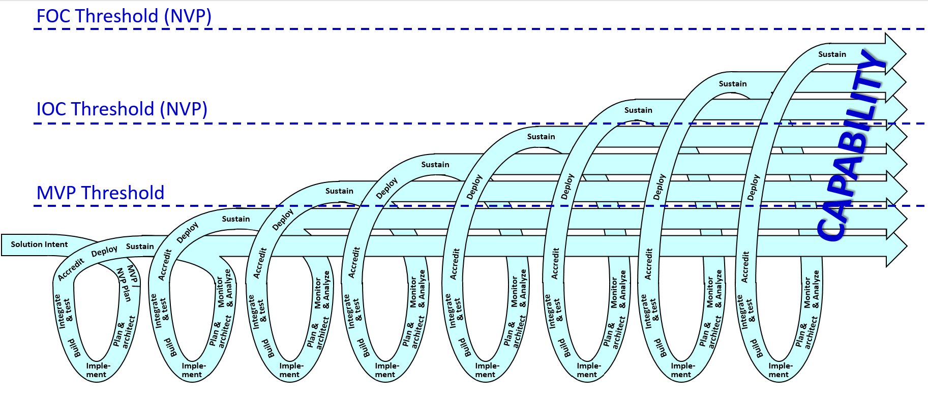
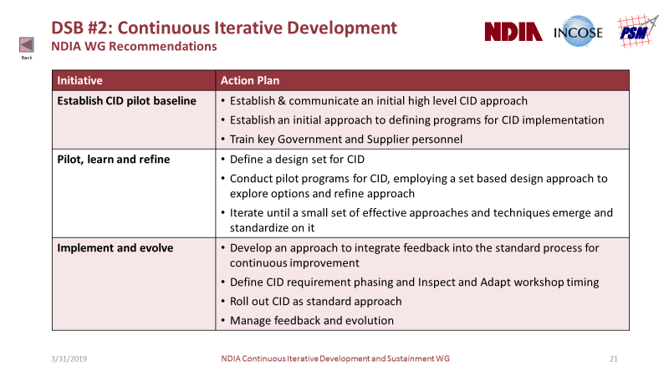
DSB #2: Continuous Iterative Development (MVP)
NDIA WG Recommendations
Picture of Success (end state)
Government / Contractor Interface
Contracting | New programs defined by solution intent (CV-1) Contracts defined by evolutionary viability products (MVP/NVP)
Funding | Contract funding structure supports seamless capability evolution
Stakeholders | Active engagement in CID lifecycle
Design | Guided by MOSA
IP | Government access to source code with negotiated IP protections
Program Execution
People | Multi-discipline agile execution includes aligned milestones Direct user/developer interaction informs design (product owner)
Process | Early SE ➢ SW sequencing, refactoring, tools, environments
Tools | Test automation accelerates delivery (rapid release, deployment)
Procurements based on iterative development of releases according to product capability thresholds
Recommendations for Path Forward:
CID: Continuous Iterative Development FOC: Final Operating Capability IOC: Initial Operating Capability IP: Intellectual Property | MOSA: Modular Open Systems Architecture MVP: Minimally Viable Product NVP: Next Viable Product
Click thumbnails to zoom

Slide 7
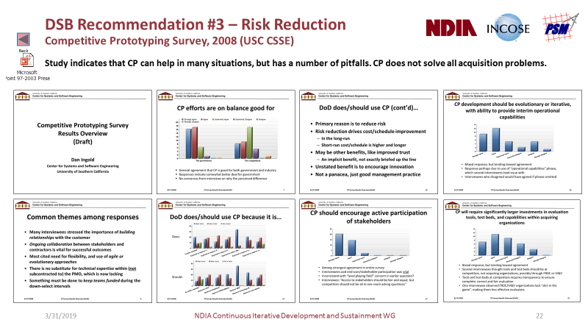
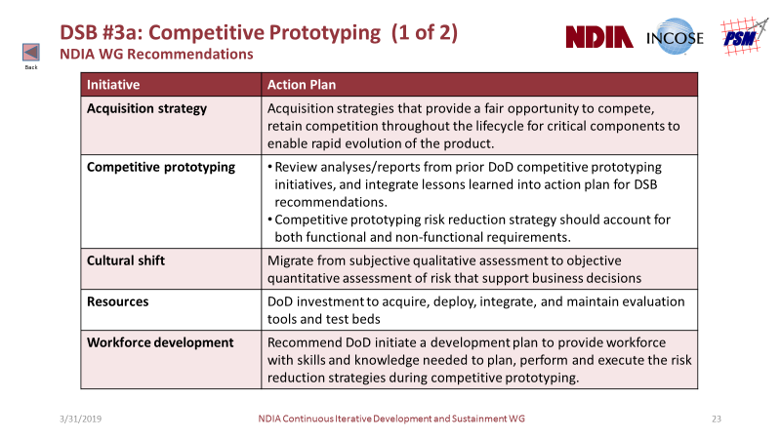
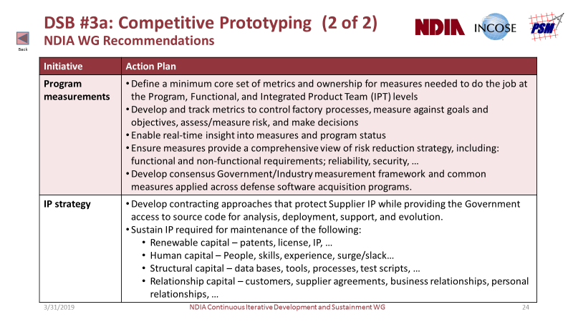
DSB #3a: Risk Reduction (Competitive Prototyping)
NDIA WG Recommendations
Picture of Success (end state)
Competition | Business case: win-win partnership, common goals, acquisition/support strategy Objective downselect evaluation criteria (RFP L&M) and feedback Open architecture on critical components
Contracts | IP agreement negotiated, sustained across the life cycle Funding and contracts aligned to support factory migration
Metrics | Continuous improvement, SMART measures against objectives Risk-based decision making
Resources | Funding, staffing, tools, environments to support multiple teams
Competitive prototyping can help in many situations, but does not solve all acquisition problems.
Recommendations for Path Forward:
IP: Intellectual Property RFP: Request for Proposal SMART: Specific, Measurable, Achievable, Relevant, Time bound
Click thumbnails to zoom

Slide 8
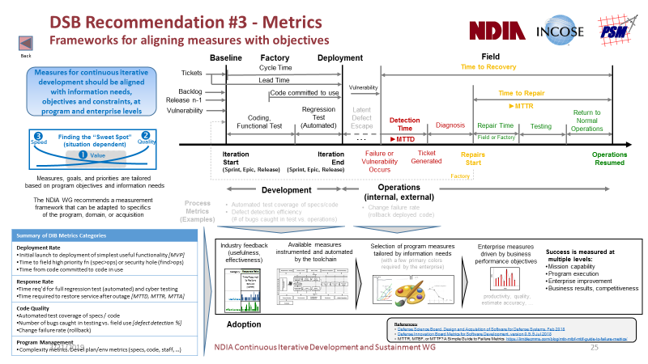
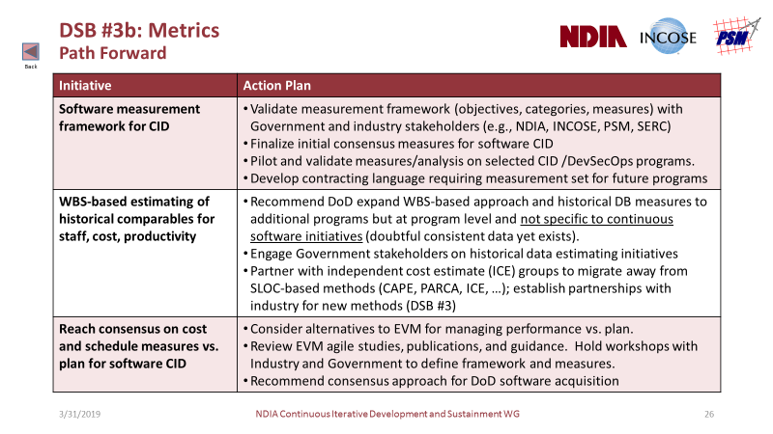
DSB #3b: Measures for CID
NDIA WG Recommendations
Picture of Success (end state)
Consensus frameworks | Objectives first - measures aligned and tailored from information needs, goals and constraints, at program and enterprise levels
Modernized measures | Migration toward consensus alternatives to traditional waterfall and phase-based SW measures (LOC, EVM, milestones, …) Derived from SW factory processes, automated by toolchain Basis for measuring cost and schedule vs. plan
History-based estimates | Repositories collect performance-based measures (e.g., WBS, staff, cost, productivity) supporting future comparisons, basis of estimates, proposals, and program monitoring
Measures for CID should be aligned with information needs and constraints, at program and enterprise levels
Recommendations for Path Forward:
CID: Continuous Iterative Development EVMS: Earned Value Management System LOC: Lines of Code WBS: Work Breakdown Structure
Click thumbnails to zoom

Slide 9
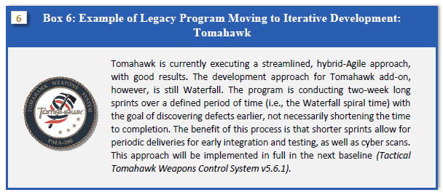
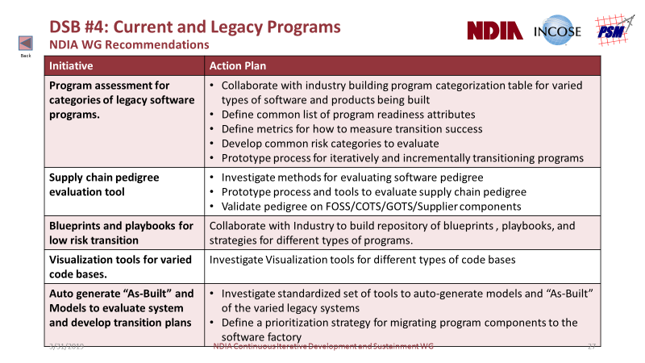
DSB #4: Transition for Current and Legacy Programs
NDIA WG Recommendations
Picture of Success (end state)
People | Skill assessment for gap analysis | Skilled capable workforce for transition on legacy programs
Process | Business case for transition Playbooks and Blue Prints for legacy code transition Assessment of supply chain and SW pedigree (FOSS, COTS, GOTS) | Risk adjusted product backlog Strategies for incrementally building up test automation
Tools | Tools to generate legacy ‘as-built’ documentation and models for legacy code base
Defense Science Board, Design and Acquisition of Software for Defense Systems, Feb 2018
See also: Defense Innovation Board SWAP Study Report: Supplementary Documents, Appendix B.6
Sustainment / Modernization Subgroup Report
Recommendations for Path Forward:
COTS: Commercial Off the Shelf FOSS: Free Open Source Software GOTS: Government Off the Shelf
Click thumbnails to zoom

Slide 10

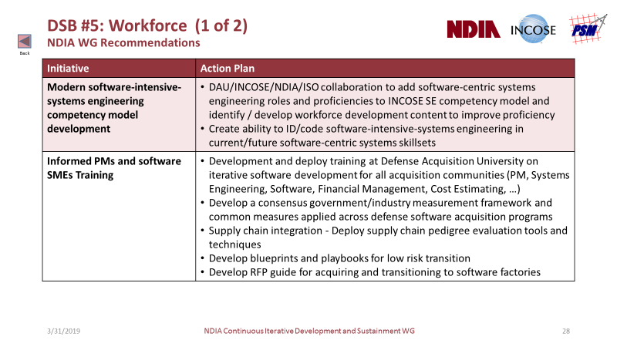
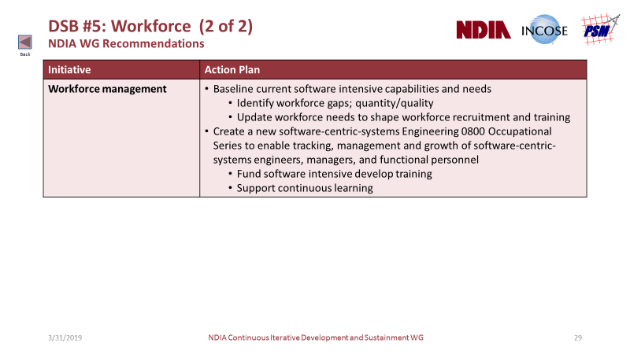
DSB #5: Workforce
NDIA WG Recommendations
Picture of Success (end state)
Education and Training | DAU curriculum for DevSecOps and modern SW-centric systems Community of practice platforms | Training across career fields (PM, sustainment, acquisition) Aligned with current/future development and recruiting needs
Stakeholder Engagement | Collaborative government / industry partnerships Trained experienced industry partners and supply chain | Consensus measurement framework Multi-discipline CID support teams (CDRLs, events, milestones)
Staffing | Increased hiring, retention, training for acquisition experts Recruiting pipeline for SW experts | Dedicated workforce funding and coaches across services PMO IPTs for modern SW practices
Continuous Iterative Software
Development, Acquisition and
Sustainment
DevSecOps
Competency Models
Practical Experience (Boot Camp)
Recommendations for Path Forward:
CDRL: Contract Data Requirements List CID: Continuous Iterative Development DAU: Defense Acquisition University IPT: Integrated Product Team PM: Program Manager PMO: Program Management Office
Click thumbnails to zoom

Slide 11
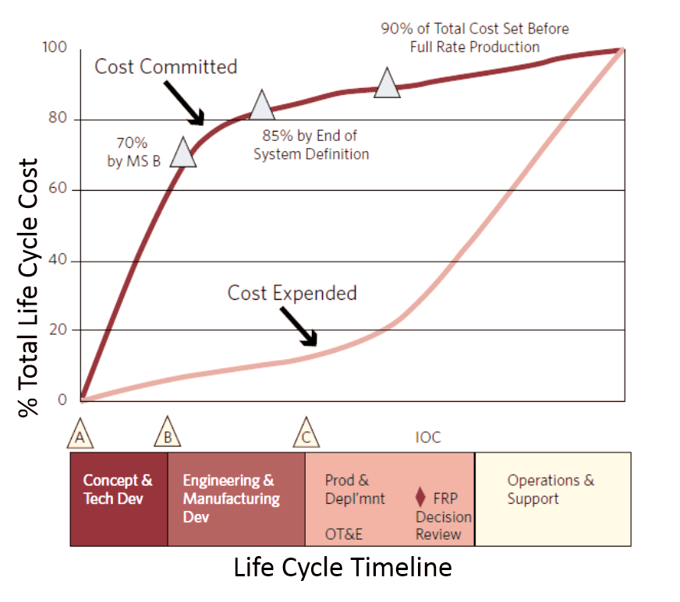
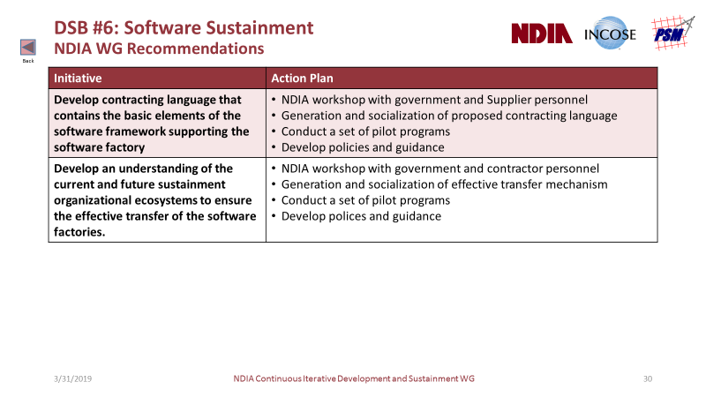
DSB #6: Sustainment (Software Is Immortal)
NDIA WG Recommendations
Picture of Success (end state)
Resources | Availability and support of a trained proficient workforce Organic DoD software infrastructure, incentives, funding Collaborative IP strategy throughout the life cycle, using a “work shared sustainment” approach
Contracting Language | Contracts specify elements of framework supporting SW factory Policies and guidance validated by workshops, pilots
Sustainment Ecosystems | Understanding of current and future organizational ecosystems to ensure effective transfer of SW factories
Recommendations for Path Forward:
Click thumbnails to zoom

Slide 12

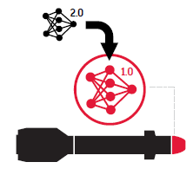
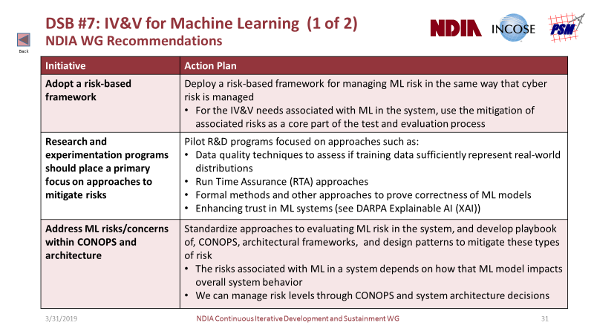
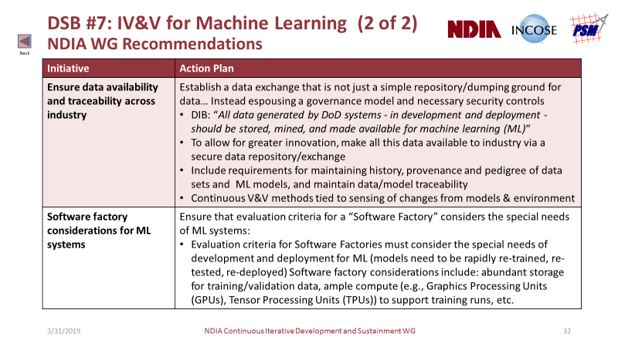
DSB #7: IV&V for Machine Learning
NDIA WG Recommendations
Picture of Success (end state)
Consensus ML IV&V Framework | Model-based inference engine considering full system context Risk-based methodology supporting T&E needs, linked to ML model failures early in system development process Mitigation throughout system design, development, sustainment
Open Data Sets | High data quality, quantity, availability, and traceability Data repository accessible to government and industry Governance model for availability, level playing field, innovation New repository data continuously collected and published
Perpetual Updates | Continuous ML model updates – evolution at speed of relevance Continuous V&V methods sensing changes from models, environment Performance/accuracy aligned with changing environment, threats
    T&E is a full lifecycle activity focused on mitigating risk of failing to meet operational needs
Perpetual Upgrades
Recommendations for Path Forward:
IV&V: Independent Verification & Validation ML: Machine Learning T&E: Test and Evaluation
Click thumbnails to zoom

Slide 13
Summary
The NDIA WG provides an industry perspective on picture of success, current state, obstacles and path forward for each DSB recommendation
DSB Recommendation | NDIA “Path Forward” recommendations
#1 – Software Factory | 14 | Contracting, funding, incentives, methods, security, supply chain, and measures
#2 – Continuous Iterative Development | 3 | Pilots and continuous improvement
#3 – Risk Reduction & Metrics | 10 | Acquisition strategy, competitive prototyping, culture, workforce, IP, and measures
#4 – Legacy Systems | 5 | Assessments, supply chain, methods, tools, and modeling
#5 – Workforce Development | 3 | Competency models, workforce assessment, workforce management, and training
#6 – Sustainment | 2 | Contracting and industry-government transfer of sustainment responsibilities
#7 – Machine Learning | 5 | Risk, research, CONOPs, ML data, and Software Factory interactions
Details of each topic and recommendation are provided in the separate report.

Slide 14
Acknowledgments
The NDIA Systems Engineering Division and its partners, INCOSE and PSM, appreciate the opportunity to provide an industry perspective for advancing the use of iterative methods in defense software acquisition.
The defense industrial base embraces the opportunities offered by the DSB and DIB recommendations and looks forward to supporting the Department of Defense with implementation.
NDIA Continuous Iterative Development and Sustainment Working Group:
Joseph Elm | L3 Technologies |  | Firas Glaiel | Raytheon |  | Virginia Perkins | MDA
Geoff Draper | Harris |  | Lemonte Green | MDA |  | Mike Phillips | SEI
James Belford | USAF STSC |  | Brian Hann | SAIC |  | Geoff Pierce | NRO
Dawn Beyer | Lockheed Martin |  | Stephen Henry | DAU |  | Marilyn Pineda | Lockheed Martin
Barry Boehm | USC |  | Paul Janusz | US Army RDEC |  | Garry Roedler | Lockheed Martin
Sean Brady | DAU |  | Suzette Johnson | Northrop Grumman |  | Heather Romero | Raytheon
Kevin Chapman | Harris |  | Cheryl Jones | US Army CCDC Armaments |  | Gene Rosenbluth | Northrop Grumman
Yann Chazal | Renault |  | Geethesh Kukkala | SAIC |  | Larri Rosser | Raytheon
David Chesebrough | NDIA |  | Richard Kutter | USAF |  | Dan Strickland | MDA
Chris Collins | DAU |  | John MacCarthy | Univ. of Maryland |  | James Thompson | OUSD(R&E) retired
Mark Cornwell | OUSD(R&E) |  | Phyllis Marbach | INCOSE |  | Steve Verga | Harris
Truc DeSa | Lockheed Martin |  | Jason McDonald | Harris |  | Ketchiozo Wandji | NAVAIR
James Doswell | US Army ARDEC |  | Mike McLendon | SEI |  | Allison Weigel | Toray
Rick Dove | Paradigm Shift |  | Jenna Meyers | HQDA ASA FM |  | Beth Wilson | retired
Jim Duffy | Raytheon |  | Jeffrey Mueller | DAU / USAF |  | Erik Wylie | MDA
Robert Epps | retired |  | Kenneth Nidiffer | SEI |  | Hasan Yasar | SEI/CERT
Mark Ginese | DAU |  | John Norton | Raytheon |  | Robin Yeman | Lockheed Martin

Slide 15
Backup
Supporting Content (Hidden Slides)
Excerpts of NDIA Recommendations by DSB Finding
(see separate briefing package for full details)

Slide 16

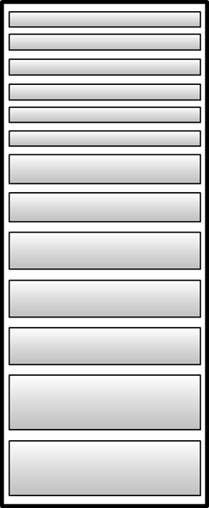



DSB #1: Securing the Factory
Back
Secure Software Factory
With security integrated
Product
Backlog
Automated
Security tests
Run daily
Release
Backlog
Security
Stories
Fuzzing
Daily
standup
Static
Analysis
Pen
Test
Shippable
Product
Business
Drivers
Definition
Of
Done
(sprint)
Definition
Of
Done
(Release)
RMF
Plan
Design
Build
Test
Dynamic
Analysis
RMF
Security
checks
Security
checks
Enablers
Threat
Modeling
Defensive
Coding
Self
Service
Security
scanning
Secure
Design
Principles
Continuous
Monitoring

Slide 17
DSB #1: Software Factory (1 of 3)
NDIA WG Recommendations
Back
Initiative | Action Plan
Contract for software factory delivery | Create a blueprint of contracts and language to enable software factory delivery Define approaches for different types of software (e.g., embedded, firmware, web) ; (life-critical, business-critical, low risk)
Fund value streams instead of projects | Pilot funding a value stream for a single vendor award program Pilot funding value streams on multi-vendor award program
Incentivize Suppliers to build interoperable software factories that are continuously exercised | Hold workshop with Industry to identify incentives Pilot options on some small short term modular contracts
Standardize software factory interfaces to facilitate data sharing | Common data architecture Define standards at the data layer for software factory to enable flexibility Define common nomenclature standards across vendors; use an existing framework such as the Scaled Agile Framework (SAFe)

Slide 18
DSB #1: Software Factory (2 of 3)
NDIA WG Recommendations
Back
Initiative | Action Plan
Publish blueprints and playbooks | Collaborate with Industry to obtain software factory blueprints and playbooks and publish for use across programs to increase success
Transparent integrated PMB | Publish blueprint of Integrated PMB (may differ across domains) Educate Government PMs on how to review PMB
Securing software factory | Define a defense-in-depth approach to secure factory Identify a required cadence of Red Team / Blue team to ensure factory safe.
Standards-based supply chain | Define supply chain standards Define interoperability for supply chain with multiple factories
Define value stream for delivery and push varied vendor baselines through factory | Define value stream for delivery and enable multiple vendor baselines to deliver into the factory. Ensure interoperability

Slide 19
DSB #1: Software Factory (3 of 3)
NDIA WG Recommendations
Back
Initiative | Action Plan
Measure practices and process for results | Document program practices and processes being used Measure success of programs by practice and environment to analyze which practices are demonstrating the best results based on customer criteria of value. (not methodology, but individual practice)
DoD-run retrospectives for a sampling of programs | Select a sampling of programs once a quarter and run a retrospective jointly between Industry and Government to identify root causes and improvements Publish best practices identified in retrospectives for all vendors
Open source | Research approach to instantiate Government-based open-sourced ways of working to leverage common modules across vendors and programs
Teams as a service (CID Cells) | Research approach to leverage cross-functional teams as a service in work areas were there is higher availability of workforce.
IATO for infrastructure | Research opportunity to obtain IATO on Infrastructure of software Factory. bare metal / cloud / database (DB) are the longest lead-time items to approve If we could secure a common architecture, the application layer would be cheaper and faster to approve, reducing cycle time for capabilities

Slide 20
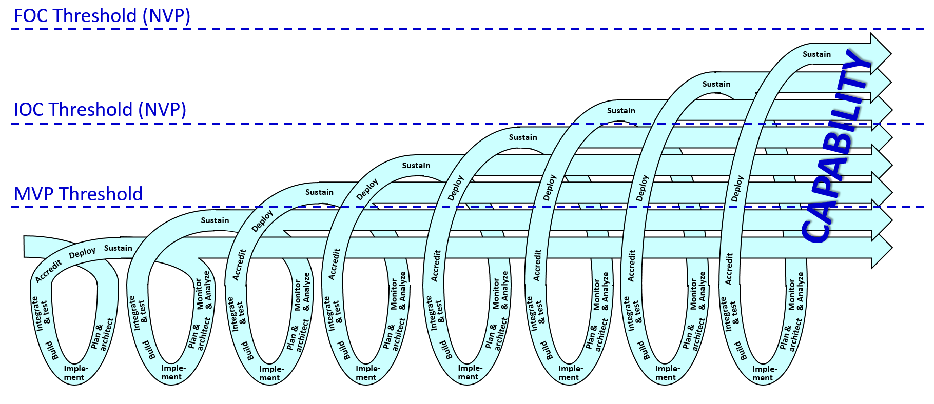
DSB #2: Continuous Iterative Development
Picture of Success (End State)
Back
Government/Contractor
Interface:
  New Programs Defined by
  Solution Intent
  Contracts Defined by Minimal
  Viable Product (MVP)
  Funding Supports Capability
  Evolution
  Stakeholders Actively Engaged
  in Continuous Iterative
  Development Lifecycle
  Design Guided by MOSA
  Government Access to Source
  Code with IP Protections
Program Execution:
  Multi-discipline agile execution includes milestones
  Direct user interaction informs design
  Test automation accelerates delivery

Slide 21
DSB #2: Continuous Iterative Development
NDIA WG Recommendations
Back
Initiative | Action Plan
Establish CID pilot baseline | Establish & communicate an initial high level CID approach Establish an initial approach to defining programs for CID implementation Train key Government and Supplier personnel
Pilot, learn and refine | Define a design set for CID Conduct pilot programs for CID, employing a set based design approach to explore options and refine approach Iterate until a small set of effective approaches and techniques emerge and standardize on it
Implement and evolve | Develop an approach to integrate feedback into the standard process for continuous improvement Define CID requirement phasing and Inspect and Adapt workshop timing Roll out CID as standard approach Manage feedback and evolution

Slide 22
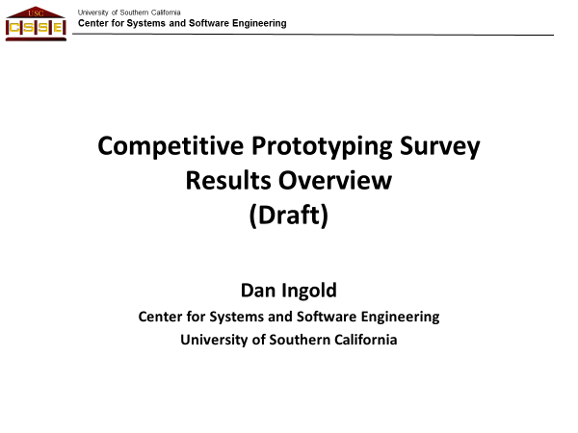
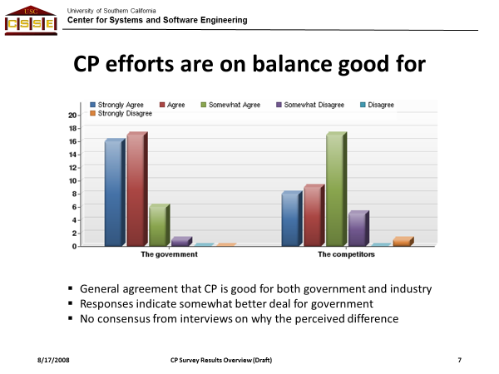
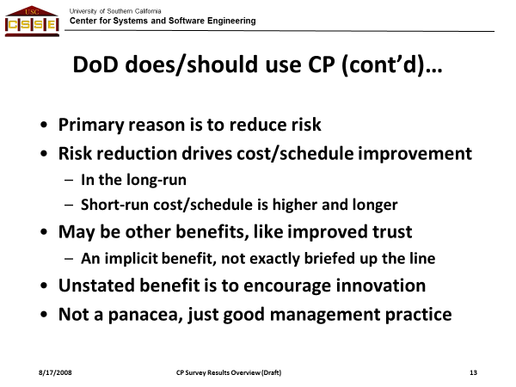
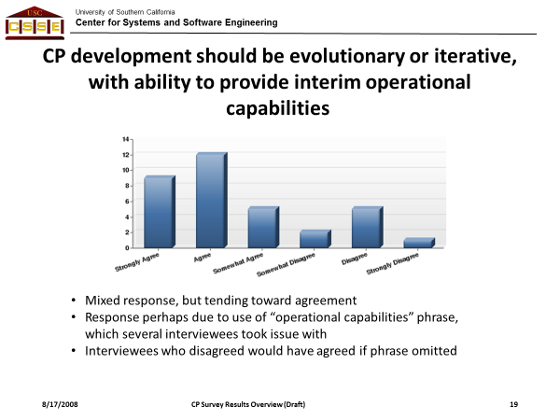
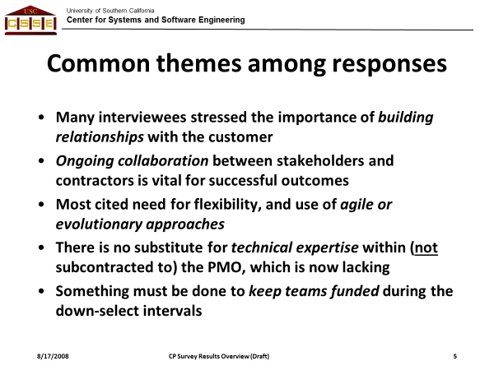
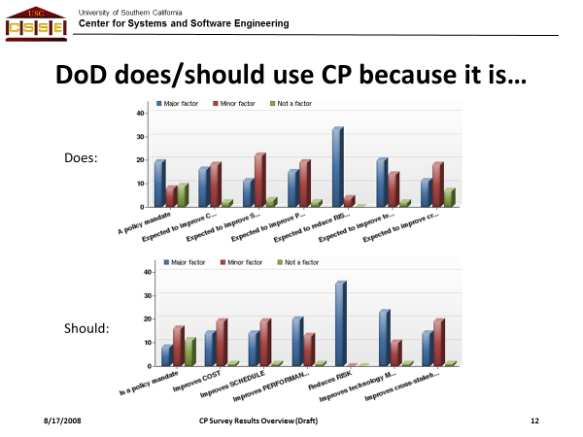
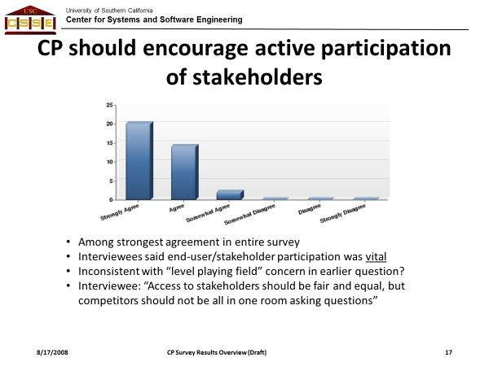
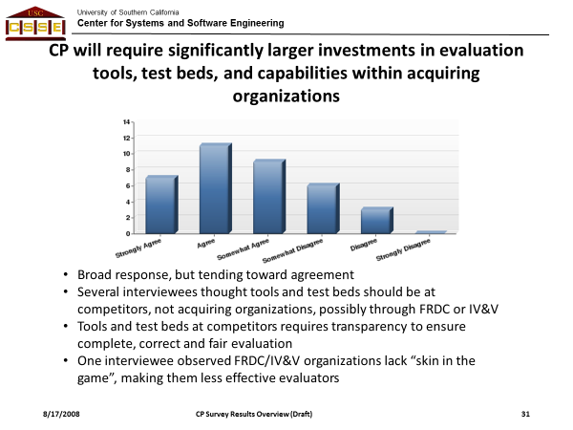
DSB Recommendation #3 – Risk Reduction
Competitive Prototyping Survey, 2008 (USC CSSE)
Back
Study indicates that CP can help in many situations, but has a number of pitfalls. CP does not solve all acquisition problems.

Slide 23
DSB #3a: Competitive Prototyping (1 of 2)
NDIA WG Recommendations
Back
Initiative | Action Plan
Acquisition strategy | Acquisition strategies that provide a fair opportunity to compete, retain competition throughout the lifecycle for critical components to enable rapid evolution of the product.
Competitive prototyping | Review analyses/reports from prior DoD competitive prototyping initiatives, and integrate lessons learned into action plan for DSB recommendations. Competitive prototyping risk reduction strategy should account for both functional and non-functional requirements.
Cultural shift | Migrate from subjective qualitative assessment to objective quantitative assessment of risk that support business decisions
Resources | DoD investment to acquire, deploy, integrate, and maintain evaluation tools and test beds
Workforce development | Recommend DoD initiate a development plan to provide workforce with skills and knowledge needed to plan, perform and execute the risk reduction strategies during competitive prototyping.

Slide 24
DSB #3a: Competitive Prototyping (2 of 2)
NDIA WG Recommendations
Back
Initiative | Action Plan
Program measurements | Define a minimum core set of metrics and ownership for measures needed to do the job at the Program, Functional, and Integrated Product Team (IPT) levels Develop and track metrics to control factory processes, measure against goals and objectives, assess/measure risk, and make decisions Enable real-time insight into measures and program status Ensure measures provide a comprehensive view of risk reduction strategy, including: functional and non-functional requirements; reliability, security, … Develop consensus Government/Industry measurement framework and common measures applied across defense software acquisition programs.
IP strategy | Develop contracting approaches that protect Supplier IP while providing the Government access to source code for analysis, deployment, support, and evolution. Sustain IP required for maintenance of the following: Renewable capital – patents, license, IP, … Human capital – People, skills, experience, surge/slack… Structural capital – data bases, tools, processes, test scripts, … Relationship capital – customers, supplier agreements, business relationships, personal relationships, …

Slide 25
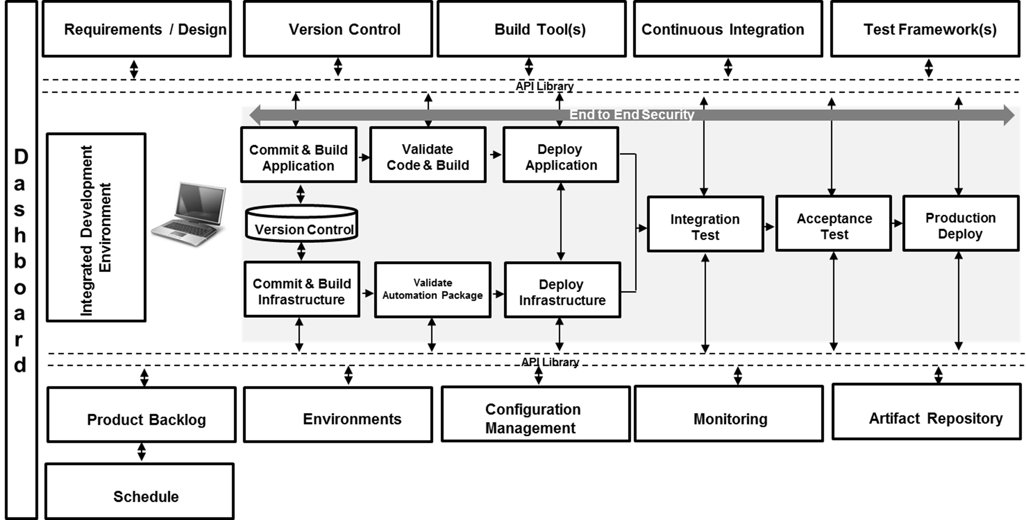
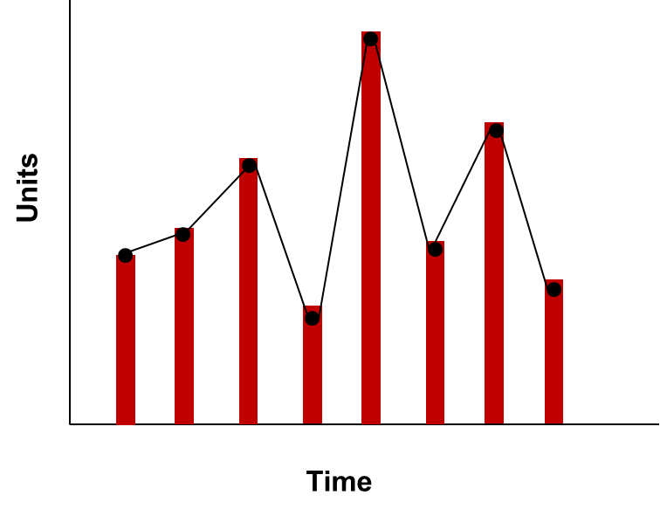
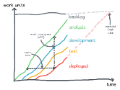
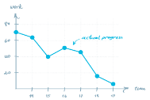

DSB Recommendation #3 - Metrics
Frameworks for aligning measures with objectives
Back
Baseline
Factory
Deployment
Field
Measures for continuous iterative development should be aligned with information needs, objectives and constraints, at program and enterprise levels
Tickets
Cycle Time
Time to Recovery
Lead Time
Backlog
Code committed to use
Vulnerability
Time to Repair
Release n-1
►MTTR
Vulnerability
Regression
Test
(Automated)
Latent
Defect
Escape
Return to
Normal
Operations
Coding,
Functional Test
Detection
Time
Diagnosis
❷
Repair Time
Testing
❸
Finding the “Sweet Spot”
(situation dependent)
…
►MTTD
Field or Factory
Speed
Quality
❶
Value
Iteration
Start
(Sprint, Epic, Release)
Iteration
End
(Sprint, Epic, Release)
Failure or
Vulnerability
Occurs
Ticket
Generated
Repairs
Start
Operations
Resumed
Measures, goals, and priorities are tailored
based on program objectives and information needs
Factory
Development
Operations
(internal, external)
The NDIA WG recommends a measurement
framework that can be adapted to specifics
of the program, domain, or acquisition
Process
Metrics
(Examples)
Automated test coverage of specs/code
Defect detection efficiency
(# of bugs caught in test vs. operations)
Change failure rate
(rollback deployed code)
Summary of DIB Metrics Categories
Deployment Rate Initial launch to deployment of simplest useful functionality [MVP] Time to field high priority fn (spec>ops) or security hole (find>ops) Time from code committed to code in use
Response Rate Time req’d for full regression test (automated) and cyber testing Time required to restore service after outage [MTTD, MTTR, MTTA]
Code Quality Automated test coverage of specs / code Number of bugs caught in testing vs. field use [defect detection %] Change failure rate (rollback)
Program Management Complexity metrics. Devel plan/env metrics (specs, code, staff, …)
Industry feedback
(usefulness,
effectiveness)
Available measures
instrumented and automated
by the toolchain
Selection of program measures
tailored by information needs
(with a few primary colors
required by the enterprise)
Enterprise measures
driven by business
performance objectives
Success is measured at
multiple levels:
Mission capability
Program execution
Enterprise improvement
Business results, competitiveness
productivity, quality, estimate accuracy, …
Adoption
References:
Defense Science Board, Design and Acquisition of Software for Defense Systems, Feb 2018
Defense Innovation Board Metrics for Software Development, version 0.9, 9 Jul 2018
MTTR, MTBF, or MTTF? A Simple Guide to Failure Metrics. https://limblecmms.com/blog/mttr-mtbf-mttf-guide-to-failure-metrics/
Notes:
This graphic depicts the context for several of the measures proposed by the DSB, DIB, and feedback from the defense industry community.
The top left graphic illustrates the tradeoffs that must be made in determining an effective CID measurement set, including a balance between speed/agility and quality attributes that may vary greatly according to the characteristics of a program or domain. What works well for an information system application with ready access to the operational environment for frequent capability releases may not apply as well to a high reliability space application with stringent operational limitations and on-orbit constraints for uploading SW updates via satellite uplinks. Many of these constraints are beyond industry control or influence. The graphic suggests these are strategic decisions every program must make, and there is a “sweet spot” that balances these constraints or attributes (critical success factors) for the program situation, and the measures appropriate to that situation can, and will, vary. It for these reasons that NDIA recommends consideration of appropriate SW measures should begin with a framework characterizing the objectives and information needs to provide decision makers with objective data to make informed decisions.
The bottom left table summarizes the 4 measurement categories used by the DIB in its proposed set of SW measures. The NDIA WG adopted these categories as a basis for deriving an initial framework of information needs and measures using the PSM measurement process as a guide (i.e., Information Needs, Information Categories, Measurable Concepts, and a set of candidate measures aligned with them.) The NDIA WG has reached out the defense industry community (through NDIA, INCOSE, and PSM) in numerous workshops, working groups, and surveys to judge the extent of consensus that the measures recommended by the DSB and DIB (and the information needs derived from them) are considered useful and effective in practice.
The top graphic depicts conceptual descriptions for several of the measures proposed by the DSB/DIB to help facilitate progress toward a common understanding of these measures, their intent, and where in the development cycle they might apply. Note that in order to communicate most effectively with the targeted defense industry respondents, NDIA has ‘translated’ several of the DIB measures proposed from the context of defense acquirers to synonyms that commonly apply in defense industry jargon and are perhaps more easily understood. Included in the latter are examples of post-release quality measures (e.g., MTTD, MTTR, MTTF, MTTA). Traditionally applied even in operational programs following a waterfall life cycle model, the NDIA WG believes these measures can also be meaningfully applied iteratively to baselines released through the software factory.
The bottom graphics represent that the CID measurement set applied to programs within industry companies must not only provide insight for effectively managing program performance, but to also support the enterprise needs for continuous improvement, organizational capability, and business competitiveness. The toolchain can be instrumented to provide numerous automated potential measures (e.g., progress and quality). Some of these measures may, or may not, be useful for providing insight toward the specific information needs at the program and/or enterprise levels. Some measures that make good sense for one program or domain may not be as relevant to others – to require ‘standard’ measures in spite of this is not productive. Rather, the candidate measures available from the toolchain or other sources (“palette of measures”) should be tailored and applied according to the information needs applicable to the situation (potentially driven by program and/or enterprise levels).

Slide 26
DSB #3b: Metrics
Path Forward
Back
Initiative | Action Plan
Software measurement framework for CID | Validate measurement framework (objectives, categories, measures) with Government and industry stakeholders (e.g., NDIA, INCOSE, PSM, SERC) Finalize initial consensus measures for software CID Pilot and validate measures/analysis on selected CID /DevSecOps programs. Develop contracting language requiring measurement set for future programs
WBS-based estimating of historical comparables for staff, cost, productivity | Recommend DoD expand WBS-based approach and historical DB measures to additional programs but at program level and not specific to continuous software initiatives (doubtful consistent data yet exists). Engage Government stakeholders on historical data estimating initiatives Partner with independent cost estimate (ICE) groups to migrate away from SLOC-based methods (CAPE, PARCA, ICE, …); establish partnerships with industry for new methods (DSB #3)
Reach consensus on cost and schedule measures vs. plan for software CID | Consider alternatives to EVM for managing performance vs. plan. Review EVM agile studies, publications, and guidance. Hold workshops with Industry and Government to define framework and measures. Recommend consensus approach for DoD software acquisition
Notes:
Just as the software factory is fundamental to all DSB recommendations, so does the NDIA WG believe the measurement framework – and not the recommended measures themselves – is the critical element in implementing DSB recommendation #3.
As discussed on prior slides, it may be some time before the defense industry converges on a consistent set of measures collected widely across CID defense programs in order to develop a trusted repository suitable for use in developing or validating future estimates based on historical data. During that transition period, the industry may need to continue depending at least in part on traditional measures such as LOC and other attributes collected in repositories such as the DoD Software Resources Data Report (SRDR).
Some initial work on applying EVMS measures to agile/CID programs based on the WBS has been done by groups including PARCA, NSA, and the NDIA Program Management Division.

Slide 27
DSB #4: Current and Legacy Programs
NDIA WG Recommendations
Back
Initiative | Action Plan
Program assessment for categories of legacy software programs. | Collaborate with industry building program categorization table for varied types of software and products being built Define common list of program readiness attributes Define metrics for how to measure transition success Develop common risk categories to evaluate Prototype process for iteratively and incrementally transitioning programs
Supply chain pedigree evaluation tool | Investigate methods for evaluating software pedigree Prototype process and tools to evaluate supply chain pedigree Validate pedigree on FOSS/COTS/GOTS/Supplier components
Blueprints and playbooks for low risk transition | Collaborate with Industry to build repository of blueprints , playbooks, and strategies for different types of programs.
Visualization tools for varied code bases. | Investigate Visualization tools for different types of code bases
Auto generate “As-Built” and Models to evaluate system and develop transition plans | Investigate standardized set of tools to auto-generate models and “As-Built” of the varied legacy systems Define a prioritization strategy for migrating program components to the software factory

Slide 28
DSB #5: Workforce (1 of 2)
NDIA WG Recommendations
Back
Initiative | Action Plan
Modern software-intensive-systems engineering competency model development | DAU/INCOSE/NDIA/ISO collaboration to add software-centric systems engineering roles and proficiencies to INCOSE SE competency model and identify / develop workforce development content to improve proficiency Create ability to ID/code software-intensive-systems engineering in current/future software-centric systems skillsets
Informed PMs and software SMEs Training | Development and deploy training at Defense Acquisition University on iterative software development for all acquisition communities (PM, Systems Engineering, Software, Financial Management, Cost Estimating, …) Develop a consensus government/industry measurement framework and common measures applied across defense software acquisition programs Supply chain integration - Deploy supply chain pedigree evaluation tools and techniques Develop blueprints and playbooks for low risk transition Develop RFP guide for acquiring and transitioning to software factories

Slide 29
DSB #5: Workforce (2 of 2)
NDIA WG Recommendations
Back
Initiative | Action Plan
Workforce management | Baseline current software intensive capabilities and needs Identify workforce gaps; quantity/quality Update workforce needs to shape workforce recruitment and training Create a new software-centric-systems Engineering 0800 Occupational Series to enable tracking, management and growth of software-centric-systems engineers, managers, and functional personnel Fund software intensive develop training Support continuous learning

Slide 30
DSB #6: Software Sustainment
NDIA WG Recommendations
Back
Initiative | Action Plan
Develop contracting language that contains the basic elements of the software framework supporting the software factory | NDIA workshop with government and Supplier personnel Generation and socialization of proposed contracting language Conduct a set of pilot programs Develop policies and guidance
Develop an understanding of the current and future sustainment organizational ecosystems to ensure the effective transfer of the software factories. | NDIA workshop with government and contractor personnel Generation and socialization of effective transfer mechanism Conduct a set of pilot programs Develop polices and guidance

Slide 31
DSB #7: IV&V for Machine Learning (1 of 2)
NDIA WG Recommendations
Back
Initiative | Action Plan
Adopt a risk-based framework | Deploy a risk-based framework for managing ML risk in the same way that cyber risk is managed For the IV&V needs associated with ML in the system, use the mitigation of associated risks as a core part of the test and evaluation process
Research and experimentation programs should place a primary focus on approaches to mitigate risks | Pilot R&D programs focused on approaches such as: Data quality techniques to assess if training data sufficiently represent real-world distributions Run Time Assurance (RTA) approaches Formal methods and other approaches to prove correctness of ML models Enhancing trust in ML systems (see DARPA Explainable AI (XAI))
Address ML risks/concerns within CONOPS and architecture | Standardize approaches to evaluating ML risk in the system, and develop playbook of, CONOPS, architectural frameworks, and design patterns to mitigate these types of risk The risks associated with ML in a system depends on how that ML model impacts overall system behavior We can manage risk levels through CONOPS and system architecture decisions

Slide 32
DSB #7: IV&V for Machine Learning (2 of 2)
NDIA WG Recommendations
Back
Initiative | Action Plan
Ensure data availability and traceability across industry | Establish a data exchange that is not just a simple repository/dumping ground for data… Instead espousing a governance model and necessary security controls DIB: “All data generated by DoD systems - in development and deployment - should be stored, mined, and made available for machine learning (ML)“ To allow for greater innovation, make all this data available to industry via a secure data repository/exchange Include requirements for maintaining history, provenance and pedigree of data sets and ML models, and maintain data/model traceability Continuous V&V methods tied to sensing of changes from models & environment
Software factory considerations for ML systems | Ensure that evaluation criteria for a “Software Factory” considers the special needs of ML systems: Evaluation criteria for Software Factories must consider the special needs of development and deployment for ML (models need to be rapidly re-trained, re-tested, re-deployed) Software factory considerations include: abundant storage for training/validation data, ample compute (e.g., Graphics Processing Units (GPUs), Tensor Processing Units (TPUs)) to support training runs, etc.

