Slide 1
NISP UPATE
2021 NDIA-AIA SPRING WEBINAR
Unclassified
Notes:
POC: presenter name, phone number, email.civ@mail.mil

Slide 2
AGENDA
National Industrial Security Program Operating Manual (NISPOM) at 32 Code of Federal Regulations (CFR) part 117
DD Form 254 and Instructions: Administrative Changes
Questions

Slide 3
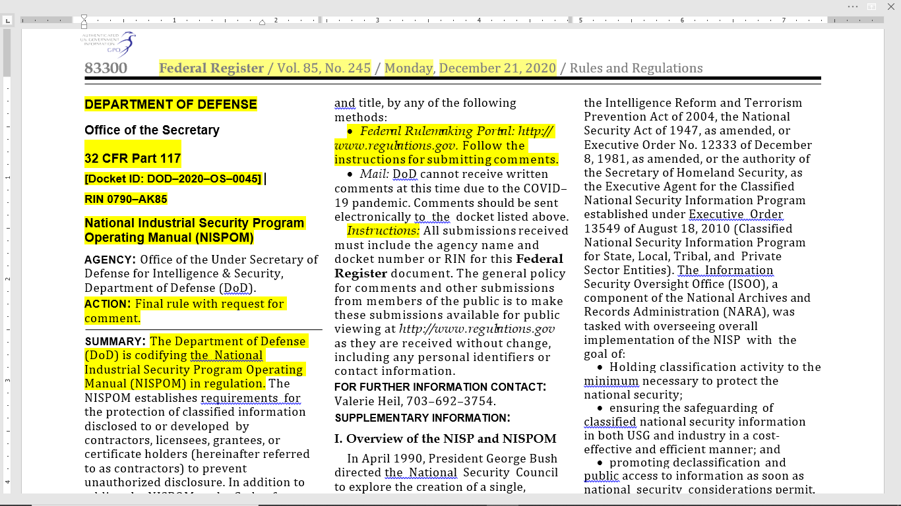
32 CFR Part 117 (NISPOM)

Slide 4
32 CFR Part 117 (cont.)
Final rule published in Federal Register on December 21, 2020
Effective date: February 24, 2021
Compliance: Contractors have no more than 6 months after effective date to comply
NISP Cognizant Security Agencies (DoD, DOE, NRC, ODNI and DHS) will provide supplementary guidance (DoD will provide Industrial Security Letter(s), as applicable)

Slide 5
32 CFR Part 117 FORMATTING
Preamble, pages 83300 – 83312
Body of rule, pages 83312- 83364
Sections 117.1 – 117.24 (117.3, acronyms and definitions on page 83312)
Paragraph levels (from Table 2.4, Office of Federal Register Document Drafting Handbook)
level 1 (a), (b), (c), etc. (Example: 117.1(a) on page 83312 of 32 CFR part 117)
level 2 (1), (2), (3), etc. (Example: 117.2(a)(1) on page 83312 of 32 CFR part 117)
level 3 (i), (ii), (iii), etc. (Example: 117.6(g)(6)(i) on page 83321 of 32 CFR part 117)
level 4 (A), (B), (C), etc. (Example: 117.7(h)(1)(ii)(A) on page 83322 of 32 CFR part 117)
level 5 (1), (2), (3), etc. [italicized] (Example: 117.19(b)(5)(vi)(A)(1) on page 83349 of 32 CFR part 117)
level 6 (i), (ii), (iii), etc. [italicized] (Example: 117.19(d)(2)(ii)(E)(4)(ii) on page 83351 of 32 CFR part 117)

Slide 6
Tools To Assist With Changes
List of major changes is in the preamble of the Rule
32 CFR Part 117 NISPOM Rule Cross Reference Tool
Click on a NISPOM citation to be shown the CFR Rule
Located on the CDSE Website on the Industrial Security Homepage and in the FSO Toolkit

Slide 7
Major Changes
117.8: Reporting Requirements….117.8(a) General. …contractors must submit reports pursuant to this rule, SEAD 3 and CSA guidance to supplement unique CSA mission requirements.
117.9(m) Limited entity eligibility determination (Non-FOCI) and, 117.11(e) Limited entity eligibility
117.11(d)(2)(iii)(A) Requirement for National Interest Determinations (NIDs)
117.15(e)(2) TOP SECRET Information: Permits specific determinations by a CSA with respect to requirements for TOP SECRET accountability
117.15(d)(4) Intrusion Detection System Installation
117.7(b)(2) Senior Management Official
117.13(d)(5) Clarifies to the contractor that upon completion of a classified contract, the ‘‘contractor must return all government provided or deliverable information to the custody of the government.”

Slide 8
DD Form 254 and Instructions: Administrative Changes
DSS name change to DCSA, web site links and address
Inclusion of FAR clause reference for requirement to use NCCS
Added note that NISPOM is now a federal rule and references to the DoD Manual will be removed when the rule is effective since compliance will occur no more than 6 months after effective date
Changed ISFD to NISS as system of record for facility clearances
Update of reference to CUI policy with DoD Instruction 5200.48
NCCS will be updated as well but changes have to be scheduled.

Slide 9
QUESTIONS

