Slide 1
National Industrial Security Program Policy Advisory Committee (NISPPAC)
NISPPAC Industry Updates
April 2021 Update

Slide 2
NISPPAC Members
INDUSTRY
Heather Sims, Spokesperson | General Dynamics
Aprille Abbott | MITRE
Rosie Borrero | ENSCO
Derek Jones | MIT Lincoln Labs
Dan McGarvey | Alion S & T***
Dennis Arriaga | CAES***
Tracy Durkin | Mantech
Cheryl Stone | RAND Corp
Jessica Giguere, Northup Grumman Industry Coordinator
INDUSTRY MOU
Kai Hanson | AIA
Jonathan Fitz-Enz | ASIS
Joe Kraus | CSSWG
Jordan Baxter | FFRDC/UARC
Kathy Pherson | INSA
Greg Sadler | ISWG
Cathe Kaohi | NCMS
Michelle Sutphin | NDIA
Marc Ryan | PSC**
***-Elections for 2 Industry NISPPAC Members in September
**-Marc Ryan recently replaced Charlie Sowell
For the most up to date member listing, refer to archieves.gov/isoo.oversight-groups/nisppac

Slide 3
Current NISPPAC Working Groups
NISP Systems
Insider Threat
FOCI
Clearance
NISA
Policy
NCCS
DISS
SWFT
NBIS
NISS

Slide 4
National Level Policy Updates
NISPOM Rule, 32 CFR, Part 117
Published Dec 21, 2020 (SEAD 3 Incorporated)
Public Comment period ended February 21, 2021
Rule effective February 24, 2021
Cleared industry must comply within 6 months of the effective date of the rule
Cross Reference Tool
Previously Routed Draft ISLs –What’s Next? Rescinding or Reissuance?
SEAD 3-Adverse Information Reporting –sent for Industry Feedback March 2021
32 CFR, Part 117 and SEAD 3 Reporting have been drafted and sent to industry for comment-Sent to Industry for Feedback March 2021
DISS System of Record*-Memo or ISL
Usage of EPL List and Crosscut Shredders*
Insider Threat-?
Top Secret Accountability*
GSA Announcement of Black Label Phase Out (Black and silver label)
Phase out of GSA approved security containers and Vault Doors manufactured prior to 1989
Phasing out from 1954-1989
Over a period of 4 years starting as of October 1, 2024

Slide 5
NISPOM Rule, 32 CFR, Part 117
Key Changes
Granting FCLs-Gov’t
SMO Duties-applies to 100% of Cleared Companies
TS Accountability- applies to less than 100 Cleared Companies
IDS Installation- applies to Cleared Companies that have IDS
Safeguarding-applies to less than 4000 of Cleared Companies
Classified Information Retention-applies to 100% of Cleared Companies that have safeguarding
Section 842 Public Law 115-232-Gov’t
Incorporation of SEAD 3 reporting requirements-applies to 100% of Cleared Companies
Two Types of Limited FCLs-Gov’t
Tools
List of major changes in the preamble of the Rule
Cross Reference Tool
CDSE Webinar and Other Upcoming Engagements
DCSA updating tools, oversight guidance/rating system and NISP systems
CSAs to provide their updates on NISPOM implementation at next Public NISPPAC Meeting
Recommendations for Industry
Don’t wait, start reading now and update your programs
Use available tools

Slide 6
Biggest Industry Impacts
Personnel Security Reform/Trusted Workforce
Transfer of Trust (Reciprocity)
Information Sharing (Gov’t to Gov’t; Gov’t to Industry; Industry to Industry)
Continuous Vetting (CE)
Marijuana Usage and Investments Guidance
Cryptocurrency Guidance
Far Right/Left Groups implications on PCLs Guidance
Supply Chain Risk Management
RMF Timelines and Processes
NISP Systems-DISS/NBIS/NCCS
New and Emerging Process and Guidance Changes
Operating Remotely-Our New Reality
DIB Gov’t Oversight-What does this look like?
Implementing the new NISPOM Rule
CUI
CMMC

Slide 7

Evolving NISP Understanding Impact to Industry
Alignment/Unity of Industry on the Basics
Understanding changes in advance and how all the changes will affect our security operations and that of our supply chains?
What can we expect from an oversight perspective in the future?
Each new process asked of industry adds additional administrative and resource burdens taking us away for real risk management and security responsibility.
Engagement at all levels but at the right level!
Identify issues quickly and partner w/Gov’t-Don’t operate in Fear
TWF 2.0
RMF
DISS
CUI
FOCI
Supply Chain
Insider Threat
CMMC
NIST 800-171
NCCS

Slide 8
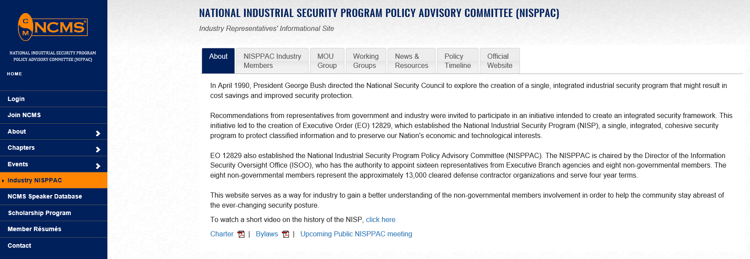
Industry NISPPAC on the Web
https://classmgmt.com/nisppac.php
Industry NISPPAC by email
nisppacindustry@gmail.com

Slide 9
QUESTIONS
???

