Slide 1
NDIA PROCUREMENT DIVISION MEETING
October 13, 2020

Slide 2
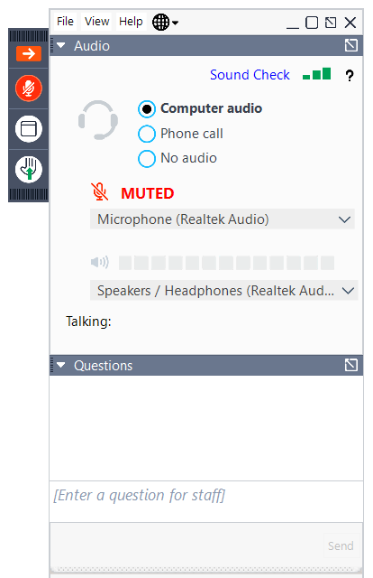
Virtual Meeting Etiquette
All attendees are muted upon entry
If you have a question, please utilize the Question Box and our moderators will address them after the briefing

Slide 3
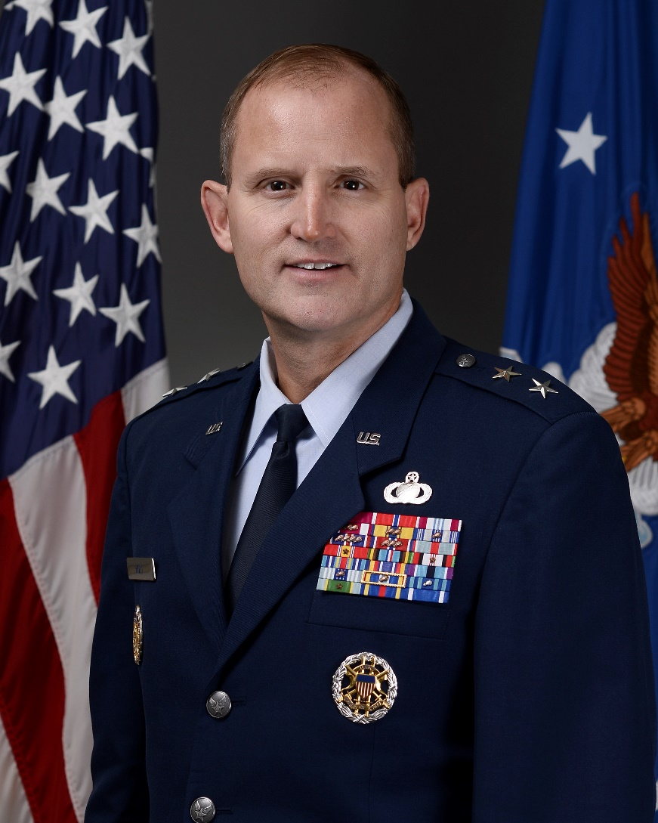
NDIA Procurement Division Meeting
Speaker:
Major General Cameron Holt, USAF
Office of the Assistant Secretary of the Air Force for Acquisition, Technology and Logistics
Deputy Assistant Secretary for Contracting

Slide 4
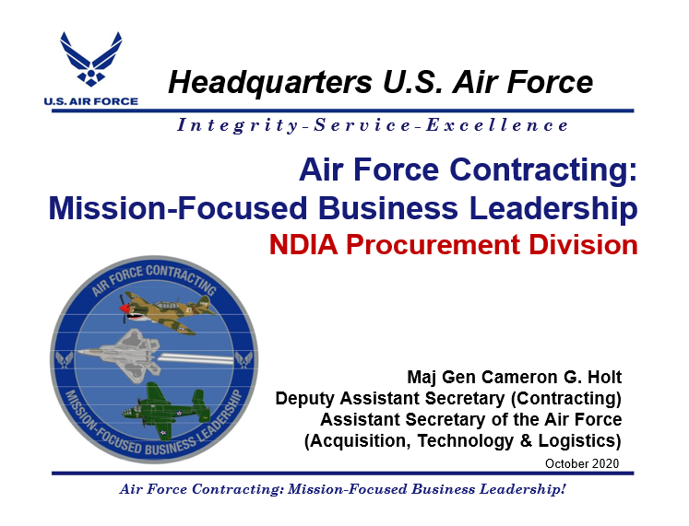

Slide 5
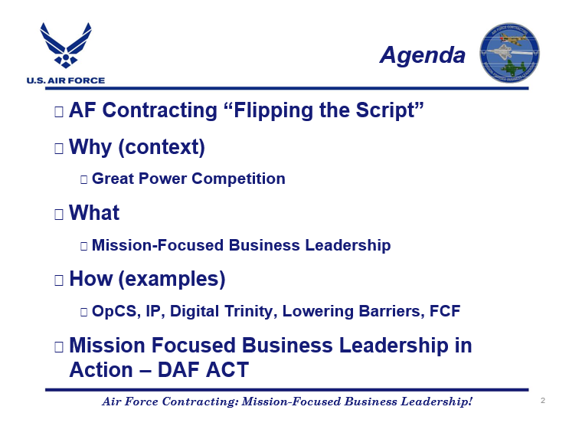

Slide 6
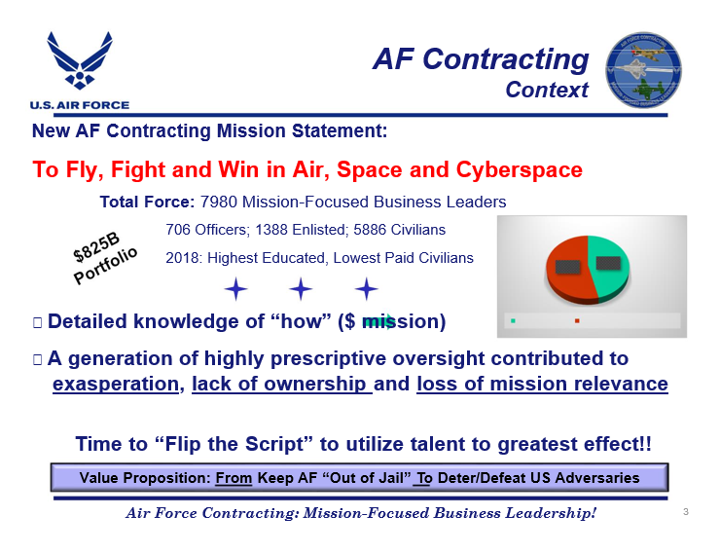

Slide 7
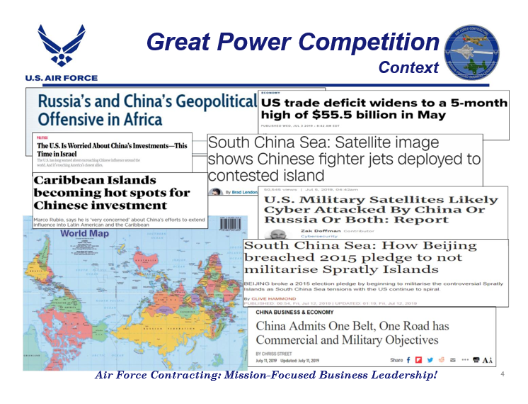

Slide 8
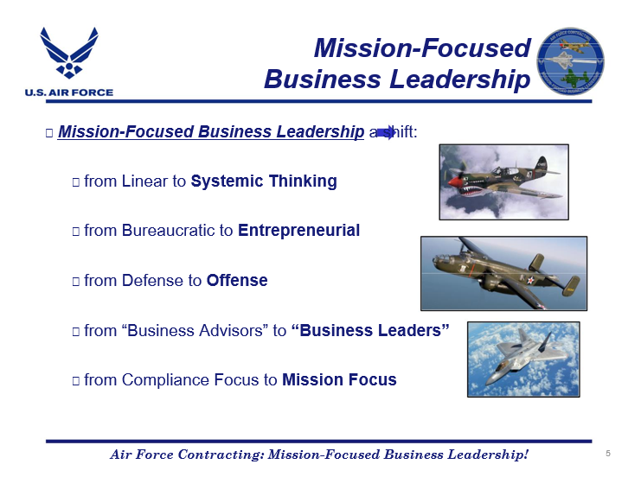

Slide 9
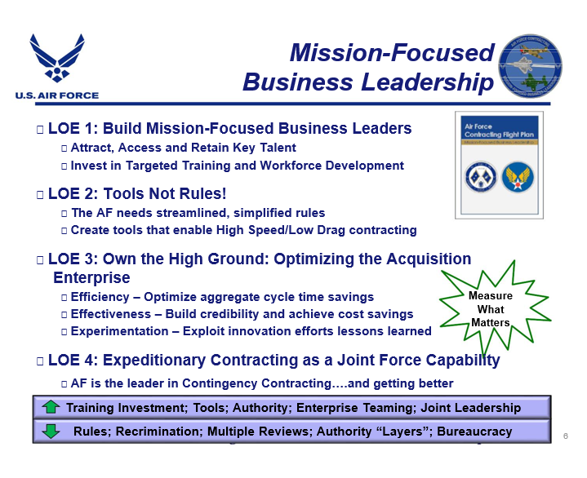

Slide 10
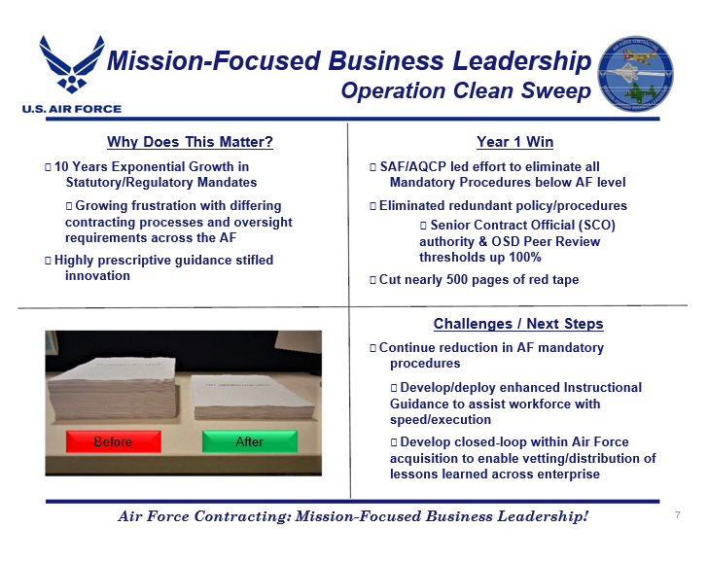

Slide 11
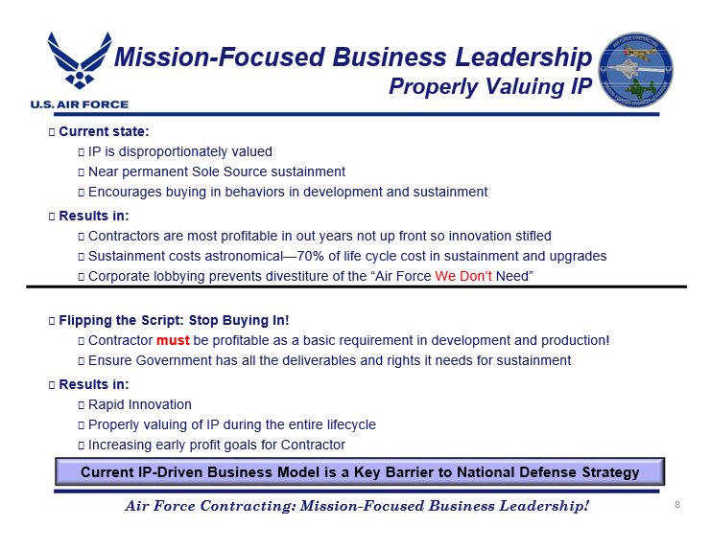

Slide 12
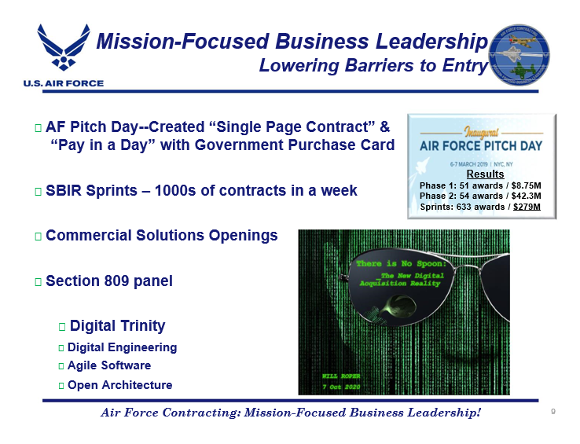

Slide 13
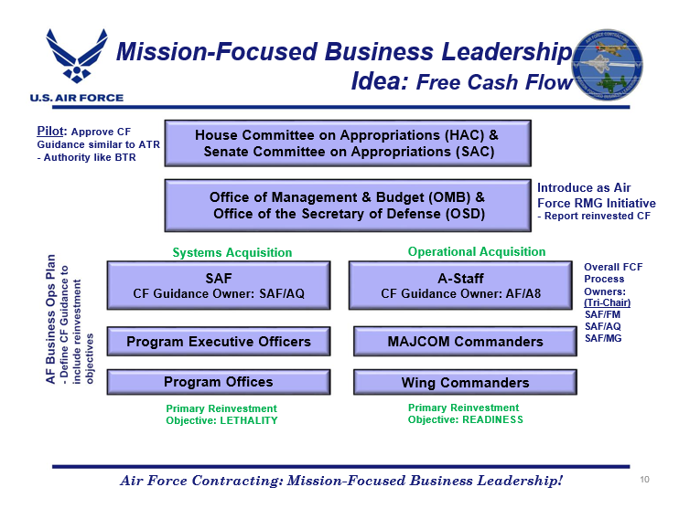

Slide 14
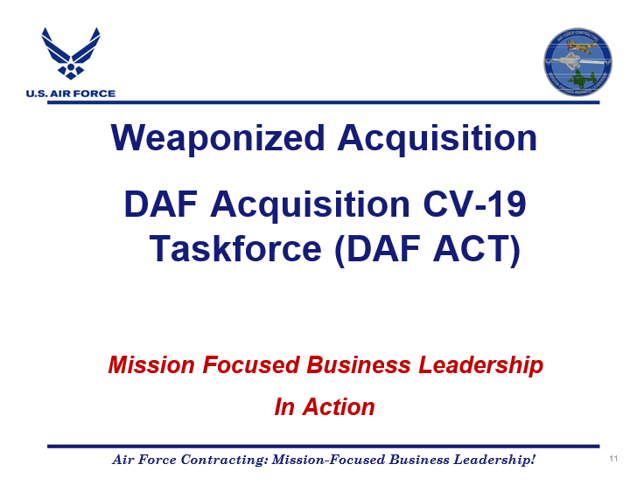

Slide 15
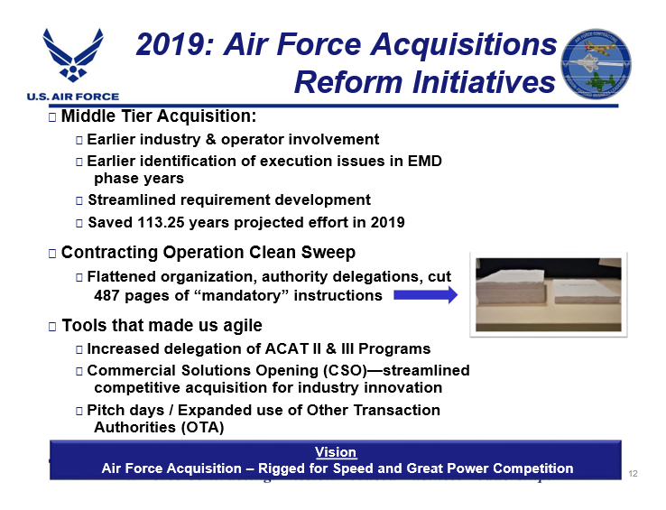

Slide 16
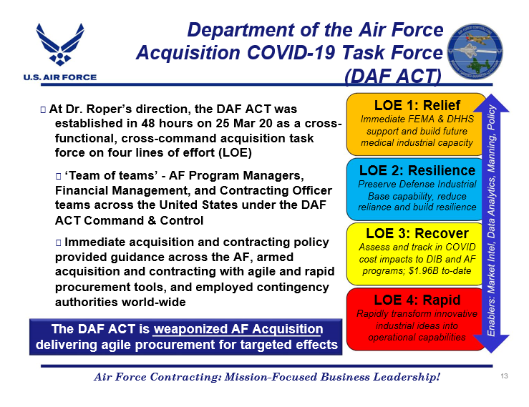

Slide 17
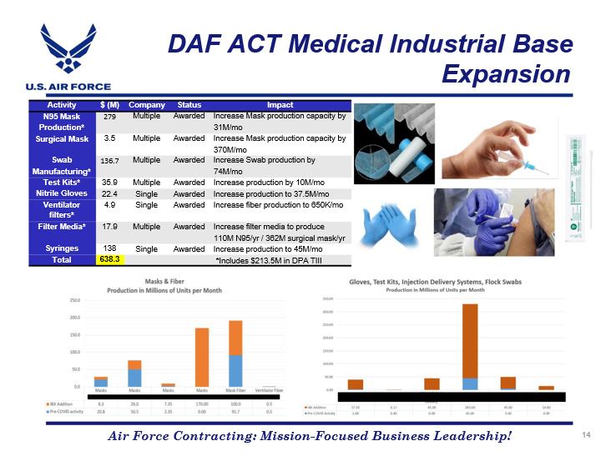

Slide 18
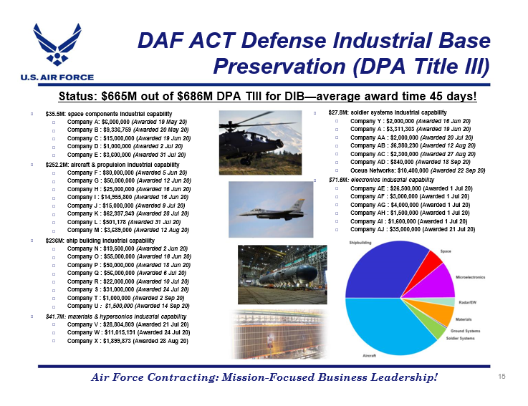

Slide 19
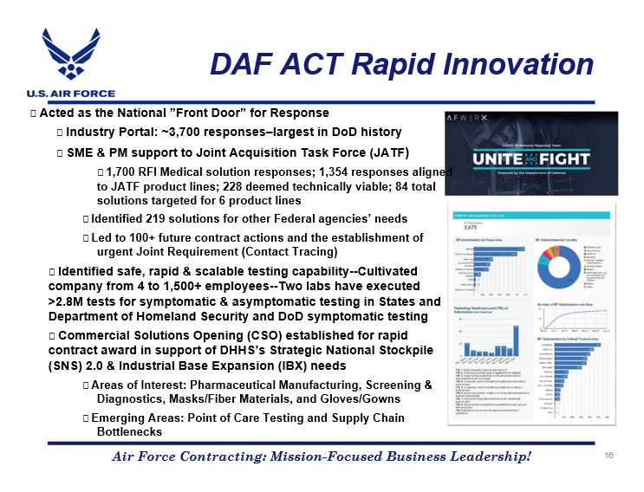

Slide 20
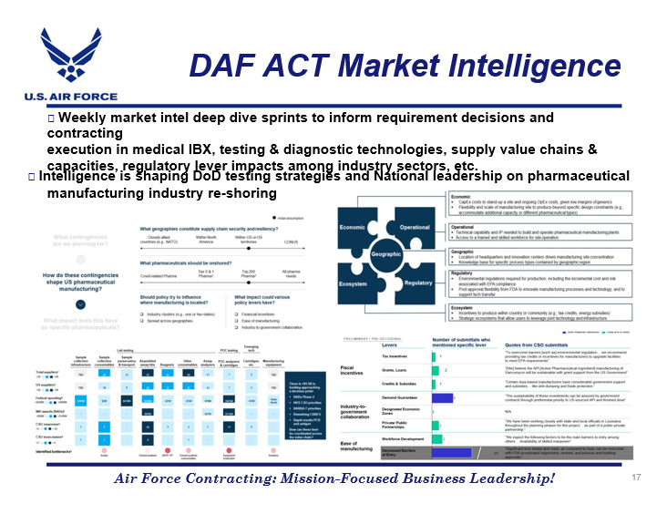

Slide 21
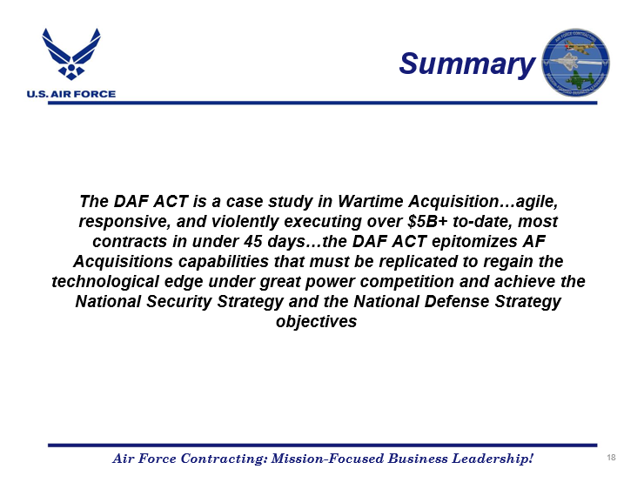

Slide 22


Slide 23

NDIA Procurement Division Meeting
Panelists:
Moshe Schwartz (Moderator)
Associate
Etherton and Associates, Inc.
Samantha L Clark
Special Counsel
Covington & Burling LLP
Lindsay Ratliff
Legislative Director for Congressman Jim Banks
U.S. House of Representatives
Sandeep Kathuria
Assistant General Counsel
Cybersecurity and Security Law, Leidos

Slide 24


Slide 25
Question & Answer
PROCUREMENT DIVISION MEETING
Utilize the Question Box

