Slide 1
"Thoughts of Future Supply Chains – Breaking with the Past in a Post-COVID-19 Environment"
NDIA Manufacturing Supply Chain Network Committee and Logistics Division
July 8, 2020

Slide 2
"Thoughts of Future Supply Chains – Breaking with the Past in a Post-COVID-19 Environment"
Can we find the right balance to optimize supply chain performance while minimizing supply chain vulnerability? What methodologies are available to us? Do we have the right data? Do we have visibility through multiple supply chain tiers? Can DoD exercise the right judgement in collaboration with stakeholders upstream and downstream? Does DoD know the right questions to ask?

Slide 3
Our subject matter experts:
Wes Hallman, Sr. Vice President of Policy, NDIA
Carol Ptak, Partner, Demand Driven Institute
Greg Schlegel, Founder, SCRM Consortium
Moderators:
Irvin Varkonyi, President, Supply Chain Operations Preparedness Education
Stacy Newstead, Program Director, Supply Chain and Obsolescence Alion Science and Technology

Slide 4
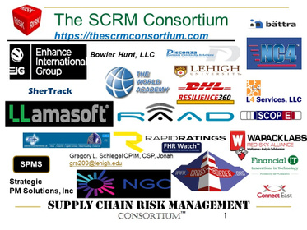
Greg Schlegel, Founder SCRM Consortium
was born out of an MBA classroom setting at Lehigh University while exploring the impact of supply chain disruptions on global supply chains. Founded by Greg Schlegel CPIM, CSP, Jonah, the Consortium has grown to include 28 companies who bring unique core competencies in supply chain risk. These competencies range from SCRM education and body-of-knowledge emanating from our new book, to risk identification, assessment/quantification, mitigation tactics, Business Continuity Planning, Enterprise Risk Management, Supply Chain Cyber Threat Analysis, Supply Chain Mapping, Six Sigma, Supply Chain Transformation and much more.

Slide 5
Carol Ptak, Partner Demand Driven Institute

Slide 6
Question and Answer format today
We will ask a series of polling questions, asking attendees to pick answers that speak to their organizations.
Please also use the question box to ask questions which we will monitor and raise them with our SME’s.

Slide 7
"Thoughts of Future Supply Chains – Breaking with the Past in a Post-COVID-19 Environment"
POLLING QUESTIONS

Slide 8
Please contact our speakers with your additional questions and comments at:
Carol Ptak, cptak@demanddriveninstitute.com
(253) 279 3291
Greg Schlegel,
gregschlegel@thescrmconsortium.com
(973) 615-2050
Thank you for attending. This session has been recorded and will be available at NDIA.org.
The Logistics Division and

