Slide 1
Brad Arterbury, PMP
Business Development Manager

Slide 2
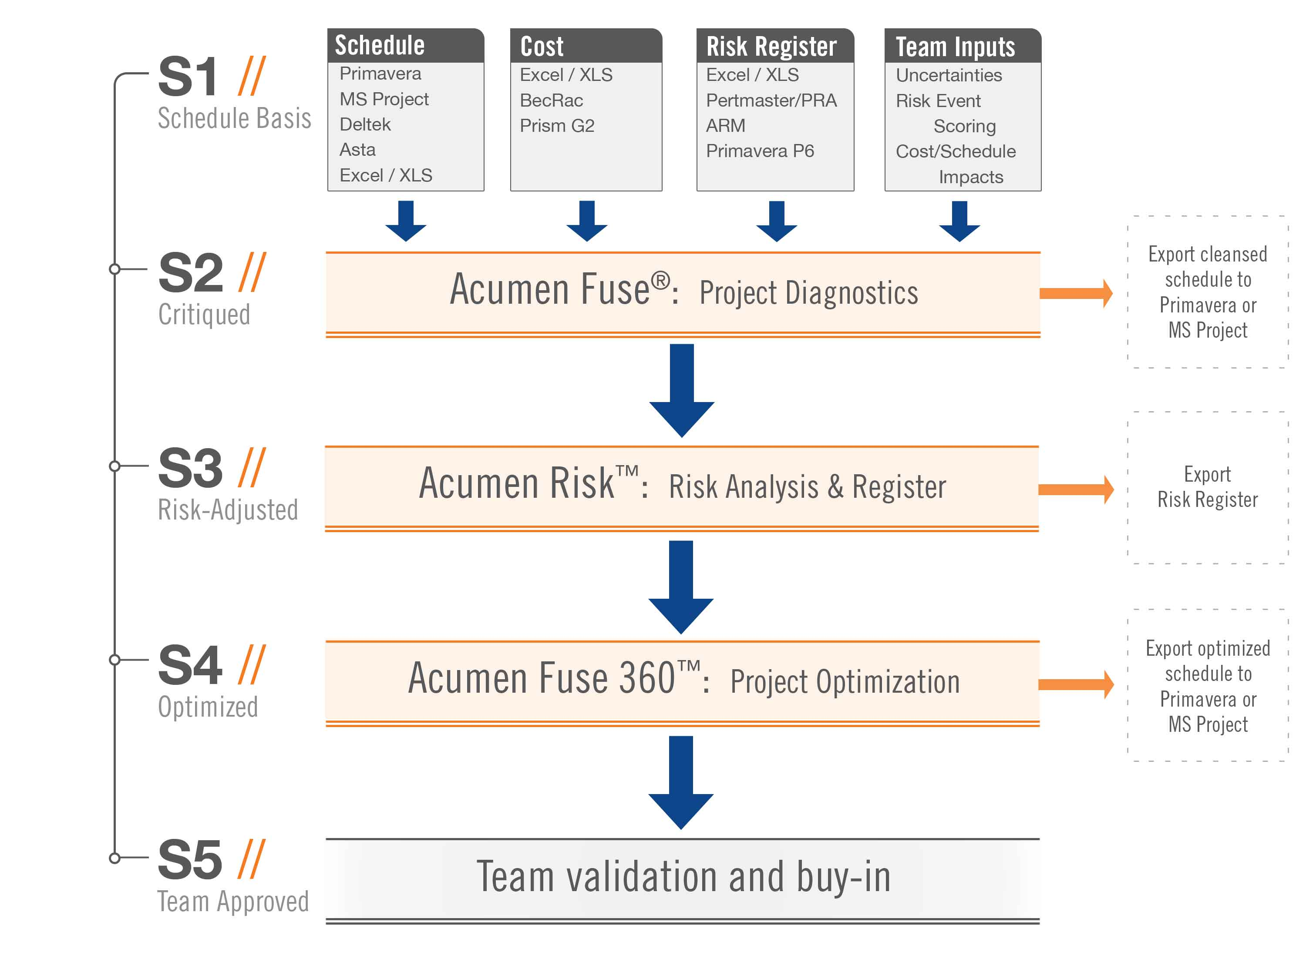
Acumen Software
S1 // S5 Schedule Maturity

Slide 3
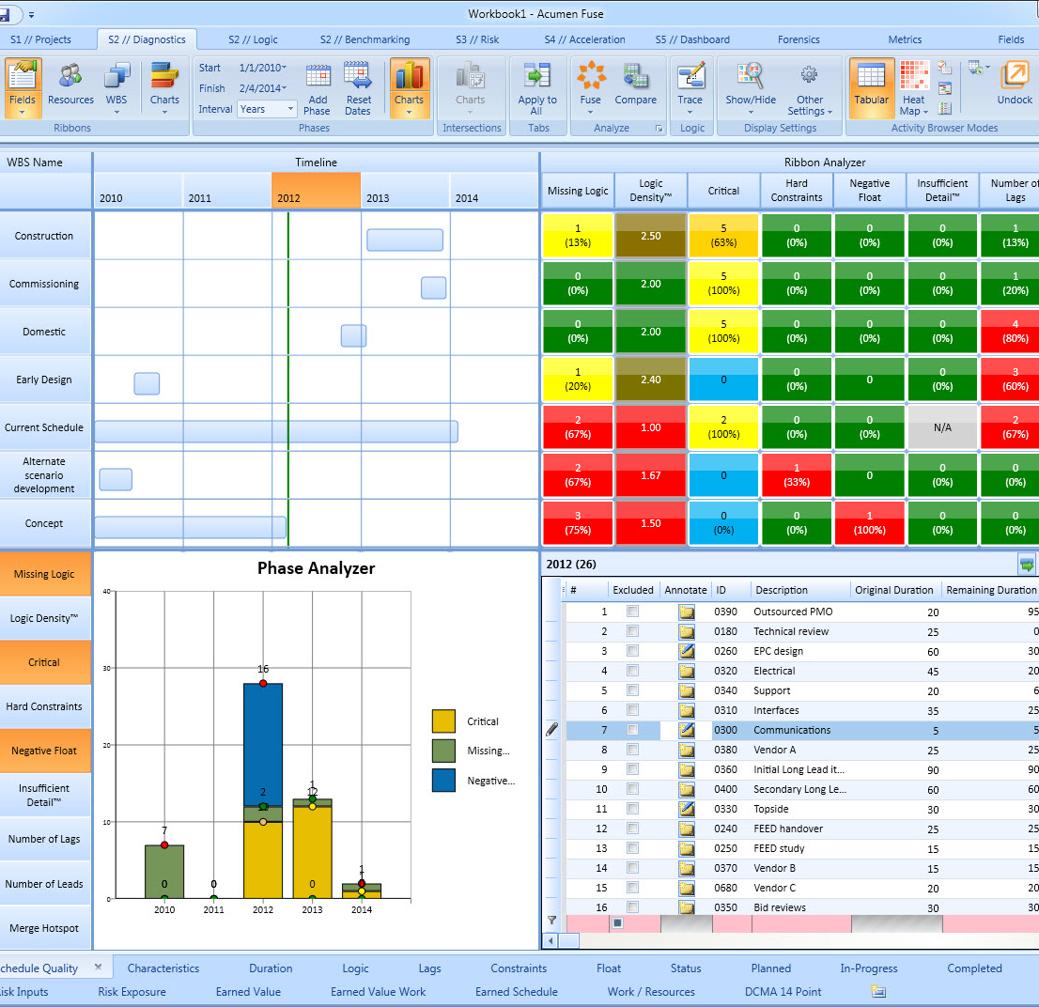
Acumen Fuse®
Project Diagnostics
Benefit:
  Insight into shortcomings
  Improved project quality
  Reliable project plans
Audience:
  Schedulers / Planners
  Project Controls
  Forensic Analyzers
Features:
  Industry standard metrics
  Forensic analysis
  Dashboards & reports
  Industry Benchmarking
Acumen Fuse® pinpoints, and more importantly, resolves project shortcomings in a matter of minutes.

Slide 4
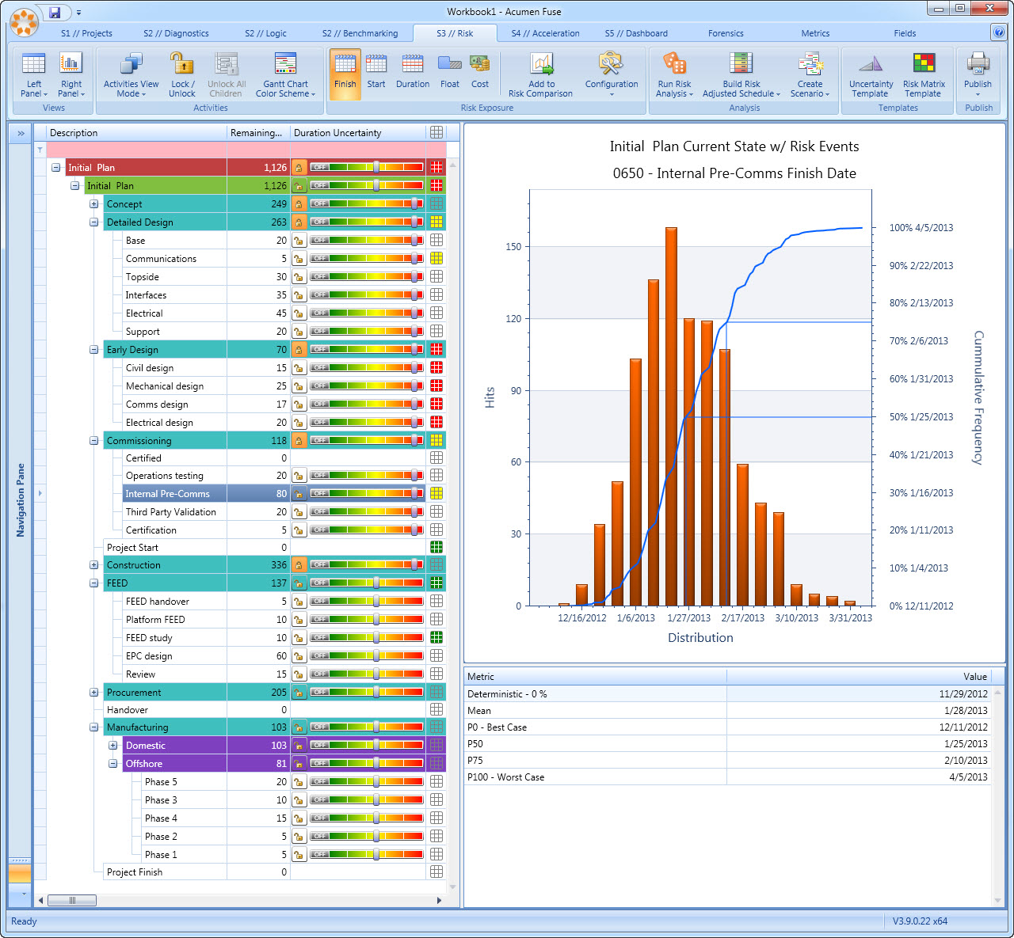
Acumen Risk™
Project Risk Analysis
Benefit:
  Risk exposure reduction
  Insight into mitigation
  Improved project confidence
Audience:
  Risk analysts
  Project Stakeholders
  Project managers
Features:
  Combined Cost/Schedule risk
  Integrated risk register
  Risk driver identification
Acumen Risk™ simplifies traditional risk analysis without sacrificing power or accuracy.

Slide 5
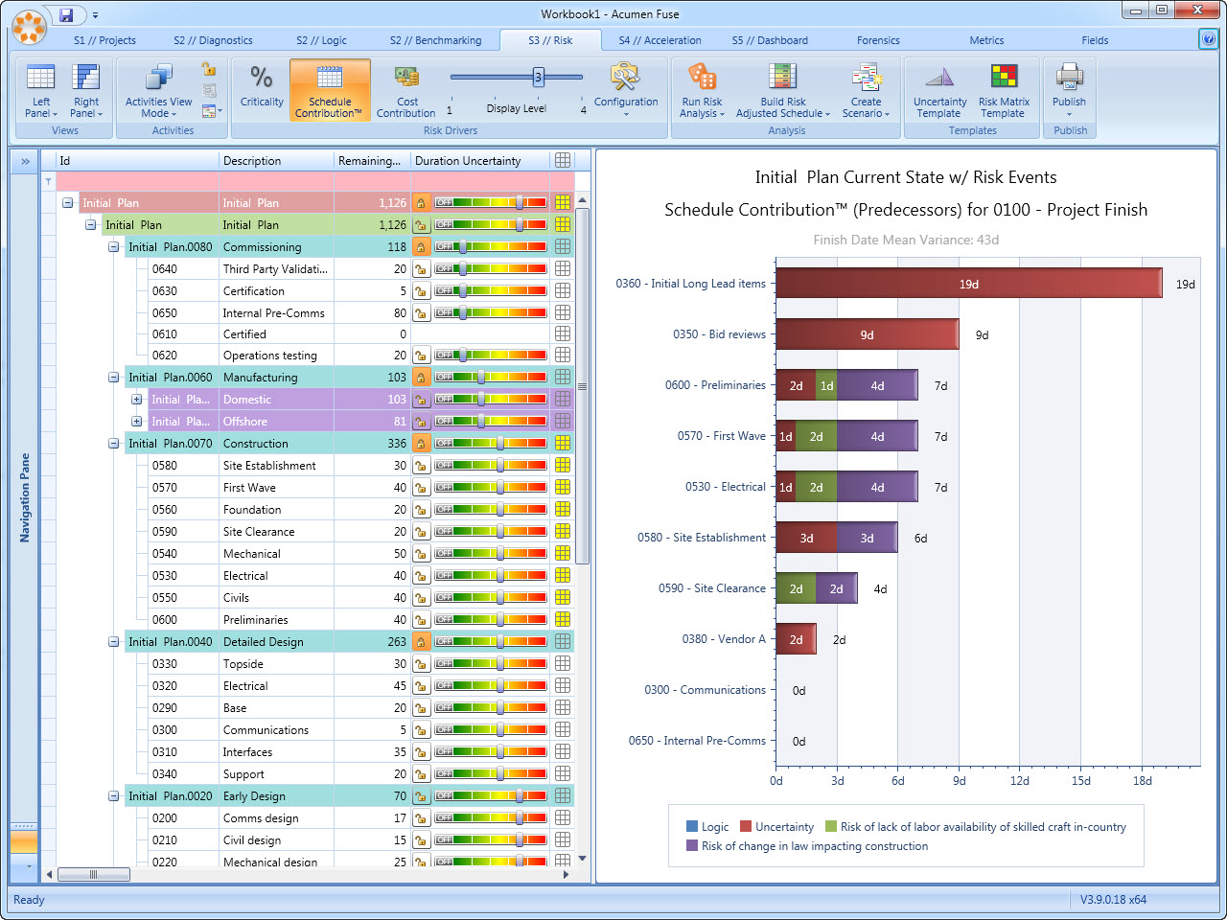

Slide 6
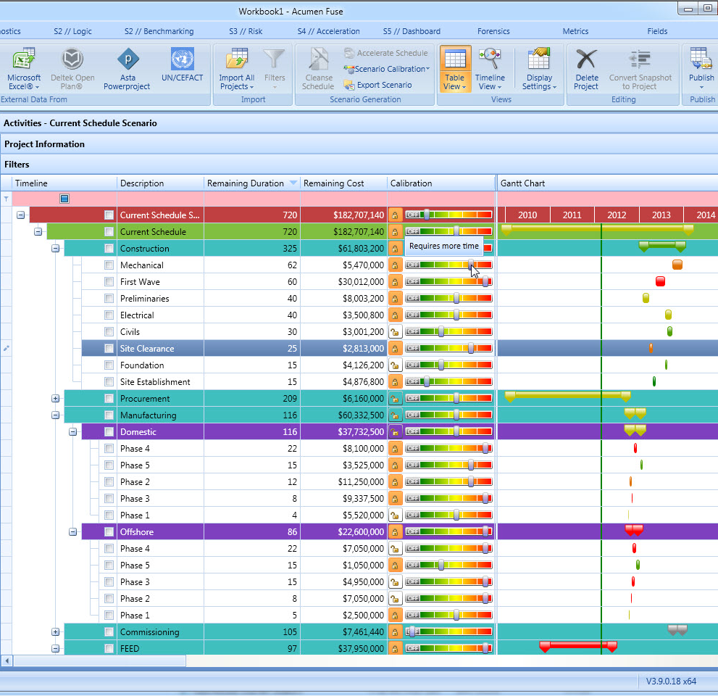
Acumen 360™
Project Optimization
Benefit:
  Alignment with project goals
  Recovery from delays
  Automatic scenario generation
Audience:
  Schedulers / Planners
  Project Managers
  Project Stakeholders
Features:
  Three modes of acceleration
  Scenario comparison
  Scenario export
  “What-If…” analysis
Acumen 360™ accelerates (or decelerates) time frames in seconds helping you meet your project goals.

Slide 7
More information:
White papers: www.projectacumen.com
Software Trial: www.projectacumen.com/trial
Twitter: @projectacumen
Email: info@projectacumen.com

