Slide 1
Brad Arterbury, PMP
Business Development Manager

Slide 2
Acumen Software
S1 // S5 Schedule Maturity

Slide 3
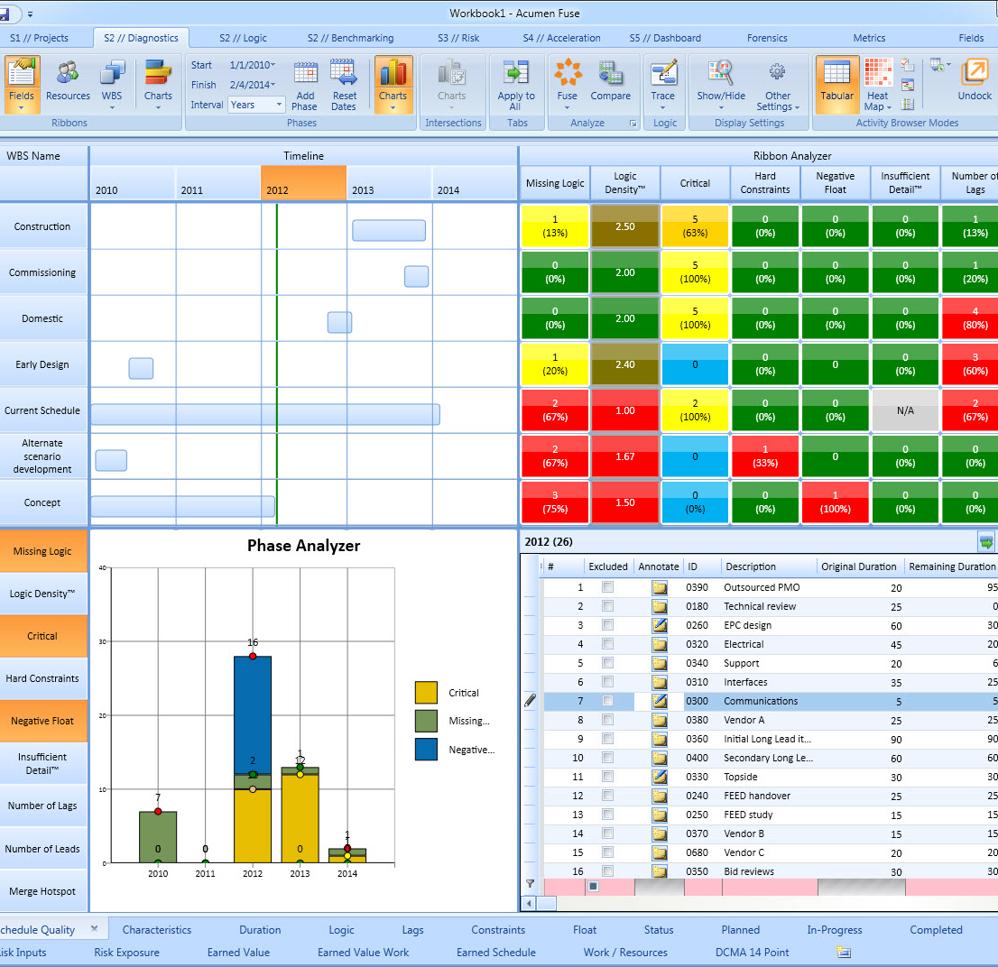
Acumen Fuse®
Project Diagnostics
Benefit:
Insight into shortcomings
Improved project quality
Reliable project plans
Audience:
Schedulers / Planners
Project Controls
Forensic Analyzers
Features:
Industry standard metrics
Forensic analysis
Dashboards & reports
Industry Benchmarking
Acumen Fuse® pinpoints, and more importantly, resolves project shortcomings in a matter of minutes.

Slide 4
Acumen Risk™
Project Risk Analysis
Benefit:
Risk exposure reduction
Insight into mitigation
Improved project confidence
Audience:
Risk analysts
Project Stakeholders
Project managers
Features:
Combined Cost/Schedule risk
Integrated risk register
Risk driver identification
Acumen Risk™ simplifies traditional risk analysis without sacrificing power or accuracy.

Slide 5
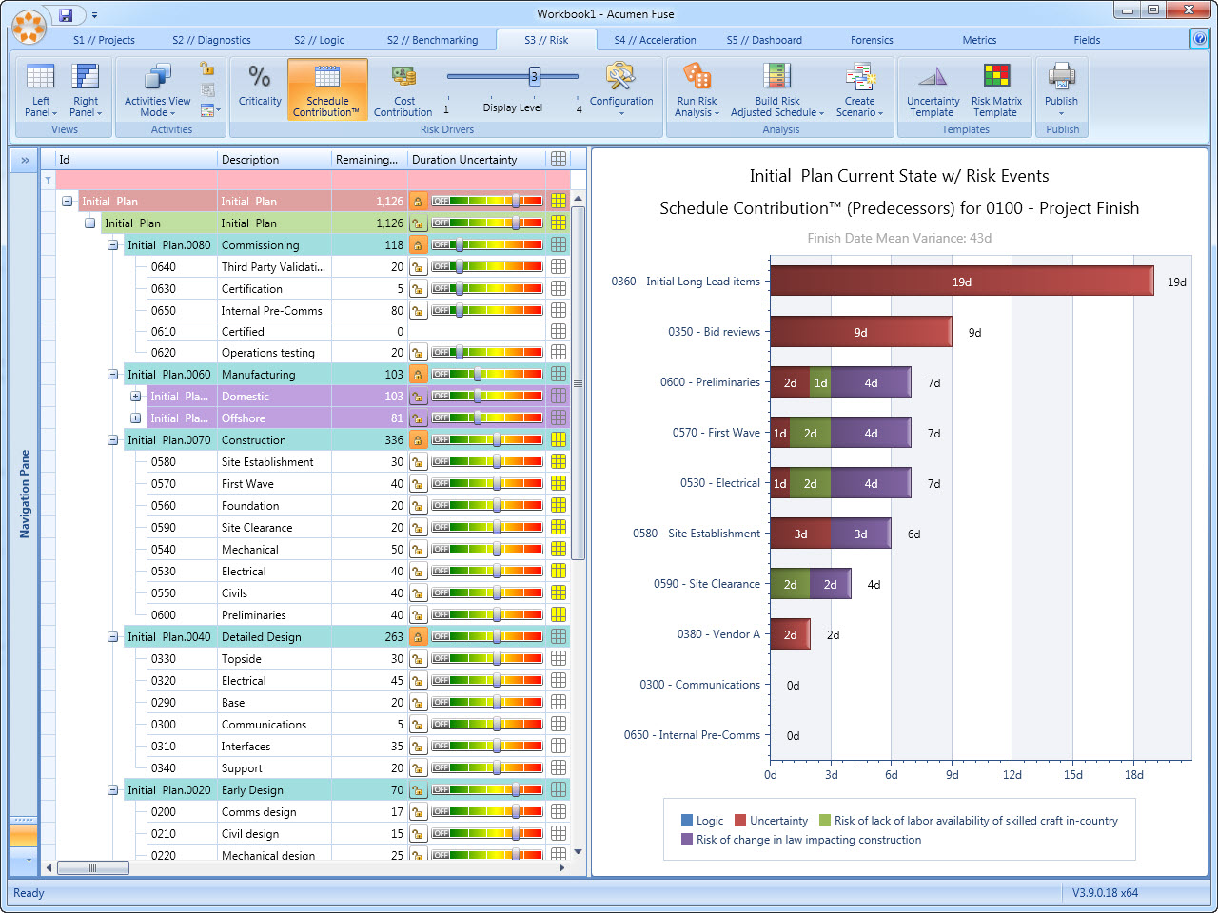

Slide 6
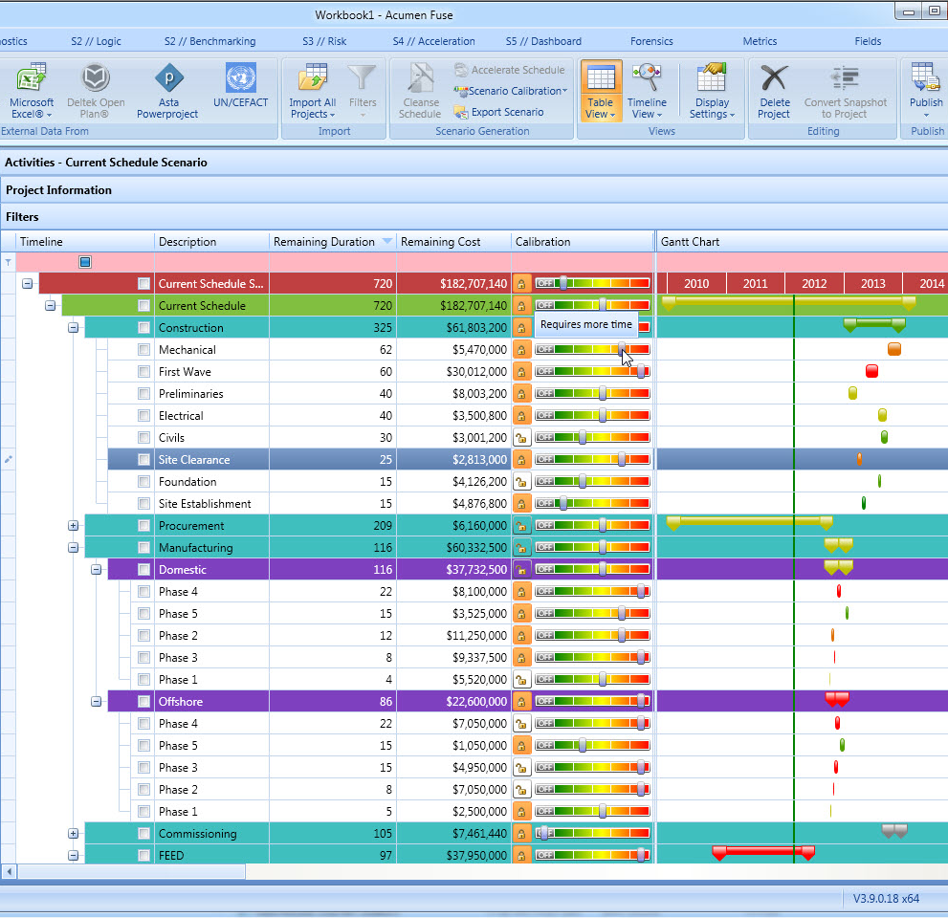
Acumen 360™
Project Optimization
Benefit:
Alignment with project goals
Recovery from delays
Automatic scenario generation
Audience:
Schedulers / Planners
Project Managers
Project Stakeholders
Features:
Three modes of acceleration
Scenario comparison
Scenario export
“What-If…” analysis
Acumen 360™ accelerates (or decelerates) time frames in seconds helping you meet your project goals.

Slide 7
More information: White papers: www.projectacumen.com Software Trial: www.projectacumen.com/trial Twitter: @projectacumen Email: info@projectacumen.com

