Slide 1
UN/CEFACT XML Schema Status and Data Exchange Requirement Guidelines
Joan Ugljesa
NDIA PMSC
August 26, 2010

Slide 2
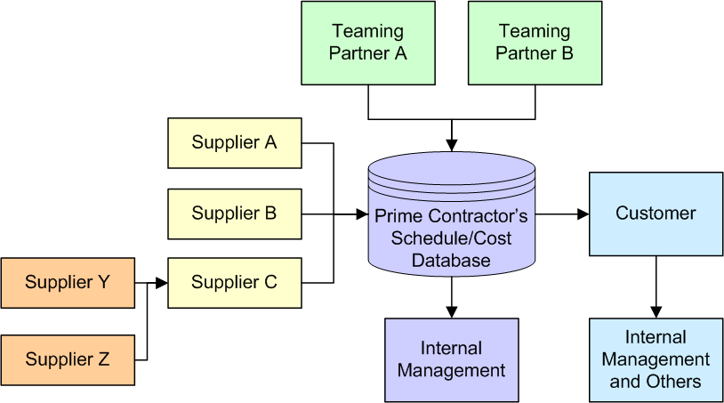
UN/CEFACT XML - Background
What’s the purpose?
  Replace the existing (and limiting) ANSI X12 Electronic Data Interchange (EDI) transaction sets (806 and 839) with an XML equivalent
  Provide means to exchange schedule, cost, and related auxiliary data in an industry recognized standard format
  Address formal government contractual requirements
  Facilitate data exchange for
  all parties –
  subcontractors, prime
  contractors, customers,
  program offices,
  internal
  management

Slide 3
End Objective
A library of schedule, cost, and auxiliary XML data components (data model and schemas) that can be used by the project management community worldwide regardless of industry
Formal, published international standard – United Nations Centre for Trade Facilitation and Electronic Business (UN/CEFACT) – that can be cited in contracts and requirements
Software vendor neutral format
Prevent new projects from reinventing the wheel – use standards based XML components in a web environment
  Consistent, standard approach

Slide 4
Schema Information Areas
Targeted schemas for specific data exchange
  Can be used alone or combined
  Flexible – can be tailored to project needs
Targeted schemas include:
  Schedule data – activities, milestones, relationship details, resource availability and assignment details
  Cost data - Budget, actual, earned value, estimate (cumulative/at complete or time phased)
  Combined schedule and cost data
  Contract and project summary data
  Funding data
  Auxiliary data – reporting structures, calendars, resources, thresholds

Slide 5
Current Events - Guidelines
Joint Industry/Government Data Exchange Requirement Guidelines for the UN/CEFACT XML Schemas
  Development effort with industry, DCMA, OSD Central Repository, and software vendors
  Goal: Clearly articulate specific data content requirements
    Software vendors can use to produce acceptable instance documents
    Foundation to do validation check – verify an instance document complies with requirements
    Support OSD Central Repository and DCMA end users as well as industry (prime and subcontractor data exchange)
First set published March, 2009 (UN/CEFACT Data Library D08B)
August, 2010 update (UN/CEFACT Data Library D09B)
    Incorporates data maintenance and comments as a result of first set of guidelines

Slide 6
Current Events - Guidelines
Updated Guidelines include:
  DID specific
    CPR (DI-MGMT-81466A)
    CFSR (DI-MGMT-81468)
    IMS (DI-MGMT-81650)
    CWBS (DI-MGMT-81334C)
  Other targeted end use scenarios
    Time Phased Cost
    Network Schedule and Cost (broader use guideline that can be used for data calls to exchange detail level data)
    Reporting Structures (WBS, OBS, IMP, etc.)
    Common Industry Code List for use with schedule related guidelines
Host web site: http://dcarc.pae.osd.mil/EVM/Index.aspx
  Alternate technical URL: evg3.dcma.mil/wiki

Slide 7
What’s Next
Data Item Descriptions need to be updated to reflect UN/CEFACT Standard
  X12 transaction sets and federal implementation conventions (ICs) out of date and not maintained
  Eliminate proprietary formats
  Consistent requirement for all DIDs
  UN/CEFACT Data Library, schemas, and guidelines are actively supported and maintained
End result: Broader support from software vendors
  Just another import/export format – makes it easy for the end users

Slide 8
Points of Contact
DCMA
  John Van Dinther, schema development sponsor (John.Vandinther@dcma.mil)
  Chris Hassler, Schema Editor (Chris.Hassler.ctr@dcma.mil)
  David Calvano, software vendor liaison (dcalvano@live.com)
Data Requirement Guidelines
  Joan Ugljesa (jugljesa@newvistasgroup.com),
  Chris Hassler, or David Calvano
OSD Central Repository/web host
  Jennifer Horner (jhorner@tecolote.com) or
  John McGahan (jmcgahan@tecolote.com)

