Slide 1
DoD COST REPORTING OVERVIEW
CSDR & EVM-CR

Slide 2
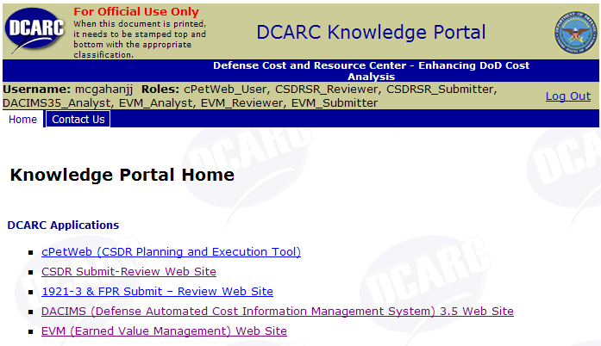
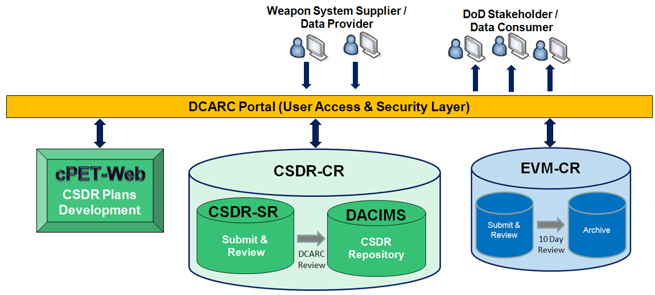
DCARC Systems Overview
Authoritative Data Source for CSDR and EV Data for Major Defense Acquisition Programs

Slide 3
CSDR Systems OVERVIEW

Slide 4
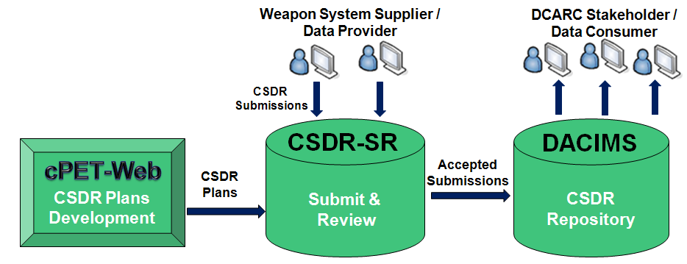
CSDR Systems Overview
The DCARC's Defense Automated Cost Information Management System (DACIMS) provides the cost community with instant access to current and historical cost and software resource data needed to develop independent, substantiated estimates.
Core CSDR IT Systems

Slide 5
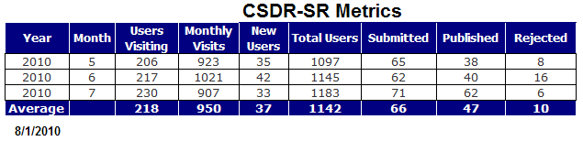
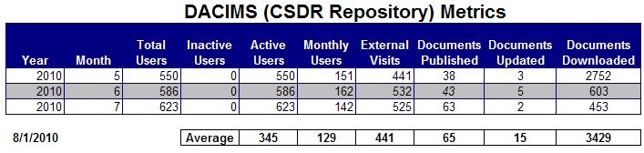
CSDR Metrics
Number of Submissions
  CSDR-SR Only (since July 2009): 1025
  Average Monthly New Submissions: 64
  DACIMS Documents: >30,000
Number of Users
  CSDR-SR: 1098
  DACIMS: 586
Average Downloads Per Months: 3600

Slide 6
CSDR Compliance
 | ACAT 1D | ACAT 1C | PRE-MDAP | POST MDAP | TOTAL
GREEN | 38 | 31 | 12 | 4 | 85
YELLOW | 15 | 3 | 1 | 3 | 22
RED | 5 | 2 | 1 | 0 | 8
NOT RATED | 7 | 5 | 29 | 0 | 41
TOTAL | 65 | 41 | 43 | 7 | 156
Status as of 08/01/2010
6

Slide 7
CSDR System Improvements
CSDR Business Process Changes
  2007 DID is the current standard (with support for legacy 2003 DID)
  2009: Reinstated 1921-3 (Contractor Business Data Report)
  2010 DID to be release Fall 2010
    Minor updates and improved to existing formats
    Introduces 1921-S for sustainment and CLS activity reporting
Major System Improvements Planned through Spring 2011
  cPET: CSDR Planning and Execution Tool
    Fall 2010: cPET-Web release; support for 2010 DIDs (plans, 1921, 1921-1)
    Spring 2011: 1921-2 & 1921-S support; single XML file schema update
  CSDR-SR: CSDR Submit & Review
    Fall 2010: simplify request for event date changes and contract data access requests; attached contract CDRLs and supporting contract documents; program-level CSDR Reporting Compliance Dashboard.
    Spring 2011: Improved Dashboard; DCMA/DCAA audit request and tracking; on-line help
  DACIMS: CSDR Repository
    Fall 2010: Improved searches and filters; bulk document packager and download
    Spring 2011: Improved analyst support functions (Build 1 cost databases)

Slide 8
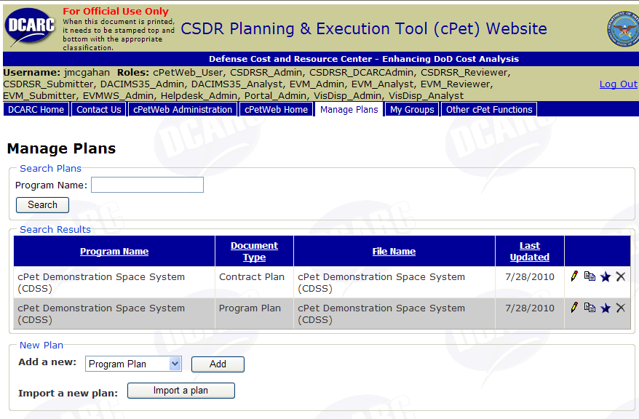
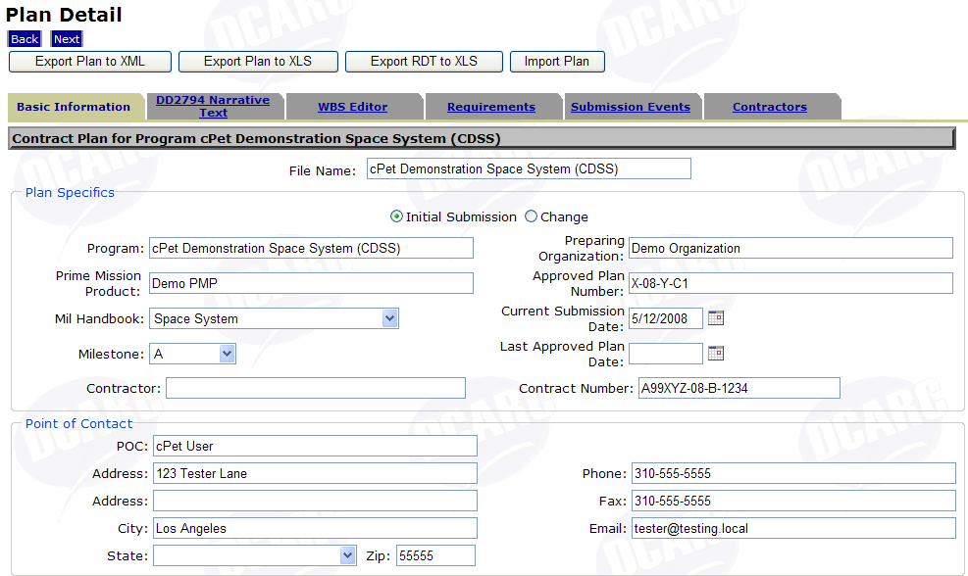
cPET-Web
Access from DCARC Portal
Create/Edit CSDR Plans
  Define WBS and reporting requirements
  Define submission events
  Assign contractors and create RDT

Slide 9
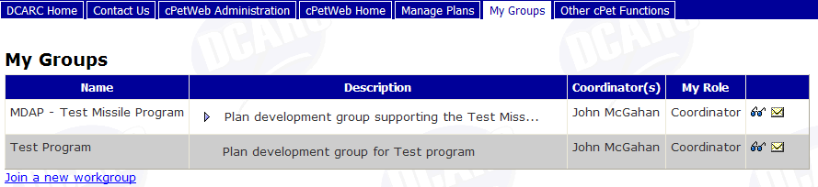
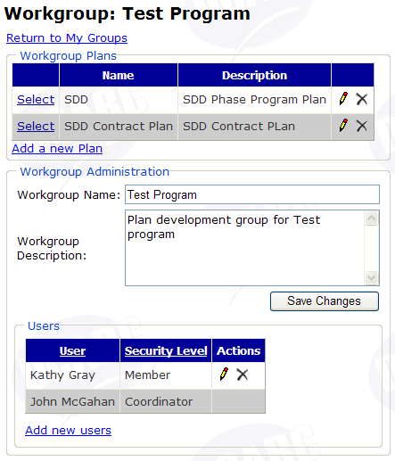
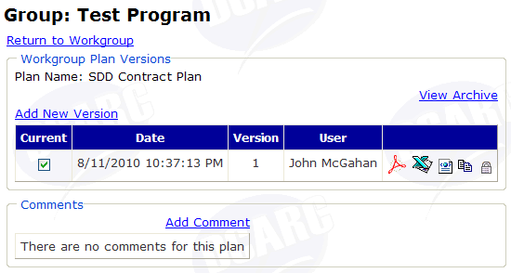
cPET-Web Workgroups

Slide 10
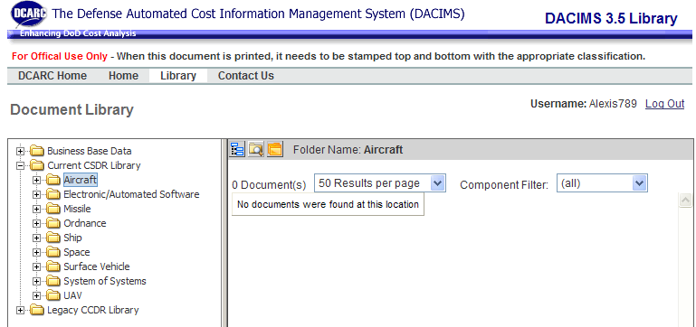
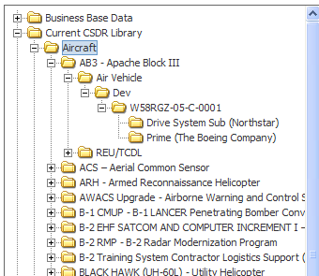
DACIMS
Current CSDR Library folder contains actively reporting programs
Organized by Mil-Handbook

Slide 11
EVM-CR OVERVIEW

Slide 12
EVM-CR Overview
Provides…
Centralized reporting, collection, and distribution for Key Acquisition Data, starting with Contract Performance Reports (CPRs)
Complete, accurate, timely, and secure transfer of electronic data from the contractor to the CR
Secure and controlled warehousing of data in the CR
Controlled, timely, and secure access to data by authorized users
Business rules that govern reporting, access, and availability of data
Minimal workload impact and required resources to implement CR

Slide 13
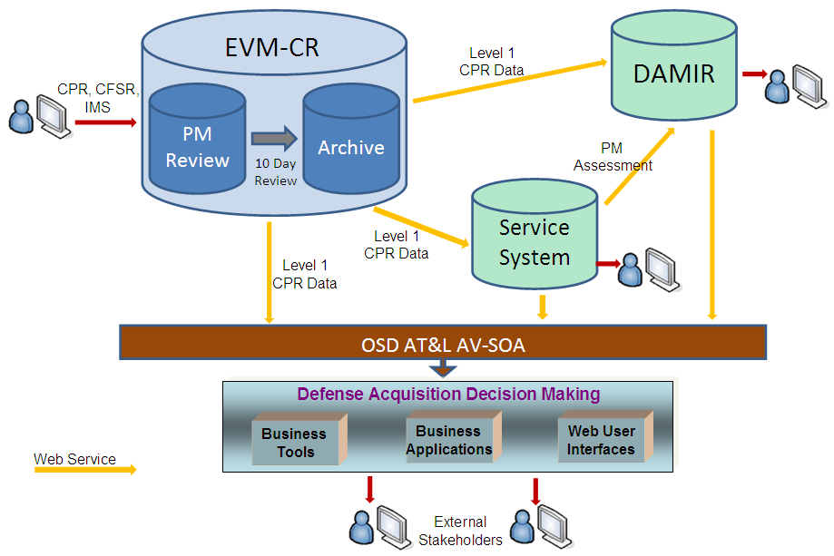
EVM-CR Overview
Providing Timely and Accurate Key Acquisition Data

Slide 14
EVM-CR Policy/Business Rules
Applies to ACAT 1A, 1C and 1D program/contracts with EVM Reporting Requirements
What is submitted and when:
  What you have on contract, due on contracted dates
  E.g., CPR, CFSR, IMS
    However, IMS can be “coordinated” with EVM Help Desk based on file size limitations
Submission Form Factors
  CPR:
    Formats 1-5 as defined on contract
    Formats 1-4: EDI 839 or XML (e.g., wInsight TRN or XML)
    Formats 1-4: Human readable (e.g., Excel)
    Format 5: Human readable (e.g., MS Office)
  CFSR: Human readable (e.g., Excel)
  IMS: coordinated with EVM-CR Help Desk

Slide 15
EVM-CR Policy/Business Rules
Other submission requirements/issues
  Annual history or backup file (and after re-baselines)
  gradual transition to DCMA-sponsored XML schema
  no executables, macros, or links
Business Rules/Process For Submission
  Day 0: Contractor Submits to CR
    Reviewer and submitter teams notified
    Level 1 CPR extract data available to Service database (AIM, Dashboard, SMART)
  10-day review window before publishing
  Day 10: Level 1 extract data available to other OSD systems (OSD AV/SOA & DAMIR) unless rejected

Slide 16
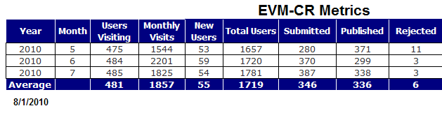
EVM-CR Metrics
Number of Submissions
  Total (since October 2006): 9849
  Monthly: >300 New Submissions
Number of Users
  Total: 1720
  Active: 1021
Downloads Per Months: >3000

Slide 17
EVM-CR Improvements
Supporting Monthly DAES Assessments
  On-going review of data quality and reporting compliance
  Re-examining CDRL and DID language to clarify requirements
Major Software System Improvements Planned through Spring 2011
  Improved Reporting Compliance
  Improved Dashboard
  Improved EDI/XML handling
    support for large data files
    data browser (web and desktop support)
  DCMA Roles (audits and evaluations)

Slide 18
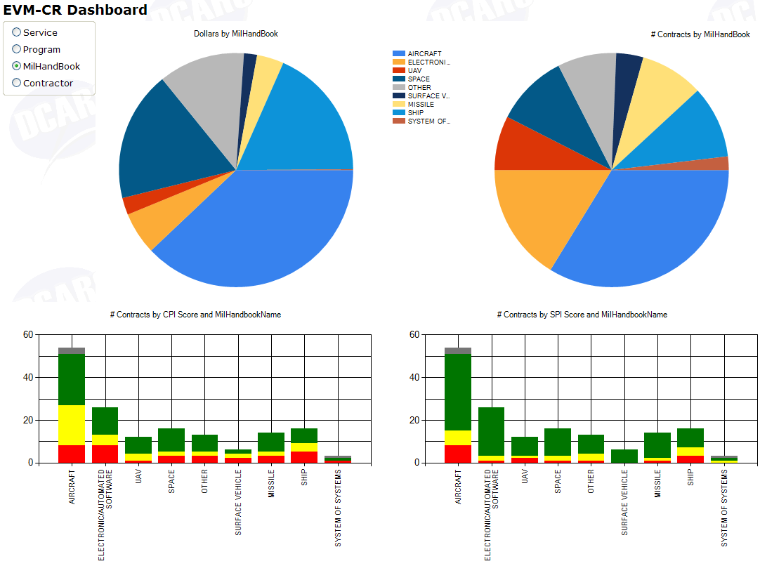
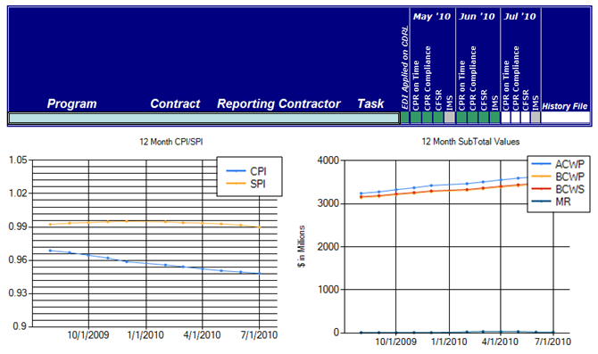
Dashboard & Reporting Compliance
Dashboard provides real-time aggregation of summary EV data to program level, mil-handbook, or service
EV reporting compliance assessment is a critical component of the monthly DAES assessments
Reporting Compliance Metrics
Contract CDRLs provided
Submission Timeliness
Form Factor (EDI / XML)
CFSR
IMS
Current CPR History File

Slide 19
Questions?

