Slide 1


Foresight and Insight:
The Value of Collaboration in Project Management
Nicholas Pisano
President and CEO
Safran North America, LLC
NDIA PMSC Meeting 12 May 2010

Slide 2
Planning and Scheduling is the Backbone for Collaboration
Plans and Schedules assist in identifying all constraints of a project (time, cost, scope, quality, benefits, technical, risk, etc.) as well as the methodology used by other disciplines
Scheduling tools generally accommodate the ability to interface with other systems (through custom fields, outline codes, activity ID’s)
Communicate all contractual components
Plans and Schedules drive management decisions in all capacities
Provide repeatable processes to standardize across portfolios
They’re a basis for collaboration across project events including feedback loop management processes

Slide 3
Cost and Schedule from the Ground Up
Single data source provides greater traceability and data fidelity
Tied to the actual work
Resource and financial constraints are more easily identified
Integration at the lowest level provides greater ease of use and less effort to develop and maintain the data

Slide 4
Integration Challenges
Stove piped, best of breed applications
  Promotes disconnected islands of data
Lack of business process integration
  Processes are inefficient, plagued by human interactions and requirements are to integrate bare minimum
Heavy reliance on PowerPoint for reporting and Excel for reconciliation
  Information is cleansed from baseline systems as it gets passed up and shared
Significant investment already made in existing applications, customization and legacy systems
  Resistance to change within executing programs
Technologies available in the past made this difficult, time consuming and costly
  Data transfers files, Data Warehousing, OLAP Cubes, API/Web Service Integration
Glorified PowerPoint presentations on the Web

Slide 5
Opportunities for Integration and Collaboration
Scheduling Tools
Earned Value Engines
Job Card & Detail Milestone Applications
Cost Estimating Tools
Quantitative and Qualitative Risk Applications
ERP Systems
Financial & Timesheet Applications
Document Management & Requirements
Procurement Systems
Analytical and Reporting Tools

Slide 6
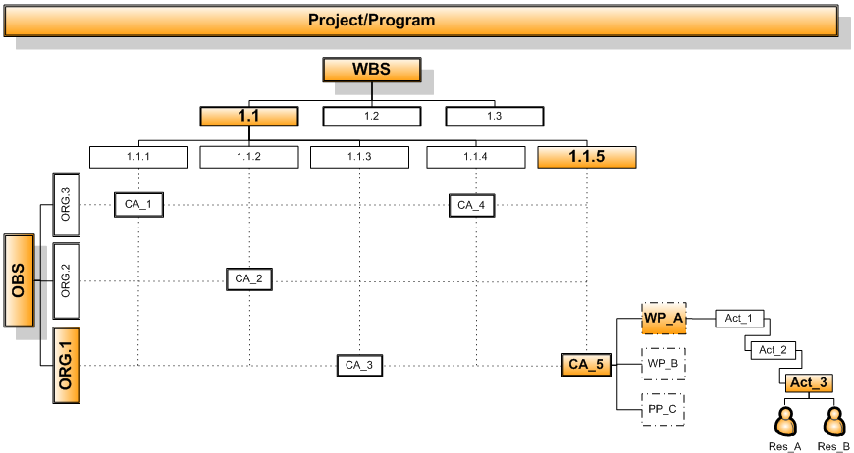
Integration Points for Across Applications are Relational

Slide 7
Aggregate Data as Appropriate According to Role Regardless of the Underlying Application
Consumers
Executive Management
Performers
Program Managers
Caretakers
Financial & EVM Analyst
Functional Management
Customers
Oversight Agencies
CAM’s & Engineering Leads
Sub Contractors
Product, Test & Other Support Centers
Master Planner & Schedulers
Performance and Risk Managers
Program Controls

Slide 8
Appropriate level of integration and aggregation varies based on vertical roles
Executives
Functional Managers & Analyst
Program Managers & Program Controls
Control Account Managers & Engineering Leads
Concerns: Funding, Profitability, Expenditures
Visibility: Vertically at high level
Concerns: Metrics, inconsistencies, analysis
Visibility: Vertically at detail level
Concerns: On schedule and on budget
Visibility: Vertically/Horizontally at mid level
Concerns: Health, progress, forecast
Visibility: Horizontally at detail level

Slide 9
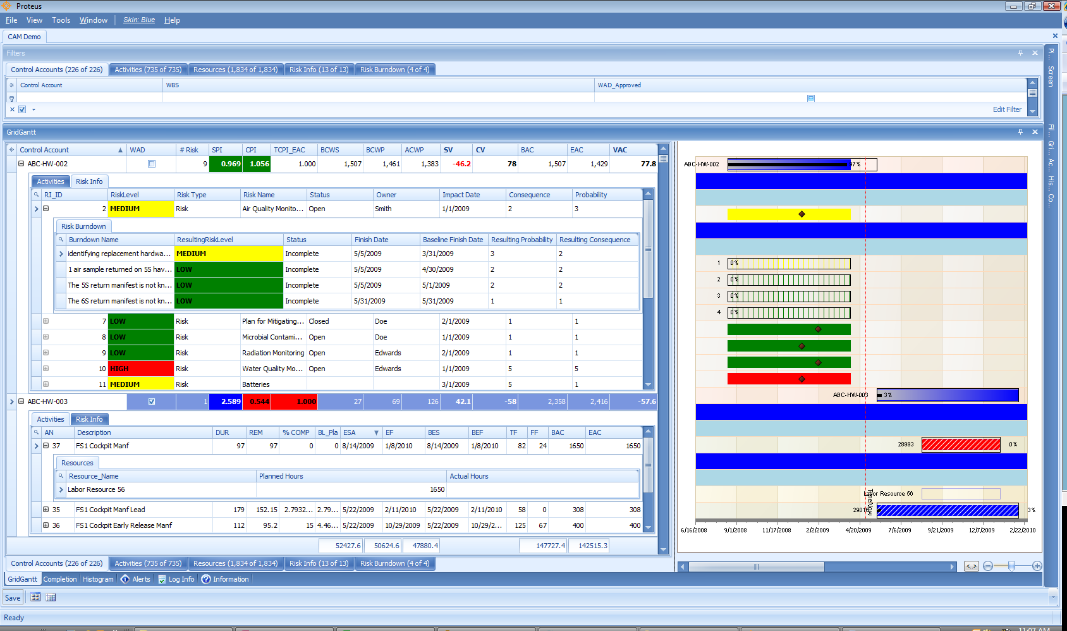
Data Integration and Collaboration Across Disparate Systems
EV
Schedule
Resource
Risk

Slide 10
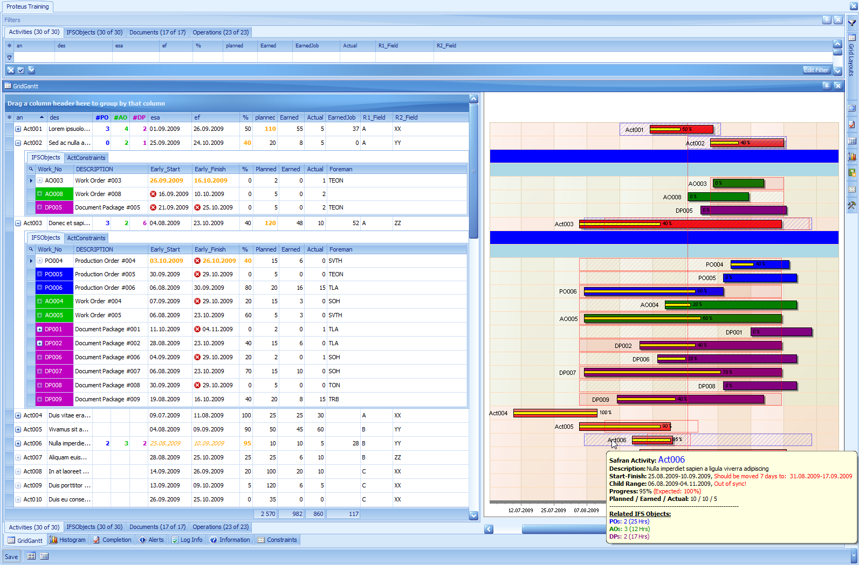
Data Integration and Collaboration Across Disparate Systems
Schedule
Jobs
Document
PO’s

Slide 11
Visualization Elements and Controls Needed for PM Data
Data Grid
  Color Coding, filtering, sorting, grouping
Gantt Control
  Visualize time scaled data
Charts
  Line, pie, bar, stack, etc.
Data Modeling
  Sandbox for pivoting related datasets
Other…
  Completion report, tabular reports, area maps

Slide 12
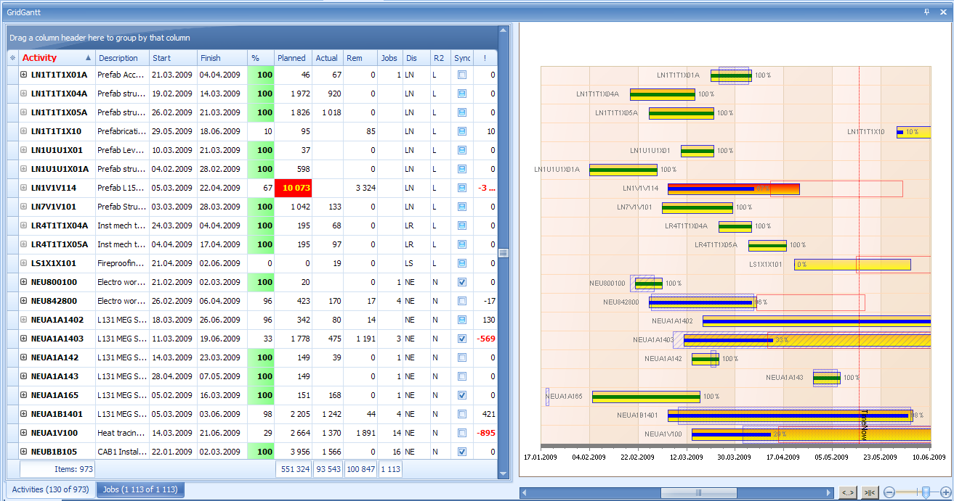
Visual Elements in Grid and Gantt
_{Progress bar is green if 100%}
_{Bar} _{is} _{red if > 10 000 hours}
Show expected Range if Behind Schedule
The more negative the number, the more attention it should get:
_{Score = Hours * Delta% / 100}
Blue box indicates child-range (min - max).
_{Hatch=Outside parent range!}
This bar is more “yellow”, indicating it has more hours. Transparency controlled by hours – compare with topmost bar!

Slide 13
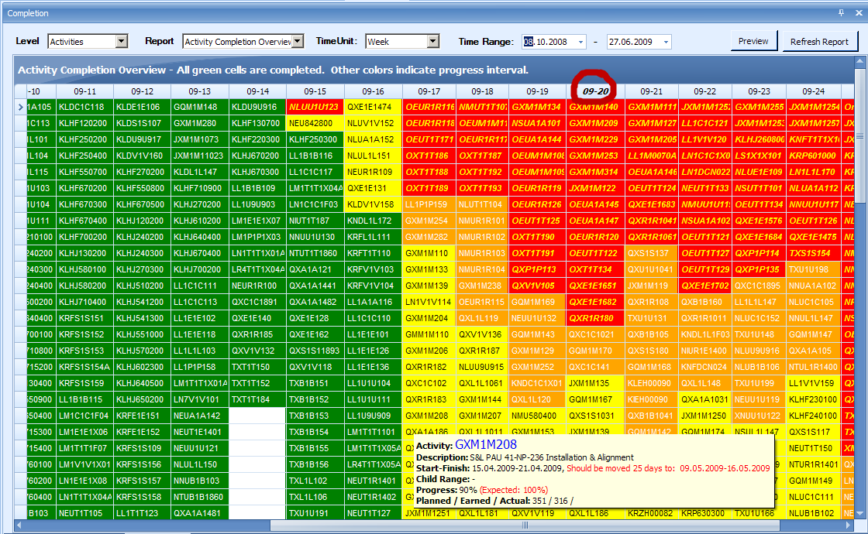
Completion Report

Slide 14
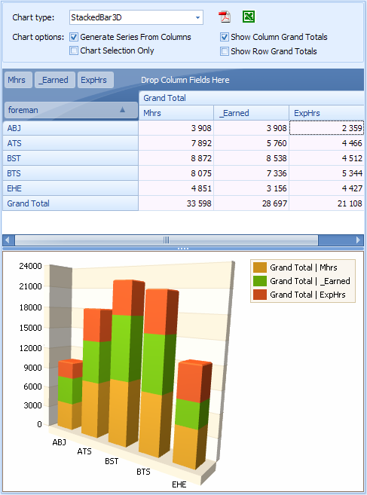
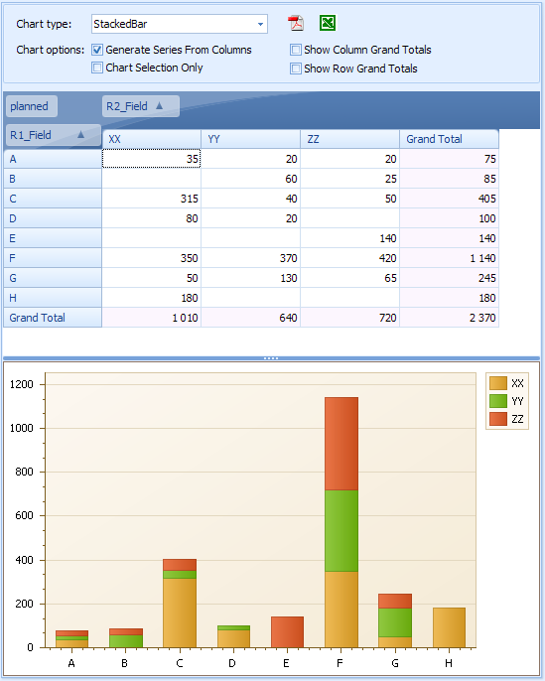
Pivot Tables and Charts

Slide 15
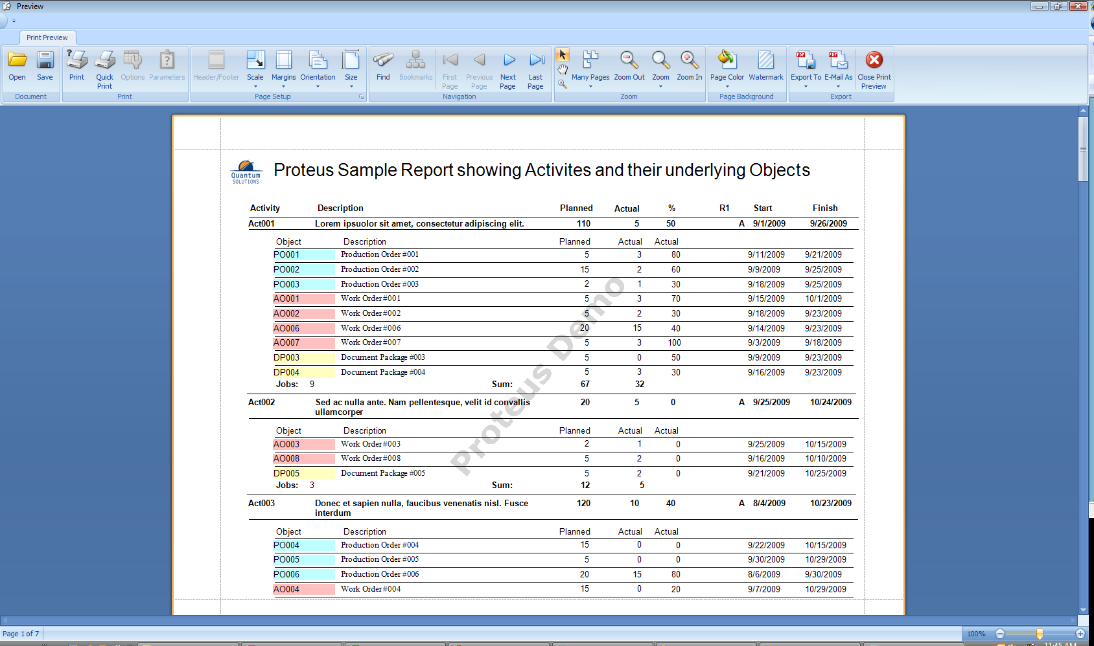
Reports

Slide 16
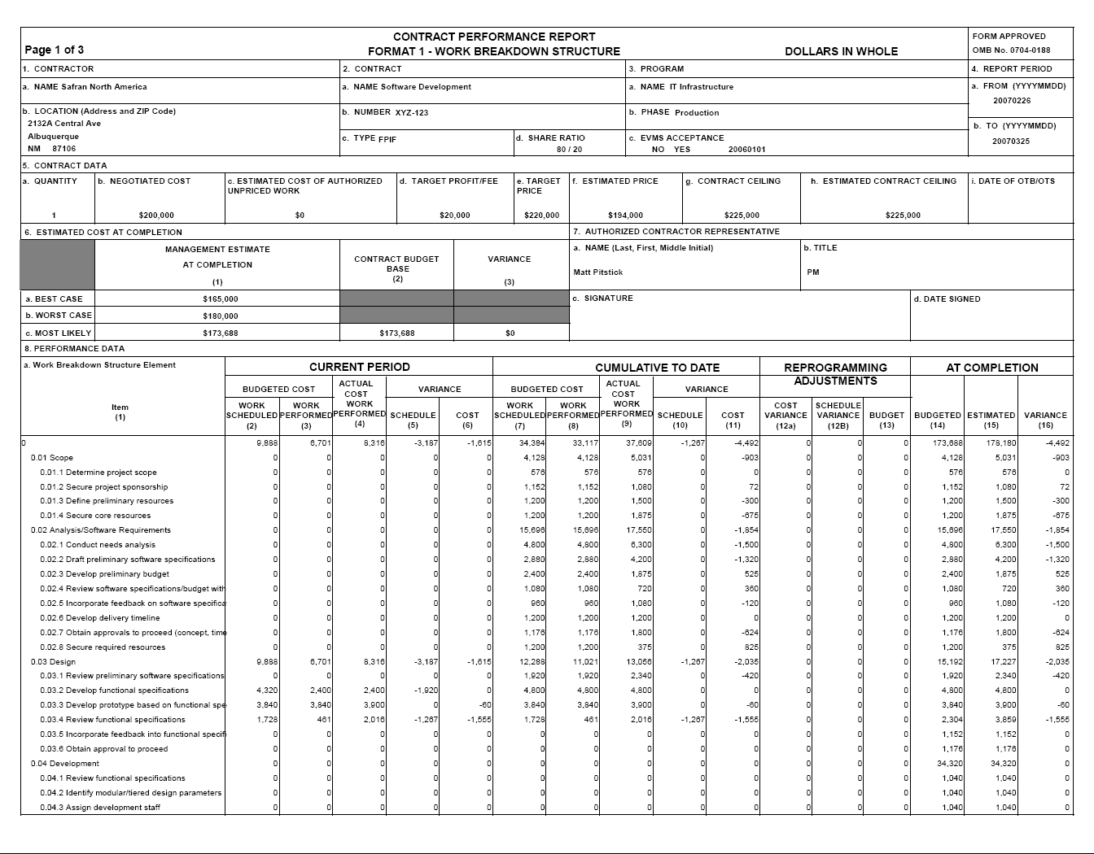
Including Government Reports such as the CPR, other EVM artifacts and deliverables

Slide 17
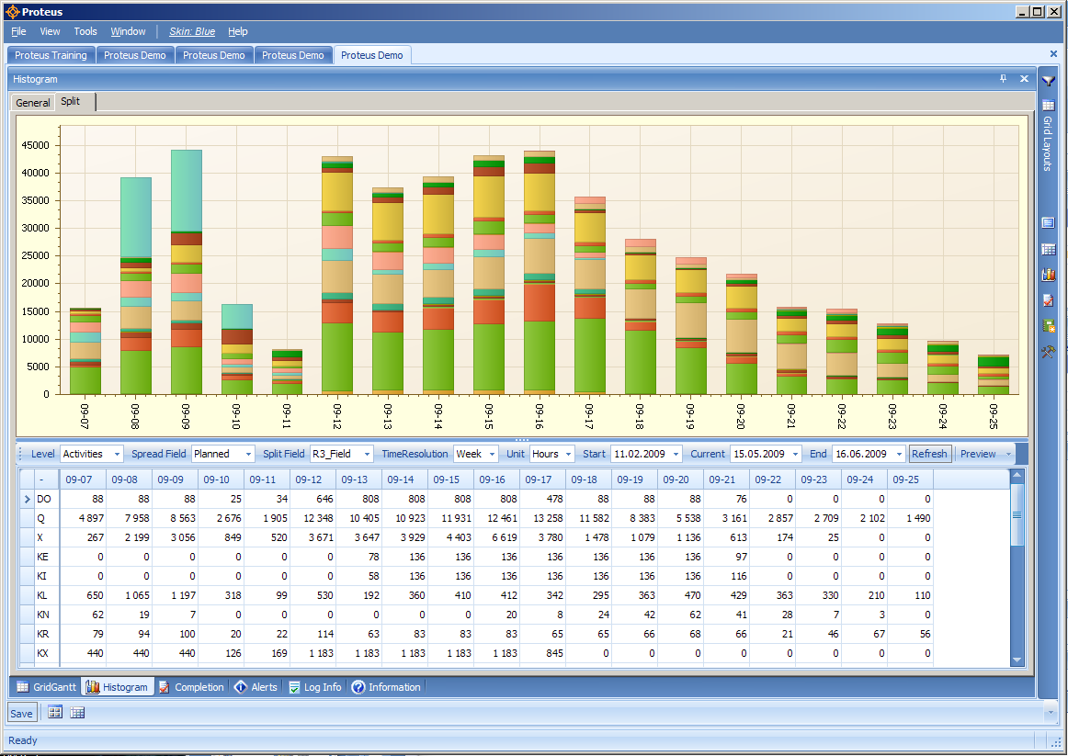
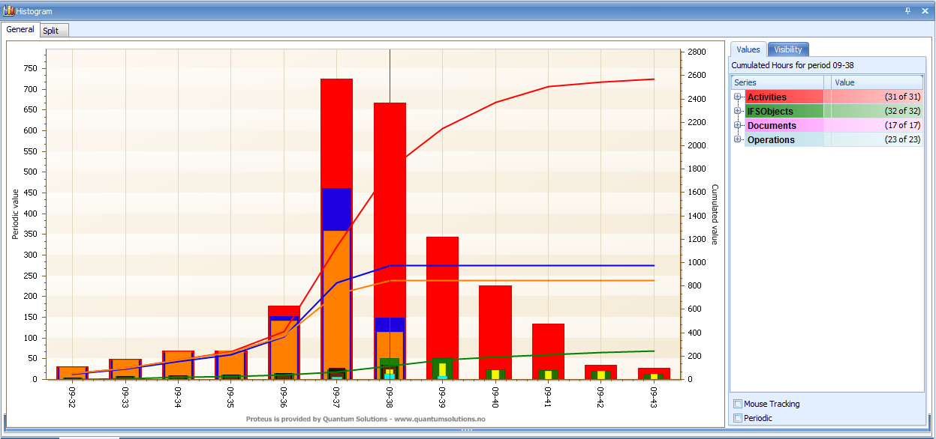
Histograms and S-Curves

Slide 18
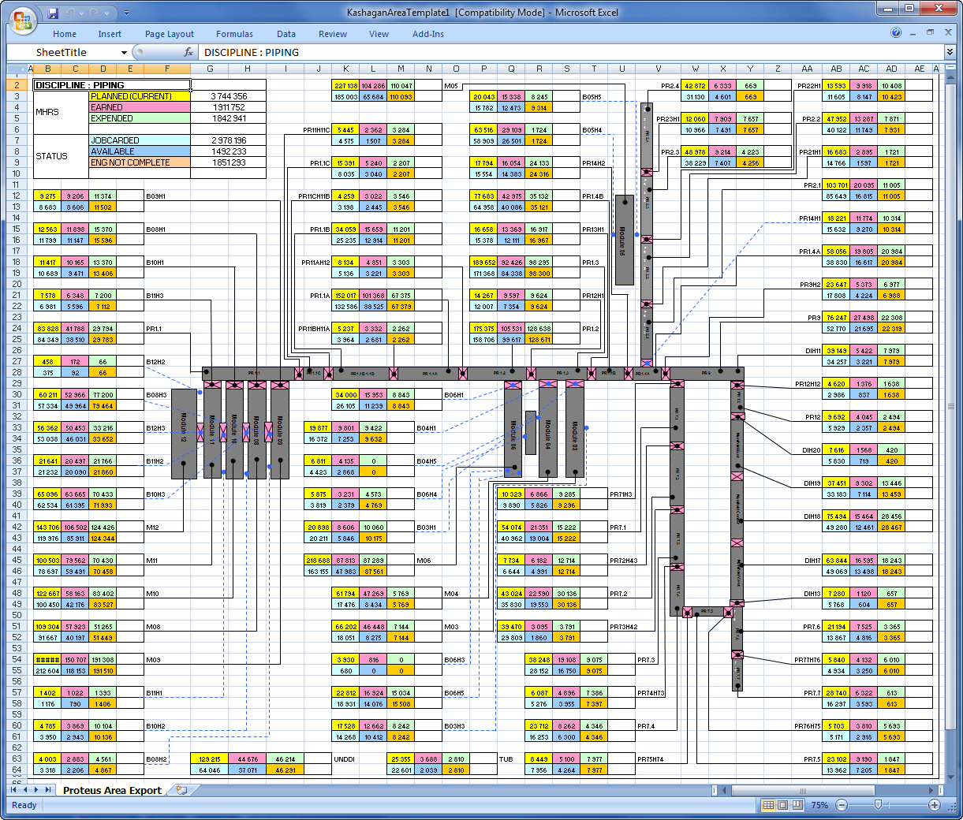
Custom Outputs

Slide 19
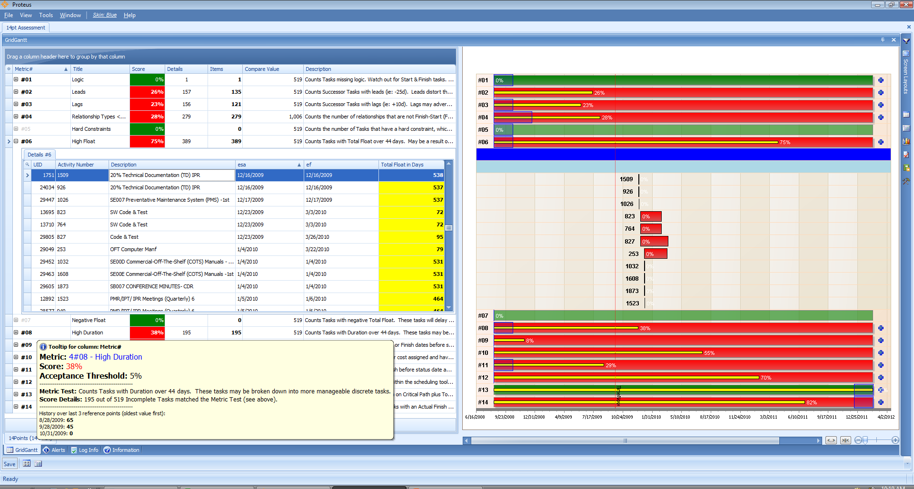
Adapt Quickly To New Requirements

Slide 20
Collaboration provides Foresight
Dashboards and Stop-lights are old hat and easy to game
Intelligence is needed in extending our systems in lieu of collecting a row of metrics
Apply best practice parametrics to normalize and quantify measurements
Make the underlying data actionable!
Stop reinventing the wheel – tools exist to preclude labor intensive custom software development: COTS/NDI model now applies to cross-application, cross-discipline integration without data transfer

Slide 21
Layering intelligence to take out the grunt work of Project Management
The ability to visualize data makes it easier for us to conceptualize trends and to transform raw data into intelligence
Modeling allows us to filter out false leads
With appropriate source data and business rules we can be more precise and rational in our business decisions
Moves us away from glorified PowerPoint
This approach allows for integration and value-added intelligence of subcontractor data

Slide 22
Applying Parametric Analysis to Source Data
Technical performance measures
Qualitative measures
Assessments of risk
Assessing proportionality of impact
Predictive methodologies for complex adaptive systems
A complete real time project control ecosystem

Slide 23
Evolution of Integrated Digital Environment
Hard-coded development
Rudimentary data cut and paste (with scripting)
Rudimentary data transfer (PA, X12)
Data mining, cubes, mapping and interfacing
Advanced data transfer (XML)
Virtual data repository (Open OLE-DB)

Slide 24
Where to find more information on these concepts:
  www.safranna.com
  Safran User’s Group – LinkedIn
  E-mail: npisano@safranna.com

Slide 25
Evening event on the Terrace tonight at 6pm – Tapas and Drinks

