Slide 1
Recommendations for Isolating DoD Data from Foreign Adversaries
Briefing to the NDIA Cyber Division
27 June 2017
Dr. Robert Rolfe, Project Leader
Mr. Russell Smith, Principal Investigator & Briefer

Slide 2
Agenda
History of Research
Major Themes
Methodology and Paper Outline
Research Questions
Conclusions
Recommendations

Slide 3
History
IDA Research Paper P-5269
Multiple recommendations to isolate DoD data in contractor networks
NIST SP -171 does not sufficiently address Advanced Persistent Threats
Only a small subset of contracts should be affected
Defense Industrial Base (DIB) Security Requirements Guide (SRG) to improve isolation/protection of DoD data
Assigned to MITRE
IDA providing analysis

Slide 4
Major Themes
Passive defensive cyber measures, i.e., vulnerability-centric model, are not sufficient to prevent breaches, so industry must move to active defensive cyber measures, i.e., threat-centric model.
Major prime contractors are more successful in protecting their enterprise information technology systems hosting Controlled Technical Information and Intellectual Property against modern threats like APTs, but the challenges continue to grow.
Small and Medium Businesses (SMB) are not effectively moving to a threat-centric model due to a lack of cybersecurity resources and personnel. This situation could be substantially improved by adopting outsourcing of their cyber defense requirements.
Security Operations Centers implementing a threat-centric model must include enhanced automation in their security information and event management (SIEM) tools to reduce cost growth.

Slide 5
Methodology and Paper Outline
Methodology
Develop scenarios for identification, data flows, protection, and incident response of CTI in defense contractor networks
Identify challenges and gaps in current environments (SMB & IT/OT)
Explore APT challenge/threat- vs. vulnerability-centric model
Recommend future architectures
Review and recommend policy changes
Paper Outline
Introduction & Defense Industrial Base (DIB) Scenarios
APT Threat Assessment
DIB Current Environment
Measures of Effectiveness
Proposed Solution and Architectural Designs
Policy Recommendations
Conclusions and Recommendations

Slide 6
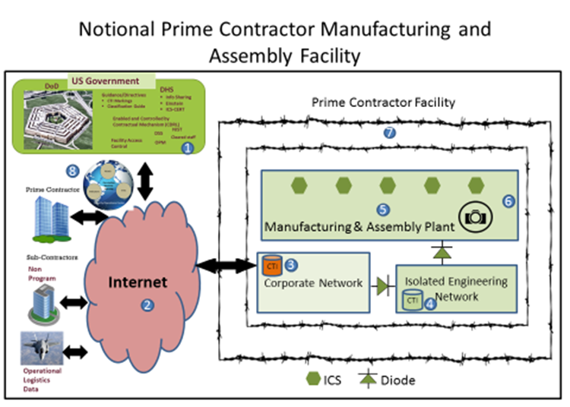
High Level Architecture (Example #1)
Notes:
Prime:
The figure displays notionally the typical flow of CTI for a DIB prime contractor at its manufacturing and assembly facility and the associated targets of opportunity for an attacker. The information flow process starts with the identification of CTI and traces its evolution through critical phases of material development. The relevant steps are:
Step 1—USG identifies CTI in a Tier 1 or 2 program and issues instructions to limit distribution; most of this is accomplished on USG information systems, and NIST 171 controls do not apply.
Step 2—DoD transmits CTI to the prime contractor’s facility. Several options are available, ranging from using traditional mail to using electronic means via the Internet. If the Internet is used, encryption techniques will be employed to deliver the CTI to the vendor’s specified delivery point. In this notional example, the PMO office in the corporate office at the vendor’s manufacturing and assembly plant is the target delivery point.
Step 3—The CTI is temporarily stored in a limited access enclave, until it can be transmitted via secure means (one-way cross-domain solution) to an Isolated Engineering Network. Upon successful transmittal, the CTI in the PMO office is electronically wiped from the corporate network .
Step 4—CTI remains on the vendor’s isolated engineering network with no external connections to the Internet where the data is manipulated and transformed into detailed design data to drive manufacturing, assembly and test operations. No remote access services are enabled on the engineering network. At the conclusion of the contract, DoD will issue destruction instructions to the vendor for CTI under their control.
Step 5—During production (manufacturing, assembly and test) processes, CTI will be transmitted to isolated industrial control systems on the factory floor. This transmission will be via man-in-the-loop (using external device, such as CD) or using a one-way data diode to specified ICS on the factory floor. Machine operators will use either 2-man control or 2-factor authentication to load the CTI. If feasible, no CTI data will be permanently stored on the ICS device. If permanent storage on the ICS cannot be disabled, then once the part is completed the CTI data is wiped from the ICS.
Step 6 & 7—Throughout Steps 3 through 5 numerous levels of physical access control will be in place. Multiple physical barriers, such as gates and guards, coupled with controlled access for employees and visitors, along with strategic placement of cameras at every data exchange point will be used to amplify safeguards.
Step 8—A best practice for prime contractors is the use of a Security Operations Center (SOC). This is a corporate resources that that monitors sensors across the enterprise to identify and pinpoint anomies and non-standard behaviors. The goal is to employ machine learning techniques and predictive analytics to detect insider threats, correlate approved changes, and track activities. There is a lengthy discussion of SOCs later in this chapter.

Slide 7
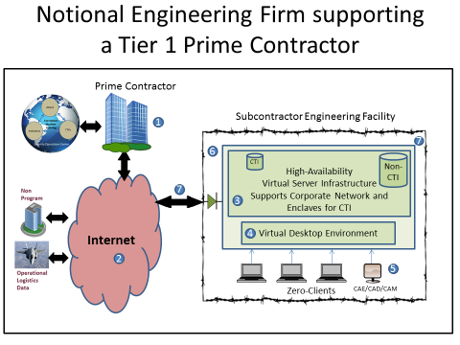
High Level Architecture (Example #2)
Notes:
Mid Tier Supplier:
The process starts with the transfer of CTI from the prime contractor’s office and traces its evolution through critical phases of engineering development process. The relevant steps are:
Step 1—The prime contractor selects a subcontractor to provide engineering and design services that include Tier 1 and 2 program CTI. The subcontractor selection will be based on objective evidence that all current NIST SP 800-171 controls and augmentations, based on the DIB SRG, are effectively implemented to receive, process, manipulate, and store CTI.
Step 2—The prime contractor uses a Federal Information Processing Standard (FIPS) 140-2 encrypted tunnel across the Internet to make a point-to-point transfer of the CTI through a cross-domain solution (diode). The CDS is configured to only allow one-way traffic—the default setting does not allow any outbound traffic. Optional transmission via courier and registered mail are acceptable.
Step 3—The engineering subcontractor receives and stores the CTI on the local virtual server infrastructure using VLAN separation, dedicated virtual machines, containers, etc.
Step 4—All access to the stored CTI will be accomplished using a virtual desktop environment. The VDI environment provides only a view of the CTI running on a dedicated virtual machine. This architecture provides an optimal level of separation from the non-program data.
Step 5—The subcontractors’ engineering staff uses zero clients to view and manipulate the CTI resident in the virtual server infrastructure. Access to the zero clients is restricted based on need to know as described in the system security plan (SSP).
Step 6 —The subcontractor’s facility uses multiple layers of physical barriers and two-man controls to gain access to the zero clients. The subcontractor may opt to use two-factor authentication.
Step 7—When the subcontractor’s engineering staff has completed its assigned work, the CDS will be temporarily modified to allow a single outbound session for a secure file transfer back to the prime contractor’s facility. Optionally, the completed work can be transferred by mail or courier.

Slide 8
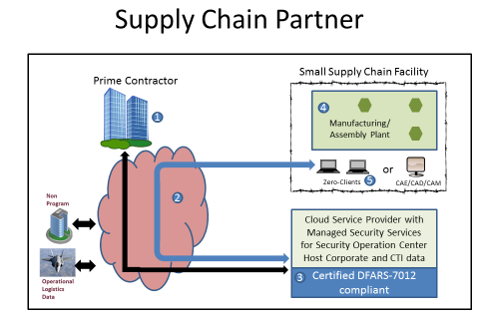
High Level Architecture (Example #3)
Notes:
Small Supply Chain:
The process starts with the transfer of CTI from the prime contractor’s office and traces its evolution through critical phases of the small supply chain partner’s engineering and development processes. The relevant steps are:
Step 1—The prime contractor uses a secure file transfer mechanism to send the CTI to the small supply chain partner. This partner does not have any organic information technology capability. Instead, it will use a DFARS 252.204-7012 certified Cloud Service Provider (CSP) for computing and storage. In other words, the CSP will meet the requirements of the FedRAMP moderate baseline.
Step 2—The supply chain partner authorized staff will access CSP resources using a zero-client and a virtual private network.
Step 3—The supply chain partner buys cloud computing services along with managed security services that are certified DFARS -7012 compliant. The prime contractor will require evidence that the CSP has addressed each of the security controls identified in the most current version of NIST SP 800-171.
Step 4—All Industrial Control Systems (ICS) at the partner’s facility for machining, assembly, and testing will be isolated from the Internet. Logic specifications to drive the ICS will be air gaped and entered by authorized staff.
Step 5—The partner’s supply chain facility will be protected by two layers of physical barriers, e.g., fencing and one or more locked doors.
Step 6—Access to these zero-client resources will be restricted, consistent with local system security plan and CSP protocols.

Slide 9
Conclusions (1 of 2)
Just increasing the specificity in the current vulnerability-centric NIST SP 800-171 requirements will not protect government CTI as effectively as migrating to a threat-centric cybersecurity architecture that can protect CTI against today’s and future APTs.
Many large DIB contractors have reached an adequate level of maturity in the implementation in the NIST SP 800-171 requirements, and have already implemented a threat-centric approach to protecting CTI.
Small and medium businesses are in need of expanded mentoring from large prime contractors within the supply chain for DoD critical programs.
Cloud-based IT service providers have reached a sufficient level of maturity for use by DIB small and medium companies seeking to extend their IT infrastructures. DoD FedRAMP moderate requirements, however, are perceived by DIB members as a hindrance for wide adoption of this solution.

Slide 10
Conclusions (2 of 2)
The size of the cyber staffs of most small and medium DIB companies is inadequate. However, small and medium businesses could leverage Managed Security Service Providers (MSSP) for enhanced cyber resiliency.
Small and medium DIB companies are not able to maintain the required level of cyber skills in their IT staff, due in large part to high personnel and tools cost.
A substantial number of cyber-attacks continue to be initiated through simple phishing and can be easily prevented if users are properly trained and sensitized to the importance of basic measures when accessing the Internet or reading email
Effective cyber security against APTs starts with a deep knowledge of the organization’s infrastructure. Improving the inventorying of the infrastructure (Change Management processes) is critical to countering the APTs.
Threat information sharing is suboptimal and makes it harder for DIB companies to improve their incident response.

Slide 11
Recommendations
Small and Medium DIB contractors should outsource cybersecurity whenever possible
Prime DIB Contractors should stand up a security operations center with advanced analytics
The DoD should use cost incentives tied to the protection of CTI
The DoD should make policy changes to reflect the DIB SRG
DIB Contractors and DoD should incorporate measures of effectiveness
DIB Contractors Should:
Assess the use of alternative network architectures to counter APTs and protect CTI and periodically refresh network assets
Limit persistence storage of CTI
Limit access to CTI in IT and OT systems
Manage inventory changes to their enterprise IT environments
Select secure operating systems
Produce an enhanced system security plan
Improve user education
UNCLASSIFIED

Slide 12
Questions?

