Slide 1
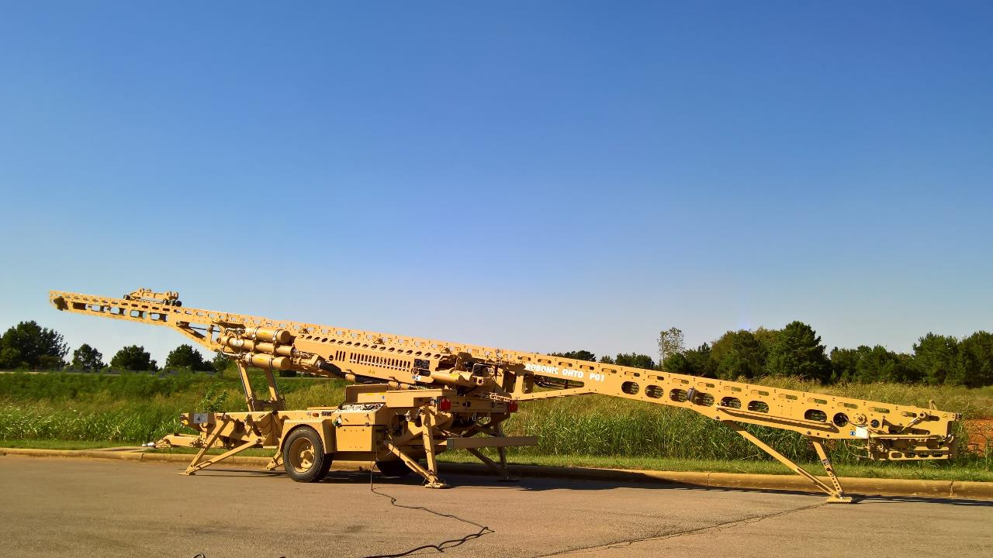


Development of the
OHTO UAV Launcher

Slide 2


LM and AFDA Collaboration Event – Jan 2012 UK
Provide Overview of LM
Gain better understanding of Finland’s capabilities and future needs
Introductions to a selected group of Finnish companies
Build long-term partnerships
Notes:
I have often been asked of the worth of these trips. I have heard rumours of companies signing contracts next days and am delighted to hear of these. In reality these occasions are a start of a journey where two meet. No wonder we call the initial meetings between suppliers and buyers “speed dating”. Joking aside - the opportunity to present your products and services to the buyers, business developers and people in the community, …
Our joint cooperation starts from one of these sessions in January 2012 …

Slide 3
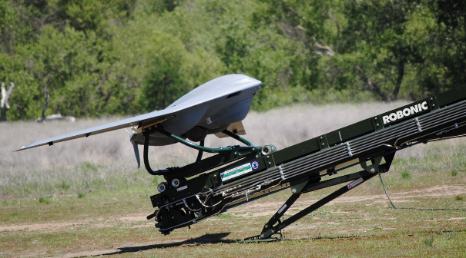
Development of the OHTO Launcher
Robonic Ltd Oy (subsidiary of Safran Electronics and Defence)
LM successfully used Kontio launchers for Group 3 UAV “Fury”
  Design and development
  Testing
  Robonic considered a strategic partner
Kontio
  provides more power than needed
  too large for customer requirements
RFI / SOW and contract negotiations
Supply and Licensing Agreement
Notes:
Setting the stage

Slide 4
OHTO Timeline
Notes:
Story of the name – bear 100 synonyms in the Finnish language
Based on customer feedback we started internally discussing the OHTO concept in 2009.
In discussions with AME the team out in San Luis Obispo, CA told us that the potential end user was wanting a smaller, more easily transportable launcher. We started the discussions of the first SOW.
At the time of LM finalising the acquisition of AME we had started the discussions of industrial cooperation – my counterparts were Michelle and Mark Cooper of ???
The same time the team from SLO was discussing the requirement internally. And so were we where we were looking at what this would mean in practice from a mere engineering point of view. One of the drives was total mass.
In 2013 we signed a TAA with LM and received the formal RFI. As one thing leads to another in 2014 we started the prototyping negotiations from a commercial aspect. We met both here in Crystal City and in Paris four times and in the interim exchanged emails on the subject matter.
In March of 2015 we signed the Supply and Licensing Agreement and received the PO.

Slide 5
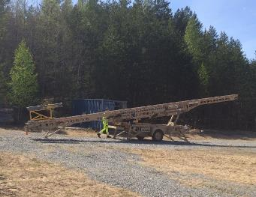
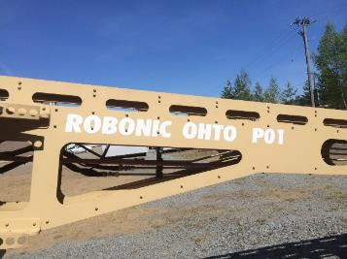
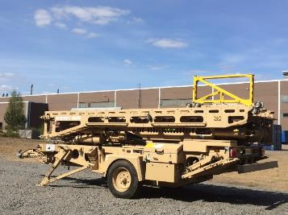
Development of the OHTO Launcher
Major engineering effort
Some 60% of design ready at the of signing the SLA
Agreement to design, test and have ready for delivery within a year of contract signature
Extensive testing to ensure targets are met
OHTO P01 was completed and tested on time and on budget
Notes:
We had agreed to a delivery of a prototype launcher for the Fury, a runway independent UAV within 12 months. And in this time the design would be finalised, we would source the components, get the prototype built, tested and accepted.

Slide 6
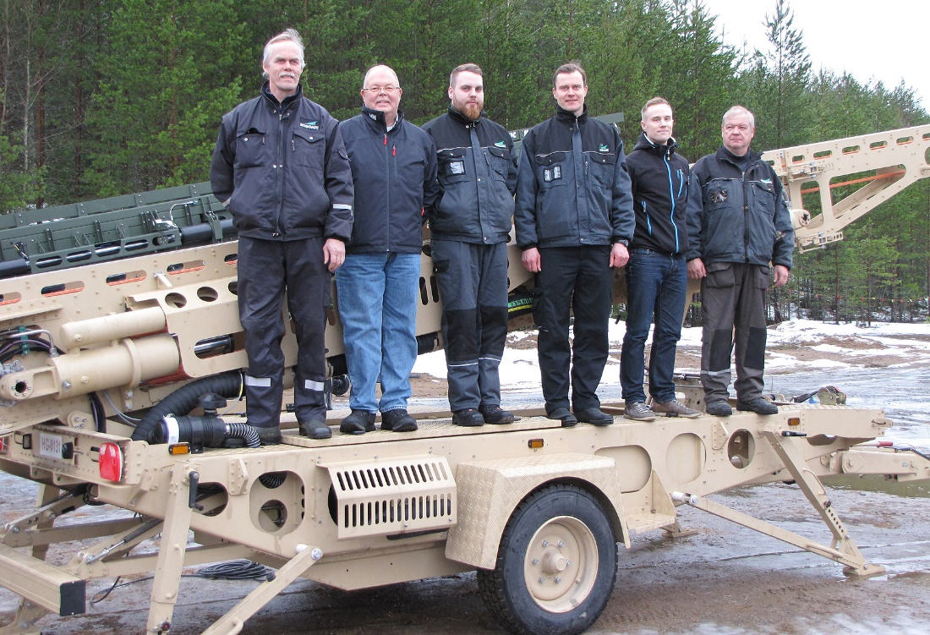
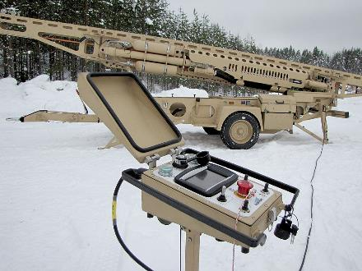
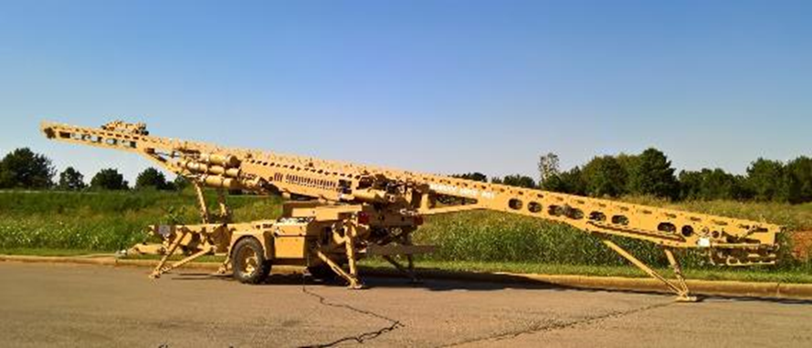
Development of the OHTO Launcher
Notes:
The team at home, with whom I extremely proud of having a chance to work with did miracles, worked long days, came up with new and innovative solutions, engaged the academia, new companies we had never worked with and designed and produced a launcher which will well exceeds in performance, both mass and exit velocity, the requirements we were set.

Slide 7
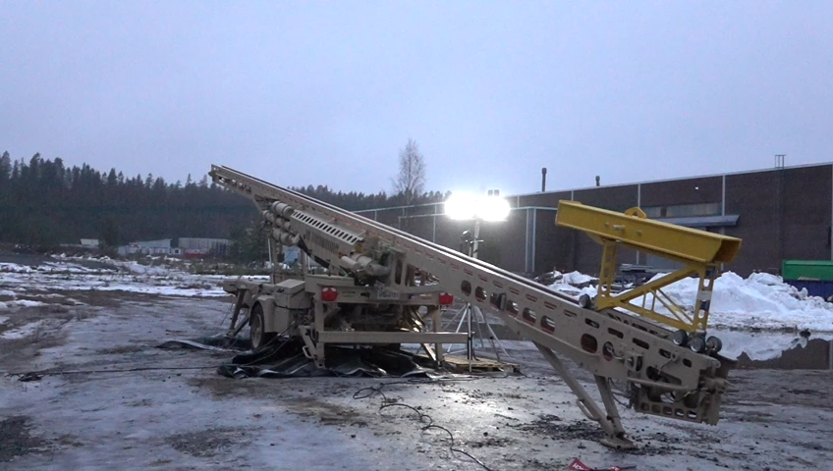
First dummy mass launch off the OHTO
Notes:
And this is what it looked like when the team did its first test launch.
Poor winter – and for us a winter …
The team conducting the testing launched the dummy mass or blivet over 150 times. Each one to a predefined exit velocity and mass. Each one was duly recorded – we had a accelerometer attached on the adapter, the interface between the launcher the mass, we videoed each launch by using high speed video cameras and at the end of the day provided data to the UAV team at LM which they were able to review and validate the launcher and its performance.

Slide 8
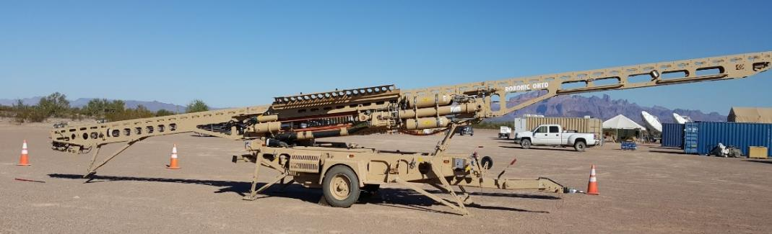
Today and Tomorrow with OHTO
OHTO prototype launcher - flight testing with the Fury aircraft by end of 2017 at Yuma Proving Grounds
Fury program working on a DCS opportunity that could require the purchase of 1-3 Kontio launchers next year
Still working US customer opportunities

Slide 9
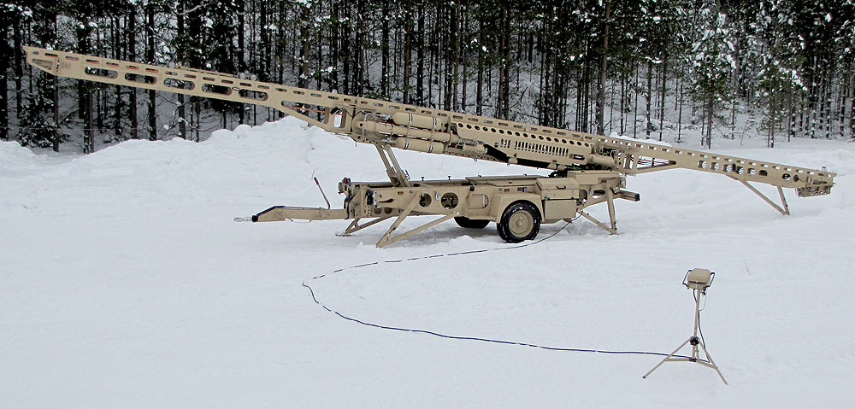
Questions
J. Michelle Achuff
Manager, Industrial Participation
LM Rotary and Mission Systems
+1-484-524-5094
jacquelyn.m.achuff@lmco.com
Juha Moisio
CEO
Robonic Ltd Oy
+358 40 751 6363
juha.moisio@robonic.fi
Notes:
… and that is what a good winter should look like to us Finns – yes Tuija, at least to most of us.

