Slide 1
Bittium Story
Establishing Cyber Security Research Co-operation Between Finland and USA
Iiro Siivonen
17.11.2017

Slide 2
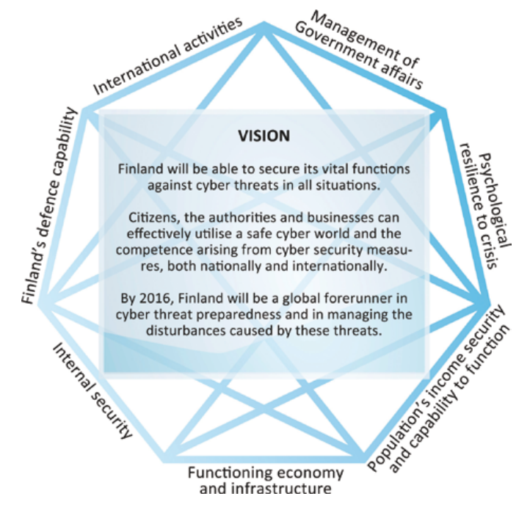
Cyber Security co-op Between Finland and USA
Background
2013 Finland defines national cyber security strategy
Principles:
  Cyber security relies on the information security arrangements of the whole society. Cyber security depends on appropriate and sufficient ICT and telecommunication network security solutions established by every actor operating in the cyber world. Various collaborative arrangements and exercises advance and support their implementation.
  Cyber security is being constructed to meet its functional and technical requirements. In addition to national action, inputs are being made into international cooperation as well as participation in international R&D and exercises. The implementation of cyber security R&D and education at different levels does not only strengthen national expertise, it also bolsters Finland as an information society.
Source: Finland’s Cyber Security Strategy 2013

Slide 3
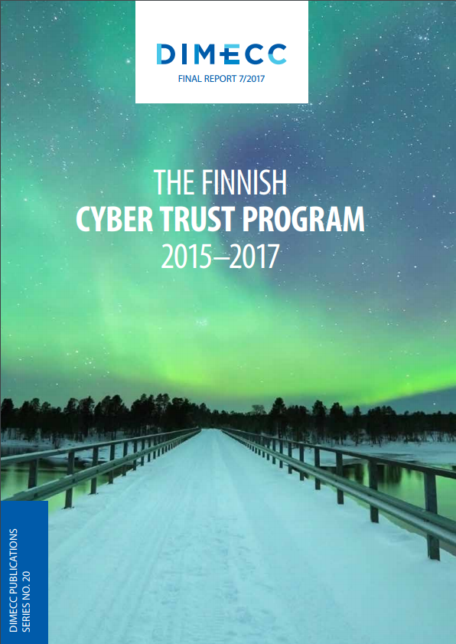
Cyber Security co-op Between Finland and USA
Cyber Trust -“we bring the Trust to the Digital World”
Started in 2014
Co-operation of 27 Finnish entities
Largest Cyber Security research program in Finland and one the largest in the whole of Europe
Lead by Mr. Markku Korkiakoski of Bittium
Cyber Trust: www.cybertrust.fi

Slide 4
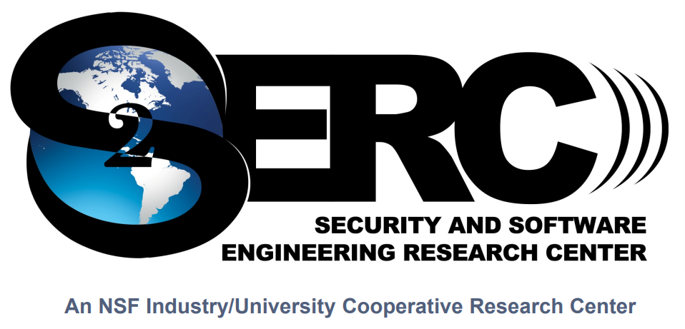
Cyber Security co-op Between Finland and USA
Establishment of NSF/S2ERC Research Center in Oulu
Released February 20 2017:
NSF CYBER SECURITY SITE ABOUT TO BE ESTABLISHED
International collaboration is one of the goals in DIMECC Cyber Trust Program. This ambitious target will be realized through ongoing work with establishing of the Cyber Security and Software Engineering Research Site in collaboration with National Science Foundation Industry/University Cooperative Research Centers (I/UCRC) –program. The site is planned to be a part of Software Engineering Research Centre (S2ERC, https://www.serc.net) that is one of the existing centers in I/UCRC and has been operating since 2010 in the US. The mission of S2ERC is to conduct a program of applied and basic research on software security, system security and software technology problems of interest to its members.
Cyber Security and Software Engineering Research Site is open for all Finnish universities and research institutes and it will physically be based on the University of Oulu. DIMECC is playing a key role in establishing this highly important international collaboration between Finland and US in the field of Cyber Security research.

Slide 5
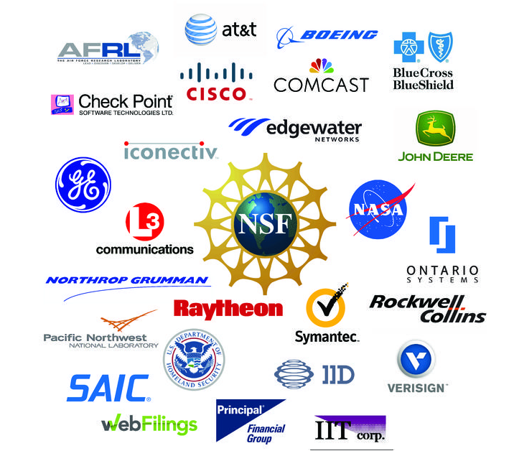
Cyber Security co-op Between Finland and USA
Why join?
Participating to the research site activities has several advantages:
  Research projects tailored to your interests and needs
  Access to expertise in new security and software engineering technologies
  Networking opportunities with industry and government leaders
  Visibility into a large range of research that may be of interest to companies now and in the future.
For more information, contact:
  Markku Korkiakoski, Program Director – DIMECC Cyber Trust (markku.korkiakoski@bittium.com)
  Tapio Frantti, University of Oulu (tapio.frantti@oulu.fi)

Slide 6
Contact us.
www.bittium.com
iiro.siivonen@bittium.com

