Slide 1
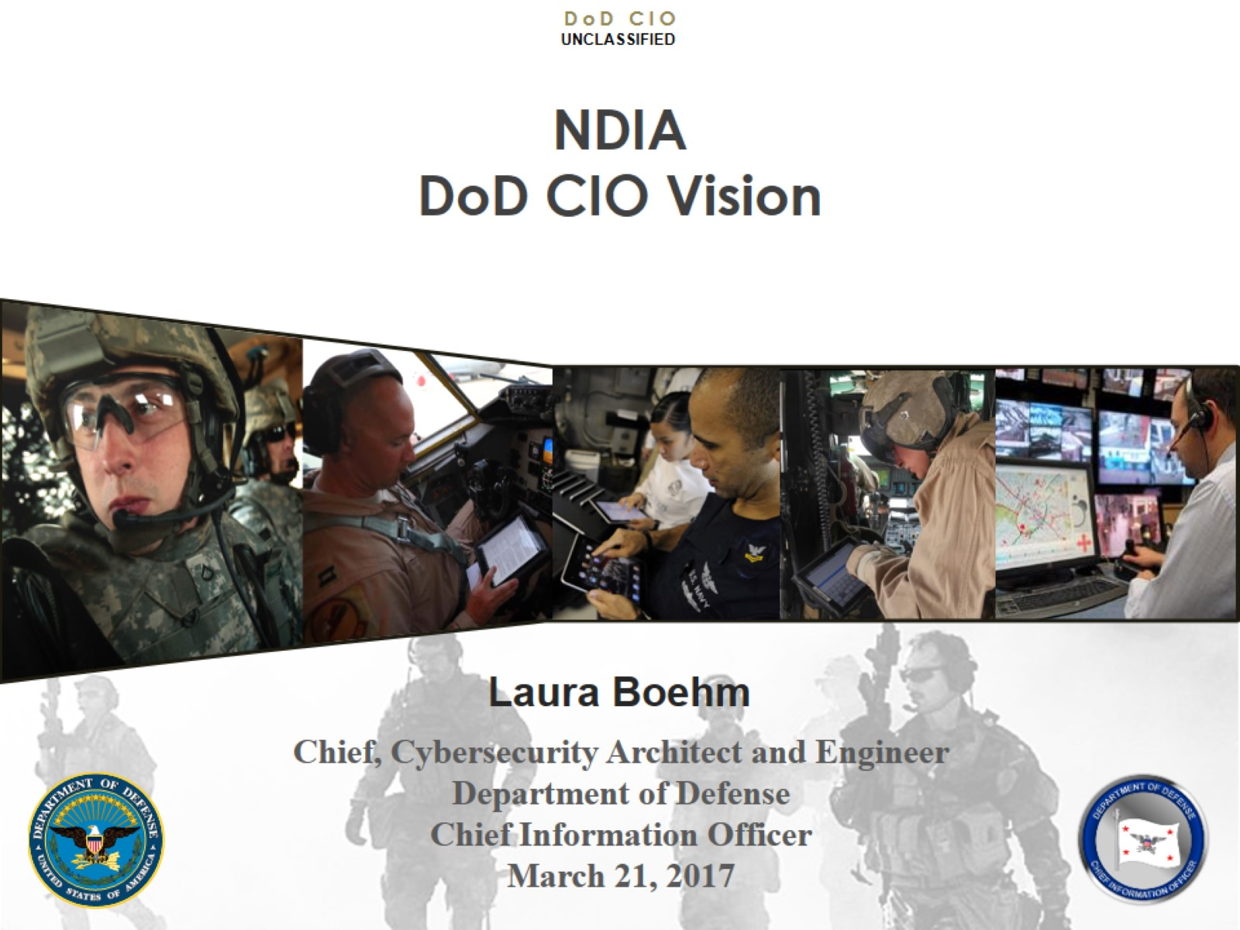
NDIA DoD CIO Vision

Slide 2
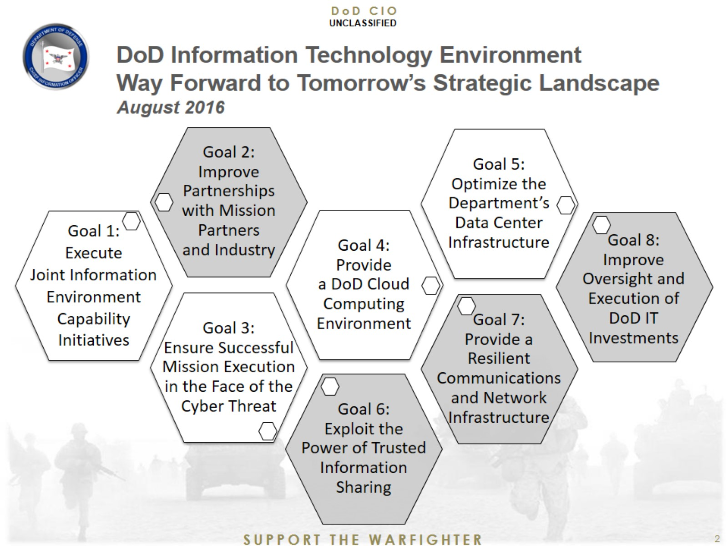
DoD Information Technology Environment Way Forward to Tomorrow’s Strategic Landscape August 2016

Slide 3
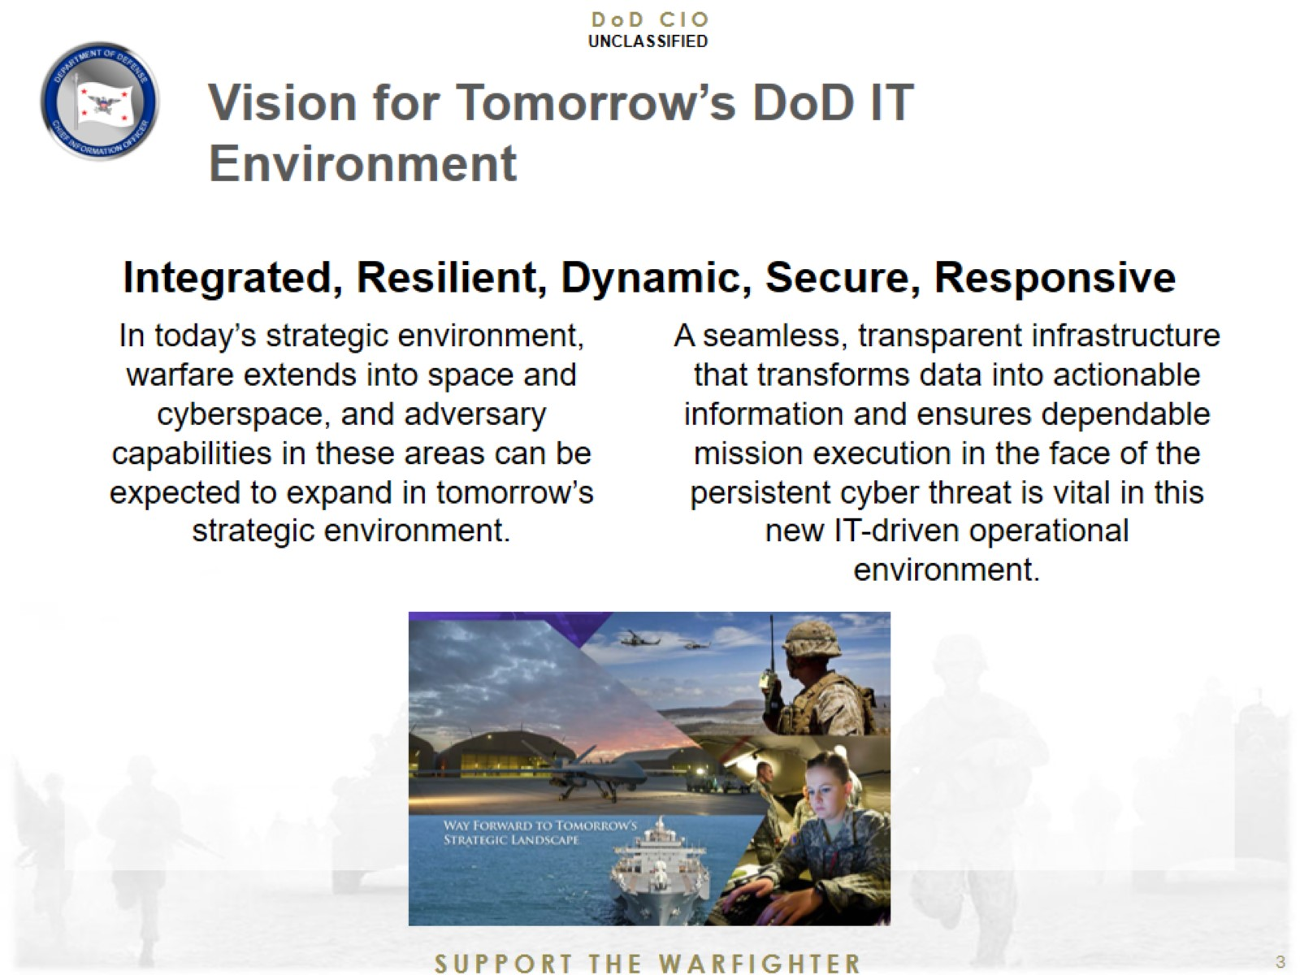
Vision for Tomorrow’s DoD IT Environment

Slide 4
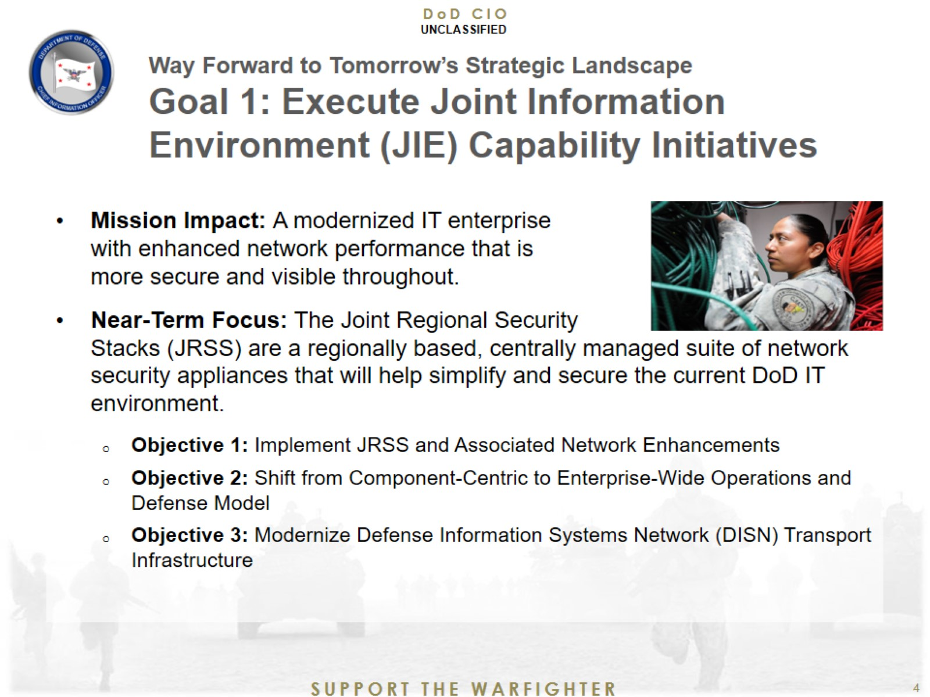
Way Forward to Tomorrow’s Strategic Landscape Goal 1: Execute Joint Information Environment (JIE) Capability Initiatives

Slide 5
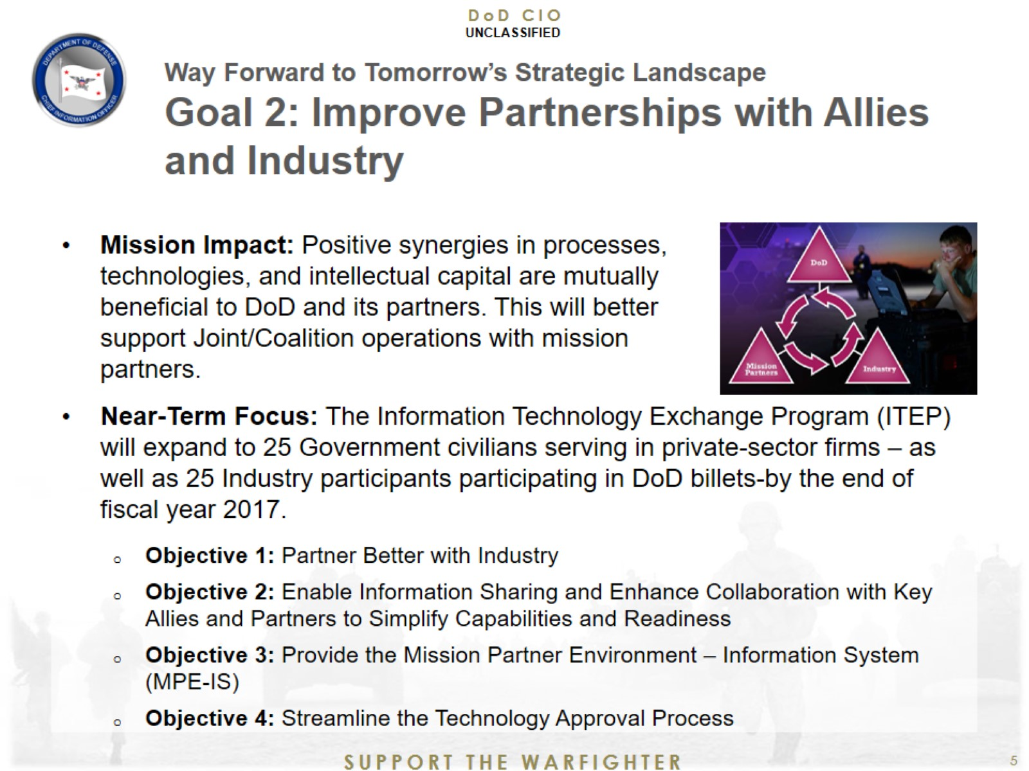
Way Forward to Tomorrow’s Strategic Landscape Goal 2: Improve Partnerships with Allies and Industry

Slide 6
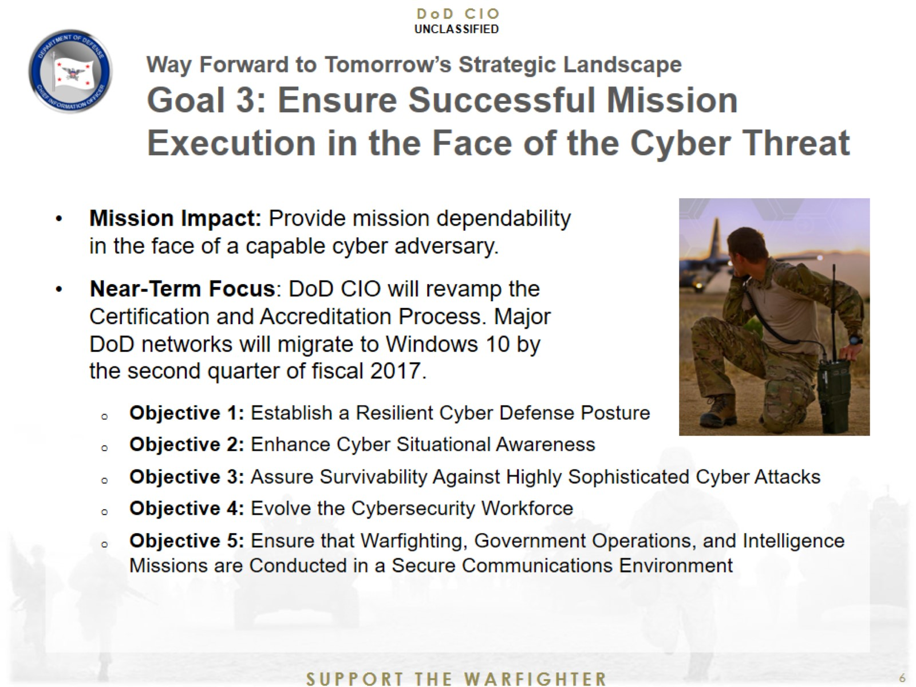
Way Forward to Tomorrow’s Strategic Landscape Goal 3: Ensure Successful Mission Execution in the Face of the Cyber Threat

Slide 7
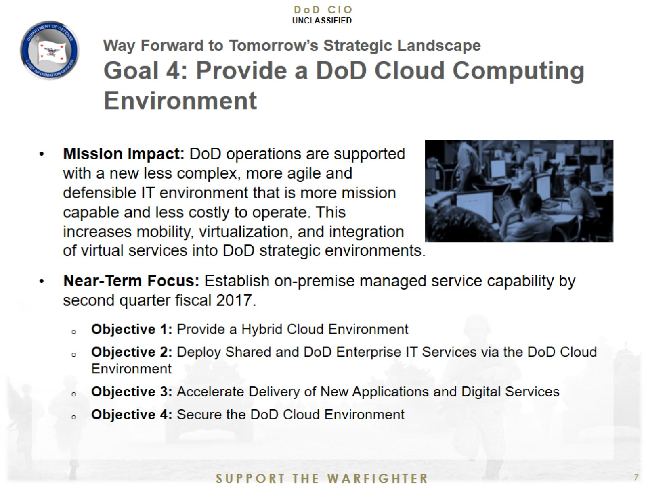
Way Forward to Tomorrow’s Strategic Landscape Goal 4: Provide a DoD Cloud Computing Environment

Slide 8
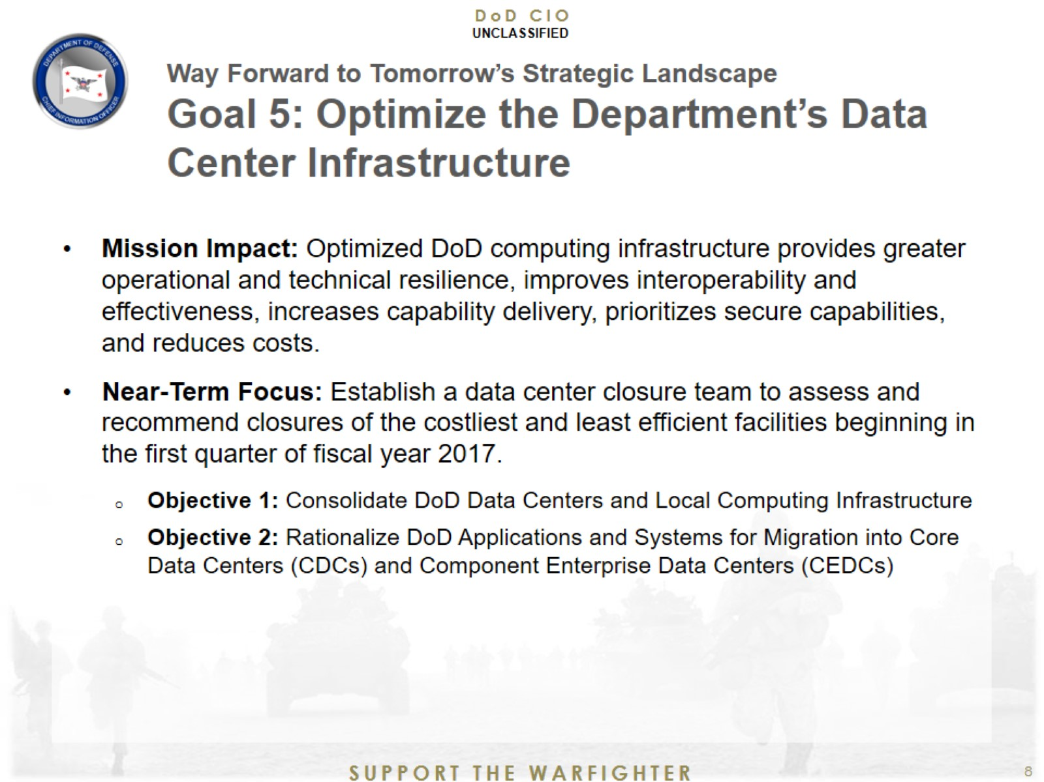
Way Forward to Tomorrow’s Strategic Landscape Goal 5: Optimize the Department’s Data Center Infrastructure

Slide 9
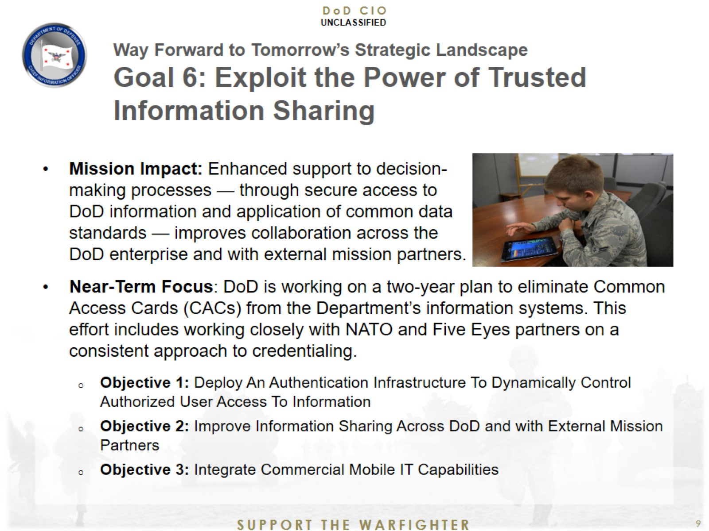
Way Forward to Tomorrow’s Strategic Landscape Goal 6: Exploit the Power of Trusted Information Sharing

Slide 10
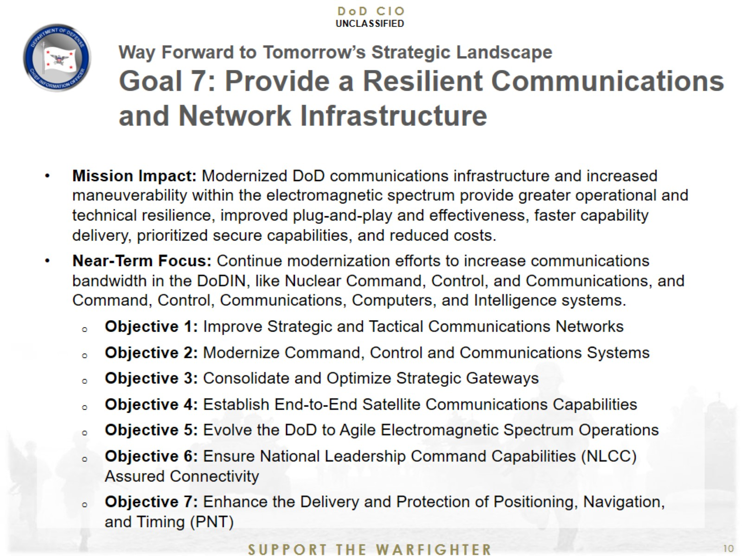
Way Forward to Tomorrow’s Strategic Landscape Goal 7: Provide a Resilient Communications and Network Infrastructure

Slide 11
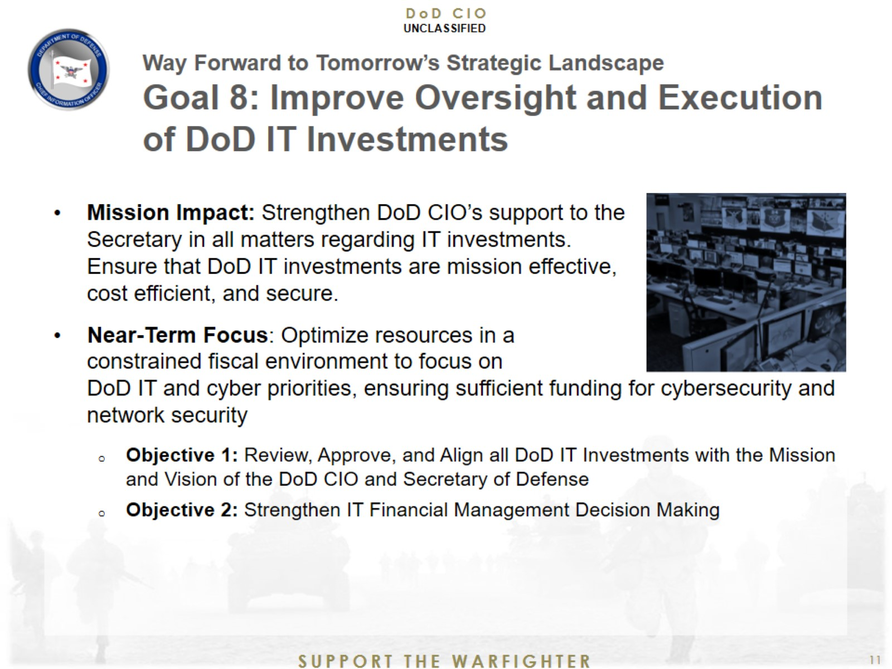
Way Forward to Tomorrow’s Strategic Landscape Goal 8: Improve Oversight and Execution of DoD IT Investments

Slide 12


