Slide 1
Radiological and Nuclear Defense Capability Development (RNDCD) Directorate
NDIA Spring Quarterly Forum:
The Future of Radiological and Nuclear Defense Programs and Capabilities
April 10, 2024

Slide 2
Office of the Secretary of Defense
* Responsibility for modernizing and procuring radiological and nuclear defense capabilities, to include detection and identification, delegated to DASD(TRAC) by ASD(NCB)

Slide 3
Threat Reduction and Arms Control

Slide 4
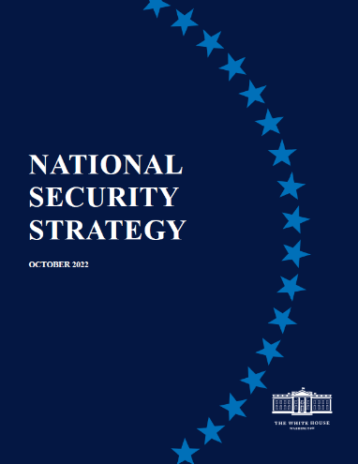
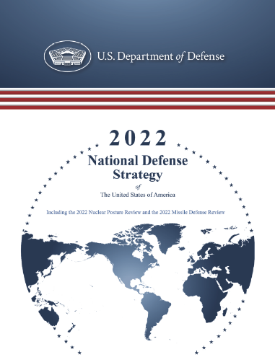
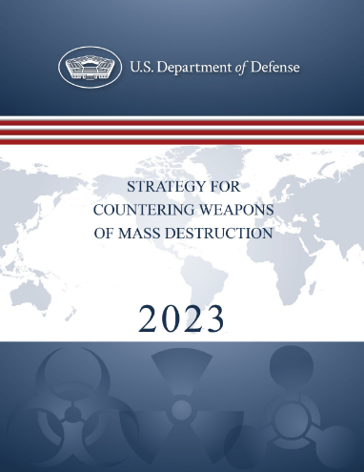
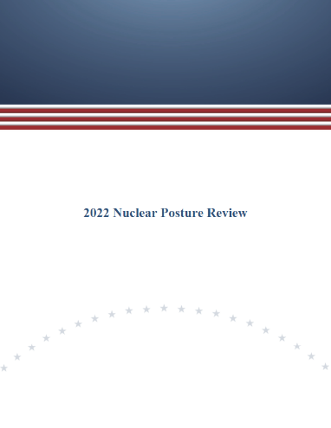
DoD Guiding Strategic Priorities
DoD must be able to survive, fight, and prevail in the event that our adversaries employ radiological or nuclear weapons on or near the Joint Force.
(NSS) Part III: Our Global Priorities:
“The United States will not allow Russia, or any power, to achieve its objectives through using, or threatening to use, nuclear weapons.”
(NDS) Deterring Strategic Attacks:
“…synchronizing conventional and nuclear aspects of planning – including by improving conventional forces’ ability to operate in the face of limited nuclear, chemical, and biological attacks so as to deny adversaries benefit from possessing and employing such weapons.”
(CWMD Strategy):
- Enable the Joint Force to prevail in a CBRN-contested environment.
- Build a Joint Force that can campaign, fight, and win in a CBRN environment.
“[DoD must] recapitalize, and in some cases reconstitute, its ability to conduct large-scale joint operations within a WMD-contested battlespace.”
(NPR):
“…the Joint Force must be able to survive, maintain cohesion, and continue to operate in the face of limited nuclear attacks.”
“Further development of plans and force requirements to enable military operations in a nuclear environment will be a focus of NPR implementation”

Slide 5
Radiological and Nuclear Defense Capabilities Development (RNDCD)
Mission Statement:
Enable the Joint Force and National Guard Bureau to operate in a radiological or nuclear (R/N) environment by providing modernized detection and identification equipment.
Vision Statement:
A Joint Force and National Guard Bureau that can detect and identify R/N threats and operate effectively in an R/N environment.
Deliverables:
R/N capabilities the Joint Force can leverage to address current and future threats, delivered through rapid fielding of innovative, cutting-edge technologies in a cost effective and streamlined process.

Slide 6
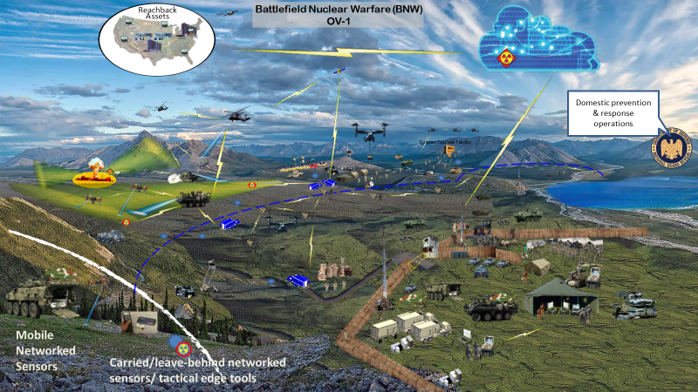
RNDCD OV-1

Slide 7
RNDCD Program Overview
Enhance DoD’s ability to campaign across the domains of threats and spectrums of conflict by improving the Department’s capability to survive, fight, and prevail in an R/N environment.
WHAT WE DO
Invest in validated requirements by resourcing and advocating for advanced RDT&E, and procuring R/N equipment to support the National Guard Bureau and special end users with limited procurement dollars.
HOW WE DO IT
Enables protection of the Joint Force in a R/N environment; serves as a central node for R/N defense development reducing duplicative efforts; accomplishes NDS and CWMD Strategy objectives by building R/N defense capabilities within the Joint Force and National Guard Bureau
WHY IT MATTERS
Joint Force, National Guard Bureau, Combatant Commands, Defense Agencies, Industry Partners
STAKEHOLDERS

Slide 8
R/N Mission Space
Defend the Homeland
Deter WMD Attacks
Prevail in a CBRN Environment
Prevent New WMD Threats
Interdiction
Elimination
Passive Defense
Consequence Management
Forensics
R/N Standoff
Manned Platform Mounted
R/N Standoff
Isotope Identifiers
Unmanned Platform Mounted
Telescoping Remote Detection
Telescoping Remote Detection
Area Detectors
Isotope Identifiers
Wide Area Search
Unmanned Platform Mounted
Collective Protection (4.g.6)
Sample Collection
Alternative Signatures
Contamination Mitigation Fixed Site (4.g.5)
Warning & Reporting
Sample Containment & Handling
Contamination Mitigation Equipment
Portal Monitoring
Contamination Mitigation Fixed Site (4.g.6)
Man-portable X-ray
Continuous Air Monitoring
Attribution
Render Safe
Thermal/Flash Protection
Geo-Physical Detection
Geo-Physical Detection
Shielding (4.a)
Decision Analysis & Management
Contamination Mitigation - Personnel
Respiratory & Ocular RN Protection (4.a)
Bio/Internal Dosimetry (4.a)
Contamination Monitoring (RDS)
R/N Medical (4.a)

Slide 9
A Phased Approach
TRAC will use a phased approach to implement R/N investment
Phase 1, FY24-27: Improve detection capabilities across the Joint Force to meet near term readiness requirements
Complete development and enable fielding of existing validated Joint Force capability requirements
Develop and publish RNDCD Charter that establishes roles between ODASD(TRAC), CCMDs, Services, JRO-CBRND, DTRA, and NGB to review and prioritize near term capability gaps and develop FY 26-30 POM recommendations for ASD(NCB)
Phase 2, FY27-30: Institutionalize RNDCD processes and ensure Joint Force RND readiness
If justified through cost-benefit analysis and supported by DoD Components, expand the research and development program beyond detection/identification capability requirements
Refine/update RNDCD Charter and incorporate capability development methodologies that will accelerate acquisition; define synchronization processes to leverage existing DTRA funding for S&T investments for emerging requirements
Develop and publish a RNDCD DODI
Assess future capability development efforts against mid-term Joint Force readiness requirements
Phase 3, FY30 and beyond
RNDCD institutionalized, right-sized, and providing necessary RND capabilities to support NDS

Slide 10
RNDCD Partners
Key Stakeholders
Military Services (Army, Navy, Marine Corps, Air Force)
National Guard Bureau
Defense Agencies and Developmental Centers
Defense Threat Reduction Agency (DTRA)
Armed Forces Radiobiology Research Institute (AFRRI)
Joint Program Executive Office for Chemical, Biological, Radiological, and Nuclear Defense (JPEO-CBRND)
Naval Information Warfare Center (NIWC)
Naval Air Warfare Center Aircraft Division (NAWCAD)
Industry Partners
Various, mostly interfacing with DTRA on early development efforts

