Slide 1

Security Compliance for Small, Lower Medium & Upper Medium Businesses
www.netwatcher.com

Slide 2
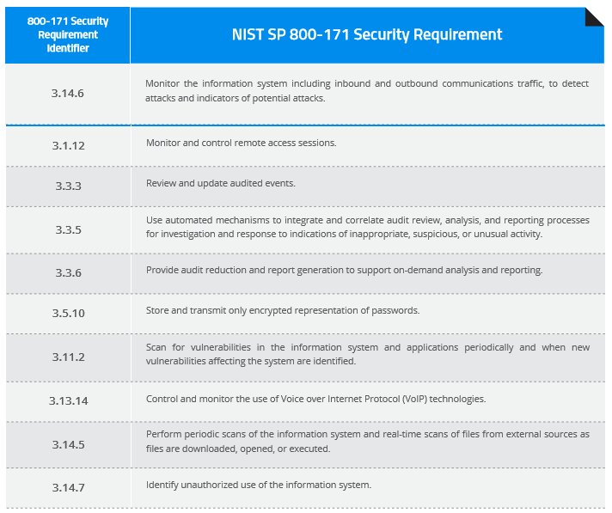
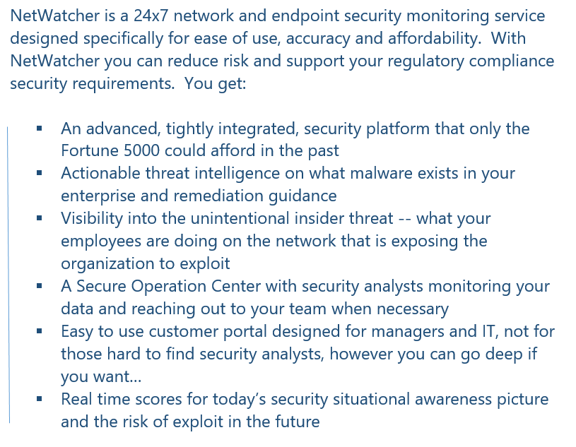
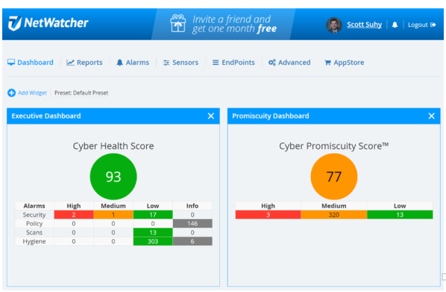
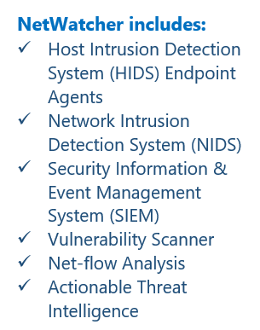
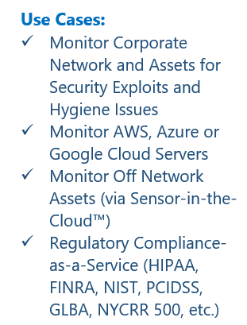
What is NetWatcher
www.netwatcher.com

Slide 3


Compliance Creates Opportunity..
Small
Medium
Large
5M+
Threat Intelligence
SIEM
End Point Technology
Intrusion Detection
Intrusion Protection
…big gap…
Firewall
Anti-virus
10k
Solutions expensive
difficult to use
security analysts don’t exist
opportunities
Customer demands
and compliance mandates
HIPAA, FINRA, PCI-DSS, GBLA….NIST 800 – 171, 23 NYCRR 500…
opportunities
25k
Security
Sophistication
opportunities
HP
IBM
FireEye
Palo Alto
Etc…
MSSPs
Managed Security Providers
Security is the #1 Growth area for Managed Services Providers (MSPs)—CompTIA
Size of Business
www.netwatcher.com

Slide 4
SMB – ‘S’ & ‘M’ are Drastically Different
According to the latest US Census, there are 7.6 Million employer-based SMBs in the US. Or roughly 25% of all SMBs that actually have payrolls.
# of Employees
 | <20 | 20-49 | 50-99 | 100-299 | 300-499 | 500-999 | 1,000-4,999 | 5,000-9,999 | 10,000+
Professional, scientific, and technical services | 721,841 | 30,828 | 9,106 | 5,811 | 1,158 | 942 | 1,290 | 291 | 458
Retail trade | 628,726 | 40,552 | 12,969 | 7,465 | 1,159 | 849 | 870 | 204 | 343
Health care and social assistance | 539,491 | 45,348 | 15,593 | 13,841 | 2,701 | 1,887 | 1,676 | 235 | 193
Accommodation and food services | 379,301 | 68,002 | 18,258 | 7,878 | 1,413 | 1,018 | 747 | 115 | 122
Finance and insurance | 232,604 | 10,612 | 4,382 | 3,410 | 719 | 536 | 693 | 169 | 263
Information | 61,292 | 6,048 | 2,257 | 1,645 | 408 | 326 | 451 | 105 | 217
Management of companies and enterprises | 5,295 | 2,828 | 3,270 | 6,148 | 2,620 | 2,614 | 3,350 | 670 | 814
Utilities | 4,377 | 529 | 339 | 267 | 47 | 48 | 80 | 27 | 42
Educational services | 60,734 | 9,326 | 4,090 | 2,698 | 540 | 552 | 525 | 56 | 99
Construction | 697,644 | 43,101 | 12,462 | 6,264 | 877 | 527 | 438 | 66 | 95
Administrative | 290,893 | 20,766 | 8,311 | 6,867 | 1,709 | 1,426 | 1,503 | 302 | 413
Wholesale trade | 280,185 | 27,368 | 9,736 | 6,861 | 1,451 | 1,179 | 1,378 | 279 | 347
Real estate and rental and leasing | 269,090 | 8,087 | 2,699 | 2,034 | 486 | 419 | 505 | 110 | 212
Manufacturing | 208,675 | 38,891 | 16,115 | 11,593 | 2,298 | 1,769 | 1,726 | 260 | 317
Transportation and warehousing | 148,967 | 11,060 | 3,871 | 3,012 | 755 | 695 | 923 | 250 | 404
Arts, entertainment, and recreation | 99,357 | 9,008 | 3,568 | 2,259 | 436 | 320 | 309 | 45 | 74
Agriculture, forestry, fishing and hunting | 20,491 | 861 | 242 | 189 | 32 | 22 | 50 | 7 | 17
Mining, quarrying, and oil and gas extraction | 17,765 | 1,849 | 680 | 532 | 114 | 103 | 164 | 31 | 50
Vertical
Copyright © 2017 NetWatcher All Rights Reserved. | 03

Slide 5
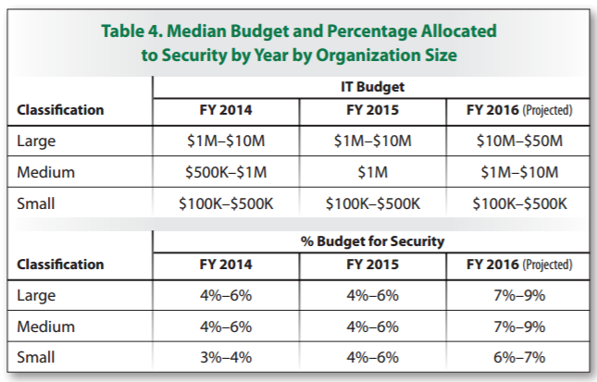
Reality of a Small Prof. Svc. Business Owner…
https://www.sans.org/reading-room/whitepapers/analyst/security-spending-trends-36697
What can a company do with 15k?
www.netwatcher.com

Slide 6
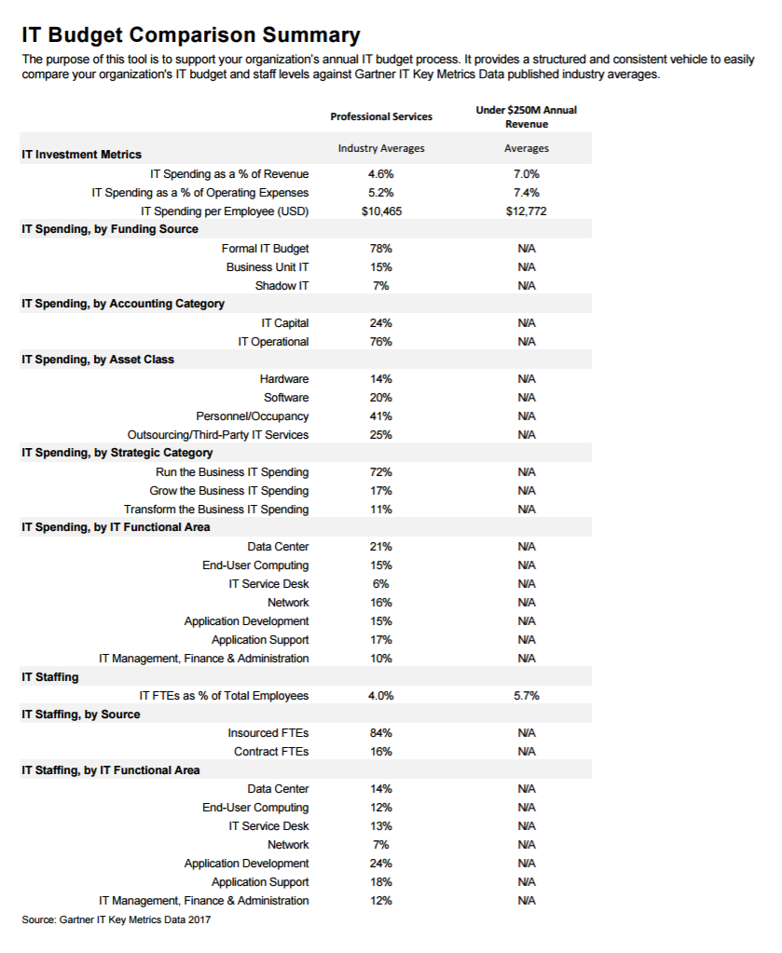
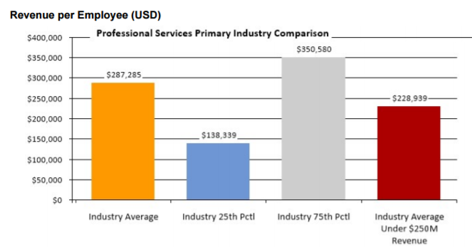
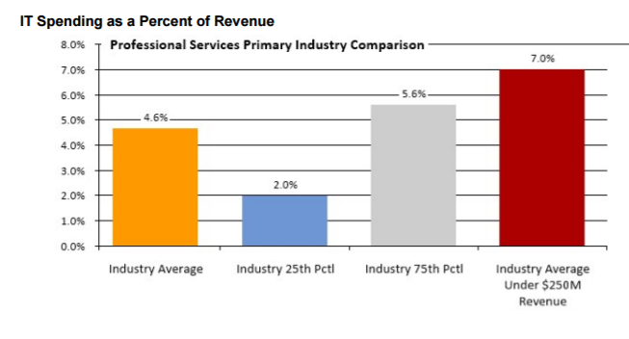
Prof Svc Budgets
https://www.gartner.com/explore/tools/it-budget/survey/setup
www.netwatcher.com

Slide 7

Reality of a Small Business Owner…
Executive is not aware of the risks – “We have a firewall and anti-virus so I think we are covered…”
Executive has bad information – “Hackers only attack the big companies, what would they want from us?”
Executive is a risk taker – “I’ll take the risk, the probability for us getting attacked is low.”
Executive is cheap – “No ROI means no priority.”
Executive doesn’t believe investment in security is worth it – “The loss involved will be so small compared to our revenues. It’s easier to take a chance and write off any losses should they occur.”
Executive is overwhelmed by the size of the necessary investment required to add additional security measures – “We can’t afford Fire Eye, IBM, HP, Palo Alto etc.. those tools are only affordable to the fortune 1000”
Executive believes they are covered when they are not – “Our vendor are responsible for our security not us…”
Executive doesn’t believe any investment in cyber-security will have much of an impact – “Big companies have all the tools and they are still getting hacked.”
www.netwatcher.com

Slide 8
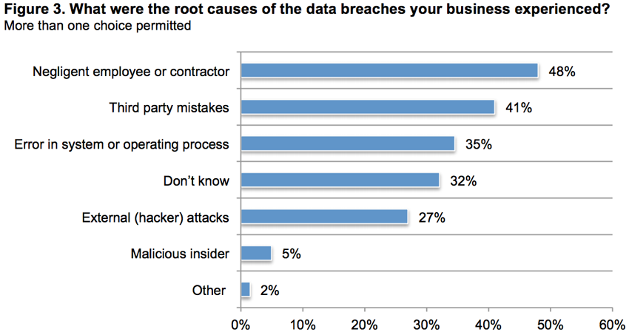
SMB Cyber Stats
https://smallbiztrends.com/2017/01/cyber-security-statistics-small-business.html
43% of cyber attacks target small business.
Only 14% of small businesses rate their ability to
mitigate cyber risks, vulnerabilities and attacks as highly
effective.
60% of small companies go out of business within six months of a cyber attack.
48% of data security breaches are caused by acts of malicious intent. Human error or system failure account for the rest.
The numbers show that small businesses are not only at risk of attack, but have already been attacked:
55% of respondents say their companies have experienced a cyber attack in the past 12 months(May 2015 -May 2016), and
50% report they had data breaches involving customer and employee information in the past 12 months (May 2015 -May 2016).
In the aftermath of these incidents, these companies spent an average of $879,582 because of damage or theft of IT assets.
In addition, disruption to normal operations cost an average of $955,429
www.netwatcher.com

Slide 9
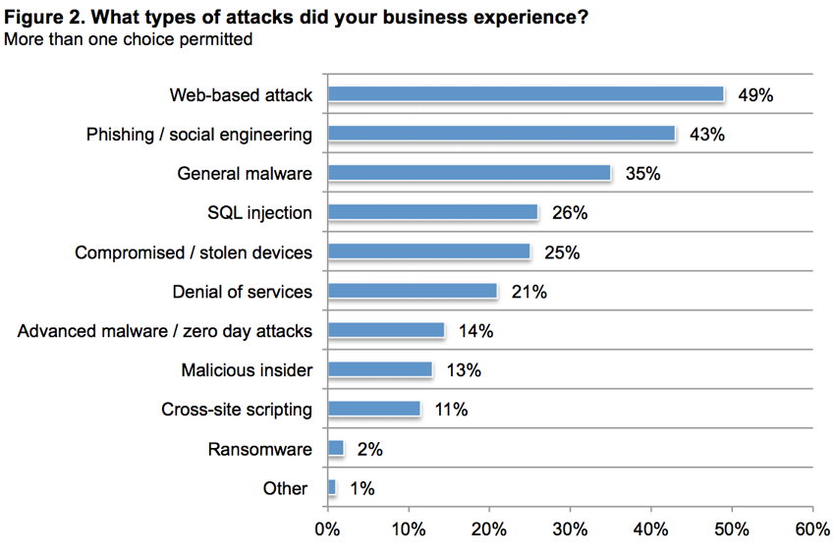
SMB Cyber Stats
https://smallbiztrends.com/2017/01/cyber-security-statistics-small-business.html
While many small businesses are concerned about cyber attacks
(58%), more than half (51%) are not allocating any budget at all
to risk mitigation.
Dangerous disconnect: one of the more popular responses as to
small businesses they don’t allocate budget to risk mitigation was that
they, “feel they don’t store any valuable data.” Yet a good number reported that they in fact DO store pieces of
customer information that are of significant value to cyber criminals:
68% store email addresses;
64% store phone numbers; and
54% store billing addresses.
Small businesses reported that only:
38% regularly upgrade software solutions;
31% monitor business credit reports; and
22% encrypt databases.
If a company has a password policy, 65% of respondents say they do not strictly enforce it. 16% of respondents admitted that they had only reviewed their cybersecurity posture after they were hit by an attack. 75% of small businesses have no cyber risk insurance.
www.netwatcher.com

Slide 10
So… There is a giant gap between the haves (Enterprise) and have nots (SMBs)… The reality is that SMBs are very far behind when it comes to enterprise security…
www.netwatcher.com

Slide 11
Now… back to DFARS 252.204.7012 and NIST 800-171
www.netwatcher.com

Slide 12
Example: I’m a small manufacturing company doing business with a prime contractor.
www.netwatcher.com

Slide 13
I have to be compliant by December 2017 or risk losing my federal business.
www.netwatcher.com

Slide 14
I’ve not been provided much guidance beyond the request to be compliant in the given timeframe. -I’m on my own…
www.netwatcher.com

Slide 15
Access Control
Audit and Accountability
Awareness and Training
Configuration Management
Identification and Authentication
Incident Response
Maintenance
Media Protection
Physical Protection
Personnel Security
Risk Assessment
Security Assessment
System and Communications Protection
System and Information Integrity
There are 14 families of security requirements associated with the NIST 800-171 standard
www.netwatcher.com

Slide 16
BASIC SECURITY REQUIREMENTS (FROM FIPS PUBLICATION 200):
3.4.1 Establish and maintain baseline configurations and inventories of organizational information systems (including hardware, software, firmware, and documentation) throughout the respective system development life cycles.
3.4.2 Establish and enforce security configuration settings for information technology products employed in organizational information systems.
DERIVED SECURITY REQUIREMENTS (FROM NIST SPECIAL PUBLICATION 800-53):
3.4.3 Track, review, approve/disapprove, and audit changes to information systems
3.4.4 Analyze the security impact of changes prior to implementation.
3.4.5 Define, document, approve, and enforce physical and logical access restrictions associated with changes to the information system.
3.4.6 Employ the principle of least functionality by configuring the information system to provide only essential capabilities.
3.4.7 Restrict, disable, and prevent the use of nonessential programs, functions, ports, protocols, and services.
3.4.8 Apply deny-by-exception (blacklist) policy to prevent the use of unauthorized software or deny-all, permit-by-exception (whitelisting) policy to allow the execution of authorized software.
3.4.9 Control and monitor user-installed software.
Example for Configuration Management from Chapter 3, Requirement 4 in NIST 800-171
www.netwatcher.com

Slide 17
Consider that many of the organizations faced with this requirement are in a bit of a quandary, considering the reality of never having had to protect CUI at this level before. They don’t want to lose these important customers but at the same time, they don’t have the people/experience, technology or money to solve it.
www.netwatcher.com

Slide 18
“This rule will apply to all contractors with covered defense information transiting their information systems. DoD estimates that this rule may apply to 10,000 contractors and that less than half of those are small businesses.”
https://www.gpo.gov/fdsys/pkg/FR-2015-08-26/pdf/2015-20870.pdf
Do they really understand the realities of the SMB?
www.netwatcher.com

Slide 19
Even the SBA recognizes the issue… but there are no great answers… The reality is that SMBs are very far behind when it comes to enterprise security…
www.netwatcher.com

Slide 20
A. DOD’s IRFA appears to be deficient.
Number of Small Entities.
Advocacy believes that DOD’s estimation of the number of small businesses affected by the rule is too low. DOD should include both small business prime contractors and small business subcontractors when estimating the number of small businesses impacted by the interim regulation. This rule will apply to all contractors with covered defense information transitioning their information systems. DOD estimates that 10,000 contractors will be impacted by this rule and no more than 5,000 will be small businesses.[8] It is unclear from DOD’s analysis whether this estimation includes prime contractors, subcontractors, or both. As discussed below, DOD’s interim rule will significantly impact small businesses serving as prime contractors as well as small businesses servings as subcontractors. If DOD’s estimation only includes small business prime contractors, Advocacy believes DOD has vastly underestimated the number of small businesses affected by this interim rule.
Significant Alternatives. In the December 30 rule, as in the August 26 rule, DOD asserts that “[n]o significant alternatives, that would minimize the economic impact of the rule on small entities, were determined.”[9] However, the Regulatory Flexibility Act (RFA) requires discussion of such alternatives as:
“(1) the establishment of differing compliance or reporting requirements or timetables that take into account the resources available to small entities;
(2) the clarification, consolidation, or simplification of compliance and reporting requirements under the rule for small entities;
(3) the use of performance rather than design standards; and
(4) an exemption from coverage of the rule, or any part thereof, for such small entities.”[10]
Consistent with the requirements under the RFA and to help alleviate the economic burden the interim final rule will place on small businesses handling covered information, Advocacy recommends that the Federal government consider either:
Collaborating with universities and other organizations to provide low-cost cybersecurity services to small businesses participating in the federal acquisition process. These institutions would provide services to supplant contracts with third-party vendors for assessments of information systems and security controls and for cybersecurity trainings and manuals for their employees;
Providing a one-time subsidy to small businesses participating in the federal acquisition process to help cover the cost of initial consultations with third-party vendors to assess their information systems and security controls for vulnerabilities. This one-time subsidy would be provided to these small businesses when they initially enter the federal acquisition process; or
Other significant alternatives as described by interested parties.
Advocacy suggests that DOD provide the public with its analysis on each of these alternatives. Given that DOD determined the entire industry, both large and small businesses, needed additional time to comply with the August 26 rule,[11] DOD should at least consider a further extension of the compliance time for affected small businesses.
https://www.sba.gov/sites/default/files/2016_02_29_12_45_40.pdf
www.netwatcher.com

Slide 21
B. The cost of compliance with DOD’s interim final rule will be a significant barrier to small businesses engaging in the federal acquisition process.
Advocacy has received input from the small business community and cybersecurity experts that the cost of compliance is the single most pressing problem associated with the interim regulation. For small businesses, the compliance cost may be viewed through two separate compliance lenses.
1. Small Business Prime Contractors
In the first lens, the small business prime contractor with DOD will clearly be required to implement the requirements of NIST SP 800-171, according to the interim rule. Compliance for these small business prime contractors is very expensive as many small businesses will be forced to purchase services from outside vendors to provide “adequate safeguards” for covered defense information. Most small businesses have neither the technical expertise nor the information technology personnel or software to conduct these services in-house.
Software. The interim final rule will force small businesses to purchase additional software from third-party vendors, and will require small businesses to purchase any annual updates to that software thereafter. For example, cybersecurity experts have told Advocacy that small businesses will need to purchase software for tracking employee computer activity to fulfill the configuration management requirements.
Infrastructure. The interim final rule will force small businesses to purchase services from third-party vendors to fulfill the infrastructural requirements. For example, small businesses will be required to create redundant systems such as off-site, back-up servers for data retrieval in case of a cyber-incident. This costly service cannot be completed in-house by the vast majority of small businesses and could require contracting services from multiple vendors. Cybersecurity experts have also told Advocacy that small businesses will incur significant costs to establish adequate access controls such as encryption, multi-factor authorization, and separation of duties to prevent malevolent collusion. Specifically, multi-factor authorization would require contracting with an outside vendor and would be very expensive to implement.
Consultation. The interim final rule will force small businesses to seek risk and security assessments from third-party consultants. Small businesses will be required to periodically evaluate their information system and security controls and to reduce or eliminate any deficiencies or vulnerabilities. Cybersecurity experts have told Advocacy that small businesses are likely not cognizant of any deficiencies or vulnerabilities and would otherwise react to vulnerabilities and deficiencies as problems arise. Therefore, small businesses will need to contract with a third-party consultant to adequately assess their information systems and security controls.
Training. The interim final rule will force small businesses to either enroll employees in a third-party cybersecurity training course or contract with a vendor to produce an internal cybersecurity training regimen. Cybersecurity experts have told Advocacy that small businesses will not be able to supply adequate cybersecurity training in-house and will have to enroll employees in a third-party cybersecurity training course. In addition, small businesses will be required to contract with a third-party vendor to produce an internal cybersecurity manual.
https://www.sba.gov/sites/default/files/2016_02_29_12_45_40.pdf
www.netwatcher.com

Slide 22
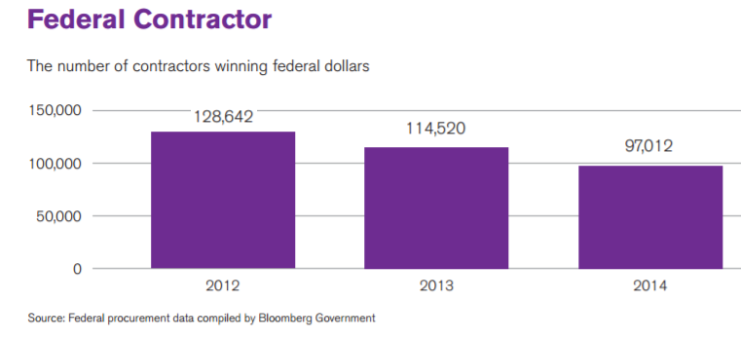
2. Small Business Subcontractors
In the second lens, the DOD small business subcontractor may also be required to become compliant with the NIST requirements and the prime vendor may impose additional requirements that are not directly required in the NIST requirements but are required for the subcontractor under the terms and conditions of the DOD contract. For example, the interim final rule requires the contractor, both prime and subcontractor, to provide DOD with notification of a security breach within 30 days of the discovery of such a cyber-incident. Some acquisition experts are suggesting that large prime contractors may require their subcontractors to report such infractions to the prime much sooner than the time required by the regulation.[12] In addition, questions have been raised as to whether small business subcontractors will be required to maintain separate security systems for each of their large prime contractors. Clearly, the intent of this interim final rule is not to expand the burdens on contractors beyond that which is necessary to have compliance with NIST. This comment letter will not explore these types of subcontract issues in greater detail, but the DFARS should have affirmative guidelines in the final rule to address the concerns of the small business subcontracting community.[13]
https://www.sba.gov/sites/default/files/2016_02_29_12_45_40.pdf
www.netwatcher.com

Slide 23
At the same time margins have never been lower and competition has never been more fierce…
www.netwatcher.com

Slide 24
In the LPTA environment, you have two options; you can either (a) reduce your margins or (b) you can reduce the operating costs associated with the management and delivery of these contracts. Long term, of course, if your rates aren’t competitive, winning new awards without reducing your back-office costs is going to lead to disaster. http://www.pvbs.net/government-contractors-must-get-leaner/
Jeremy Grant, chief development officer for Acquisition Solutions, which helps agencies develop requirements, says the average company in the S&P 500 earned about 8.5% profit margin, while most government contractors work on a 5% profit margin. http://govcentral.monster.com/benefits/articles/18679-vendors-face-smaller-profit-margins-from-government-work
www.netwatcher.com

Slide 25
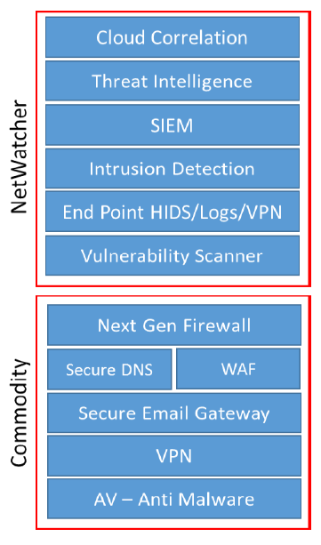
The Cost of Compliance…
People to manage pre and post compliance
Build Policies – ex. Logical access policy
Build Procedures – Incident Response Plans
Hardware / Software Updates / Upgrades
Technology Maintenance Services to Keep Up
Cyber Training
Cyber Insurance Requirements
Legal support
New Required Security Capabilities
www.netwatcher.com

Slide 26
Audit?
Head of IT Security for large DOD contractor: “If we ask, then we know…
…and then there is liability. Anyway, this isn’t a security issue it’s a
Procurement issue…”
www.netwatcher.com

Slide 27
Example for HIPAA
HHS’ Office for Civil Rights is responsible for enforcing the Privacy and Security Rules. Enforcement of the Privacy Rule began April 14, 2003 for most HIPAA covered entities. https://www.hhs.gov/hipaa/for-professionals/compliance-enforcement/
OCR enforces the Privacy and Security Rules in several ways:
by investigating complaints filed with it,
conducting compliance reviews to determine if covered entities are in compliance
performing education and outreach to foster compliance with the Rules' requirements.
OCR also works in conjunction with the Department of Justice (DOJ) to refer possible criminal violations of HIPAA.
www.netwatcher.com

Slide 28
HIPAA’s Security Rule has been in place Since 2005 and many SMBs are still not compliant…
The Final Rule on Security Standards was issued on February 20, 2003.
It took effect on April 21, 2003 with a compliance date of April 21, 2005
www.netwatcher.com

Slide 29
Even NYCRR 500 has exemptions for ‘S’
Section 500.19 Exemptions. Each Covered Entity with:
fewer than 10 employees, including any independent contractors, of the Covered Entity or its Affiliates located in New York or responsible for business of the Covered Entity
less than $5,000,000 in gross annual revenue in each of the last three fiscal years from New York business operations of the Covered Entity and its Affiliates
less than $10,000,000 in year-end total assets
http://www.dfs.ny.gov/legal/regulations/adoptions/dfsrf500txt.pdf
www.netwatcher.com

Slide 30
How Many Reds Will There Be?
x
Yes
$
Willing to make the investment
x
No
No Yes
Can Afford the Investment
www.netwatcher.com

Slide 31
Potential Best Practices
Stage the rollout (learn from NY DFS NYCRR 500)
Clearly articulate who is responsible for enforcement and the process & liabilities
Clearly articulate the DOD’s expectations of the Prime contractor tactical responsibilities
Provide Tax incentive (similar to R&D tax credits)
Offer CBT training for SMB CxO’s with boilerplate policy / procedures
Consider Business Associate Contracts (HIPAA https://www.hhs.gov/hipaa/for-professionals/covered-entities/sample-business-associate-agreement-provisions/index.html?language=en )
By 8/28/2017
Appoint a Chief Information Security Officer
Create an Incident Response Plan
By 2/15/2018
Submit your annual written statement (to the superintendent) covering the prior calendar year certifying that you are in compliance with the 23 NYCRR 500 requirements.
By 3/1/2018
Chief Information Security Officer will at a minimum once a year report on your cybersecurity program and material cybersecurity risks.
Conduct and document a periodic risk assessment
Institute the use of Multi-Factor Authentication
Create and manage a Cyber Training policy and program for all staff
Institute Continuous monitoring OR annual periodic Penetration Testing AND bi-annual vulnerability assessments.
By 9/4/2018
Document procedures used to limit user access privileges to Information Systems
Document procedures, guidelines and standards designed to ensure the use of secure development practices for in-house developed applications
Create and manage policy for Data Retention
Create and manage an Encryption policy for non-public information
Create and managed a record retention policy -- keep records required to reconstruct financial transactions for 5 years and keep cyber security event audit trails for up to three years.
By 3/1/2019
Document and manage policy for managing Third Party Service Provider Security
www.netwatcher.com

Slide 32
https://netwatcher.com

Slide 33
http://www.baesystems.com/en/what-we-do/suppliers/cybersecurity/level-1

